Slide 1
Novel Read Libraries
Johnny, Apoorva, Olin, Shubh

Slide 2
This web application is a small-scale library that hosts public domain literature that can be rented for consumption.
Books will be read via a browser's built-in PDF viewer.
This site hosts a generous collection of famous fiction, non-fiction and philosophical works from great minds of the past.
This site has been tested on Firefox and Chrome via DevTools.

Slide 3
Shouldn’t access to public domain material be a simple process? Why are so many famous works published under licenses when they are accessible to everyone under U.S copyright law?
This site strives to answer this by collecting publicly available literature and hosting it on one site site for easy access.

Slide 4
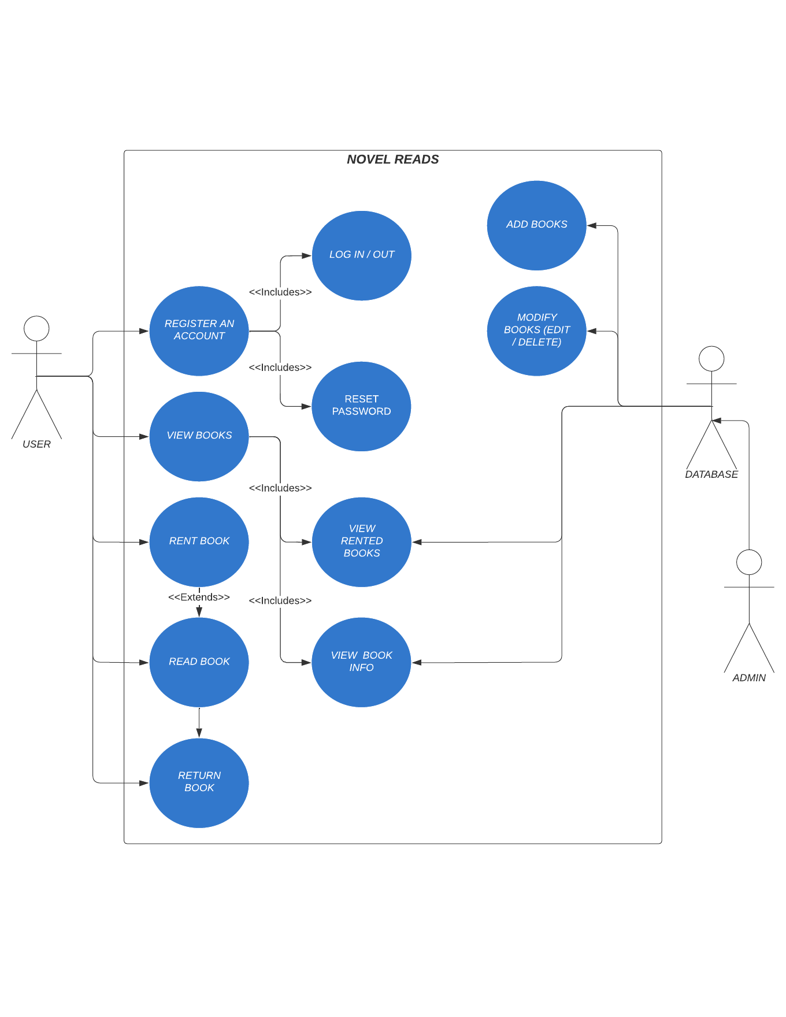
USE-CASE

Slide 5
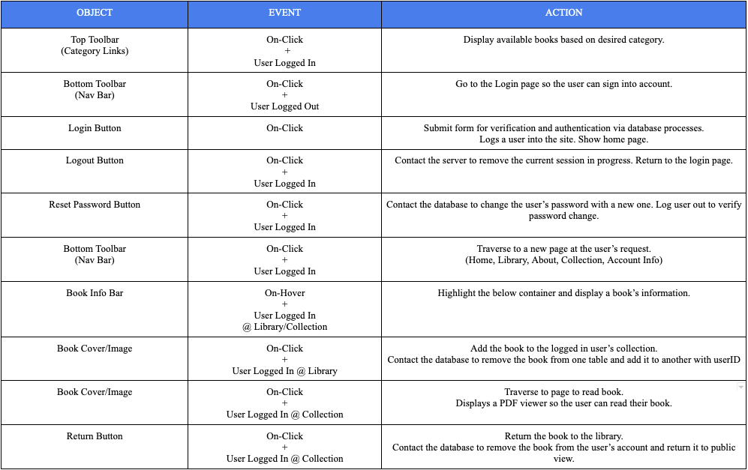
GDD

Slide 6
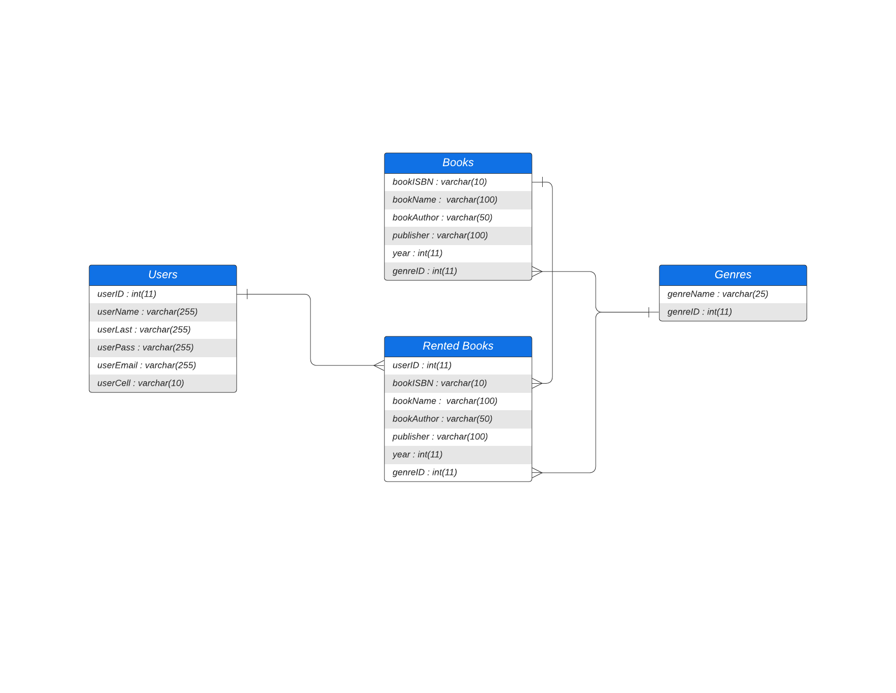
ER DIAGRAM

Slide 7
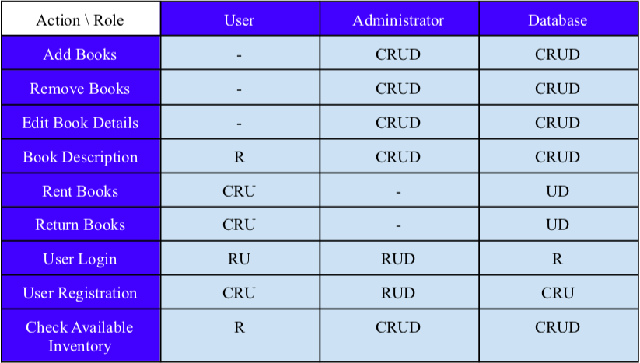
CRUD MATRIX

Slide 8
Problem Encountered - Google DevTools and CSS Box Model
At first coding CSS in an IDE and flipping between it and the browser began to become tedious.
After a bit of tinkering, it was concluded that using Google DevTools was far more useful and visualizing changes in real-time.
It was especially helpful in learning the CSS Box Model and how to manipulate margins, paddings, borders, and content.
To summarize, using Google DevTools relieved a lot of stress when trying to design the layout of the web application.

Slide 9
Problem Encountered - Using PHP to Display HTML and CSS Elements
One of the most important pieces of code in the project is the ability to display all the books for the user to interact with. What was needed was a way to access the database and retrieve every available book in the library and display its information without having to create an excessive amount of HTML code by manually adding books.
With PHP, a loop can access the database and traverse through the returned list of rows obtained. The information retrieved can then be manipulated by telling the script to display a book in a specific fashion.
The confusing part about implementing this is that one must enter PHP using its opening and closing tags repeatedly within the loop. This code is used in the files ‘library.php’ and ‘collection.php’ in the HTML sections.

Slide 10
Demonstration → → →

Slide 11
Conclusions
As is, the website is at a good stage and can still be improved.
For example, adding more accessibility options for special needs users and upgrades to for UX.

