Slide 1
Patterns of Solutions in Data Structures and Algorithms
Prefix Sum

Slide 2
The Problem
Definition
Prefix Sum involves preprocessing an array to create a new array where each element at index i represents the sum of the array from index 0 up to i
Application
This allows for efficient sum queries on subarrays
When to use
Use this pattern when you need to perform multiple sum queries on a subarray or need to calculate cumulative sums

Slide 3
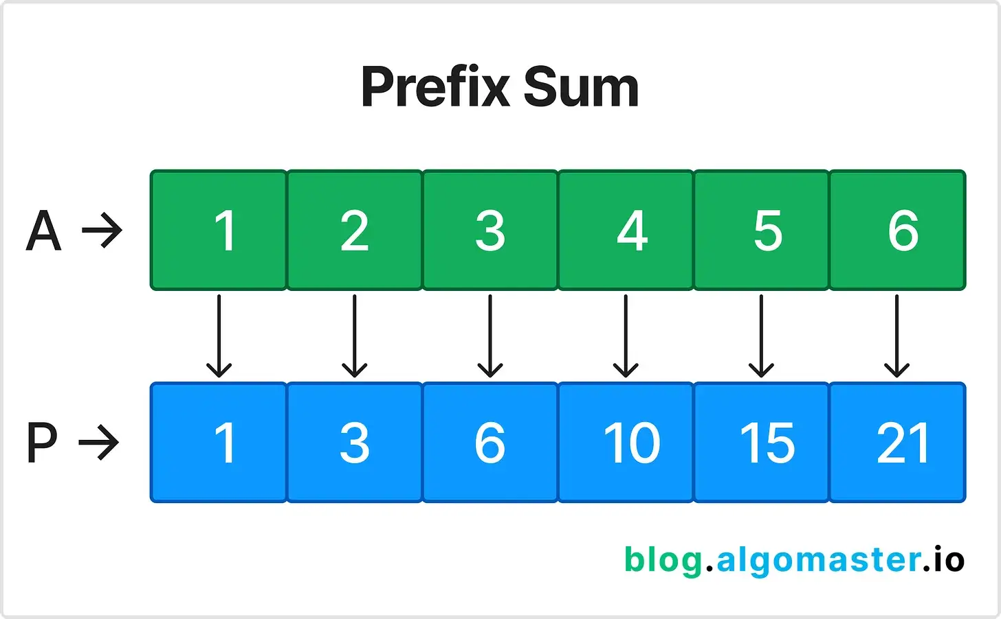
Example Prefix Sum

Slide 4
Sample Problem
Given an array nums, answer multiple queries about the sum of elements within a specific range
nums = [1, 2, 3, 4, 5, 6]
How to Solve:
Preprocess the array A to create a prefix sum array
prefixSum = [1, 3, 6, 10, 15, 21]
To find the sum between indices i and j, use the formula:
prefixSum[j] - prefixSum[i-1]
What is the sum of index 1 to index 3: Answer: 9

Slide 5
LeetCode Problems
Range Sum Query - Immutable (LeetCode #303)
Contiguous Array (LeetCode #525)
Subarray Sum Equals K (LeetCode #560)

Slide 6
Applied Solution
https://github.com/calmond1/SubarraySum/tree/main

