Slide 1
System Design

Slide 2
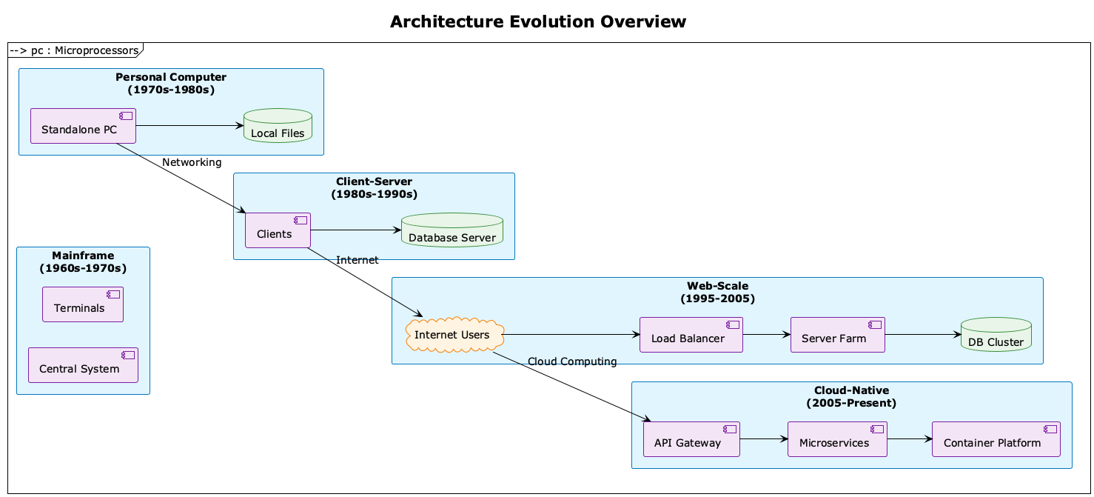
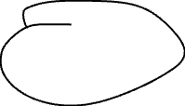





History

Slide 3
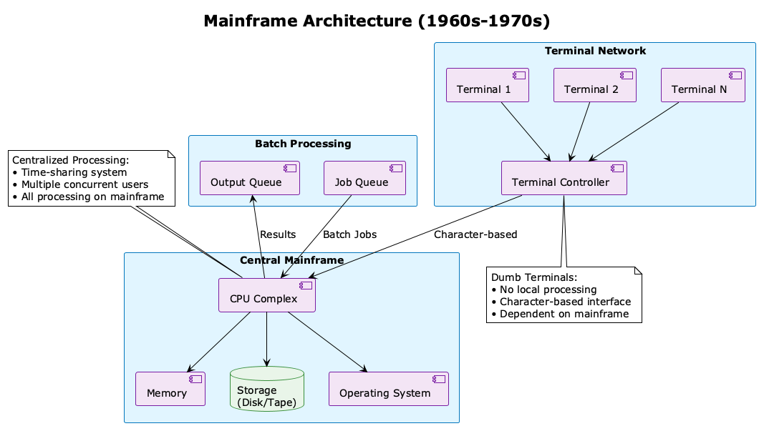

Slide 4
Key Challenges
Single Point of Failure
No quality control (Review, Test, CI/CD)
Hard to Scale
Compute
Networking
Database
Coupled Business Logic
Recover from Failure
Configuration (telnet to each server)
Notes:
Does it come from the single server architecture?
How are we solving the challenge now? What technology led to the improvement?

Slide 5
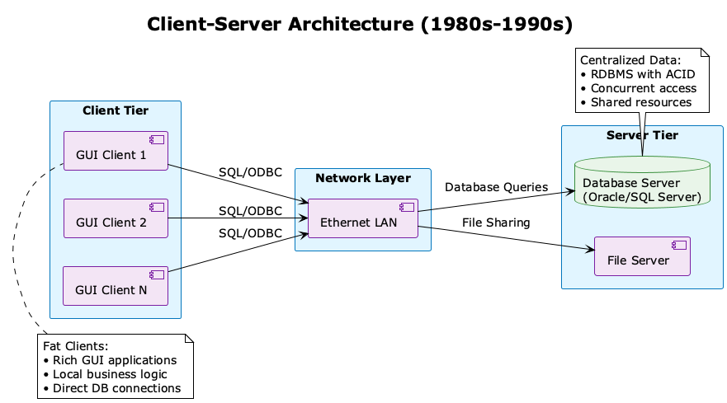
Client Server

Slide 6
Improvements
Better utilization of computing resources
Easier to add more clients
Flexibility - Different types of clients can connect to the same server
Easy to modify/upgrade either client or server without affecting the other

Slide 7
Key Challenges
Network Dependencies
Complexity in Management
Consistency Issues
Security Challenges
Development Complexity

Slide 8
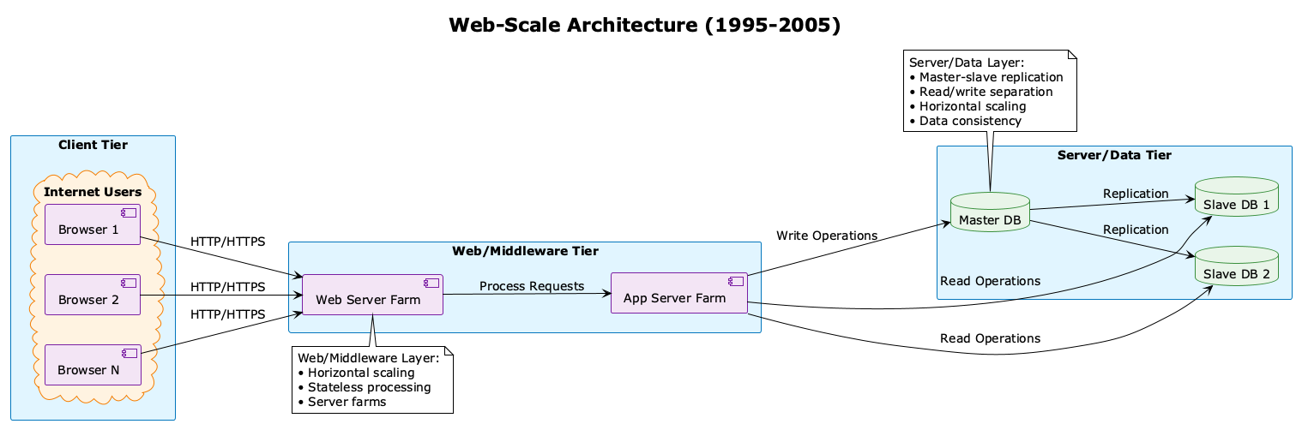

Slide 9
Improvements
No client installation
Cross-platform compatibility

Slide 10
Key Challenges
Network latency impact
Limited offline capabilities
Complex frontend frameworks
Security

Slide 11
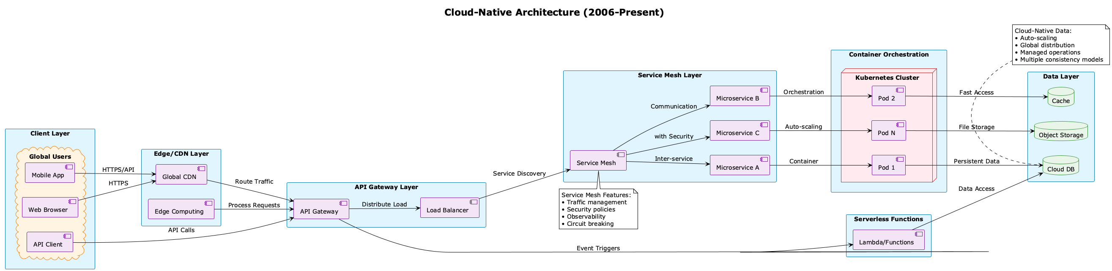
Cloud Native

Slide 12
Improvements
Scalability & Elasticity
Operational Excellence
Resilience & Reliability

Slide 13
Key Challenges
Complexity Explosion
Operational Overhead
Data Management Challenges

Slide 14

The Mythical Man-Month
"Adding manpower to a late software project makes it later" (Brooks's Law)
The man-month is a mythical unit of measurement
Conceptual integrity is the most important consideration in system design

Slide 15
The Mythical Man-Month
No Silver Bullet
Essential complexity vs. accidental complexity
No single development will solve all problems
Second-System Effect
Tendency to over-design the second system
Adding too many features
Communication Overhead
n(n-1)/2 communication paths
Team size impacts productivity

Slide 16
The Mythical Man-Month
Build one to throw away
Plan to plan
Maintain conceptual integrity
Document design decisions

Slide 17
Goal of System Design
The fundamental challenge in software engineering and system design is to create systems that effectively adapt to and support rapidly evolving business needs. The primary goal of system design is not just to solve current problems, but to build adaptable systems that can evolve with business changes while maintaining stability and efficiency.

Slide 18
Scalability
Adapts to business growth or contraction
Handles varying workloads efficiently
Supports business expansion to new markets
Enables cost-effective resource utilization

Slide 19
Availability
Ensures business continuity
Maintains service levels during changes
Supports 24/7 global operations
Minimizes business disruption

Slide 20
Operation
Facilitates quick business requirement changes
Enables rapid feature deployment
Supports easy system updates
Reduces technical debt

Slide 21
Maintainability
Facilitates quick business requirement changes
Enables rapid feature deployment
Supports easy system updates
Reduces technical debt

Slide 22
Performance
Maintains user experience during growth
Adapts to increasing data volumes
Supports real-time business operations
Handles peak business periods

Slide 23
Security
Protects expanding business assets
Adapts to new security threats
Supports compliance with changing regulations
Maintains trust as business grows

Slide 24
Flexibility
Enables business pivot capabilities
Supports new business models
Allows integration with new technologies
Facilitates business experimentation

Slide 25












Slide 26
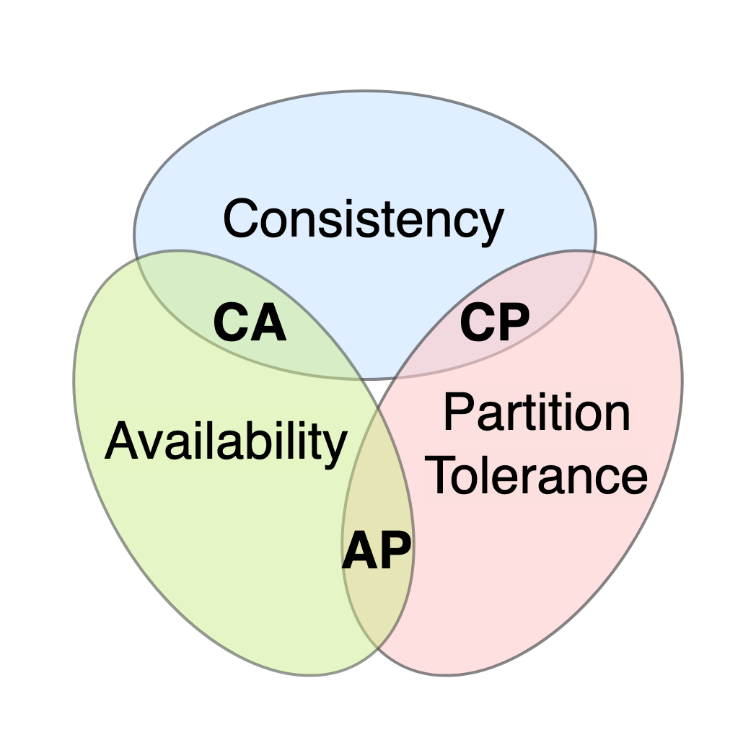





CAP Theorem
C - Consistency
A - Availability
P - Partition Tolerance

Slide 27
CAP Theorem - Consistency
Definition:
All nodes see the same data at the same time
Every read receives the most recent write
Example:
You update your profile picture
ALL servers must show the new picture immediately
No user sees the old pictur

Slide 28
CAP Theorem - Availability
Definition:
Every request receives a response (success or failure)
System remains operational even if some nodes fail
No timeouts or errors
Example:
Website always responds
Even if data might be slightly stale

Slide 29
CAP Theorem - Partition Tolerance
Definition:
System continues to work despite network failures
Nodes can't communicate but system doesn't crash
Example:
Data center in US can't reach data center in EU
Both keep operating independently

Slide 30
CAP Theorem
When network partition happens (P), you must choose:
Consistency - Reject requests until partition heals
Availability - Serve (possibly stale) data

Slide 31
CAP Theorem - CP Systems (Consistency + Partition Tolerance)
Characteristics:
Sacrifice availability during partition
Returns errors rather than stale data
Strong consistency guarantees
When partition occurs: ❌ Some nodes become unavailable ✅ Data remains consistent
Examples:
MongoDB (with strong consistency)
HBase
Redis (in certain configs)
Banking systems, financial transactions

Slide 32
CAP Theorem - AP Systems (Availability + Partition Tolerance)
Characteristics:
Always respond to requests
Might serve stale data during partition
Eventually consistent
When partition occurs: ✅ All nodes remain available ⚠️ Data might be temporarily inconsistent
Examples:
Cassandra
DynamoDB
CouchDB
Social media feeds, shopping carts

Slide 33
CAP Theorem
When to use CP
When to use AP

Slide 34
CAP Theorem - Common Misconception
Pick 2 and completely ignore the 3rd
PACELC Theorem (Extended CAP)

Slide 35
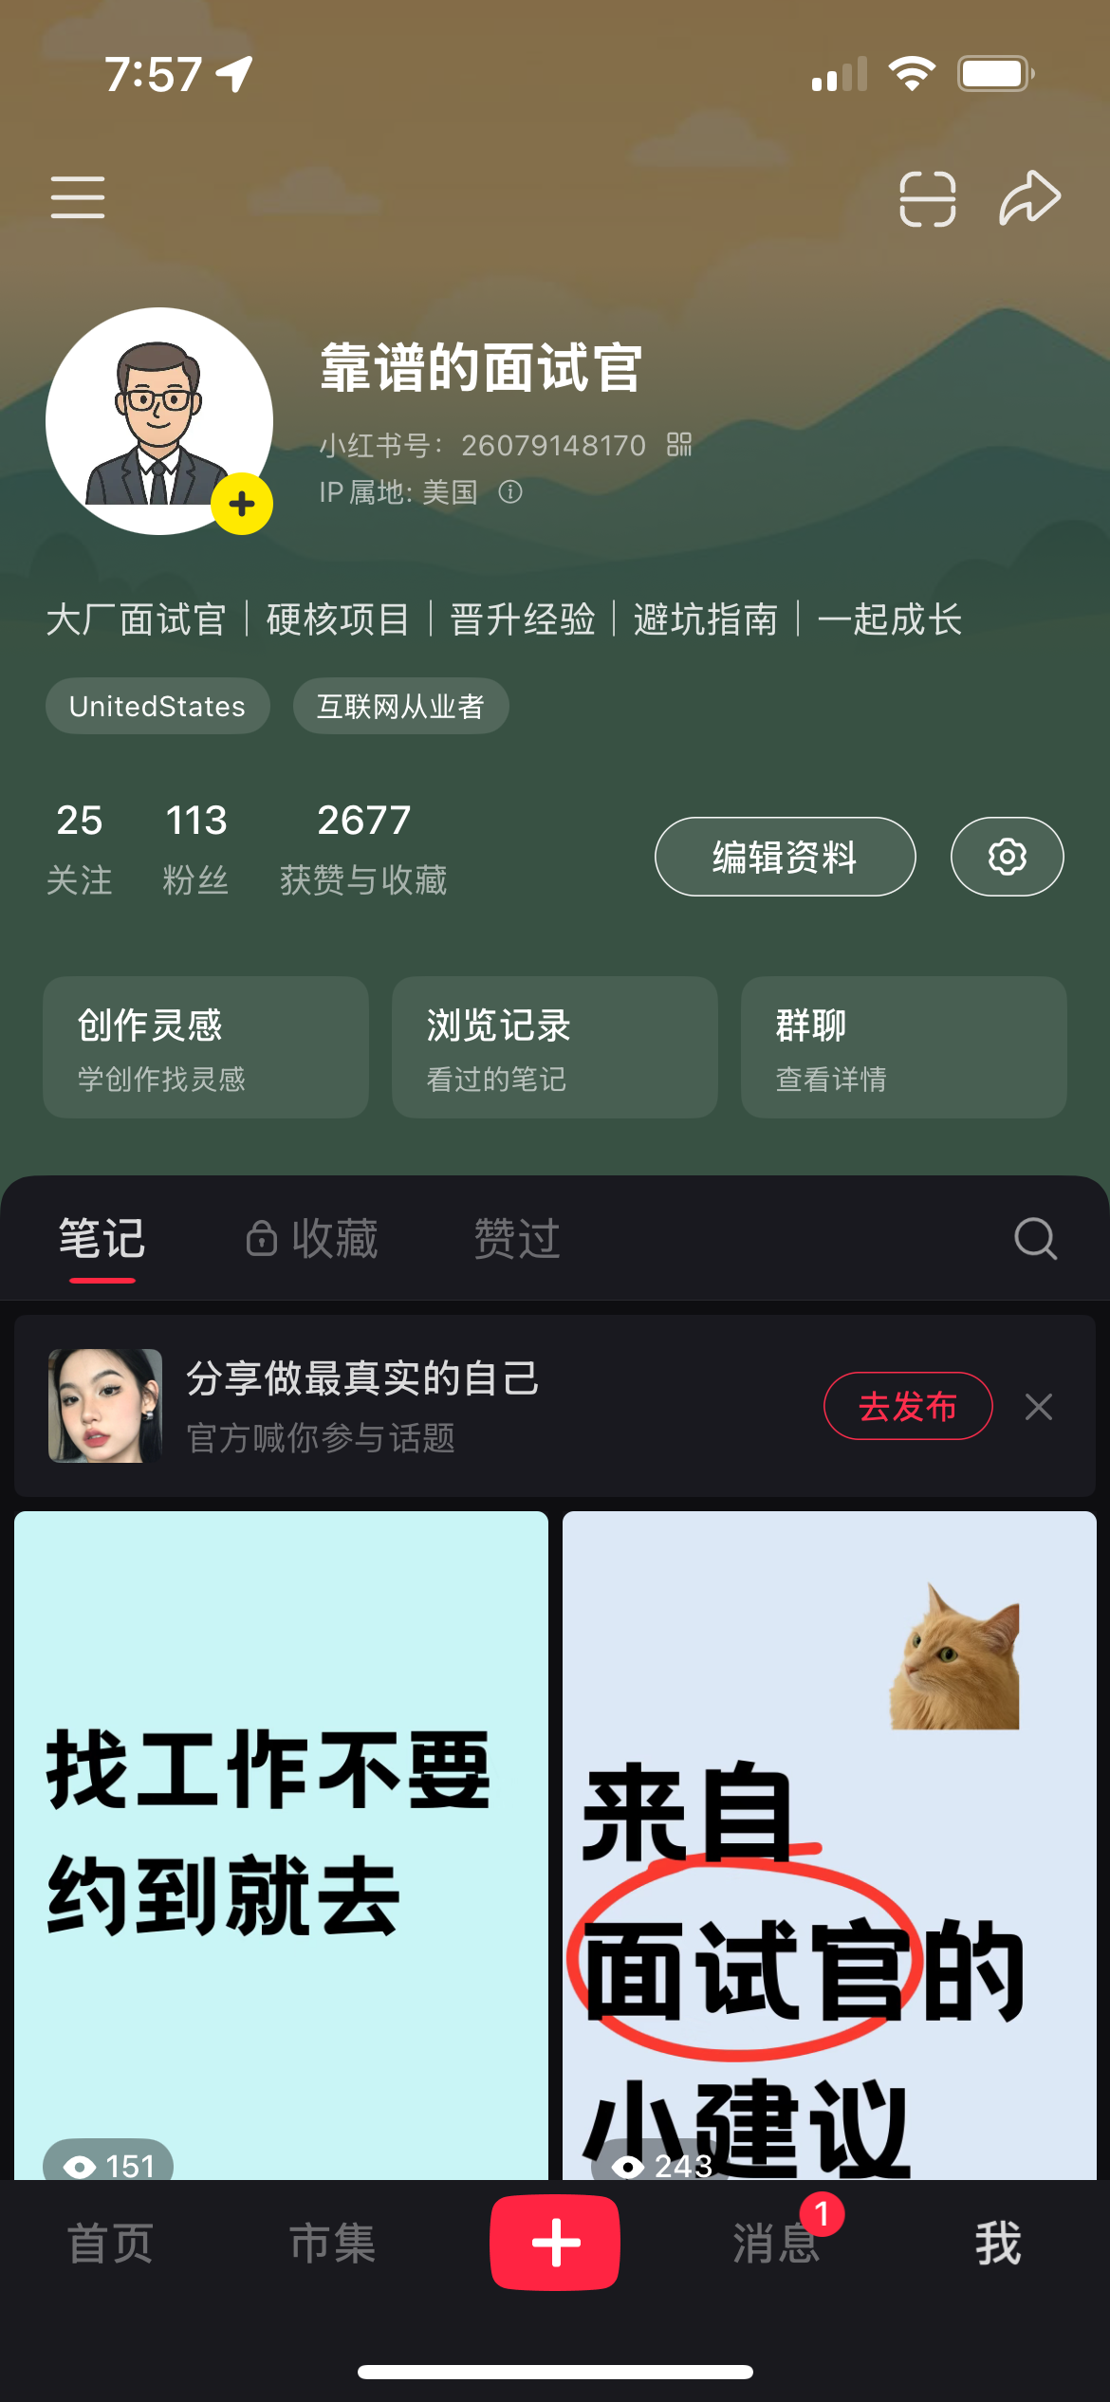
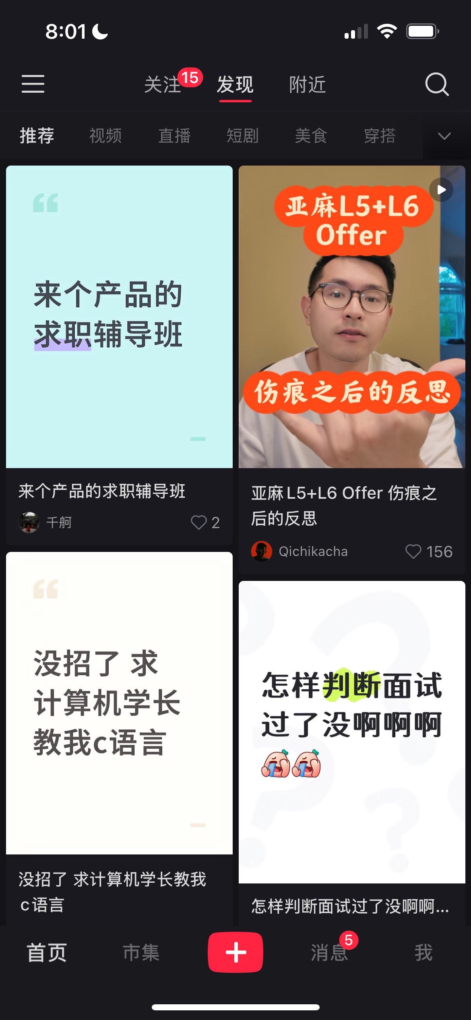
Case Study – Red Note
Home Page
New User
Update User
Add Post
Show Homepage
Notes:
https://github.com/calmrocks/system-design-dive-deep/tree/main/rednote-case-study/requirements

Slide 36
System Design Components
User Experience
High Level Design
API Design
Data Schema Design
Scaling strategy
Availability & fault tolerance
Security considerations
Performance optimization techniques
Cost
Testing Strategy
Operations & Observability
Migration & Rollout Plan
Estimation
Notes:
https://github.com/calmrocks/system-design-dive-deep/blob/main/templates/system-design-template.md

Slide 37
Write Clear User Stories
A user story is a short, simple description of a feature from the end-user's perspective, typically following this format:
"As a [type of user], I want [goal/desire], so that [benefit/reason]"

Slide 38
Write Clear User Stories - Key Components
User Role: Who wants this feature?
Action: What do they want to do?
Business Value: Why do they want it?

Slide 39
INVEST Criteria (Good user stories are)
Independent: Can be developed separately
Negotiable: Details can be discussed
Valuable: Delivers value to users
Estimable: Can be sized/estimated
Small: Fits within a sprint
Testable: Clear acceptance criteria

Slide 40
Acceptance Criteria:
Specific conditions that must be met
Written as "Given-When-Then" scenarios
Defines "done"

Slide 41
Estimating User Stories
Stories should be clear enough to estimate effort
Common sizing: Story Points (1, 2, 3, 5, 8, 13) or T-shirt sizes (S, M, L, XL)
If a story can't be estimated, it's probably too vague or too large

Slide 42
UML - What is UML
Unified Modeling Language - a standardized visual language for documenting software system design and architecture.

Slide 43
UML - Class Diagram
Shows data models, entities, and relationships
Use for: Database schema, domain models, API objects

Slide 44
UML - Sequence Diagram
Shows how components interact over time
Use for: API flows, request/response patterns, authentication flows

Slide 45
UML - Component Diagram
Shows high-level system architecture
Use for: Microservices architecture, system boundaries, dependencies

Slide 46
UML - When to Use UML
Communicating architecture to stakeholders
Documenting complex interactions
Planning database schemas
Design reviews and discussions

Slide 47
UML - When NOT to Use
Don't over-document - draw what adds value
Not for every small feature
Not a substitute for code documentation

Slide 48
UML - Tools
Use Case | Recommended Tool
Quick sketch during meeting | Excalidraw, draw.io
Documentation in GitHub/GitLab | Mermaid
Professional presentation | Lucidchart, Creately
Version control & code review | PlantUML, Mermaid
Team collaboration | Miro, Lucidchart
Learning UML | draw.io (templates), Visual Paradigm Online

Slide 49
Example - User SignUP
Story ID: US-001
Title: User Account Registration
As a new visitor to the platform I want to create an account using my email address and password So that I can access personalized features and save my preferences
Priority: P0 (Must Have) Story Points: 5 Sprint: Sprint 1

Slide 50
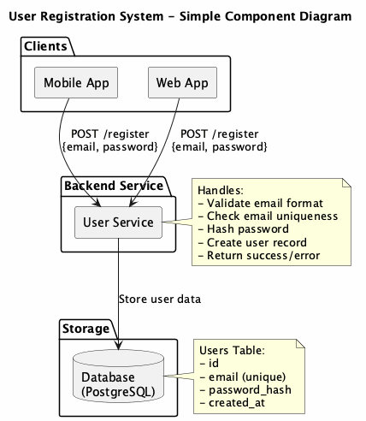
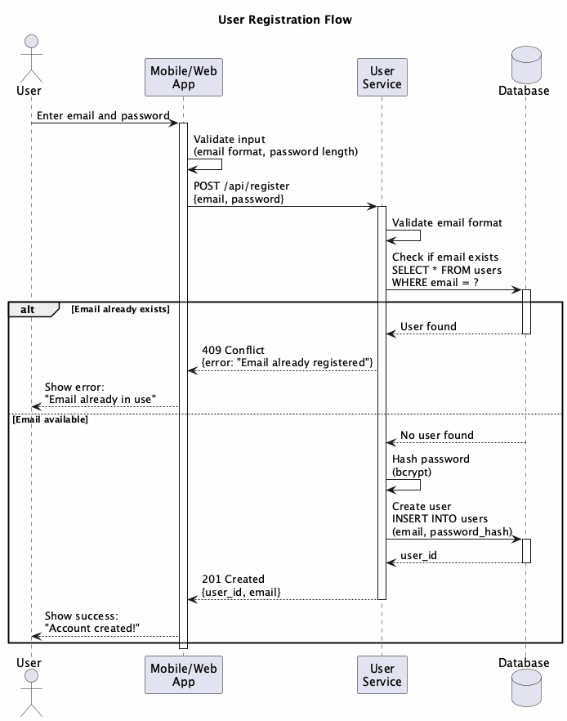

Slide 51
API Design – REST vs RPC
Aspect | REST (Resource-Oriented) | RPC (Operation-Oriented)
Philosophy | Everything is a resource | Remote function/procedure calls
Focus | Nouns (resources) | Verbs (actions)
URL Style | /users/123 | /getUser or /users/get
HTTP Methods | Semantic use (GET, POST, PUT, DELETE) | Mostly POST for everything
Example | DELETE /users/123 | POST /deleteUser with {id: 123}

Slide 52
API Design – REST vs RPC – Use Cases
Scenario | REST | RPC | Recommendation
Simple CRUD | ✅ Perfect fit | ❌ Overkill | Use REST
User Management | ✅ POST /users<br>GET /users/123 | ⚠️ POST /createUser<br>POST /getUser | Use REST
Complex Business Logic | ⚠️ Forced:<br>POST /orders/123/shipments | ✅ Natural:<br>POST /shipOrder | Use RPC
Multiple Actions on Resource | ⚠️ Awkward:<br>POST /users/123/password-resets<br>POST /users/123/activations | ✅ Clear:<br>POST /resetPassword<br>POST /activateUser | Use RPC

Slide 53
API Design – REST vs RPC – Use Cases
Scenario | REST | RPC | Recommendation
Payment Operations | ⚠️ POST /payments/123/captures<br>POST /payments/123/refunds | ✅ POST /capturePayment<br>POST /refundPayment | Use RPC
Cloud Services (AWS, GCP) | ⚠️ Too constraining | ✅ Flexible operations | Use RPC
Public Web APIs | ✅ Standard, predictable | ⚠️ Less intuitive | Use REST
Internal Microservices | ✅ Works well | ✅ Also works well | Either (or gRPC)
Real-time Operations | ⚠️ Not designed for this | ✅ Better fit | Use RPC (or WebSocket)

Slide 54
API Design – REST vs RPC – Examples
ompany/Service | Style | Example Endpoints
GitHub | REST (mostly) | GET /repos/:owner/:repo<br>POST /repos/:owner/:repo/issues
Stripe | Hybrid | POST /v1/customers (REST)<br>POST /v1/charges/:id/capture (RPC)
AWS | RPC | Action=CreateBucket<br>Action=DeleteObject
Slack | RPC | POST /api/chat.postMessage<br>POST /api/users.list
Twitter | REST | GET /tweets/:id<br>POST /tweets
Google Cloud | Hybrid | POST /v1/projects/{id}/buckets (REST-like)<br>POST /v1/buckets:create (RPC-like)
Twilio | RPC | POST /Messages.json<br>POST /Calls.json

Slide 55
API Design – RESTful Principles
1. Resource-Based URLs
✅ Good: GET /users/123/orders
❌ Bad: GET /getUserOrders?userId=123

Slide 56
API Design – RESTful Principles
2. HTTP Methods (Verbs)
GET: Retrieve resource(s) - safe, idempotent
POST: Create new resource
PUT: Replace entire resource - idempotent
PATCH: Partial update
DELETE: Remove resource - idempotent

Slide 57
API Design – RESTful Principles
3. URL Structure
/resources # Collection
/resources/123 # Single resource
/resources/123/sub # Nested resource

Slide 58
API Design – RESTful Principles
3. URL Structure
/resources # Collection
/resources/123 # Single resource
/resources/123/sub # Nested resource

Slide 59
API Design – API Components
Input (Request)
Output (Response)
Exceptions (Errors)

Slide 60
API Design – API Components
2xx Success
200 OK - Request succeeded
201 Created - Resource created
204 No Content - Success but no response body
4xx Client Errors
400 Bad Request - Invalid input
401 Unauthorized - Authentication required
403 Forbidden - No permission
404 Not Found - Resource doesn't exist
409 Conflict - Resource conflict (duplicate)
422 Unprocessable - Validation failed
429 Too Many Requests - Rate limit exceeded
5xx Server Errors
500 Internal Server Error - Something went wrong
502 Bad Gateway - Upstream service failed
503 Service Unavailable - Temporarily down

Slide 61
API Design – Pagination
Large datasets must be paginated:
# Offset-based
GET /products?page=2&limit=20
# Cursor-based (better for real-time data)
GET /products?cursor=eyJpZCI6MTIzfQ&limit=20

Slide 62
API Design – Idempotence
Same request → Same result (can retry safely)
GET, PUT, DELETE: Naturally idempotent
POST: Not idempotent (creates new resource each time)
Solution: Use idempotency keys for POST
POST /payments
Headers: Idempotency-Key: unique-key-123

Slide 63
API Design – Simple & Intuitive
Predictable naming conventions
Consistent structure across all endpoints
Self-documenting URLs: /users/123/orders (clear hierarchy)
Sensible defaults: limit=20 if not specified
Clear error messages

Slide 64
API Design – Backward Compatibility
Never break existing clients:
✅ Add new optional fields
✅ Add new endpoints
✅ Add new optional parameters
❌ Remove fields
❌ Change field types
❌ Make optional fields required
❌ Change URL structure

Slide 65
API Design – Deprecation strategy:
1. Announce deprecation (6+ months notice)
2. Add deprecation warnings in responses
3. Provide migration guide
4. Support old version during transition
5. Eventually remove (with final notice)

Slide 66
API Design – Versioning (Forward Compatibility)
# URL versioning (most common, explicit)
/v1/users
/v2/users
# Header versioning (cleaner URLs)
Accept: application/vnd.myapi.v1+json
# Query parameter (not recommended)
/users?version=1
Recommendation: URL versioning for simplicity

Slide 67
API Design – Other Important Practices
Rate Limiting:
Response Headers:
X-RateLimit-Limit: 1000
X-RateLimit-Remaining: 999
X-RateLimit-Reset: 1640000000
Security:
Always use HTTPS
Validate all inputs
Use authentication (JWT, OAuth)
Don't expose sensitive data in URLs
Documentation:
Keep API docs up-to-date
Provide examples for each endpoint
Include error scenarios

