Slide 1
NoSQL Design

Slide 2
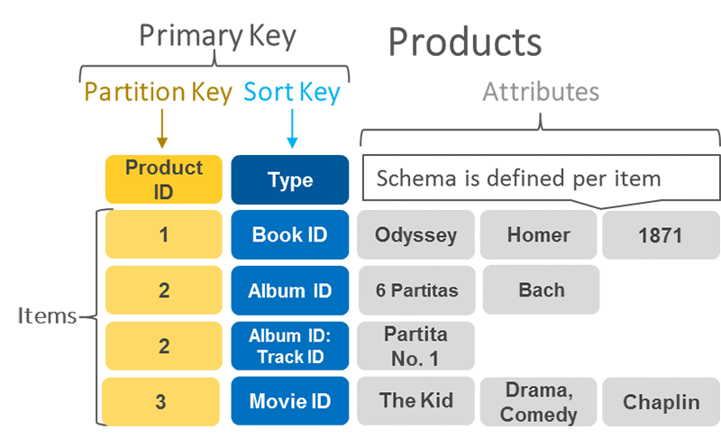
Keys

Slide 3
Partition Key
The partition key determines the physical storage location (partition) of an item within DynamoDB.
DynamoDB uses the partition key value as input to an internal hash function, which then distributes the data across multiple partitions.
All items with the same partition key value are stored together within the same partition.
For a simple primary key, the partition key must be unique across all items in the table.

Slide 4
Sort Key
The sort key, also known as a range key, is an optional component of a composite primary key.
When a sort key is defined, items within the same partition (sharing the same partition key) are stored in a sorted order based on their sort key values.
The combination of the partition key and sort key must be unique for each item in the table.
Sort keys enable efficient range queries and other operations like begins_with, between, greater than, or less than on items within a specific partition.

Slide 5
Key Differences and Relationship
Uniqueness: The partition key alone must be unique in a simple primary key. In a composite primary key, the combination of the partition key and sort key must be unique.
Data Distribution: The partition key dictates how data is distributed across partitions.
Data Ordering and Querying: The sort key determines the order of items within a partition and enables flexible querying options within that partition.
Immutability: Both the partition key and sort key, once set, are immutable for an item.

Slide 6
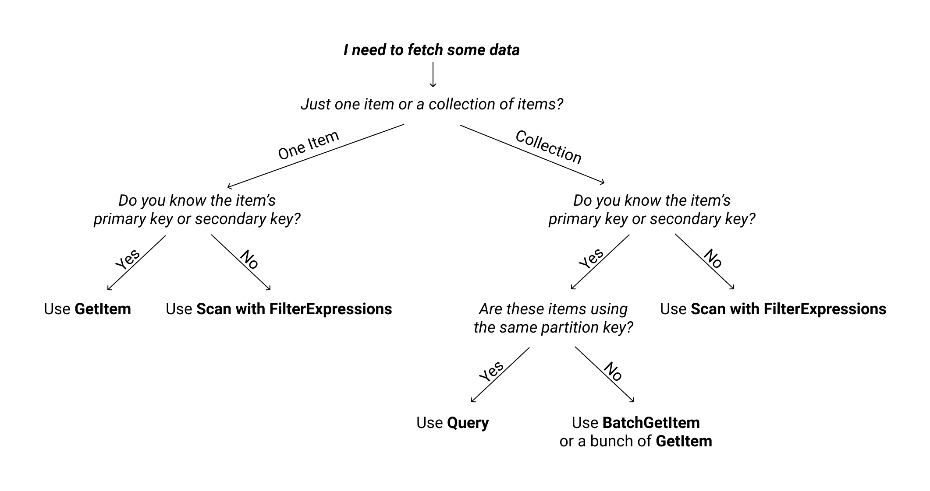
Query vs SCAN

Slide 7
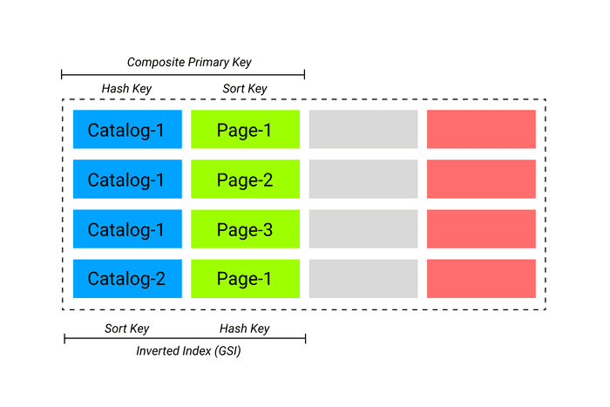
IndexeS

Slide 8
Core Principles
Query-Driven Design
Consider Eventual Consistency
Single Table Design

Slide 9
Query-Driven Design - Users
Get user by user_id (primary lookup)
Get user by email (for login)
Get user by phone number (alternative login/verification)
Get user by username (profile lookup)
Search users by name (less common, might skip)
Get users by status (active/inactive) - admin queries
Get users created in date range (admin/analytics)

Slide 10
Query-Driven Design - POSTS
Get post by post_id (view single post)
Get all posts by a user (user's profile/timeline)
Get recent posts (homepage feed, sorted by timestamp)
Get posts by category/tag
Get posts in a date range
Get top posts (by likes/views)
Search posts by keyword/content (full-text search)

Slide 11
Query-Driven Design – User Table
Users Table
Primary Key
  PK: user_id
GSIs (Global Secondary Indexes)
  GSI1: email (PK)
  GSI2: username (PK)
  GSI3: phone (PK)
getUserById(user_id) → Query on PK
getUserByEmail(email) → Query on GSI1
getUserByUsername(username) → Query on GSI2
getUserByPhone(phone) → Query on GSI3

Slide 12
Query-Driven Design – Post Table
Primary Key
  PK: user_id
  SK: created_at (or timestamp in reverse for newest first)
GSIs
  GSI1:
    PK: post_id (for direct post lookup)
  GSI2:
    PK: "POSTS" (fixed value)
    SK: created_at (for recent posts globally)
What problems in this design?

Slide 13
Query-Driven Design – Post Table
Primary Key
  PK: post_id
  SK: post_id (or constant value)
GSIs
  GSI1:
    PK: user_id
    SK: created_at
What problems in this design?
How to get recent posts globally?
Notes:
How to get recent posts globally?

Slide 14
Question
How to get posts by upvote count (most popular posts)?
Notes:
Maybe we can build a top posts table or GSI?

Slide 15
Question
How to search posts and return top posts based on upvote count?

Slide 16
Question
-- Full-text search + sort
SELECT * FROM posts
WHERE
to_tsvector('english', content) @@ to_tsquery('javascript')
AND category = 'tech'
ORDER BY upvote_count DESC
LIMIT 20;

Slide 17
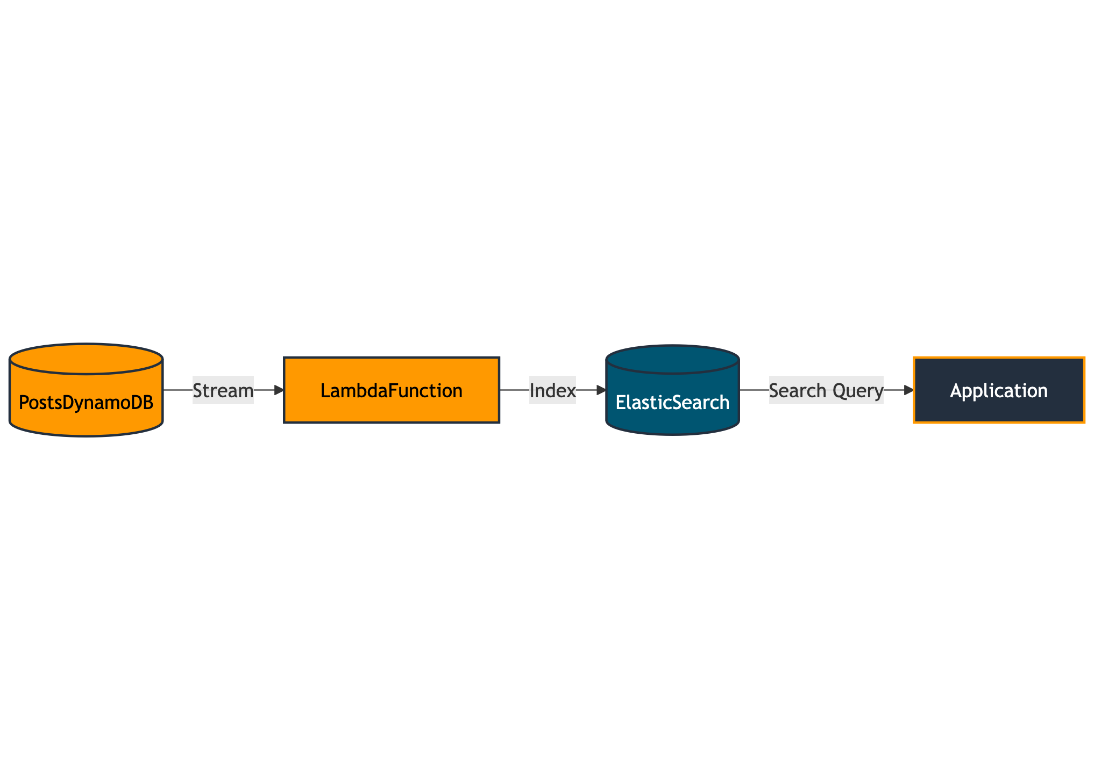

Slide 18
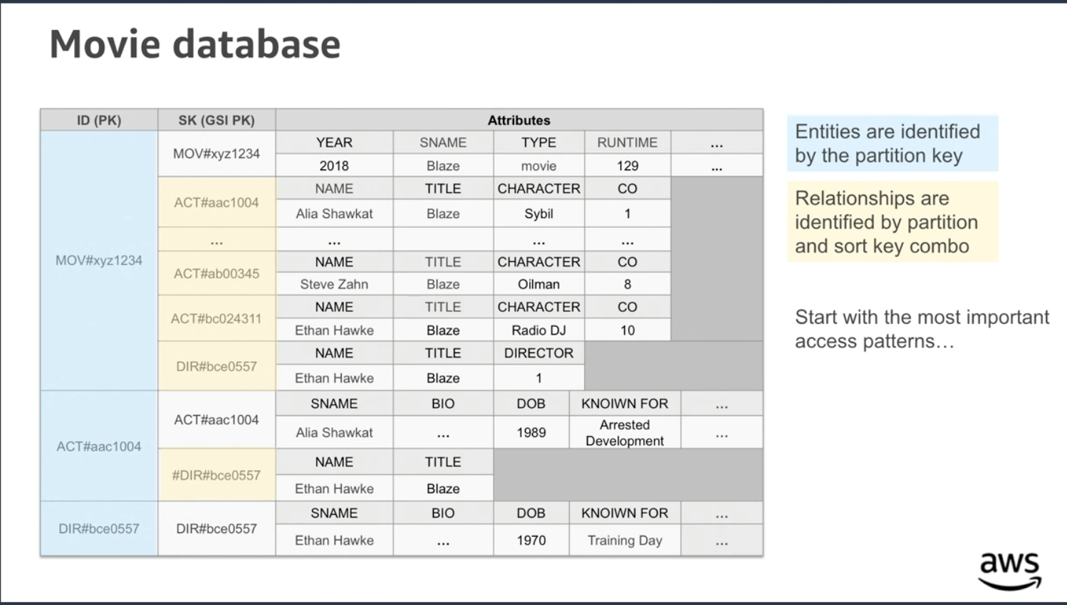
Single Table Design

Slide 19
Anti Pattern - Hot Partitions
Write sharding
Partition key design strategies
Time-based bucketing

Slide 20
Anti Pattern - Unbounded Growth
Bucketing pattern (detailed)
Pagination strategies
Archive old data

