Slide 1
C Installation 2020 Spring: Introduction to C
April 22nd, 2020

Slide 2
Today
Introduction
C Installation
Hello, World!

Slide 3
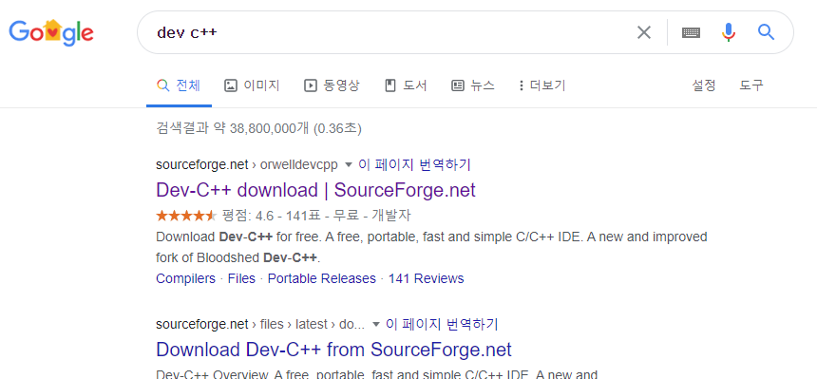
C Installation
Google Search "Dev C++"

Slide 4
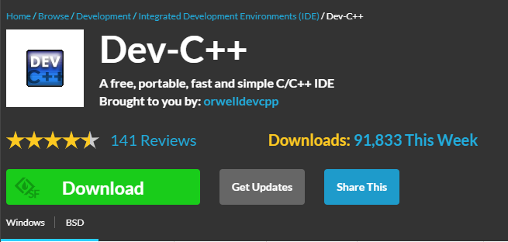
C Installation
Click on "Download"

Slide 5
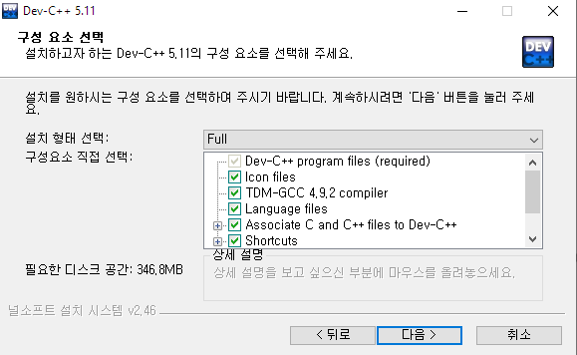
C Installation
Run downloaded file
Install options: Full
C/C++ will both be installed, but we will only use C

Slide 6
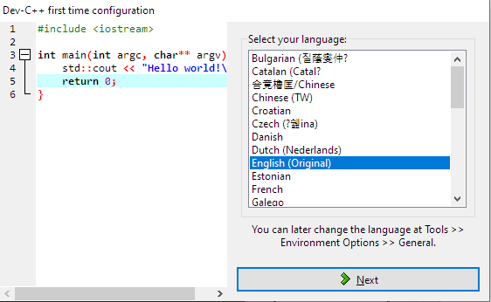
C Installation
First time configuration
English is better for future uses and Googling!

Slide 7
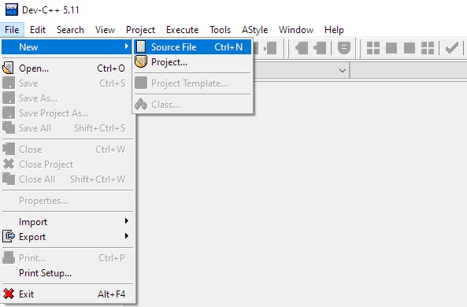
Hello, World!
We will write our first C program!
Run Dev-C++
File > New > Source File

Slide 8
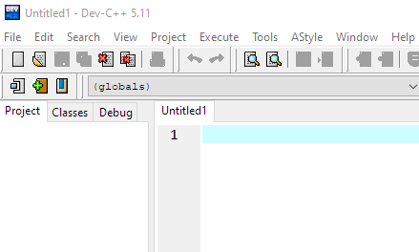
Hello, World!
New file has been created

Slide 9
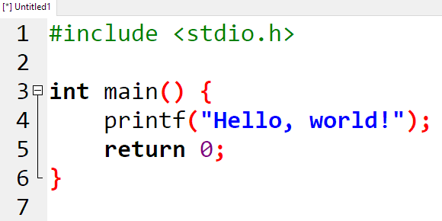
Hello, World!
Type in the following!

Slide 10
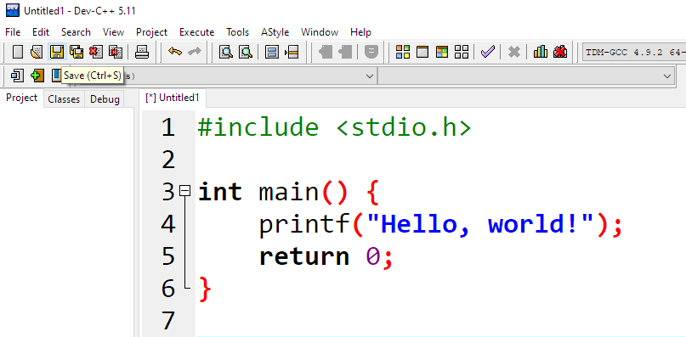
Hello, World!
Click on 'Save'

Slide 11
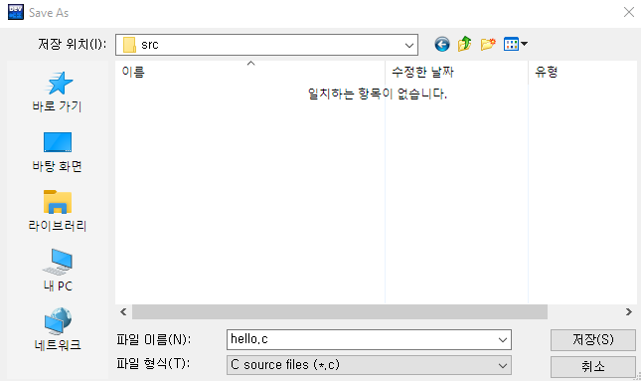
Hello, World!
Select a place to save your code for this study!
Important!
File extension must be C source files (*.c)

Slide 12

Hello, World!
Click on 'Compile & Run'
Can also be done by pressing F11 on your keyboard

Slide 13
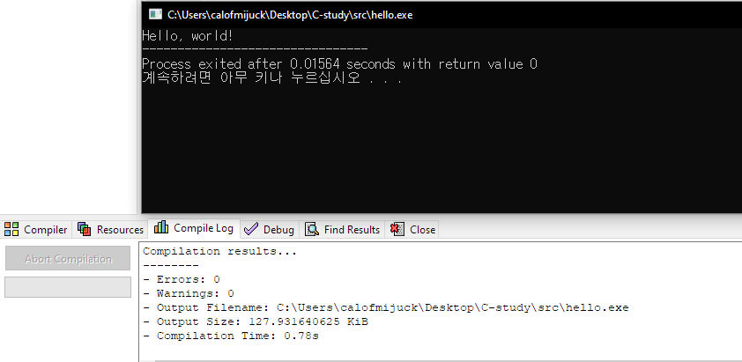
Hello, World!
A window should pop up
And it should say "Hello, world!"
Good Job!

