Slide 1
C Basics 2020 Spring: Introduction to C
April 22nd, 2020

Slide 2
Today
General Concepts
C Program Structure
C Strings
printf()
Escape sequences
Comments
C Data Types
Declaration and assignment
Representation of numbers
C Operators

Slide 3
Programming – General Concepts
Program
A set of instructions to be carried out by a computer
Programming
Creating an ordered set of instructions to solve a problem with a computer
Programming language
A systematic set of rules used to describe computations in a format that is editable by humans
Ex) C, C++, Java, Python ...

Slide 4
Programming – General Concepts
Syntax
Set of legal structures and commands that can be used in a language
Every basic C statement ends with a semicolon ;
If you violate this, you will get...
Syntax Error (Compile Error)
A problem in the structure of a program that causes compilation failure
Missing semicolon
Mismatching { } braces
Illegal variable names
...
When error occurs, read the error messages carefully!

Slide 5
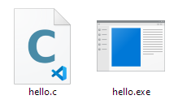
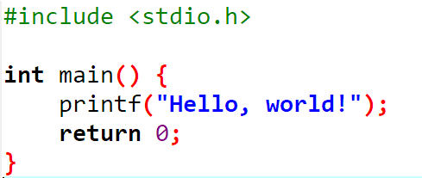
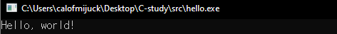
Programming – General Concepts
Write it
Code or source code: the set of instructions in a program
Compile it
compile: translate a program from one language to another
Execute it
The messages printed to the user by a program
console: Text box where the program's output is printed

Slide 6
C Program Structure
header: code to include, usually libraries
method: a named group of statements
statement: a command to be executed
Statements inside main will be executed!
… ①
… ②
… ③

Slide 7
Strings
String: a sequence of characters
Starts and ends with a " (quote) character
The quotes do not appear in the output
Examples:
"hello"
"This is a string. It's very long!"
May not span multiple lines
May not contain a " character

Slide 8
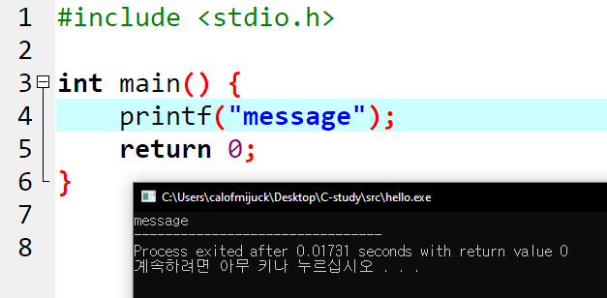
C Output
printf(...)
Defined in stdio.h - #include <stdio.h> to use it!
Prints output on the console
More about this later!
How to use printf(...)
printf("message");
Prints the given string ("message") as output

Slide 9
Escape Sequences
Escape Sequence
A special sequence of characters used to represent special characters in a string
\t tab character
\n new line character
\" quotation mark character
\\ backslash character
Example:
printf("\\hello\nhow\tare \"you\"?\\\\");
Output:
\hello
how are "you"?\\

Slide 10
Exercise
Print the following text using C
Print the following shape using C
Welcome to C study!
We are learning how to use printf()!
*
***
*****
*******
***
***

Slide 11
Exercise
Write a printf statement to produce this output
All blanks are spaces
Use a single printf statement to produce this output
All blanks are tabs
/ \ // \\ /// \\\
a b c
"\'"
Escape
sequences

Slide 12
C Comments
Comment
A note written in source code by the programmer to describe or clarify the code
Comments are ignored when your program runs
Examples
// This is a one-line comment
/* This is a
multi-line comment */
Comments are useful for:
Explaining complex pieces of code or complex programs
Multiple programmers working together

Slide 13
Data Types
Type: A category or set of data values
Used to represent real-world objects
Constrains the operations that can be performed on data
C programmers must specify types
Ex) Integers, real numbers, character, ...
Primitive Types: Built-in types
int Integers (2, -26, 3000)
double Real numbers (3.1, -0.25, 0.001)
char Single characters ('a', 'b', 'c')
And more ...

Slide 14
Variables
We want to use these data for computation
Can we store data ?
Can we perform operations on them ?
Variable: A piece of computer memory that is given a name and type, and can store a value
Steps for using a variable
Declare it - State its name and type
Initialize it - Store a value into it
Use it - Print it or use in operation

Slide 15
Variable Declaration
Variable Declaration
Sets aside memory for storing a value
Variables must be declared before usage
Syntax
type name;
The name is called an identifier
Examples
int x;
double myGPA;
x
myGPA

Slide 16
Variable Declaration
Assignment
Stores a value into a variable
= does not mean equals!
Syntax
name = expression;
Examples
x = 3;
myGPA = 3.1 + 1.2;
x
3
myGPA
4.3

Slide 17
Expressions
Expression: A value or operation that computes a value
Examples
1 + 4 * 5 // 21
(7 + 2) * 6 / 3 // 18
42 // 42
The simplest expression is a literal value
A complex expression can use operators and parentheses
As a program runs, its expressions are evaluated
1 + 1 evaluates to 2

Slide 18
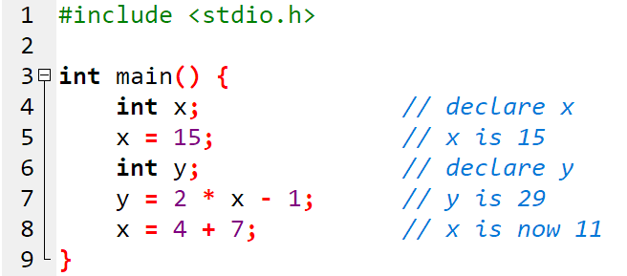
Using Variables
Once given a value, a variable can be used in expressions
You can assign a value more than once

Slide 19
Variable Declaration/Assignment
A variable can be declared and initialized in one statement.
Syntax
type name = value;
Examples
int x = 3;
double myGPA = 4.3;
x
3
myGPA
4.3

Slide 20
Assignment
= is called an assignment operator
Does not mean equals!
Means: "Store the value at right in variable at left"
The right-side expression is evaluated first, and the result is stored in the variable at left
Example
int x = 3;
x = x + 2;
x + 2 is evaluated and stored in x
x
3
x
5

Slide 21
Common Mistakes
A variable should only store a value of its own type
No errors will be shown, so be careful!
int x = 2.5; // Not good
double x = 2; // OK. 2 is a real number
A variable shouldn't be used until it is assigned a value
No errors will be shown, so be careful!
int x; // ???
int y = x + 1; // What is x? Then what is the value of y?
You may not declare the same variable twice
int x;
int x; // error: variable x is already defined

Slide 22
Identifiers and Keywords
Identifier: A name given to an item in your program
Must start with a letter or _ or $
Subsequent characters can be any of those or a number
Legal identifiers
_myName, TheCure, ANSWER_IS_42, $bling$
Illegal identifiers
me+u, 49ers, side-swipe, Ph.D's
Keyword: An identifier that you cannot use because it already has a reserved meaning in C
int, double, float ...

Slide 23
Format Strings and printf
How to print the value of variables?
Values must be formatted before printing!
Format strings are used to format when
printf("format string", parameters);
There can be many parameters
A format string can contain placeholders to insert parameters
%d integer
%lf real numbers (double)
%.Dlf real numbers, with D digits precision
%c character
%s string

Slide 24
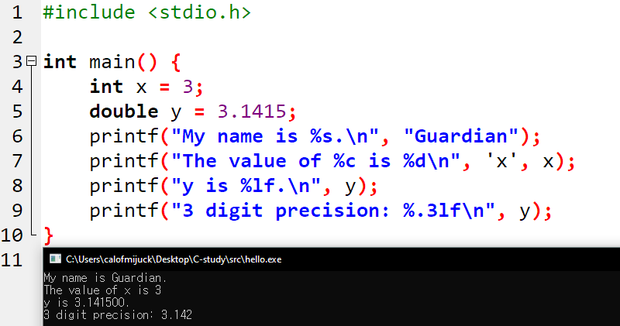
Format Strings and printf
Example

Slide 25
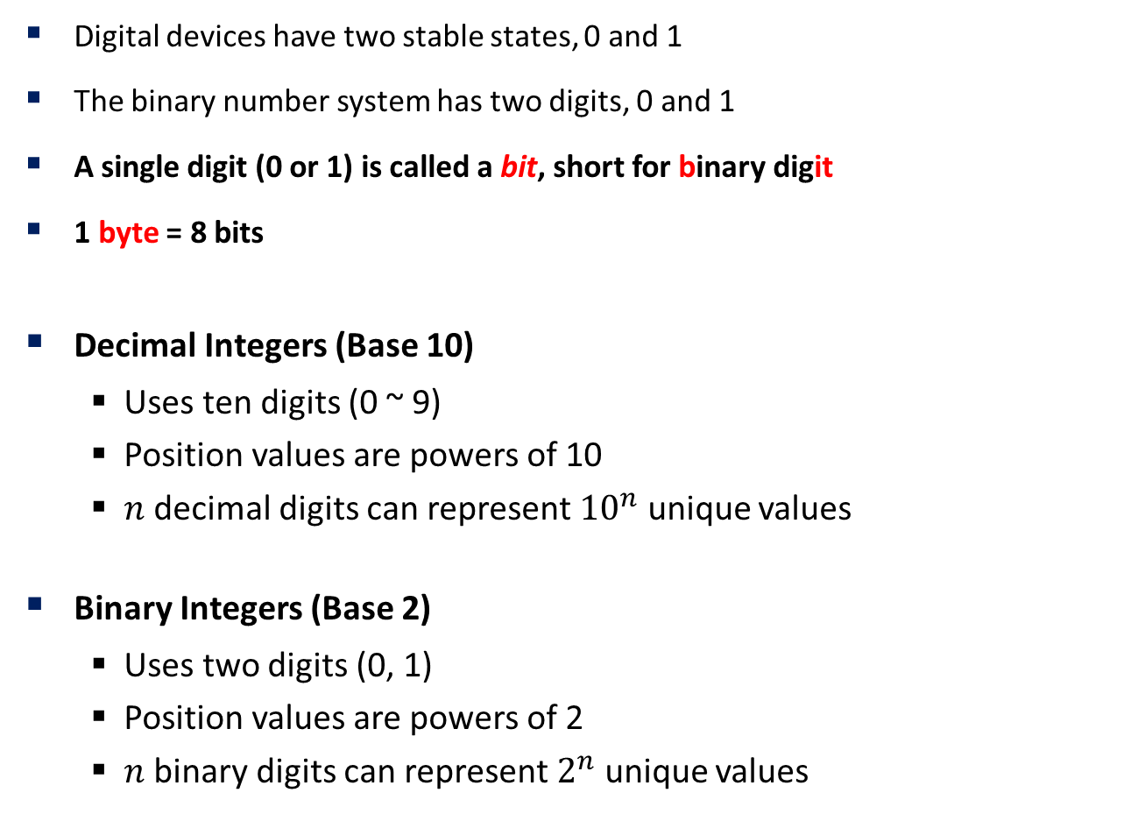
Representation of Numbers
Digital devices have two stable states, 0 and 1
The binary number system has two digits, 0 and 1
A single digit (0 or 1) is called a bit, short for binary digit
1 byte = 8 bits
Decimal Integers (Base 10)
Uses ten digits (0 ~ 9)
Position values are powers of 10
$n$ decimal digits can represent ${10}^{n}$ unique values
Binary Integers (Base 2)
Uses two digits (0, 1)
Position values are powers of 2
$n$ binary digits can represent $2^{n}$ unique values

Slide 26

Representation of Numbers
How to count in binary
C int uses 4 bytes (32 bits)
1 bit is used for sign
Stores numbers from ${−2}^{31} \sim 2^{31}−1$
Generally, $n$ bit integer can store ${−2}^{n−1} \sim 2^{n−1}−1$
128 | 64 | 32 | 16 | 8 | 4 | 2 | 1
117
0 | 1 | 1 | 1 | 0 | 1 | 0 | 1

Slide 27

Representation of Numbers
C double
Uses scientific notation
${\left(−1\right)}^{sign}∗mantissa ∗2^{exponent}$
Mantissa has finitely many digits
Causes round-off errors
Somewhat different from real numbers
sign | exponent | mantissa
1 bit | 11 bits | 52 bits

Slide 28
C Operators
Operator: Computation that combines multiple values or expressions
Arithmetic Operators
Relational Operators
Logical Operators
Assignment Operators
Increment and Decrement Operators

Slide 29
Arithmetic Operators
Used for calculation involving numbers
Can be applied to numerical types
int, double, (long long, float)
Operator | Meaning | Example
+ | Addition | 3 + x
- | Subtraction | p – q
* | Multiplication | 6 * i
/ | Division | 10 / 4
% | Remainder (mod) | 11 % 8

Slide 30
Integer Arithmetic
Integer division returns the quotient!
Ex. 14 / 4 is 3, not 3.5
Division by 0 causes an error
% operator computes the remainder from integer division
Ex. 14 % 4 is 2
Check if x is odd: x % 2
Obtain last digit of x : x % 10
Subtle when handling negative integers
-4 / 3 is -1
-5 % 3 is -2

Slide 31
Real Number Arithmetic
Examples: 6.022, -42.0, 3.1415
Placing .0 or . after an integer makes it a double
/ produces an exact answer
15.0 / 2.0 is 7.5
When int and double are mixed, the result is a double
4.2 * 3 is 12.6
7.2 / 3 is 2.4

Slide 32
Exercise
Calculate the answer of the following expression
123 + 456 * 789 / 3 % 2
Follow the steps.
Declare a variable x and assign 30
Declare a variable y and assign 15
Print x + y, x - y, x * y, x / y, x % y, respectively on each line

Slide 33
Relational Operators
Determine relations between values
Relational operators are used in boolean expressions
Boolean expressions will evaluate to true or false
Ex. 2 > 3 will evaluate to false
Operator | Meaning | Example
== | Equal to | x == 10
!= | Not equal to | 10 != 11
> | Greater than | 3 > x
< | Less than | 2 < 10.0
>= | Greater than or equal to | 3.14 >= 3.1
<= | Less than or equal to | 2.718 <= e

Slide 34
Logical Operators
Logical operators are applied to boolean expressions to form compound boolean expression that evaluate to true or false
Truth Tables
Operator | Meaning | Example
! | Logical NOT | !x
&& | Logical AND | 3 < x && x < 5
|| | Logical OR | x > 5 || x < -2
!
T | F
F | T
&& | T | F
T | T | F
F | F | F
|| | T | F
T | T | T
F | T | F

Slide 35
Assignment Operators
Provides compact form
Chaining assignment is allowed, with evaluation from right to left
next = prev = sum = 0;
Initializes sum to 0, prev to sum, next to prev
Operator | Example | Meaning
= | x = 2 | Simple assignment
+= | x += 4 | x = x + 4
-= | y -= 6 | y = y - 6
*= | p *= 5 | p = p * 5
/= | n /= 10 | n = n / 10
%= | n %= 10 | n = n % 10

Slide 36
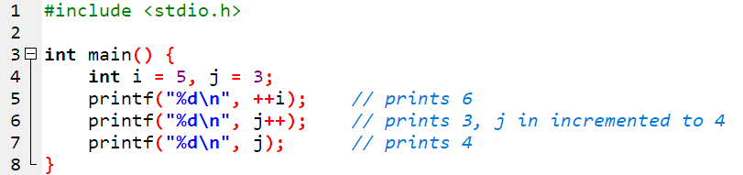
Increment/Decrement Operators
Increase or decrease the value in variable by 1
Pre-in/decrement - Calculated on evaluation
Post-in/decrement - Calculated after evaluation
Example
Operator |  | Example
++ | Pre-increment | ++i
++ | Post-increment | i++
-- | Pre-decrement | --i
-- | Post-decrement | i--

Slide 37
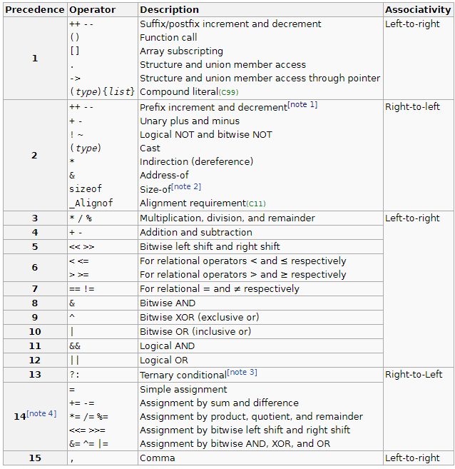
Operator Precedence
Operator precedence: Order of operator evaluation in expression
Parentheses are always evaluated first
Associativity: Order of evaluation on operators with same precedence

Slide 38
Exercise
Guess the output/value without running the code!
5 + 3 < 6 – 1
"asdf" + 1 + 2
1 + 2 + "asdf"
!(3 >= 4) && (4 != 3)
int i = 5;
int x = i++;
x > i;
x += i;

Slide 39
BOJ
Register on https://acmicpc.net
We will solve a lot of problems as homework!

