Slide 1
Control Flow 2020 Spring: Introduction to C
April 29th, 2020

Slide 2
Today
Conditional execution
if statement
switch statement
Loops
while loops
do-while loops
for loops
break, continue

Slide 3
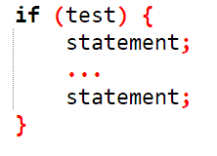
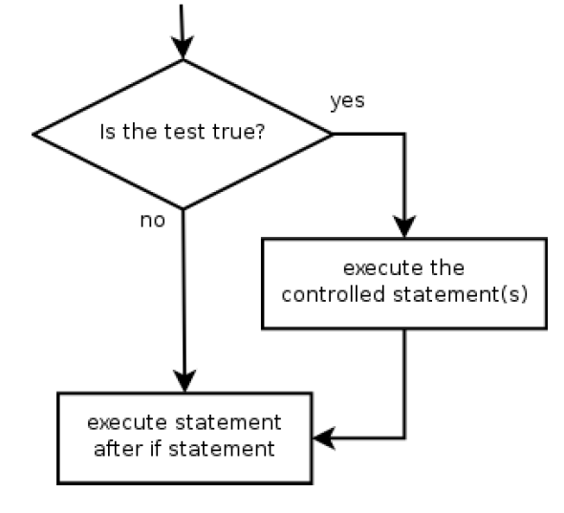
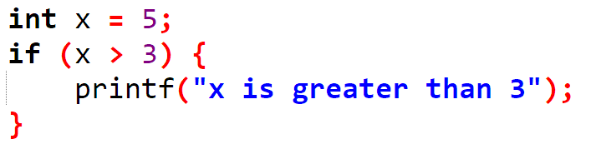
if Statement
Executes a block of statements only if a test is true
Test should be evaluated to either true or false
Example

Slide 4
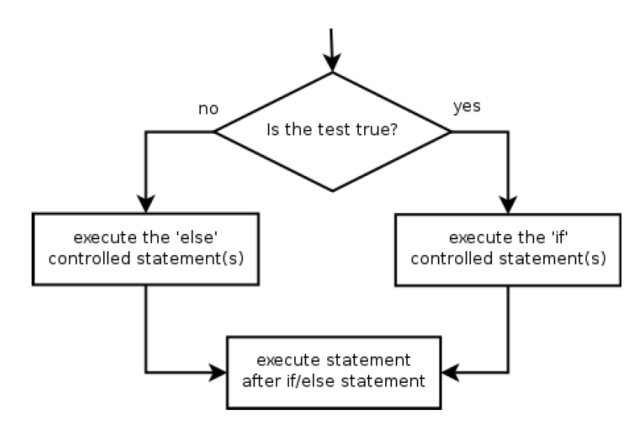
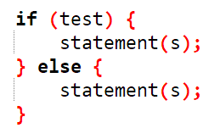
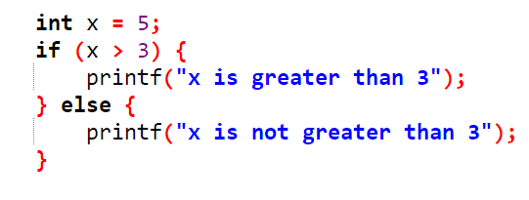
if/else Statement
Executes if block if a test is true, executes else block otherwise
Only one of the statements will be executed!
Example

Slide 5
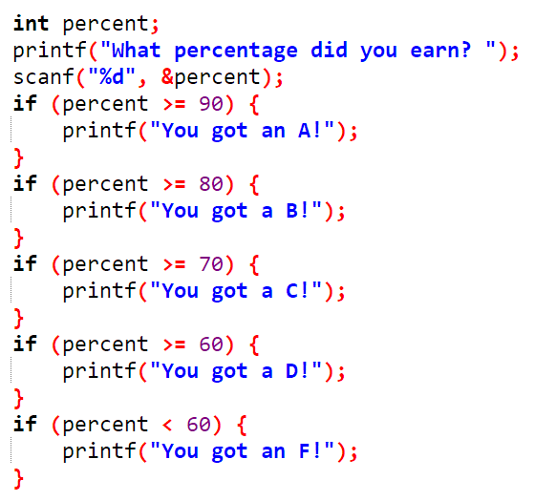
Misuse of if
What's wrong with this?

Slide 6
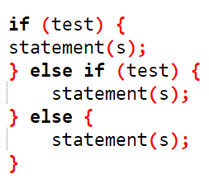
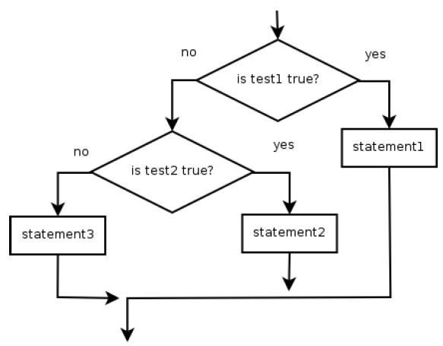
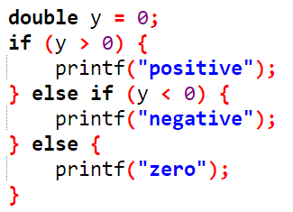
else if Statement
Chooses between outcomes using many tests
Example

Slide 7
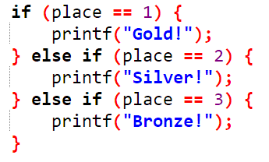
else if Statement
If it ends with else, exactly one path must be taken
If it ends with if, the code might not execute any path
Example

Slide 8
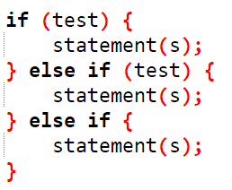
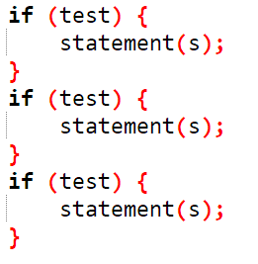
if/else Structures
Exactly 1 path
Mutually exclusive
0 or 1 path
Mutually exclusive
0, 1, or many paths
Independent tests
Not exclusive

Slide 9
Exercises
#1330 두 수 비교하기
#9498 시험 성적

Slide 10
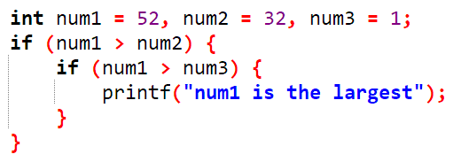
Nested if
if can contain if statements
Try changing the condition above to a single if statement
Hint: Use boolean operators!

Slide 11
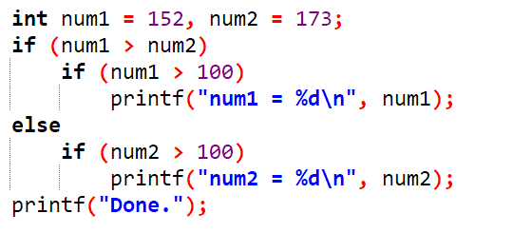
Dangling else
How should we interpret this code?

Slide 12
Dangling else
Which if statement should else be paired with?
Dangling else will be paired with the nearest if

Slide 13
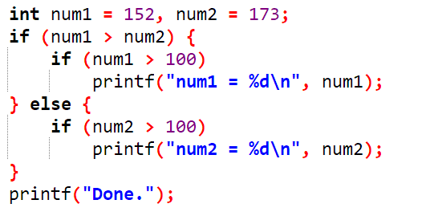
Dangling else
Should be fixed this way
Use {} to explicitly mark the boundaries of if/else statements
The code inside {} is called a block

Slide 14
Exercises
#10817 세 수
#2753 윤년

Slide 15
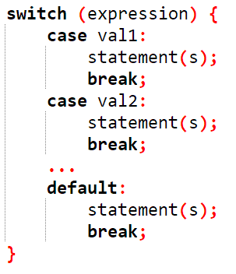
switch Statement
expression is evaluated to an integral value
If that value equals any of val1, val2, ...
The statements inside the corresponding value will be executed
And keeps executing the next statement until break is found
If corresponding value doesn't exist, statements in default is executed
default can be omitted

Slide 16
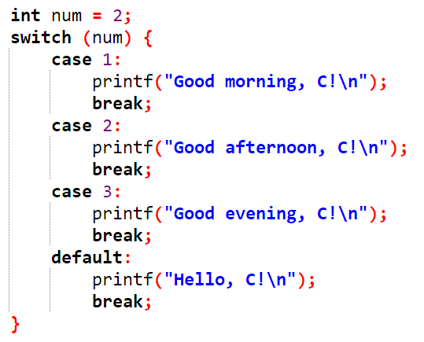
switch Statement Example
What is the output?

Slide 17
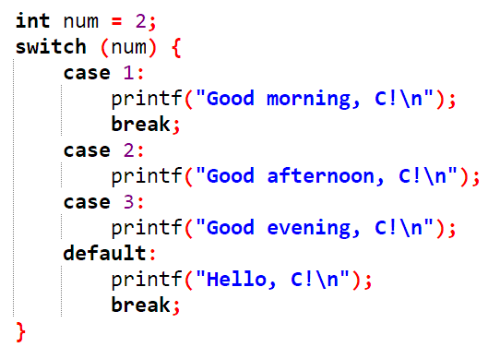
switch Statement Example
What is the output? (Look out for break s)

Slide 18




Exercise
You are given an integer. Use the switch statement to determine the remainder of that integer, when divided by 4.
The output of your program should look like this.

Slide 19
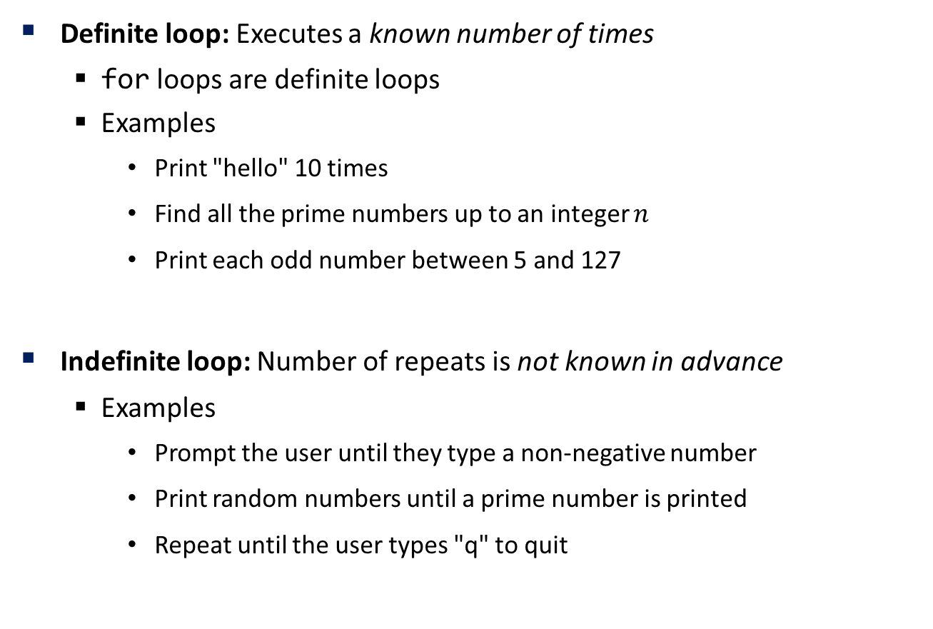
Loops
Definite loop: Executes a known number of times
for loops are definite loops
Examples
Print "hello" 10 times
Find all the prime numbers up to an integer $n$
Print each odd number between 5 and 127
Indefinite loop: Number of repeats is not known in advance
Examples
Prompt the user until they type a non-negative number
Print random numbers until a prime number is printed
Repeat until the user types "q" to quit

Slide 20
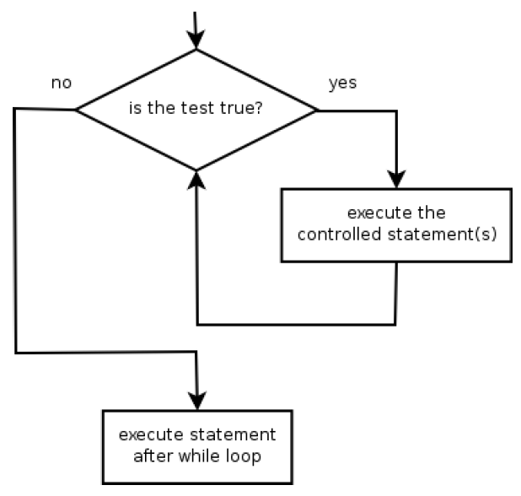
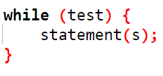
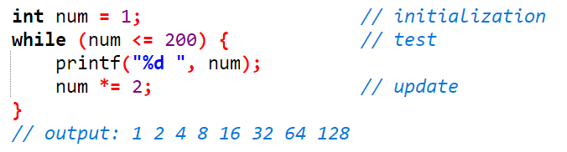
while Loop
while loop: Repeatedly executes its body while a logical test is true
Example

Slide 21

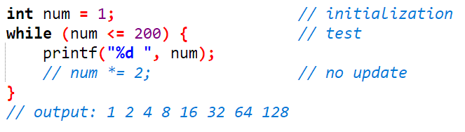
Infinite loop with while
The test is checked every time!
Press Ctrl + C to exit out of programs that don't stop (on their own)
Commonly found when updating procedure is not found

Slide 22
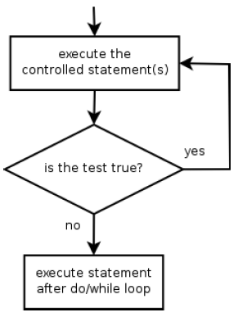
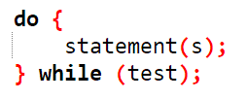
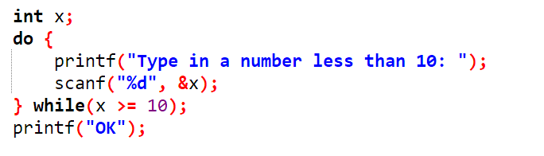
do-while loop
Execute it body once, and execute it again while the test is true
Performs its test at the end of each repetition
Guarantees that the loops body will run at least once
Must end with a semicolon after while
Example

Slide 23
Exercise
#2741 N 찍기
#10950 A + B – 3

Slide 24
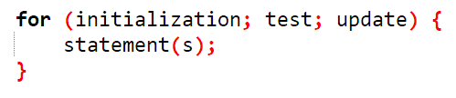
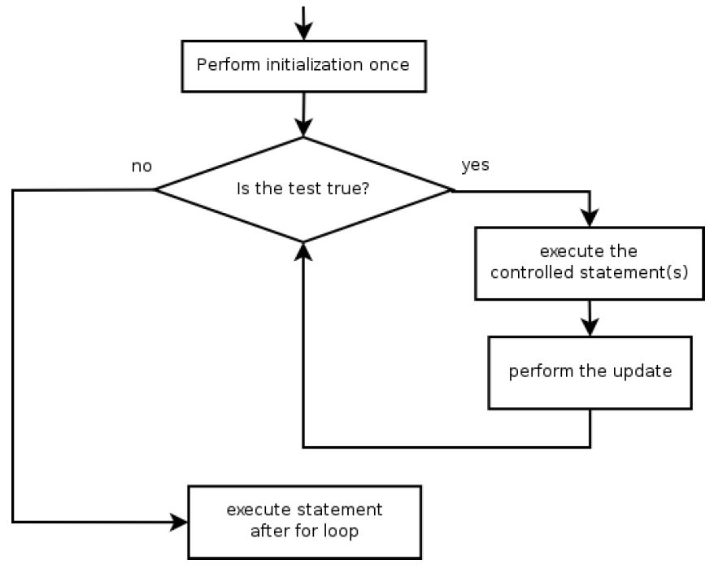
for loop
Perform initialization once
Repeat:
Check if the test is true. If false, stop
Execute the statements
Perform the update

Slide 25
for loop - Initialization
Tells C what variable to use in the loop
Performed once as the loop begins
The variable is called a loop counter
Can use other variable names
Can start at any value
Can initialize many variables at once
for (int i = 1; i <= 6; ++i) {
printf("For Example\n");
}

Slide 26
for loop - Test
Tests the expression
Must be a boolean expression (evaluates to either true or false)
Can use complex boolean expressions
If true, execute the block
If false, stop
for (int i = 1; i <= 6; ++i) {
printf("For Example\n");
}

Slide 27
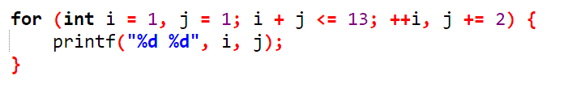
for loop - Update
Modify the loop counter
Pre/Post increment/decrement operator is used often
Can modify the loop counter to any value
for (int i = 1; i <= 6; ++i) {
printf("For Example\n");
}

Slide 28
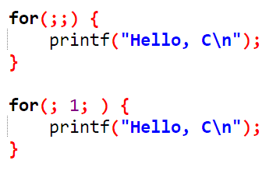
Infinite loop with for
These are possible, and will not stop

Slide 29
Exercise
#2739 구구단
#2742 기찍 N
#10871 X 보다 작은 수

Slide 30
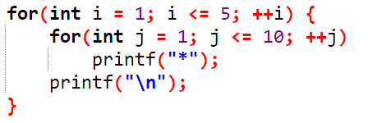
Nested for loops
Output
The inner loop executes 10 times, outer loop executes 5 times
**********
**********
**********
**********
**********

Slide 31
Exercise
#2438 별 찍기 – 1
#2439 별 찍기 – 2

Slide 32
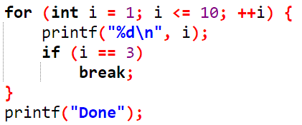
break Statement
Used to break out of for, while, do-while loops
Breaks out of loop and executes the next statement

Slide 33
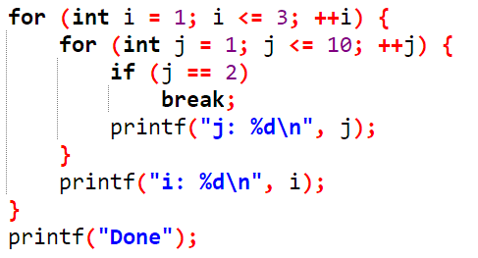
break Statement
In nested loops, break only breaks out of a single loop
Breaks out of loop and executes the next statement

Slide 34
Exercise
#10952 A + B – 5

Slide 35
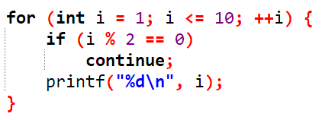
continue Statement
Used to skip the rest of the statement and execute the next loop
Example: Print odd integers from 1 to 10
If i is even, print statement is skipped

Slide 36
for/while Conversion
for loops and while loops are interchangeable!
for (initialization; test; update) {
statement(s);
}
initialization;
while (test) {
statement(s);
update;
}

