Slide 1
Functions 2020 Spring: Introduction to C
July 1st, 2020

Slide 2
Today
Functions
Scope of Variables
Parameterization
Return Values
Call by Value

Slide 3
Functions
function: A named group of statements
Eliminates redundancy by code reuse
Procedural decomposition
Dividing a problem into functions
Writing a function is like adding a new command
Steps
Design the commands
Declare (write down) the function
Call (run) the function

Slide 4
Functions
Declare: Give your function a name so it can be executed
Syntax
Call: Execute the function's code by calling
You can call as many times as you want
type name() {
statement(s);
}
int main() {
name();
printf("Hello!");
name();
}

Slide 5
Control Flow
When a function is called, the program's execution
"jumps" into that function
executes the function's statements
"jumps" back to the point where the function was called
int main() {
name();
printf("Hello!");
name();
}
type name() {
statement(s);
}
int main() {
name();
printf("Hello!");
name();
}

Slide 6
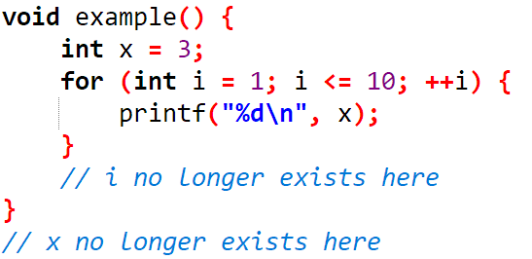
Scope of Variables
scope: The part of a program where a variable exists
Usually from its declaration to the end of the { } braces
A variable declared in a for loop exists only in that loop
A variable declared in a function exists only in that function
Example

Slide 7
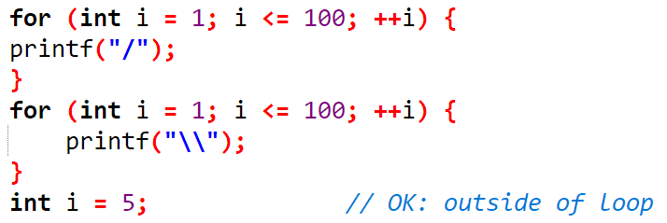
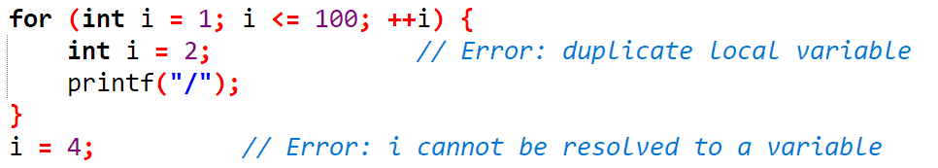
Scope of Variables
Variables without overlapping scope can have same names
A variable can't be declared twice or used out of its scope

Slide 8
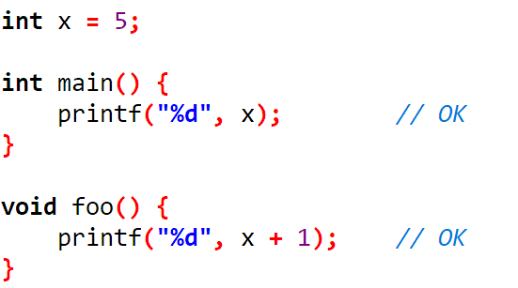
Scope of Variables
You can use variables that can be accessed anywhere in the program
Global variable: Its scope is the whole program
Global variables will always be initialized to zero-equivalent values
Generally not recommended – Best to keep scopes small as possible

Slide 9
Parameterization
parameter: A value passed to a function by its caller
Syntax
Declaration
Passing a parameter when calling the function
The value of expression must match the type in declaration
type name(type param1) {
statement(s);
}
name(expression);

Slide 10
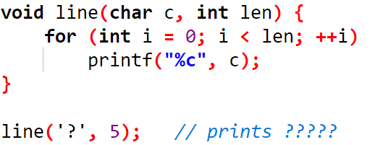
Parameterization – Multiple Parameters
Can pass multiple parameters to a function
Syntax
Declaration
Passing parameters
type name(type param1, ..., type paramn) {
statement(s);
}
name(expr1, ..., exprn);

Slide 11
Parameterization – Common Errors
If a function accepts a parameter, it is illegal to call it without passing any value for that parameter
The value passed to a function must be of the correct type
line(); // Error: parameter required
line('a', 3.2); // Error: must be of type int

Slide 12
Exercise
main 이외의 function을 사용할 것
#2440 별 찍기 – 3
#2442 별 찍기 – 5

Slide 13
Return
return: To send out a value as the result of a function
Parameters send info in from the caller to the function
Return values send information out of a function to its caller
The function call will be evaluated to its return value
Syntax
Specify the return type in declaration
void does not return anything
Function must return a value according to the type in declaration
type name(parameters) {
statement(s);
return expression;
}

Slide 14
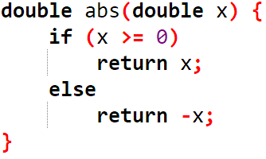
Return Example
Absolute value function
abs(1.2) will be evaluated to 1.2, with type double
Can store the return value of the function by
double y = abs(x);
Now, this y can be used in other expressions

Slide 15
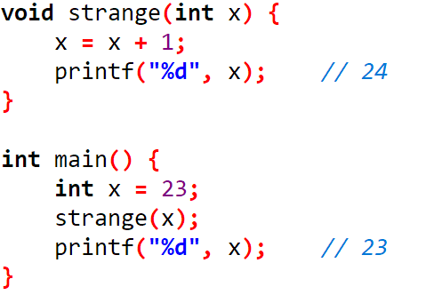
Call by Value
When a function is called:
The value is stored into the parameter variable
The function's code executes, using that value (inside variable)
call by value: When values are passed as parameters, their values are copied
Modifying the parameter will not affect the variable passed in

Slide 16
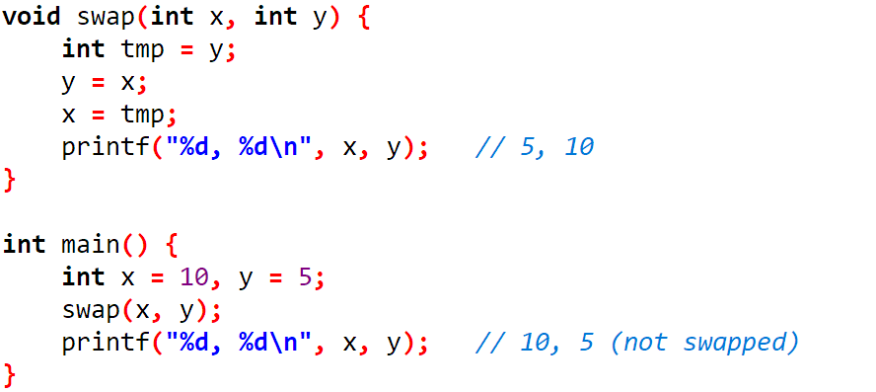
Call by Value
Example

