Slide 1
Java Basics 2020 Spring: AP Computer Science A
December 26th, 2019

Slide 2
Today
General Concepts
Java Program Structure
Java Strings
Strings and operation
println() and print()
Escape sequences
Comments
Java Data Types
Declaration and assignment
Representation of numbers
Java Operators
Interactive Programs with Scanner class

Slide 3
Programming – General Concepts
Program
A set of instructions to be carried out by a computer
Programming
Creating an ordered set of instructions to solve a problem with c computer
Programming language
A systematic set of rules used to describe computations in a format that is editable by humans
Ex) Java, C++, Python ...

Slide 4
Programming – General Concepts
Syntax
Set of legal structures and commands that can be used in a language
Every basic Java statement ends with a semicolon ;
If you violate this, you will get...
Syntax Error (Compile Error)
A problem in the structure of a program that causes compilation failure
Missing semicolon
Mismatching { } braces
Illegal variable names
Class name and file names do not match
...
When error occurs, read the error messages carefully!

Slide 5



Programming – General Concepts
Write it
Code or source code: the set of instructions in a program
Compile it
compile: translate a program from one language to another
Execute it
The messages printed to the user by a program
console: Text box where the program's output is printed
public class HelloJava {
public static void main(String[] args) {
System.out.println("Hello, Java!");
}
}

Slide 6
Java Program Structure
class: a program
Class name must equal the file name!
method: a named group of statements
statement: a command to be executed
Statements inside main will be executed!
public class HelloJava {
public static void main(String[] args) {
System.out.println("Hello, Java!");
statement;
statement;
}
}

Slide 7
Java Strings
String: a sequence of characters
Starts and ends with a " (quote) character
The quotes do not appear in the output
Examples:
"hello"
"This is a string. It's very long!"
May not span multiple lines
May not contain a " character
String concatenation
Use + between two strings to make a longer string
"hello, " + "world" is "hello, world"

Slide 8
Java Output
System.out.println()
Prints a line of output on the console
Always prints new line at the end
Two ways to use System.out.println()
System.out.println("message");
Prints the given string ("message") as output
System.out.println();
Prints a blank line of output
System.out.print()
Prints the given string without new line

Slide 9
Exercise
Print the following text using Java
Print the following shape using Java
Welcome to Java class!
We are learning how to use println()!
*
***
*****
*******
***
***

Slide 10
Escape Sequences
Escape Sequence
A special sequence of characters used to represent special characters in a string
\t tab character
\n new line character
\" quotation mark character
\\ backslash character
Example:
System.out.println("\\hello\nhow\tare \"you\"?\\\\");
Output:
\hello
how are "you"?\\

Slide 11
Exercise
Write a println statement to produce this output
All blanks are spaces
Use a single println statement to produce this output
All blanks are tabs
/ \ // \\ /// \\\
a b c
"\'"
Escape
sequences

Slide 12
Java Comments
Comment
A note written in source code by the programmer to describe or clarify the code
Comments are ignored when your program runs
Examples
// This is a one-line comment
/* This is a
multi-line comment */
Comments are useful for:
Explaining complex pieces of code or complex programs
Multiple programmers working together

Slide 13
Data Types
Type: A category or set of data values
Used to represent real-world objects
Constrains the operations that can be performed on data
Java programmers must specify types
Ex) Integers, real numbers, character, string ...
Primitive Types: Built-in types
int Integers (2, -26, 3000)
double Real numbers (3.1, -0.25, 0.001)
boolean logical values (true, false)
char Single characters ('a', 'b', 'c')
4 more: byte, short, long, float

Slide 14
Exercise
Write the following code and check its output
You can ignore comments
public class TypeExample {
public static void main(String[] args) {
System.out.println(-1); // -1 (int)
System.out.println(3.1415); // 3.1415 (double)
System.out.println('a'); // a (char)
System.out.println(true); // true (boolean)
}
}

Slide 15
Variables
We want to use these data for computation
Can we store data ?
Can we perform operations on them ?
Variable: A piece of computer memory that is given a name and type, and can store a value
Steps for using a variable
Declare it - State its name and type
Initialize it - Store a value into it
Use it - Print it or use in operation

Slide 16
Variable Declaration
Variable Declaration
Sets aside memory for storing a value
Variables must be declared before usage
Syntax
type name;
The name is called an identifier
Examples
int x;
double myGPA;
x
myGPA

Slide 17
Variable Declaration
Assignment
Stores a value into a variable
= does not mean equals!
Syntax
name = expression;
Examples
x = 3;
myGPA = 3.1 + 1.2;
x
3
myGPA
4.3

Slide 18
Expressions
Expression: A value or operation that computes a value
Examples
1 + 4 * 5 // 21
(7 + 2) * 6 / 3 // 18
42 // 42
The simplest expression is a literal value
A complex expression can use operators and parentheses
As a program runs, its expressions are evaluated
1 + 1 evaluates to 2
System.out.println(3 * 4); // prints 12

Slide 19
Using Variables
Once given a value, a variable can be used in expressions
You can assign a value more than once
public class VariableExample {
public static void main(String[] args) {
int x; // Declare
x = 15; // Set x to 15
System.out.print("x is ");
System.out.println(x); // x is 15
System.out.println("x is " + x);
System.out.println(2 * x - 1); // 29
x = 4 + 7; // x is now 11
System.out.println(x); // 11
}
}

Slide 20
Variable Declaration/Assignment
A variable can be declared and initialized in one statement.
Syntax
type name = value;
Examples
int x = 3;
double myGPA = 4.3;
x
3
myGPA
4.3

Slide 21
Assignment
= is called an assignment operator
Does not mean equals!
Means: "Store the value at right in variable at left"
The right-side expression is evaluated first, and the result is stored in the variable at left
Example
int x = 3;
x = x + 2;
x + 2 is evaluated and stored in x
x
3
x
5

Slide 22
Assignment and Compile Errors
A variable can only store a value of its own type
int x = 2.5; // error: incompatible types
double x = 2; // OK. 2 is a real number
A variable can't be used until it is assigned a value
int x;
System.out.println(x); // error: x might not have been initialized
You may not declare the same variable twice
int x;
int x; // error: variable x is already defined

Slide 23
Identifiers and Keywords
Identifier: A name given to an item in your program
Must start with a letter or _ or $
Subsequent characters can be any of those or a number
Legal identifiers
_myName, TheCure, ANSWER_IS_42, $bling$
Illegal identifiers
me+u, 49ers, side-swipe, Ph.D's
Camelcase Convention
When naming a variable with multiple words, capitalize each word except for the first
Ex) myVariableName, longVariableName, totalSum
Keyword: An identifier that you cannot use because it already has a reserved meaning in Java
int, double, boolean ...

Slide 24
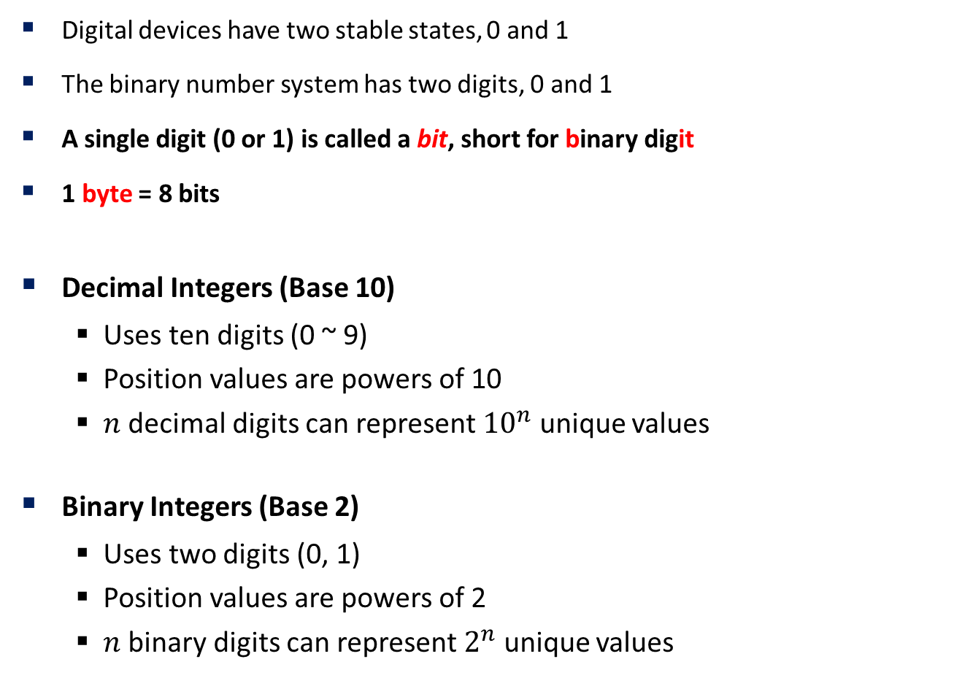
Representation of Numbers
Digital devices have two stable states, 0 and 1
The binary number system has two digits, 0 and 1
A single digit (0 or 1) is called a bit, short for binary digit
1 byte = 8 bits
Decimal Integers (Base 10)
Uses ten digits (0 ~ 9)
Position values are powers of 10
$n$ decimal digits can represent ${10}^{n}$ unique values
Binary Integers (Base 2)
Uses two digits (0, 1)
Position values are powers of 2
$n$ binary digits can represent $2^{n}$ unique values

Slide 25

Representation of Numbers
How to count in binary
Java int uses 4 bytes (32 bits)
1 bit is used for sign
Stores numbers from ${−2}^{31} \sim 2^{31}−1$
Generally, $n$ bit integer can store ${−2}^{n−1} \sim 2^{n−1}−1$
128 | 64 | 32 | 16 | 8 | 4 | 2 | 1
117
0 | 1 | 1 | 1 | 0 | 1 | 0 | 1

Slide 26

Representation of Numbers
Java double
Uses scientific notation
${\left(−1\right)}^{sign}∗mantissa ∗2^{exponent}$
Mantissa has finitely many digits
Causes round-off errors
Somewhat different from real numbers
sign | exponent | mantissa
1 bit | 11 bits | 52 bits

Slide 27
Java Operators
Operator: Computation that combines multiple values or expressions
Arithmetic Operators
Relational Operators
Logical Operators
Assignment Operators
Increment and Decrement Operators

Slide 28
Arithmetic Operators
Used for calculation involving numbers
Can be applied to numerical types
int, double, (byte, short, long, float)
+ can also be used to concatenate data with strings
Operator | Meaning | Example
+ | Addition | 3 + x
- | Subtraction | p – q
* | Multiplication | 6 * i
/ | Division | 10 / 4
% | Remainder (mod) | 11 % 8

Slide 29
Integer Arithmetic
Integer division returns the quotient!
Ex. 14 / 4 is 3, not 3.5
Division by 0 causes an error
% operator computes the remainder from integer division
Ex. 14 % 4 is 2
Check if x is odd: x % 2
Obtain last digit of x : x % 10
Subtle when handling negative integers
-4 / 3 is -1
-5 % 3 is -2

Slide 30
Real Number Arithmetic
Examples: 6.022, -42.0, 3.1415
Placing .0 or . after an integer makes it a double
/ produces an exact answer
15.0 / 2.0 is 7.5
When int and double are mixed, the result is a double
4.2 * 3 is 12.6
7.2 / 3 is 2.4

Slide 31
Exercise
Calculate the answer of the following expression
123 + 456 * 789 / 3 % 2
Follow the steps.
Declare a variable x and assign 30
Declare a variable y and assign 15
Print x + y, x - y, x * y, x / y, x % y, respectively on each line

Slide 32
Relational Operators
Determine relations between values
Relational operators are used in boolean expressions
Boolean expressions will evaluate to true or false
Ex. 2 > 3 will evaluate to false
Operator | Meaning | Example
== | Equal to | x == 10
!= | Not equal to | 10 != 11
> | Greater than | 3 > x
< | Less than | 2 < 10.0
>= | Greater than or equal to | 3.14 >= 3.1
<= | Less than or equal to | 2.718 <= e

Slide 33
Logical Operators
Logical operators are applied to boolean expressions to form compound boolean expression that evaluate to true or false
Truth Tables
Operator | Meaning | Example
! | Logical NOT | !x
&& | Logical AND | 3 < x && x < 5
|| | Logical OR | x > 5 || x < -2
!
T | F
F | T
&& | T | F
T | T | F
F | F | F
|| | T | F
T | T | T
F | T | F

Slide 34
Assignment Operators
Provides compact form
Chaining assignment is allowed, with evaluation from right to left
next = prev = sum = 0;
Initializes sum to 0, prev to sum, next to prev
Operator | Example | Meaning
= | x = 2 | Simple assignment
+= | x += 4 | x = x + 4
-= | y -= 6 | y = y - 6
*= | p *= 5 | p = p * 5
/= | n /= 10 | n = n / 10
%= | n %= 10 | n = n % 10

Slide 35
Increment/Decrement Operators
Increase or decrease the value in variable by 1
Pre-in/decrement - Calculated on evaluation
Post-in/decrement - Calculated after evaluation
Example
int i = 5, j = 3;
System.out.println(++i); // prints 6
System.out.println(j++); // prints 3, j is incremented to 4
System.out.println(j); // prints 4
Operator |  | Example
++ | Pre-increment | ++i
++ | Post-increment | i++
-- | Pre-decrement | --i
-- | Post-decrement | i--

Slide 36
Operator Precedence
Operator precedence: Order of operator evaluation in expression
!, ++, --
*, /, %
+, -
<, >, <=, >=
==, !=
&&
||
=, +=, -=, *=, /=, %=
Parentheses are always evaluated first
Associativity: Order of evaluation on operators with same precedence
Right to left for 1, 8
Left to right otherwise

Slide 37
Exercise
Guess the output/value without running the code!
5 + 3 < 6 – 1
"asdf" + 1 + 2
1 + 2 + "asdf"
!(3 >= 4) && (4 != 3)
int i = 5;
int x = i++;
x > i;
x += i;

Slide 38
Interactive Programs
An interactive program reads input from the console
While the program runs, it asks the user to type input
The input typed by the user is stored in variables in the code
Interactive programs have more interesting behavior!
Use Scanner class to receive input from user!

Slide 39
Scanner Class
Scanner class is found in the java.util package
Write the following line at the top of your source code
import java.util.Scanner;
Declaring a Scanner
Scanner name = new Scanner(System.in);
Example
Scanner sc = new Scanner(System.in);

Slide 40

Scanner Example
Run the following code
The console waits for the user to type the input and press Enter
The value typed by the user is returned
prompt: A message telling the user what input to type
import java.util.Scanner;
public class ScannerExample {
public static void main(String[] args) {
Scanner sc = new Scanner(System.in);
System.out.print("How old are you? ");
int x = sc.nextInt();
System.out.println("You are " + x + " years old!");
}
}

Slide 41
Scanner Usage
Scanner sc = new Scanner(System.in);
Usage
Method | Description
sc.nextInt() | Reads an int from the user
sc.nextDouble() | Reads a double from the user
sc.next() | Reads a one-word string from the user
int x = sc.nextInt(); // reads int and stores it into x
double y = sc.nextDouble(); // reads double and stores it into y
String s = sc.next(); // reads string and stores it into s

Slide 42

Scanner Example 2
Run the following code
The Scanner can read multiple values from one line
They values must be separated ...
import java.util.Scanner;
public class ScannerExample2 {
public static void main(String[] args) {
Scanner sc = new Scanner(System.in);
System.out.print("Type two numbers: ");
int x = sc.nextInt();
int y = sc.nextInt();
int product = x * y;
System.out.println("The product is " + product);
}
}

Slide 43
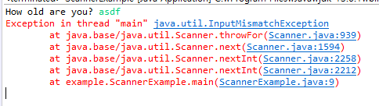
Scanner Input Tokens
token: A unit of user input, as read by the Scanner
Tokens are separated by whitespace (spaces, tabs, new lines)
How many tokens are there in the following line?
When a token is not the type you ask for, the program crashes
Refer to ScannerExample
23 John Smith 42.0 "Hello world" $2.50 " 19"

Slide 44


Strings as User Input
Scanner's next() method reads a token as a String
String declaration
String str = "This is a string";
Example
import java.util.Scanner;
public class ScannerExample3 {
public static void main(String[] args) {
Scanner sc = new Scanner(System.in);
System.out.print("Type in a word: ");
String str = sc.next();
System.out.println("You typed: " + str);
}
}

Slide 45

Strings as User Input
To read multiple words in a line, use nextLine()
Do not use nextLine mixed with next? methods
import java.util.Scanner;
public class ScannerExample4 {
public static void main(String[] args) {
Scanner sc = new Scanner(System.in);
System.out.print("Type in words: ");
String line = sc.nextLine();
System.out.println("You typed: " + line);
}
}

Slide 46


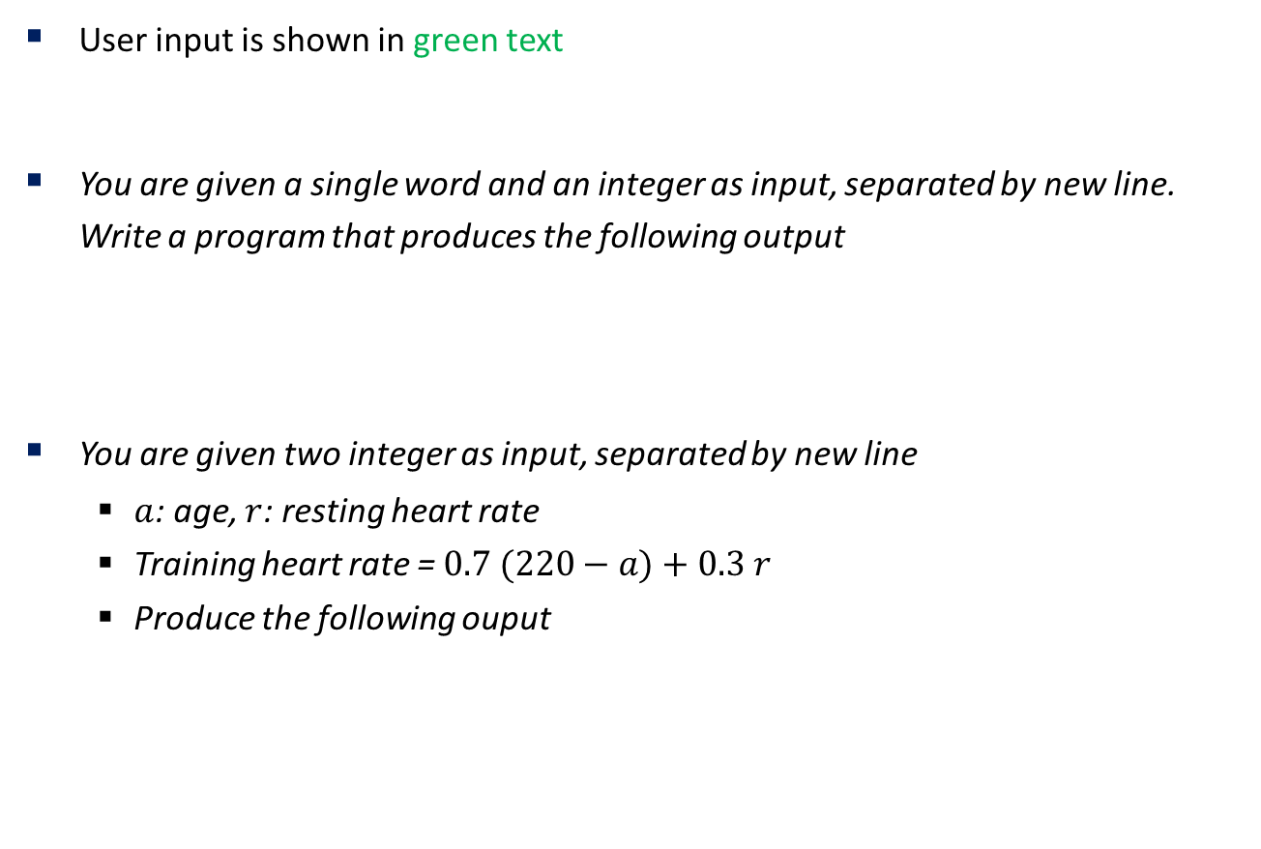
Exercise
User input is shown in green text
You are given a single word and an integer as input, separated by new line. Write a program that produces the following output
You are given two integer as input, separated by new line
$a$: age, $r$: resting heart rate
Training heart rate = $0.7 (220−a)+0.3 r$
Produce the following ouput

Slide 47
BOJ
Register on https://acmicpc.net
We will solve a lot of problems as homework!

