Slide 1
Classes and Objects 2020 Spring: AP Computer Science A
January 15th, 2020

Slide 2
Today
Classes and objects (General idea)
Strings revisited
Arrays
null
Reference Semantics
Abstraction
Writing a Java class
Object state: Fields
Object behavior: Methods
Object initialization: Constructors
Encapsulation
Static methods/fields

Slide 3
Classes and Objects
class: A program entity that represents either
A program / module, or
A type of objects
A class is a blueprint or template for constructing objects
Java has thousands of built-in classes
We can also write our own
object: An entity that combines data and behavior
Object-oriented programming (OOP)
Programs that perform their behavior as interactions between objects

Slide 4
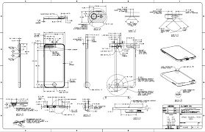
Blueprint Analogy
iPod #1
state
Into the Unknown
12
35%
behavior
turn on
turn off
change song
change volume
choose random song
iPod Blueprint / Factory
state
current song
volume
battery life
behavior
turn on
turn off
change song
change volume
choose random song
iPod #2
state
Show Yourself
12
35%
behavior
turn on
turn off
change song
change volume
choose random song

Slide 5
Objects
object: An entity that contains data and behavior
data: variables inside the object
behavior: methods inside the object
You interact with the methods, the data is hidden in the object
An object is an instance of a class
Syntax
Constructing (creating) an object
Type objectName = new Type(parameters);
Calling an object's method
objectName.methodName(parameters);
Accessing an object's data
objectName.data;

Slide 6
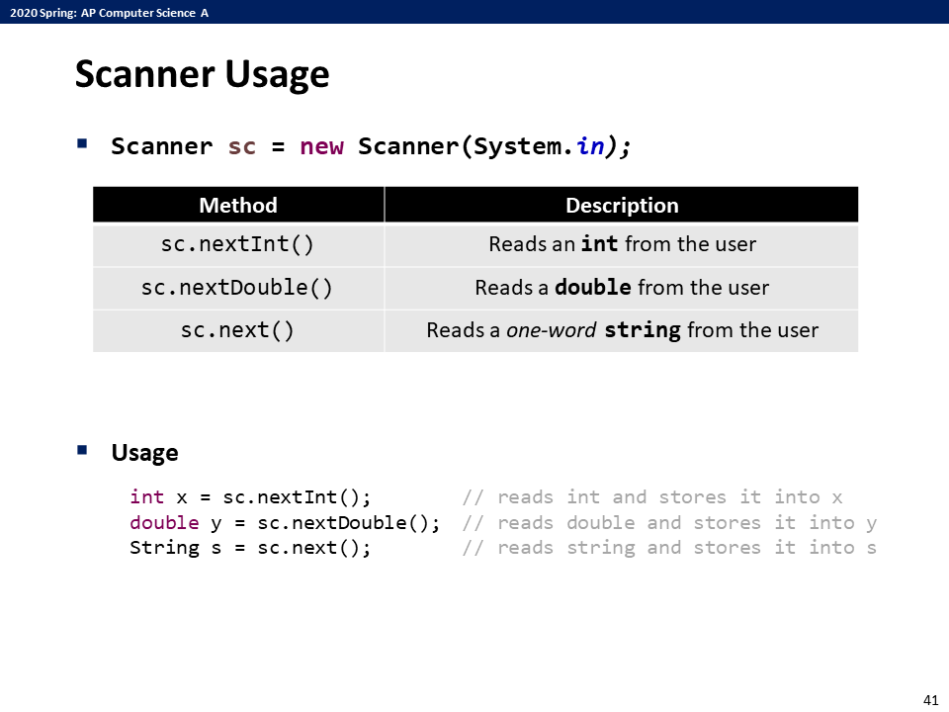
Scanner Object
Scanner was actually an object!
Declaration with new keyword
Has methods that we can call on

Slide 7
Strings
Java strings are also objects!
string: An object storing a sequence of text characters
Construction
String name = new String("text");
String name = "text";
Methods will be shown later
Each character of a string are numbered with 0-based indices
String str = "Hi, Java!";
First character's index: 0
Last character's index: (string's length) – 1
Individual characters are values of type char
index | 0 | 1 | 2 | 3 | 4 | 5 | 6 | 7 | 8
char | H | i | , |  | J | a | v | a | !

Slide 8
String Methods
https://docs.oracle.com/en/java/javase/11/docs/api/java.base/java/lang/String.html
And many more ...!
Return Type | methodName(params) | Description
int | indexOf(String) | Returns the index within this string of the first occurrence of the given String
int | length() | Returns the length of this string
String | substring(int, int) | Returns a string that is a substring of this string.
String | substring(int) | Returns a string that is a substring of this string.
String | toLowerCase() | Converts all the characters in this String to upper case
String | toUpperCase() | Converts all the characters in this String to lower case
boolean | equals(Object) | Compares this string to the specified object.
boolean | equalsIgnoreCase(String) | Compares this String to another String, ignoring case considerations.
boolean | startsWith(String) | Tests if this string starts with the specified prefix.
boolean | endsWith(String) | Tests if this string ends with the specified suffix.
boolean | contains(String) | Returns true if and only if this string contains the given String.
char | charAt(int) | Returns the char value at the specified index.

Slide 9
Exercises
#11654 아스키 코드
#10809 알파벳 찾기
#2675 문자열 반복
#1157 단어 공부 (★)

Slide 10
Programming Problem
#4344 평균은 넘겠지
For simplicity, only consider the problem for a single test case.
Try to solve this problem!
Input
5
50
50
70
80
100
Output
40.000%

Slide 11
Why is it hard?
We need each input value twice
To compute the average
To count how many were above average
We could read each value into a variable, but we
don't know how many values are needed until the program runs
don't know how many variables to declare
Need a way to declare many variables in one step.

Slide 12
Arrays
array: An object that stores many values of the same type
element: One value in an array
index: A 0-based integer to access an element from an array
Declaration
type[] name = new type[length];
Example
index | 0 | 1 | 2 | 3 | 4 | 5 | 6 | 7 | 8
value | 12 | -1 | 49 | 0 | 5 | 7 | -19 | 128 | 1
int[] arr = new int[10];
index | 0 | 1 | 2 | 3 | 4 | 5 | 6 | 7 | 8 | 9
value | 0 | 0 | 0 | 0 | 0 | 0 | 0 | 0 | 0 | 0

Slide 13
Arrays
The array's length can be any integer expression.
Each element initially gets a "zero-equivalent" value
int x = 2 * 3 + 1;
int[] data = new int[x % 5 + 2];
Type | Default value
int | 0
double | 0.0
boolean | false
String or other objects | null (no object)

Slide 14
Arrays
Accessing elements
Can be used like a variable
Example
name[index] // access
name[index] = value; // modify
arr[0] = 27;
arr[3] = -6;
System.out.println(arr[0]);
if (arr[3] < 0) {
System.out.println("Element 3 is negative.");
}
index | 0 | 1 | 2 | 3 | 4 | 5 | 6 | 7 | 8 | 9
value | 27 | 0 | 0 | -6 | 0 | 0 | 0 | 0 | 0 | 0

Slide 15
ArrayIndexOutOfBoundsException
Legal indices: Between 0 and the array's length – 1
Reading or writing any index outside this range will throw an ArrayIndexOutOfBoundsException
Example
Writing to element at index -1 will cause an exception
Trying to print (which requires reading) the element at index 10 will cause an exception
int[] arr = new int[10];
arr[-1] = -1;
System.out.println(arr[10]);

Slide 16
Arrays and for Loops
It is common to use for loops to access array elements
The loop counter is used as an index
We can also assign each element a value in a loop
Array's length field stores its number of elements
Access by name.length
To traverse an array, change the loop condition as follows
for(int i = 0; i < 10; ++i) {
arr[i] = 2 * i;
}
for(int i = 0; i < arr.length; ++i) {
arr[i] = 2 * i;
}

Slide 17
for-each Loop
This loop is used to iterate over an array or collection
Syntax
Read as "for each var in arr"
Example
Notes
This loop hides the index variable, so this can't be used when indices are needed
Cannot modify elements as you traverse the array
type[] arr = new type[length];
for (type var : arr) {
statement(s);
}
for (int e : arr) {
System.out.println(e);
}

Slide 18
Exercise
#4344 평균은 넘겠지
Use an integer array to store all the scores
#10818 최소, 최대
Use an integer array to store all the values
Traverse the array to find the maximum/minimum
#2562 최댓값
#2577 숫자의 개수 (★)

Slide 19
Quick Array Initialization
Suppose we want to create this array (no evident pattern)
Normally, we would do...
index | 0 | 1 | 2 | 3 | 4 | 5
value | -2 | 10 | -7 | 0 | 5 | 1
int[] num = new int[6];
num[0] = -2;
num[1] = 10;
num[2] = -7;
num[3] = 0;
num[4] = 5;
num[5] = 1;

Slide 20
Quick Array Initialization
Suppose we want to create this array (no evident pattern)
Instead, we can use initializer list
type[] name = {value, value, ..., value};
Useful when you know what the array's elements will be
The compiler figures out the array size by counting the values.
index | 0 | 1 | 2 | 3 | 4 | 5
value | -2 | 10 | -7 | 0 | 5 | 1
int[] num = {-2, 10, -7, 0, 5, 1};

Slide 21
Limitations of Arrays
You cannot resize an existing array
You cannot compare arrays with ==
Will see why this is false later
Comparing arrays – on the next slide
An array doesn't know how to print itself
int[] a = new int[4];
a.length = 10; // error
a = new int[10]; // must reassign
int[] a1 = {1, 2, 3, 4};
int[] a2 = {1, 2, 3, 4};
if(a1 == a2) { ... } // false
int[] a1 = {1, 2, 3, 4};
System.out.println(a1); // [I@372f7a8d

Slide 22
Arrays Class
Class Arrays in package java.util has useful methods for arrays
https://docs.oracle.com/en/java/javase/11/docs/api/java.base/java/util/Arrays.html
Syntax
Arrays.methodName(parameters)
Must import java.util.Arrays
Return Type | methodName(params) | Description
type[] | copyOf(type[], int) | Copies the specified array, truncating or padding with zero-equivalent value (if necessary) so the copy has the specified length.
boolean | equals(type[], type[]) | Returns true if the two specified arrays are equal to one another.
void | fill(type[], type) | Assigns the specified value to each element of the specified array.
void | sort(type[]) | Sorts the specified array into ascending numerical order.
String | toString(type[]) | Returns a string representation of the contents of the specified array.

Slide 23
Arrays as Parameters
Can pass arrays as parameters, can return arrays
public static type[] methodName(type[] arr);
Solve #12605 단어순서 뒤집기
Use a method that returns an array with elements in reversed order

Slide 24
null
a
index | 0 | 1 | 2
value | null | null | null
When initializing an array of objects, each element initially gets null
null: A value that does not refer to any object
You can
Store null in an object variable or an object array
String s = null;
Print a null reference
System.out.println(s); System.out.println(null);
Check if something is null
if(s == null) { ... }
Pass null as a parameter to a method
someMethod(null);
Return null from a method (often to indicate failure)
return null;

Slide 25
NullPointerException
dereference: To access data or methods of an object with the dot(.) notation
str.length(), arr.length, sc.nextInt() ...
It is illegal to dereference null
null is not any object, so it has no methods or data
You will get a NullPointerException if you dereference null
Your code should be fixed!

Slide 26
Reference Semantic (Objects)
Compare these two code segments
What is the expected behavior?
What is the actual output?
int a = 1;
int b = a;
b = 3;
System.out.println(a);
int[] a1 = {4, 0, -7};
int[] a2 = a1;
a2[1] = 3;
System.out.println(Arrays.toString(a1));

Slide 27
Reference Semantic (Objects)
reference semantics: Behavior where variables actually store the address of an object in memory
Applies to objects! (Primitive types use value semantics)
When one variable is assigned to another, the object is not copied, and both variables refer to the same object, reference is copied
Modifying the value of one variable will affect others
value semantics: Behavior where values are copied when assigned, passed as parameters, or returned
When one variable is assigned to another, its value is copied
Modifying the value of one variable does not affect others

Slide 28
In Detail
Variable a1 contains the reference to the array {4, 0, -7}
int[] a1 = {4, 0, -7};
int[] a2 = a1;
a2[1] = 3;
System.out.println(Arrays.toString(a1));
a1
index | 0 | 1 | 2
value | 4 | 0 | -7

Slide 29
In Detail
Variable a2 is assigned the same value as a1
Now a2 also contains the reference to the array {4, 0, -7}
Both a1, a2 refer to the same object!
int[] a1 = {4, 0, -7};
int[] a2 = a1;
a2[1] = 3;
System.out.println(Arrays.toString(a1));
a1
index | 0 | 1 | 2
value | 4 | 0 | -7
a2

Slide 30
In Detail
Change the 1st element of a2 to 3
Now the array has been changed to {4, 3, -7}
int[] a1 = {4, 0, -7};
int[] a2 = a1;
a2[1] = 3;
System.out.println(Arrays.toString(a1));
a1
index | 0 | 1 | 2
value | 4 | 3 | -7
a2

Slide 31
In Detail
Print the elements of a1
[4, 3, -7]
int[] a1 = {4, 0, -7};
int[] a2 = a1;
a2[1] = 3;
System.out.println(Arrays.toString(a1));
a1
index | 0 | 1 | 2
value | 4 | 3 | -7
a2

Slide 32
References and Objects
Arrays and objects use reference semantics
Efficiency: Copying large objects slows down a program
Sharing: It's useful to share an object's data among methods
When an object is passed as a parameter, the object is not copied, the reference to that object is copied!
Thus the parameter refers to the same object
If the object (referred by the parameter) is modified, it will affect the original object
public static void main(String[] args) {
int[] num = {1, 2, 3};
add(num);
System.out.println(Arrays.toString(num));
}
public static void add(int[] a) {
for(int i = 0; i < a.length; ++i)
a[i] = a[i] + 100;
}

Slide 33
References and Objects
Compare these two swap methods
swapFail does not swap, while swap actually swaps
What is the difference?
public static void main(String[] args) {
int[] a1 = {1, 2, 3}, a2 = {4, 5, 6};
swapFail(a1, a2);
System.out.println(Arrays.toString(a1)); // [1, 2, 3]
System.out.println(Arrays.toString(a2)); // [4, 5, 6]
swap(a1, a2);
System.out.println(Arrays.toString(a1)); // [4, 5, 6]
System.out.println(Arrays.toString(a2)); // [1, 2, 3]
}
public static void swapFail(int[] arr1, int[] arr2) {
int[] tmp = arr2;
arr2 = arr1; arr1 = tmp;
}
public static void swap(int[] arr1, int[] arr2) {
for (int i = 0; i < arr1.length; ++i) {
int tmp = arr2[i];
arr2[i] = arr1[i]; arr1[i] = tmp;
}
}

Slide 34
swapFail – In Detail
public static void main(String[] args) {
int[] a1 = {1, 2, 3}, a2 = {4, 5, 6};
swapFail(a1, a2);
System.out.println(Arrays.toString(a1)); // [1, 2, 3]
System.out.println(Arrays.toString(a2)); // [4, 5, 6]
}
public static void swapFail(int[] arr1, int[] arr2) {
int[] tmp = arr2;
arr2 = arr1;
arr1 = tmp;
}
a1
Initially, a1, a2 refer to the arrays
index | 0 | 1 | 2
value | 1 | 2 | 3
index | 0 | 1 | 2
value | 4 | 5 | 6
a2

Slide 35
swapFail – In Detail
public static void main(String[] args) {
int[] a1 = {1, 2, 3}, a2 = {4, 5, 6};
swapFail(a1, a2);
System.out.println(Arrays.toString(a1)); // [1, 2, 3]
System.out.println(Arrays.toString(a2)); // [4, 5, 6]
}
public static void swapFail(int[] arr1, int[] arr2) {
int[] tmp = arr2;
arr2 = arr1;
arr1 = tmp;
}
a1
swapFail is called
arr1, arr2 also refer to the arrays (reference is copied)
arr1
index | 0 | 1 | 2
value | 1 | 2 | 3
arr2
index | 0 | 1 | 2
value | 4 | 5 | 6
a2

Slide 36
swapFail – In Detail
public static void main(String[] args) {
int[] a1 = {1, 2, 3}, a2 = {4, 5, 6};
swapFail(a1, a2);
System.out.println(Arrays.toString(a1)); // [1, 2, 3]
System.out.println(Arrays.toString(a2)); // [4, 5, 6]
}
public static void swapFail(int[] arr1, int[] arr2) {
int[] tmp = arr2;
arr2 = arr1;
arr1 = tmp;
}
a1
tmp contains the reference to arr2
arr1
index | 0 | 1 | 2
value | 1 | 2 | 3
arr2
index | 0 | 1 | 2
value | 4 | 5 | 6
tmp
a2

Slide 37
swapFail – In Detail
public static void main(String[] args) {
int[] a1 = {1, 2, 3}, a2 = {4, 5, 6};
swapFail(a1, a2);
System.out.println(Arrays.toString(a1)); // [1, 2, 3]
System.out.println(Arrays.toString(a2)); // [4, 5, 6]
}
public static void swapFail(int[] arr1, int[] arr2) {
int[] tmp = arr2;
arr2 = arr1;
arr1 = tmp;
}
a1
arr2 contains the reference to arr1
arr1
index | 0 | 1 | 2
value | 1 | 2 | 3
arr2
index | 0 | 1 | 2
value | 4 | 5 | 6
tmp
a2

Slide 38
swapFail – In Detail
public static void main(String[] args) {
int[] a1 = {1, 2, 3}, a2 = {4, 5, 6};
swapFail(a1, a2);
System.out.println(Arrays.toString(a1)); // [1, 2, 3]
System.out.println(Arrays.toString(a2)); // [4, 5, 6]
}
public static void swapFail(int[] arr1, int[] arr2) {
int[] tmp = arr2;
arr2 = arr1;
arr1 = tmp;
}
a1
arr1 contains the reference to tmp
arr1
index | 0 | 1 | 2
value | 1 | 2 | 3
arr2
index | 0 | 1 | 2
value | 4 | 5 | 6
tmp
a2

Slide 39
swapFail – In Detail
public static void main(String[] args) {
int[] a1 = {1, 2, 3}, a2 = {4, 5, 6};
swapFail(a1, a2);
System.out.println(Arrays.toString(a1)); // [1, 2, 3]
System.out.println(Arrays.toString(a2)); // [4, 5, 6]
}
public static void swapFail(int[] arr1, int[] arr2) {
int[] tmp = arr2;
arr2 = arr1;
arr1 = tmp;
}
a1
When swapFail is finished, tmp, arr1, arr2 all goes away
a1, a2 did not change!
index | 0 | 1 | 2
value | 1 | 2 | 3
index | 0 | 1 | 2
value | 4 | 5 | 6
a2

Slide 40
swap – In Detail
public static void main(String[] args) {
int[] a1 = {1, 2, 3}, a2 = {4, 5, 6};
swap(a1, a2);
System.out.println(Arrays.toString(a1)); // [4, 5, 6]
System.out.println(Arrays.toString(a2)); // [1, 2, 3]
}
public static void swap(int[] arr1, int[] arr2) {
for (int i = 0; i < arr1.length; ++i) {
int tmp = arr2[i];
arr2[i] = arr1[i];
arr1[i] = tmp;
}
}
a1
Initially, a1, a2 refer to the arrays
index | 0 | 1 | 2
value | 1 | 2 | 3
index | 0 | 1 | 2
value | 4 | 5 | 6
a2

Slide 41
swap – In Detail
public static void main(String[] args) {
int[] a1 = {1, 2, 3}, a2 = {4, 5, 6};
swap(a1, a2);
System.out.println(Arrays.toString(a1)); // [4, 5, 6]
System.out.println(Arrays.toString(a2)); // [1, 2, 3]
}
public static void swap(int[] arr1, int[] arr2) {
for (int i = 0; i < arr1.length; ++i) {
int tmp = arr2[i];
arr2[i] = arr1[i];
arr1[i] = tmp;
}
}
a1
swapFail is called
arr1, arr2 also refer to the arrays (reference is copied)
arr1
index | 0 | 1 | 2
value | 1 | 2 | 3
arr2
index | 0 | 1 | 2
value | 4 | 5 | 6
a2

Slide 42
swap – In Detail
public static void main(String[] args) {
int[] a1 = {1, 2, 3}, a2 = {4, 5, 6};
swap(a1, a2);
System.out.println(Arrays.toString(a1)); // [4, 5, 6]
System.out.println(Arrays.toString(a2)); // [1, 2, 3]
}
public static void swap(int[] arr1, int[] arr2) {
for (int i = 0; i < arr1.length; ++i) {
int tmp = arr2[i];
arr2[i] = arr1[i];
arr1[i] = tmp;
}
}
a1
for loop (i = 0)
Swap 0th element of arr1 and 0th element of arr2
arr1
index | 0 | 1 | 2
value | 4 | 2 | 3
arr2
index | 0 | 1 | 2
value | 1 | 5 | 6
a2

Slide 43
swap – In Detail
public static void main(String[] args) {
int[] a1 = {1, 2, 3}, a2 = {4, 5, 6};
swap(a1, a2);
System.out.println(Arrays.toString(a1)); // [4, 5, 6]
System.out.println(Arrays.toString(a2)); // [1, 2, 3]
}
public static void swap(int[] arr1, int[] arr2) {
for (int i = 0; i < arr1.length; ++i) {
int tmp = arr2[i];
arr2[i] = arr1[i];
arr1[i] = tmp;
}
}
a1
for loop (i = 1)
Swap 1st element of arr1 and 1st element of arr2
arr1
index | 0 | 1 | 2
value | 4 | 5 | 3
arr2
index | 0 | 1 | 2
value | 1 | 2 | 6
a2

Slide 44
swap – In Detail
public static void main(String[] args) {
int[] a1 = {1, 2, 3}, a2 = {4, 5, 6};
swap(a1, a2);
System.out.println(Arrays.toString(a1)); // [4, 5, 6]
System.out.println(Arrays.toString(a2)); // [1, 2, 3]
}
public static void swap(int[] arr1, int[] arr2) {
for (int i = 0; i < arr1.length; ++i) {
int tmp = arr2[i];
arr2[i] = arr1[i];
arr1[i] = tmp;
}
}
a1
for loop (i = 2)
Swap 2nd element of arr1 and 2nd element of arr2
arr1
index | 0 | 1 | 2
value | 4 | 5 | 6
arr2
index | 0 | 1 | 2
value | 1 | 2 | 3
a2

Slide 45
swap – In Detail
public static void main(String[] args) {
int[] a1 = {1, 2, 3}, a2 = {4, 5, 6};
swap(a1, a2);
System.out.println(Arrays.toString(a1)); // [4, 5, 6]
System.out.println(Arrays.toString(a2)); // [1, 2, 3]
}
public static void swap(int[] arr1, int[] arr2) {
for (int i = 0; i < arr1.length; ++i) {
int tmp = arr2[i];
arr2[i] = arr1[i];
arr1[i] = tmp;
}
}
a1
When swap is finished, arr1, arr2 all goes away
a1, a2 changed!
arr1
index | 0 | 1 | 2
value | 4 | 5 | 6
arr2
index | 0 | 1 | 2
value | 1 | 2 | 3
a2

Slide 46
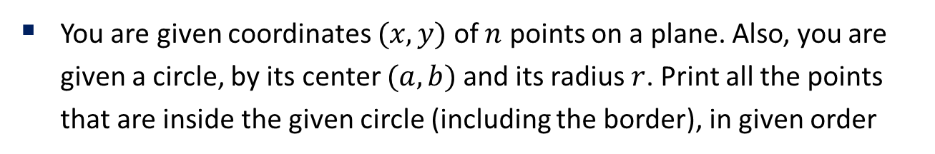
Points Inside Circle
You are given coordinates $(x, y)$ of $n$ points on a plane. Also, you are given a circle, by its center $(a, b)$ and its radius $r$. Print all the points that are inside the given circle (including the border), in given order
Input
5 // number of coordinates
0 0 // coordinates of cities
-3 1
3 -5
1 2
-2 -2
3 2 // center of circle
4 // radius of circle
Output
(0, 0)
(1, 2)

Slide 47
Points Inside Circle – Bad Solution
Need 2 arrays with related data at same indices
Simple, but dirty code...
public static void main(String[] args) {
Scanner sc = new Scanner(System.in);
int n = sc.nextInt();
int[] x = new int[n];
int[] y = new int[n];
for (int i = 0; i < n; ++i) {
x[i] = sc.nextInt();
y[i] = sc.nextInt();
}
int a = sc.nextInt(), b = sc.nextInt(), r = sc.nextInt();
for (int i = 0; i < n; ++i) {
double dist2 = (a - x[i]) * (a - x[i]) + (b - y[i]) * (b - y[i]);
if (Math.sqrt(dist2) <= r) {
System.out.println("(" + x[i] + ", " + y[i] + ")");
}
}
}

Slide 48
Observations
The data in this problem is a set of points
Apply OOP!
Want to solve the problem through interaction between objects!
It would be better to store the data as Point objects!
What are its states/data and behavior?

Slide 49
Abstraction
abstraction: A distancing between ideas and details
We can use objects without knowing how they work
Abstraction in an iPod
You understand its external behavior (buttons, screens, touch)
You don't understand its inner details, you don't need to
Inner details: circuits, software, etc.
We create objects through abstraction
Understand the object's state/data and behavior
But don't need to understand the implementation details

Slide 50
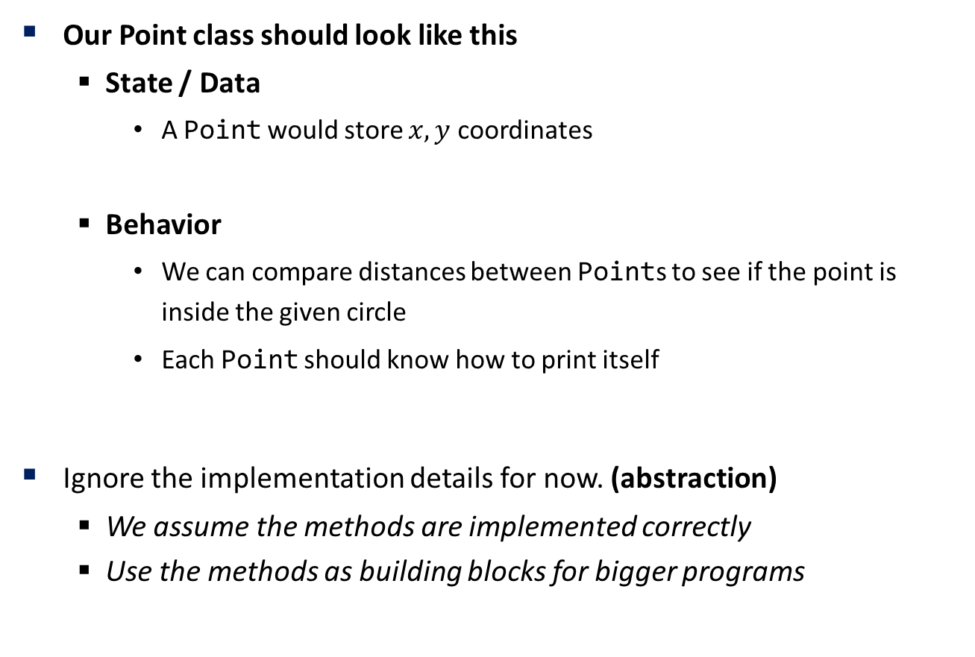
Point Object through Abstraction
Our Point class should look like this
State / Data
A Point would store $x, y$ coordinates
Behavior
We can compare distances between Points to see if the point is inside the given circle
Each Point should know how to print itself
Ignore the implementation details for now. (abstraction)
We assume the methods are implemented correctly
Use the methods as building blocks for bigger programs

Slide 51
Point Object through Abstraction
Point object should have x, y as its data
Methods (behavior) should look like this:
Return Type | methodName(params) | Description
void | setLocation(int x, int y) | Set the point's x, y to the given values
void | translate(int dx, int dy) | Adjust the point's x and y by the given amounts
double | distance(Point p) | Returns the distance from another Point p
void | print() | Prints the point

Slide 52
Object State: Fields
field: A variable inside an object that is part of its state
Each object has its own copy of each field
Declaration syntax
type name;
Example: In Point.java
The above creates a new type named Point
Each Point object contains two pieces of data
Two integers, x and y
The object do not contain any behavior for now
public class Point {
int x;
int y;
}

Slide 53
Object State: Fields
Other classes can access/modify an object's fields.
Access: variable.field
Modify: variable.field = value;
Example: In PointMain.java
Point.java will not have a main method, so it's not a runnable program
It will be used by other client programs
PointMain.java, in our case
public class PointMain {
public static void main(String[] args) {
Point p1 = new Point();
System.out.println(p1.x); // access
p1.y = 13; // modify
System.out.println(p1.y);
}
}

Slide 54
Modify the Solution
public class PointSolution {
public static void main(String[] args) {
Scanner sc = new Scanner(System.in);
int n = sc.nextInt();
Point[] p = new Point[n];
for (int i = 0; i < n; ++i) {
p[i] = new Point();
p[i].x = sc.nextInt();
p[i].y = sc.nextInt();
}
int a = sc.nextInt(), b = sc.nextInt(), r = sc.nextInt();
for (int i = 0; i < n; ++i) {
double dist2 = (a - p[i].x) * (a - p[i].x) + (b - p[i].y) * (b - p[i].y);
if (Math.sqrt(dist2) <= r) {
System.out.println("(" + p[i].x + ", " + p[i].y + ")");
}
}
}
}
Declare array of Points, initialize and set x, y fields
Access and use them later in computation

Slide 55
Object Behavior: Methods
Our client program wants to print Point objects
To print it in other places, the code must be repeated
We should remove the redundancy by using a method
But if we use a static method:
Every program that prints a Point object would need this method
The syntax wouldn't match, how we're used to using objects
print(p[i]); // static (bad)
The point of classes is to combine state and behavior
The print behavior is closely related to a Point's data
The method should belong inside each Point object
p[i].print() // inside object (better)

Slide 56
Object Behavior: Methods
instance method (object method): A method that exists inside each object of a class and gives behavior to each object
Same syntax as static methods, but without static keyword
Declaration Syntax
Example: In Point.java
public type name(parameters) {
statements;
}
public class Point {
int x;
int y;
public void print() {
// ?
}
}

Slide 57
Object Behavior: Methods
The print method no longer has a Point p parameter
How will the method know which point to print?
How will the method access that point's x, y data?
Each Point object has its own copy of the print method
It can operate on that object's state!
implicit parameter: The object on which an instance method is called
In the call p1.print(), p1 is the implicit parameter
The instance method can refer to that object's fields
We say that it executes in the context of a particular object
print can refer to the x and y of the object it was called on

Slide 58
Object Behavior: Methods
Now our Point class should look like this
Now each Point object contains a print method that prints the points current position
public class Point {
int x;
int y;
public void print() {
System.out.println("(" + x + ", " + y + ")");
}
}

Slide 59
Kinds of Methods
accessor: A method that lets clients examine object state
Example: distance
Often has non-void return type
mutator: A method that modifies an object's state
Example: setLocation, translate
Add the methods!
Thanks to abstraction, we can only focus on the method itself

Slide 60
Printing Objects
By default, Java does not know how to print objects
So we defined a print method, but System.out.println(p) is a lot more coherent and easier to use than p.print()
Every class has a toString method, even if it isn't in your code
Default: class's name @ object's memory address (base 16)
This method is automatically called when
Passed to System.out.println()
Concatenated with another string
Point p = new Point();
System.out.println(p); // Point@2f92e0f4

Slide 61
Printing Objects
toString() syntax
Method name, return type, parameters must match exactly
Example:
Now we can use
System.out.println(p);
public String toString() {
// return a String representing the object
}
public String toString() {
return "(" + x + ", " + y + ")";
}

Slide 62
Current Point Class
public class Point {
int x;
int y;
public void setLocation(int newX, int newY) {
x = newX;
y = newY;
}
public void translate(int dx, int dy) {
x += dx;
y += dy;
}
public double distance(Point p) {
int dx = x - p.x, dy = y - p.y;
return Math.sqrt(dx * dx + dy * dy);
}
public String toString() {
return "(" + x + ", " + y + ")";
}
}

Slide 63
Modify the Solution
public class PointSolution {
public static void main(String[] args) {
Scanner sc = new Scanner(System.in);
int n = sc.nextInt();
Point[] p = new Point[n];
for (int i = 0; i < n; ++i) {
p[i] = new Point();
int x = sc.nextInt(), y = sc.nextInt();
p[i].setLocation(x, y);
}
int a = sc.nextInt(), b = sc.nextInt(), r = sc.nextInt();
Point o = new Point();
o.setLocation(a, b);
for (int i = 0; i < n; ++i) {
if (p[i].distance(o) <= r)
System.out.println(p[i]);
}
}
}
A lot cleaner and intuitive!

Slide 64
Object Initialization: Constructors
Currently creating a Point and initializing it takes
3 lines
2 lines (thanks to setLocation method)
Can we do better? Why not specify the initial values at the start?
Point p = new Point();
p.x = 3;
p.y = 8;
Point p = new Point();
p.setLocation(3, 8);

Slide 65
Object Initialization: Constructors
constructor: Initializes the state of new objects
Runs when the client uses the new keyword
No return type is specified
It implicitly "returns" the new object being created
If a class has no constructor, Java gives it a default constructor, with no parameters that sets all fields to "zero-equivalent" value
You can have multiple constructors
Each constructor must have a unique set of parameters
Syntax
public type(parameters) {
statements;
}

Slide 66
Object Initialization: Constructors
Point class constructor
public class Point {
int x;
int y;
public Point() { // default constructor
x = 0;
y = 0;
}
public Point(int initX, int initY) {
x = initX;
y = initY;
}
// omitted
}

Slide 67
Final Solution
public class PointSolution {
public static void main(String[] args) {
Scanner sc = new Scanner(System.in);
int n = sc.nextInt();
Point[] p = new Point[n];
for (int i = 0; i < n; ++i) {
int x = sc.nextInt(), y = sc.nextInt();
p[i] = new Point(x, y);
}
int a = sc.nextInt(), b = sc.nextInt(), r = sc.nextInt();
Point o = new Point(a, b);
for (int i = 0; i < n; ++i) {
if (p[i].distance(o) <= r)
System.out.println(p[i]);
}
}
}

Slide 68
Encapsulation
encapsulation: Hiding implementation details from clients
Encapsulation forces abstraction
Separates external view (behavior) from internal view
Protects the integrity of an object's data
Benefits
Protects objects from unwanted access
Can change the class implementation later
Point could be rewritten in polar coordinates with the same methods
This term also means: Combining an object's data and methods into a class

Slide 69
Private Fields
A field that cannot be accessed from outside the class
Used for information hiding
Private fields can be accessed within the class
Declaration
private type name;
Client code won't compile if it accesses private fields
public class Point {
private int x;
private int y;
...
}
System.out.println(p1.x);
Unresolved compilation problem:
The field Point.x is not visible

Slide 70
Acessing Private Fields
We use getter/setter to access/modify private variables
These methods can be accessed elsewhere
public int getX() {
return x;
}
public void setX(int newX) {
x = newX;
}

Slide 71
Acessing Private Fields
Why do we do such complicated things?
https://stackoverflow.com/a/1568230
Encapsulation of behavior associated with getting or setting the property allows additional functionality (like validation) to be added more easily later
Hiding the internal representation of the property while exposing a property using an alternative representation.
Allowing the public interface to remain constant while the implementation changes without affecting existing consumers.
Providing a debugging interception point for when a property changes at runtime - debugging when and where a property changed to a particular value can be quite difficult without this in some languages.
Getters and setters can allow different access levels - for example, the get may be public, but the set could be protected.

Slide 72
this Keyword
this: Refers to the implicit parameter inside your class
Refer to a field: this.field
Call a method: this.method(parameters)
Call another constructor: this(parameters)
shadowing: 2 variables with same name in same scope
Normally illegal, except when one variable is a field
In other parts of the code, x and y refer to the fields
In setLocation, x and y refer to the method parameters
public class Point {
private int x;
private int y;
public void setLocation(int x, int y) {
// ...
}
}

Slide 73
this Keyword
But since x, y are parameters you cannot access the class fields inside setLocation
Use this keyword to refer to the class fields!
public class Point {
private int x;
private int y;
public void setLocation(int x, int y) {
// cannot access field!
}
}
public void setLocation(int x, int y) {
this.x = x;
this.y = y;
}

Slide 74
this Keyword
Can also call another constructor
Avoid redundancy between constructors
Only a constructor can call another constructor
public Point() {
this(0, 0);
}
public Point(int x, int y) {
this.x = x;
this.y = y;
}

Slide 75
Static Members
static: Part of a class, rather than part of an object
Object classes can have static methods and fields
Not copied into each object, shared by all objects of that class
Declaration syntax
static type name;
static field: A field stored in the class, instead of each object
A "shared" global field that all objects can access and modify
Like a class constant, except that its value can be changed
Access by ClassName.fieldName

Slide 76
Static Fields
Can count how many objects of that class are created
Can also be used as constants
PI, E is a static field in Java's Math class
public class Foo {
private static int count = 0;
public Foo() {
count++;
}
public int getCount() {
return count;
}
}
public static void main(String[] args) {
Foo f = new Foo();
Foo g = new Foo();
System.out.println(f.getCount()); // 2
Foo h = new Foo();
System.out.println(h.getCount()); // 3
}
System.out.println(Math.PI); // 3.141592653589793
System.out.println(Math.E); // 2.718281828459045

Slide 77
Static Methods
static method: A method stored in a class, not in an object
Shared by all objects of the class, not replicated
Does not have any implicit parameter (this)
Cannot access any particular object's fields
Access by ClassName.methodName(parameters)
Examples
Integer.parseInt(String str);
Arrays.sort(T[] arr);

