Slide 1
Standard Classes 2020 Spring: AP Computer Science A
January 29th, 2020

Slide 2
Today
Wrapper classes
Math class
StringBuffer class
Generics
Arrays (2D)
Lists and ArrayLists
Iterators

Slide 3
Wrapper Classes
Wrapper classes provide a wrapper for primitive types
Sometimes we have to use the primitive types as objects
Primitive Type | Wrapper Class Name
byte | Byte
short | Short
int | Integer
long | Long
char | Character
float | Float
double | Double
boolean | Boolean

Slide 4
Wrapper Classes
Constructors for wrapper classes (don't do this)
Getting the primitive values inside the wrapped object
Integer i = new Integer(1);
Long l = new Long(10);
Double d = new Double(3.14);
Character c = new Character('p');
Boolean b = new Boolean(true);
int iv = i.intValue();
long lv = l.longValue();
double dv = d.doubleValue();
char cv = c.charValue();
boolean bv = b.booleanValue();

Slide 5
Auto Boxing / Unboxing
Boxing: Converting a primitive value to a wrapper class object
Unboxing: Converting a wrapper class object to a primitive value
Auto boxing and unboxing are supported in Java
Constructors for wrapper classes aren't used very often
Integer x = 2147; // boxing
int sum = x + 27; // unboxing
System.out.println(sum);

Slide 6
Wrapper Class – Static Methods
Instead of constructors, Java also has static methods
Converting String to primitive types
Integer i = Integer.valueOf(50);
Double d = Double.valueOf(3.1415);
Boolean b = Boolean.valueOf(false);
int i = Integer.parseInt("2147");
double d = Double.parseDouble("3.145");
boolean b = Boolean.parseBoolean("true");

Slide 7
Math Class
Java provides methods for mathematical calculations
All methods and fields are static
No need to instantiate an object
https://docs.oracle.com/en/java/javase/13/docs/api/java.base/java/lang/Math.html

Slide 8
Math Class
print(Math.random()); // 0 <= x < 1
print((int) (Math.random() * 6 + 1));
Random r = new Random();
print(r.nextInt(100)); // 0 <= x < 100
print(Math.abs(-10));
print(Math.floor(3.1));
print(Math.ceil(3.1));
print(Math.round(3.13)); // round to integer
print(Math.max(1, 2));
print(Math.min(1, 2));
print(Math.pow(5, 2));
print(Math.sqrt(3));
print(Math.sin(Math.toRadians(30)));
print(Math.cos(Math.PI / 3));
print(Math.tan(Math.PI / 6));

Slide 9
StringBuffer Class
Strings are immutable!
You can change string values with StringBuffer
StringBuffer is much faster than String
https://docs.oracle.com/en/java/javase/13/docs/api/java.base/java/lang/StringBuffer.html

Slide 10
StringBuffer Class
StringBuffer sb = new StringBuffer(); // empty string
print(sb.toString()); // ""
sb.append("asdf");
print(sb.toString()); // "asdf"
sb.insert(1, "gh");
print(sb.toString()); // "aghsdf"
sb.delete(1, 2);
print(sb.toString());// "ahsdf"
sb.deleteCharAt(1);
print(sb.toString());// "asdf"
sb.reverse();
print(sb.toString()); // "fdsa"

Slide 11
Generic Types
Generic types enable you to generalize the type you use in a class
The type is checked at compile time
Benefits
Enables type safety
Reduced cost for type checking
Won't have to define same structure for different types
Stack (Interface) can be used to implement
IntStack, DoubleStack, StringStack (bad – 3 classes)
Generic Stack class
The type of its element will be set at compile time

Slide 12
Generic Types
Declare type parameter as <T> in the class name
Can use T as type
Can be used as parameters
Can be used as return types
T can also be constrained to a group of types (seen later)
class MyType<T> {
T val;
public MyType() {
val = null;
}
public MyType(T val) {
this.val = val;
}
public void set(T val) {
this.val = val;
}
public T get() {
return val;
}
public String toString() {
return val.toString();
}
}

Slide 13
Generic Types
For instantiation, specify the type inside <T>
T must be an object, not a primitive type
Necessity of wrapper classes
MyType<Integer> t = new MyType<Integer>();
t.set(35);
System.out.println(t.get());
System.out.println(t);
MyType<String> s = new MyType<String>("example");
System.out.println(s);

Slide 14
Generic Types
Suppose we change the class parameter T to the following
MyType<String> doesn't work anymore
String does not extend Number
You can restrict the types by using extends in the type parameter
class MyType<T extends Number> {
...
}

Slide 15
2D Arrays
Similar to 1D arrays
Example
Access and assignment are also similar
type[][] arr = new type[row][column];
int[][] arr = new int[10][10]; // 10 x 10 int array
arr[1][3] = -1;
print(arr[5][7]);

Slide 16
2D Arrays
Initializer list syntax is also possible
Usage in return types and parameters
Can have dynamic length for each row
int[][] arr2 = { { 1, 0, 1 }, { 0, 1, 0 }, { 0, 0, 1 } };
public static int[][] foo(int[][] arr) {
return arr;
}
int[][] arr3 = new int[3][];
arr[0] = new int[1];
arr[1] = new int[3];
arr[2] = new int[2];

Slide 17
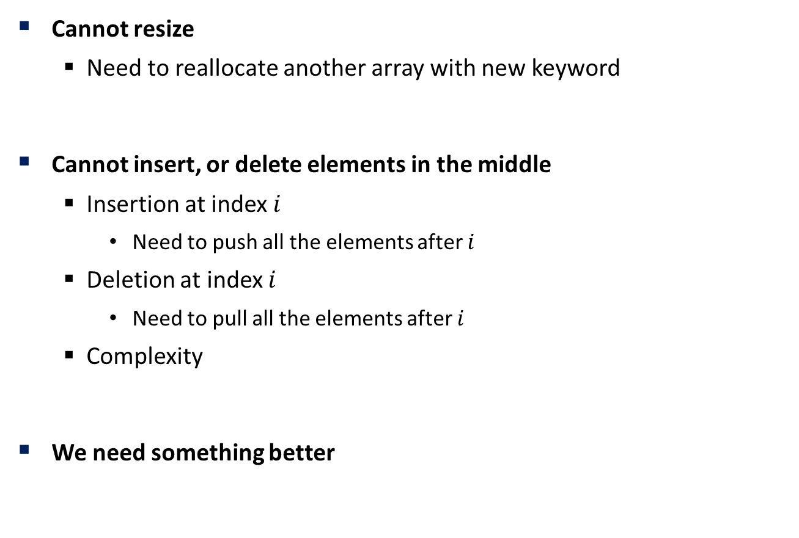
Limitations of Arrays (Revisited)
Cannot resize
Need to reallocate another array with new keyword
Cannot insert, or delete elements in the middle
Insertion at index $i$
Need to push all the elements after $i$
Deletion at index $i$
Need to pull all the elements after $i$
Complexity
We need something better

Slide 18
List<E> Interface
Contains useful methods for manipulating a list of objects
https://docs.oracle.com/en/java/javase/13/docs/api/java.base/java/util/List.html
Definition | Description
boolean add(E e) | Add element at the end of the list
void add(int idx, E e) | Add element at specified index
void clear() | Clear the list
boolean contains(Object o) | Check if the list contains the specified object
boolean isEmpty() | Check if the list is empty
E remove(int idx) | Remove and return the item at the specified index
int size() | Return the size of the list
E set(int idx, E e) | Set the element at the specified index to the specified object
E get(int idx) | Returns the element at the specified index
Iterator<E> iterator() | Returns an iterator over the elements in the list

Slide 19
ArrayList<E>
Similar to arrays, but resizing is done automatically
But note that resizing is slow
Used as arrays in generic classes
Generic arrays cannot be instantiated

Slide 20
ArrayList<E>
ArrayList<Integer> arr = new ArrayList<Integer>();
arr.add(40); // [40]
arr.add(20); // [40, 20]
arr.add(1, 10); // [40, 10, 20]
arr.add(30); // [40, 10, 20, 30]
print(arr);
print(arr.get(1)); // 10
for(int e : arr) { // you can use for-each
print(e);
}
Collections.sort(arr); // [10, 20, 30, 40]
arr.set(1, 50); // [10, 50, 30, 40]
arr.size(); // 4
arr.isEmpty(); // false

Slide 21
Exercises
Implement a generic Stack, Queue class
No size limit
Implement a double-ended queue (Deq)
pushBack, pushFront, popBack, popFront

Slide 22
Iterator<E>
Java Collections
Java provides predefined data structures for collections of objects
iterator: An object used to iterate a collection
Definition | Description
boolean hasNext() | Returns true if there is at least one more element to be examined, false otherwise
E next | Returns the next element in iteration
void remove() | Deletes the last element that was returned

Slide 23
Iterator<E>
Usage
Print and delete each element in an ArrayList
ArrayList<String> arr = new ArrayList<String>();
arr.add("element 1");
arr.add("Hi");
arr.add("Hello");
arr.add("안녕");
Iterator<String> it = arr.iterator();
while (it.hasNext()) {
String str = it.next();
System.out.println(str);
it.remove();
}
System.out.println(arr.isEmpty()); // true

Slide 24
Matrix
Implement a Matrix class!
Should be compatible with Vector class

