Slide 1
Arrays and Pointers 2020 Spring: Introduction to C
July 8th, 2020

Slide 2
Today
Arrays in C
Strings in C
Arrays and Functions
Pointers
& and * Operators
Call by Value
Pointers as Function Parameters

Slide 3
Programming Problem
#4344 평균은 넘겠지
For simplicity, only consider the problem for a single test case.
Try to solve this problem!
Input
5
50
50
70
80
100
Output
40.000%

Slide 4
Why is it hard?
We need each input value twice
To compute the average
To count how many were above average
We could read each value into a variable, but we
don't know how many values are needed until the program runs
don't know how many variables to declare
Need a way to declare many variables in one step.

Slide 5
Arrays
array: A data structure that stores many values of the same type
element: One value in an array
index: A 0-based integer to access an element from an array
Declaration
type name[length];
Example
index | 0 | 1 | 2 | 3 | 4 | 5 | 6 | 7 | 8
value | 12 | -1 | 49 | 0 | 5 | 7 | -19 | 128 | 1
int arr[10];
index | 0 | 1 | 2 | 3 | 4 | 5 | 6 | 7 | 8 | 9
value | ? | ? | ? | ? | ? | ? | ? | ? | ? | ?

Slide 6
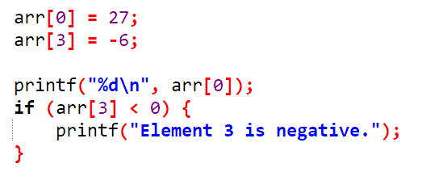
Arrays
Accessing elements
Can be used like a variable
Example
name[index] // access
name[index] = value; // modify
index | 0 | 1 | 2 | 3 | 4 | 5 | 6 | 7 | 8 | 9
value | 27 | ? | ? | -6 | ? | ? | ? | ? | ? | ?

Slide 7

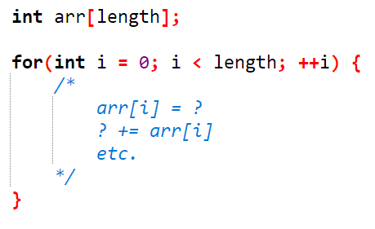
Benefits of using Arrays
Can declare multiple variables at once
Can apply similar pattern to each of the elements

Slide 8
Array Initialization
Arrays declared locally might contain random values
Initialization is necessary before accessing the array
But repeating name[index] = value is troublesome
Initializer list method
int arr1[5] = {1, 2, 3, 4, 5};
Initializes the array to the given values
int arr2[] = {1, 2, 3, 4};
If the length is unspecified, the length is checked automatically
int arr3[5] = {1, 2, 3};
Uninitialized elements will be given zero-equivalent values
int zeros[length] = {0} will zero-initialize the whole array
Global arrays will be automatically initialized to zero-equivalent values

Slide 9
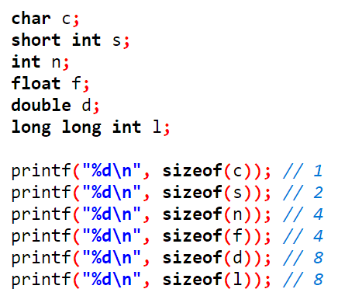
sizeof() Function
sizeof(x) returns the size of the variable x
Calculation of array length
type arr[length];
int len = sizeof(arr) / sizeof(type);
Machine dependent!

Slide 10
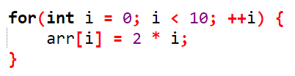
Arrays and for Loops
It is common to use for loops to access array elements
The loop counter is used as an index
We can also assign each element a value in a loop
Will be used very often!

Slide 11
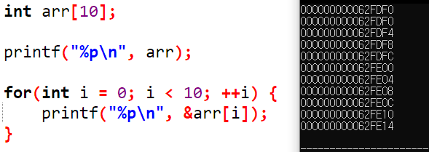
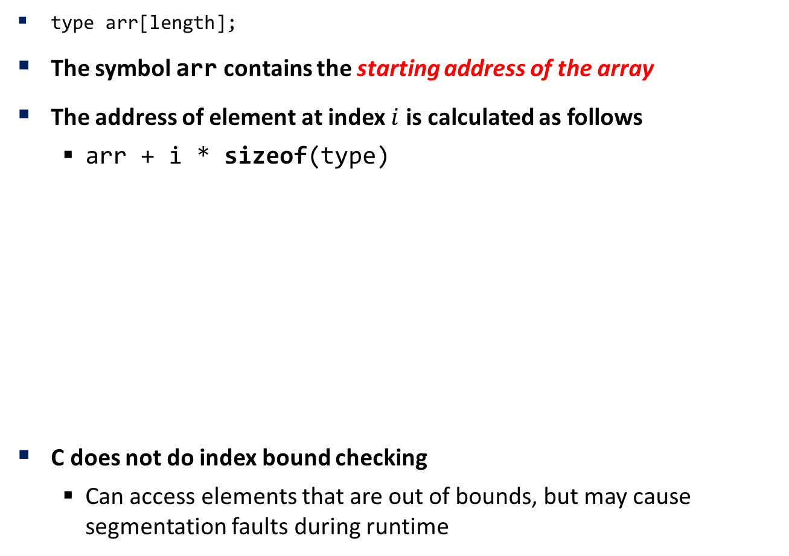
Element Access
type arr[length];
The symbol arr contains the starting address of the array
The address of element at index $i$ is calculated as follows
arr + i * sizeof(type)
C does not do index bound checking
Can access elements that are out of bounds, but may cause segmentation faults during runtime

Slide 12
Comparing and Copying Arrays
Comparing arrays cannot be done with ==
int arr1[10], arr2[10];
arr1 == arr2 will compare the starting address of each array
Will probably be different
Must compare each element one by one
Cannot copy arrays with = (assignment operator)
int arr1[3] = {1, 2, 3}, arr2[3];
arr2 = arr1; // error
Must copy each element one by one
memcpy function

Slide 13
Exercise
#4344 평균은 넘겠지
Use an integer array to store all the scores
#10818 최소, 최대
Use an integer array to store all the values
Traverse the array to find the maximum/minimum
#2562 최댓값
#2577 숫자의 개수 (★)

Slide 14
C Strings
A string in C is an array of characters!
Always ends with the null character '\0'
Used as an 'end of string' delimiter
Declaration
char str[length + 1]; // + 1 for the null character
Example
char str[10] = "Hello, C!";
index | 0 | 1 | 2 | 3 | 4 | 5 | 6 | 7 | 8 | 9
value | H | e | l | l | o | , |  | C | ! | \0

Slide 15
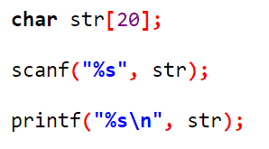
scanf, printf with C Strings
char array must be longer than the maximum input length
Uses %s as format specifier
Symbol str contains the starting address of the string
scanf will
Store each character starting from address str
If input is finished, automatically pad '\0' at the end
printf will
Print each character starting from address str
Print until '\0' (end of string) is found

Slide 16
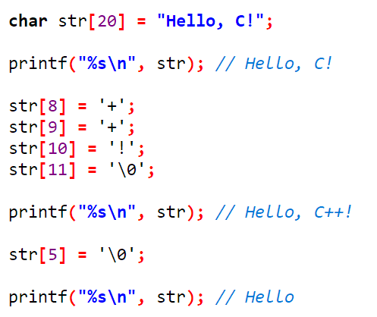
Modifying Strings
Can access or modify each character of a string, just like an array

Slide 17
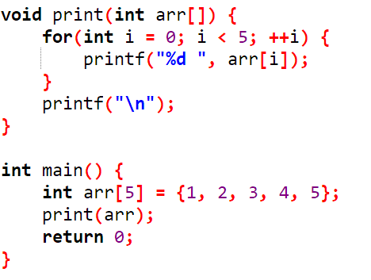
Passing an Array as Function Parameter
Function declaration
type func(type arr[])
Example

Slide 18
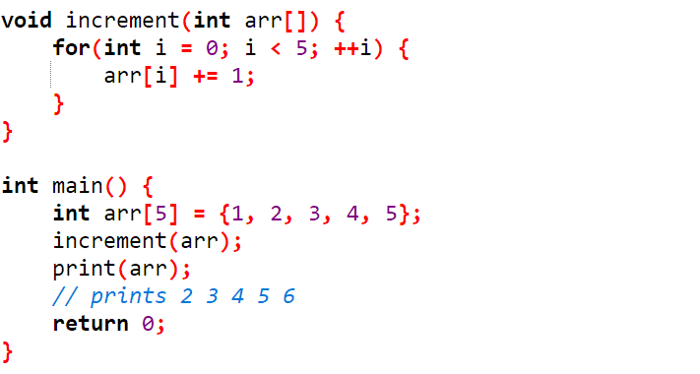
Passing an Array as Function Parameter
Be careful! The function may change the elements of the array

Slide 19
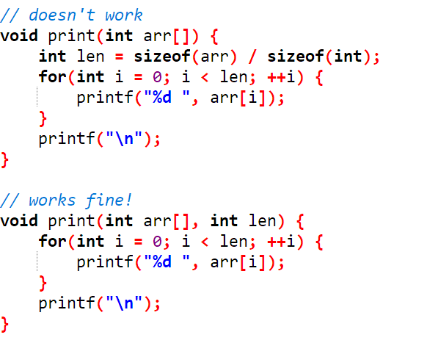
Array Length as Parameter
Declaration doesn't specify the length of array
sizeof(arr) / sizeof(type) does not work here
Must pass the length as a second parameter

Slide 20
Pointers
pointer: a variable that contains a memory address, and information about that memory address
Declaration
type * ptr; // type* ptr, type *ptr is also OK
Meaning: ptr is a pointer to a variable of type type
Think of type* as a new data type that contains addresses

Slide 21



& and * Operators
&x gives the memory address of the variable x
Scan the integer and store it to location &x
*x gives the value pointed to by x

Slide 22
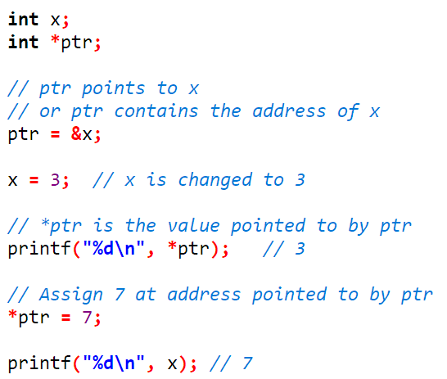
& and * Operators
Example: pointer ptr points to x

Slide 23
Necessity of Pointers
Pointers enable memory references
Pointers can be used for managing arrays and strings
Pointers can be used as writable function parameters
Addresses are always integers, why do we need pointers? We could just store the address to an integer variable.
Integer variable will have no information about that address
Pointer type contains the information about how to interpret the data at that address
double *ptr;
Data pointed to by ptr will be read as a double

Slide 24
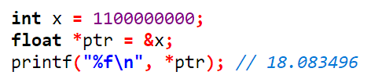
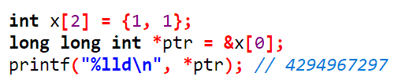
Interpreting Data in Memory
Reading an integer as a float
Reading two integers as a long long int

Slide 25
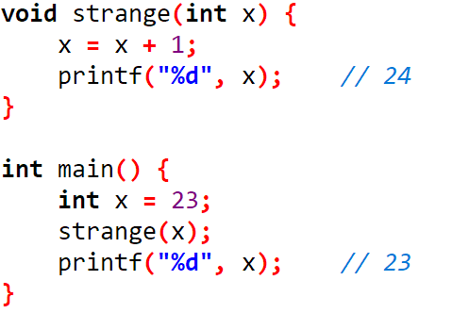
Call by Value
When a function is called:
The value is stored into the parameter variable
The function's code executes, using that value (inside variable)
call by value: When values are passed as parameters, their values are copied
Modifying the parameter will not affect the variable passed in

Slide 26
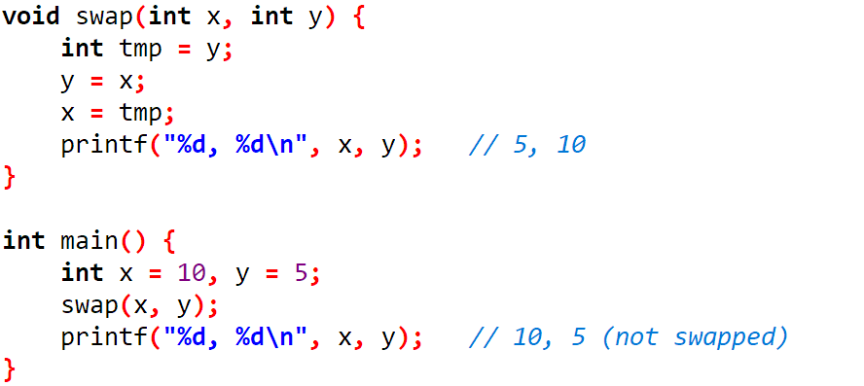
Call by Value
Example

Slide 27
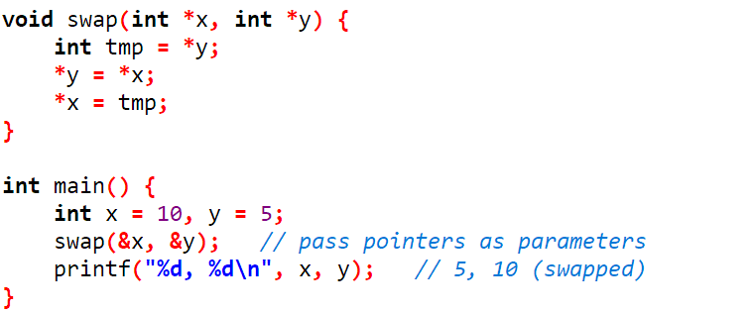
Swap with Pointers
Working version of swap with pointers as parameters
Writable function parameter

Slide 28
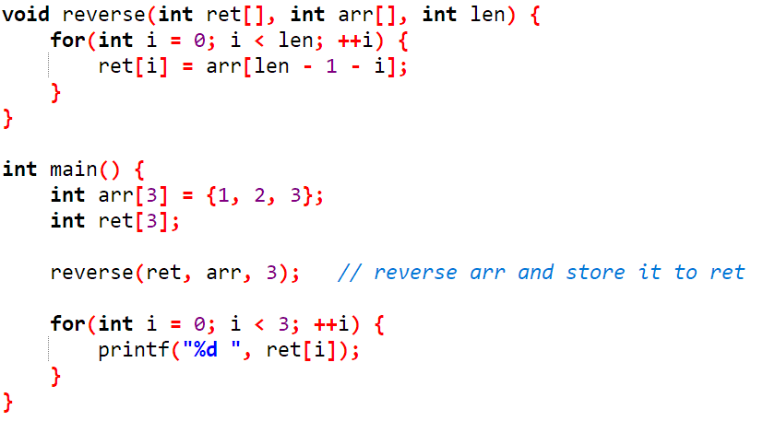
Writeable Function Parameter
Can write to the passed parameter
Can be used to modify arrays

