Slide 1
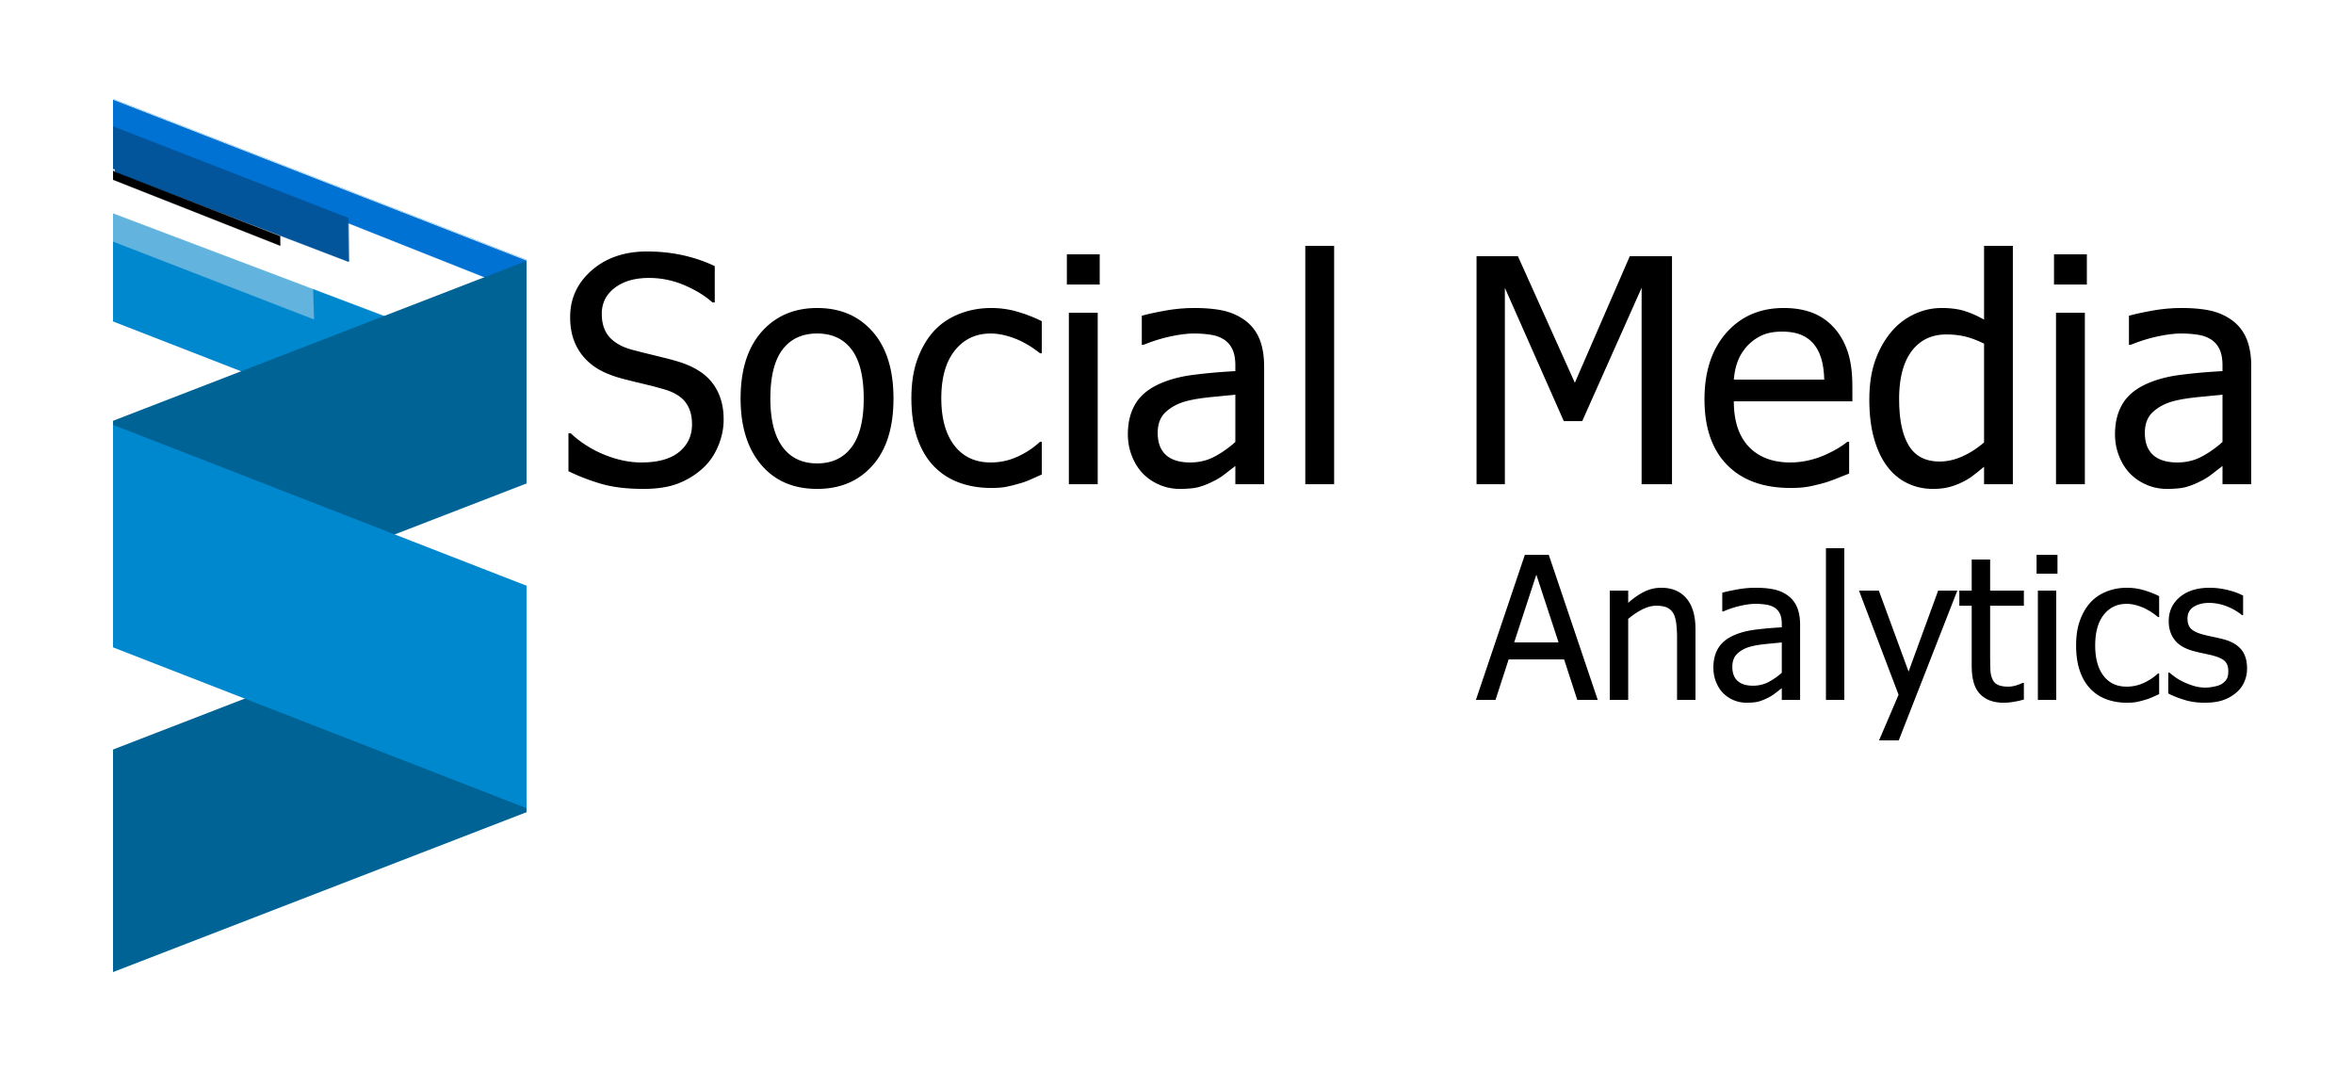
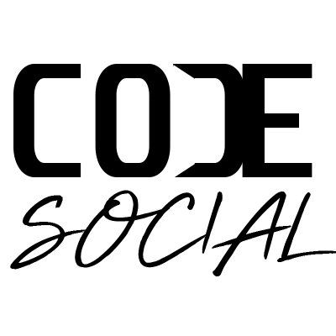

An open source initiative
Guide : Prof. Abiodun Sodiq Shofoluwe
Group 14 :
Megha Gupta 0769552
Alok Suresh Chilka 0768959
Riddhi Deshpande 0775846
In collaboration with

Slide 2


Content
Background
Importance of Social Media Analytics
Data Privacy
Project Flow
Initial Data Model
Some key changes
Common Data Model
Functional Flow - LinkedIN,Twitter,TikTok
Getting Your Cookies
Architecture
About Dataset
Dashboard
Future Scope
Benefits
Page 1

Slide 3

Background
Template built on jupyter notebook.
Open Source
Low code drivers
Wide range of connectors available.
Share across different platforms
Scheduler available
Guaranteed availability as run on AWS
Page 6

Slide 4
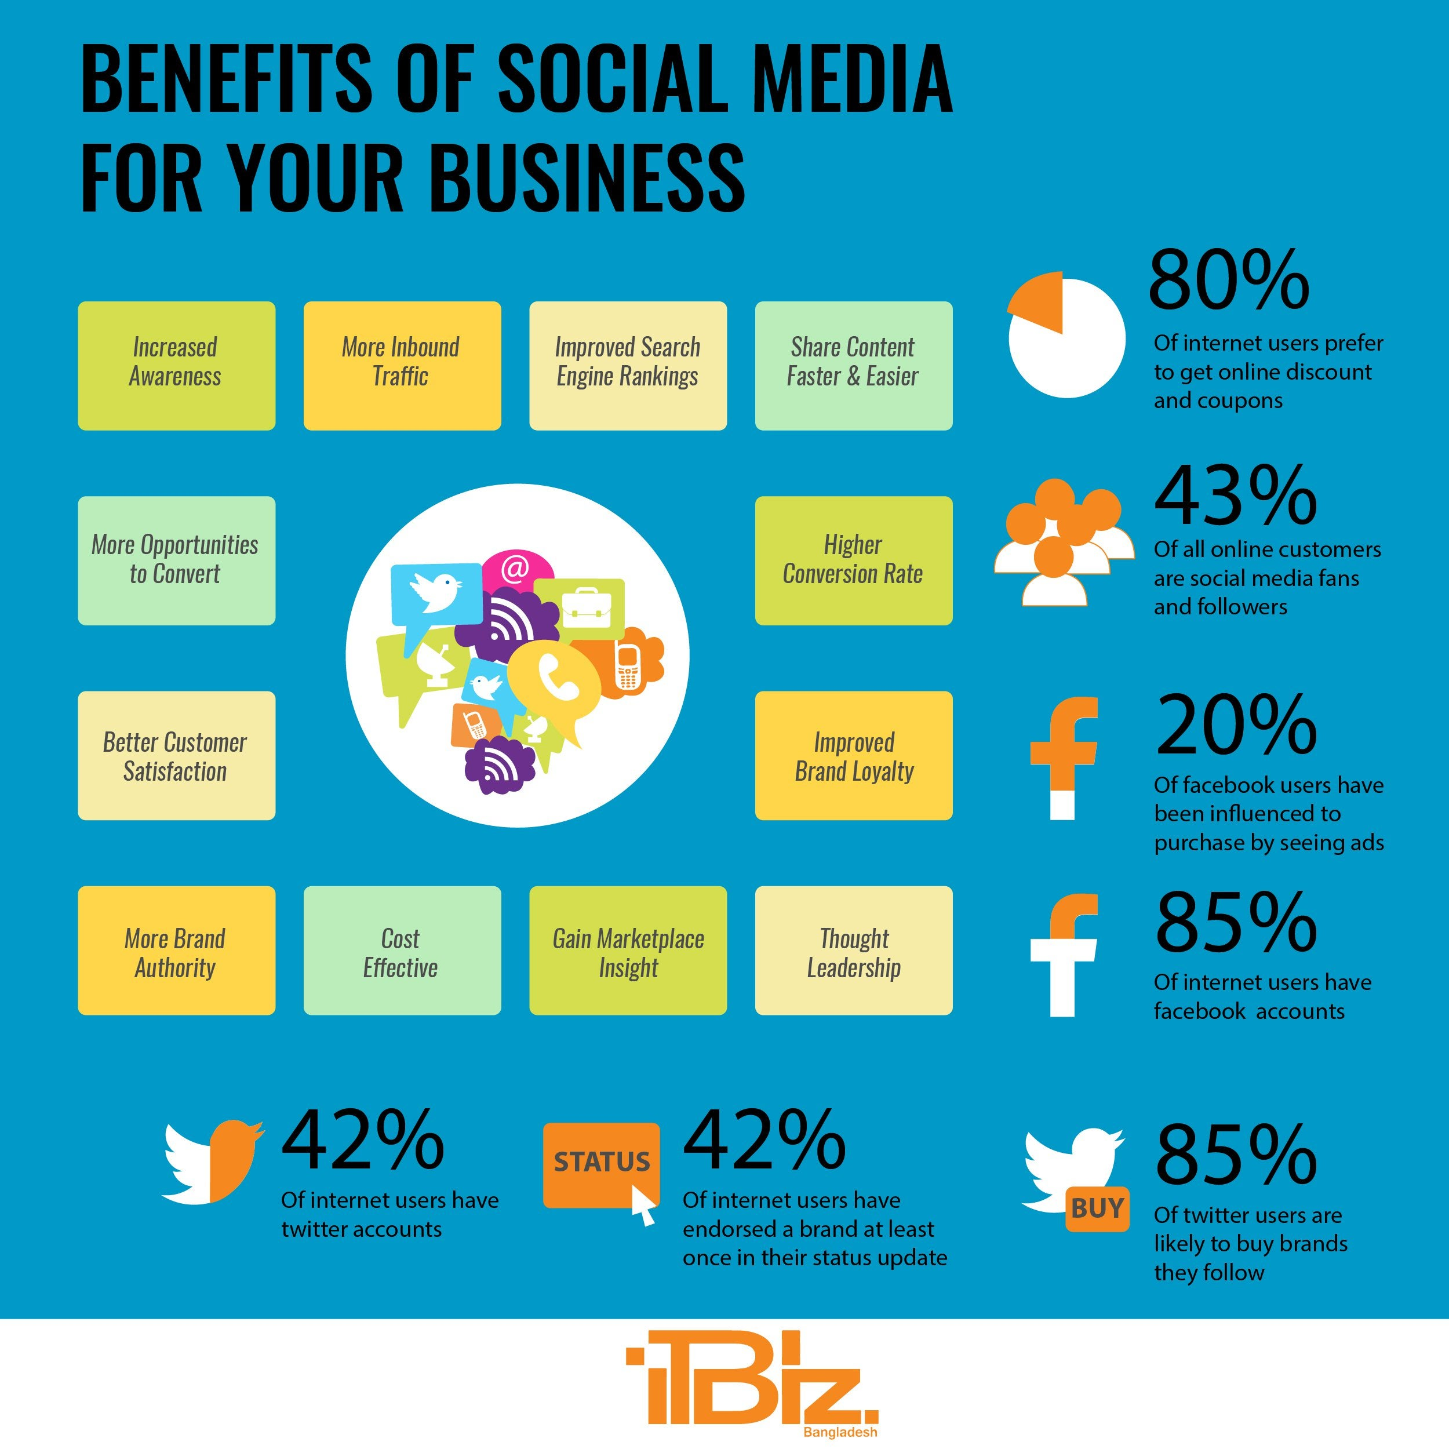
Importance of Social
Media Analytics
They help you understand your audience
They show you what your best social networks are
Social data can help you create better content
Help you Understand competitors
Social metrics can help you create a better strategy
Social media analytics shows you how a social media campaign is performing
Page 5

Slide 5
Data Privacy
When you sign up for any social media app you already give the consent as per settings on profile.
Using our notebook, the user enters his / hr own profile URL to get the data.

Slide 6
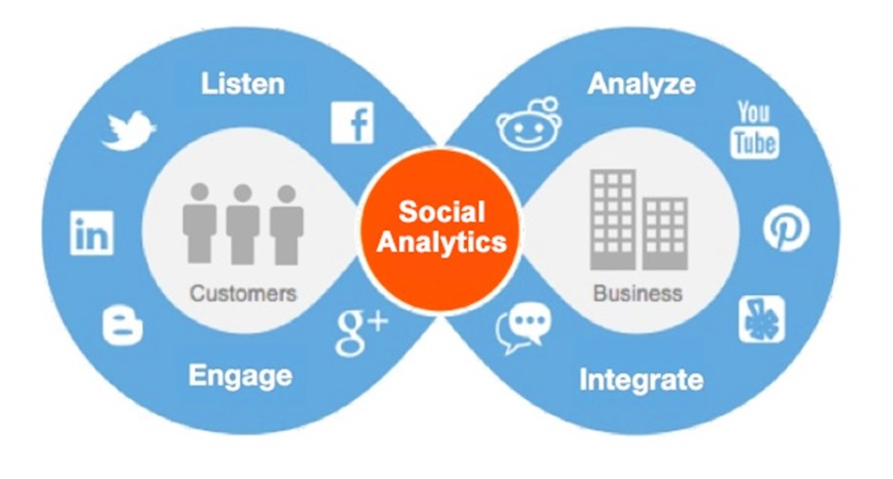
Project Flow
The information collected using various custom / built-in API’s can be used to create meaningful insights.
At first stage the content will be generated and later in second stage distributed on desired platforms.
While extracting the data we will also make sure the process complies with the data privacy regulation (GDPR, FIPPA etc)
Page 5

Slide 7
Initial Data Model
Since all the gathered data from web is unstructured in nature, it is a challenge to perform modelling and analysis on this data which doesn’t have any predefined schema. Using appropriate evaluation techniques, we need to make proper transition of the cleaned data.
Over that we get some specific information from social media which can be taken as fixed set of columns. For ex.
Columns from LinkedIN Post:
- PROFILE_URN : LinkedIn unique profile id
- PROFILE_ID : LinkedIn public profile id
- FIRSTNAME
- LASTNAME
- TEXT
- OCCUPATION
- ACTIVITY_COMMENTS
- ACTIVITY_LIKES
- DISTANCE
- POST_URL
Page 5

Slide 8
Some key changes
Data access restriction made us put 2 platforms on hold (facebook, Instagram)
Used Power BI instead Apache Superset
Leveraged existing integration of slack to send notifications
Simulated data as enough information wasn’t available due to time and account level restrictions.

Slide 9
Common Data Model
Right now we are getting different set of columns for every application, this becomes an issue while creating the dashboard as we don’t have any common field(s) to filter the data using expression.
To solve this, we have created a common list of columns which are synced across all application.
Advantages:
One single data model
One single file
Easy to analyze with “APPLICATION_TYPE” field using as primary level filter.
Page 5

Slide 10
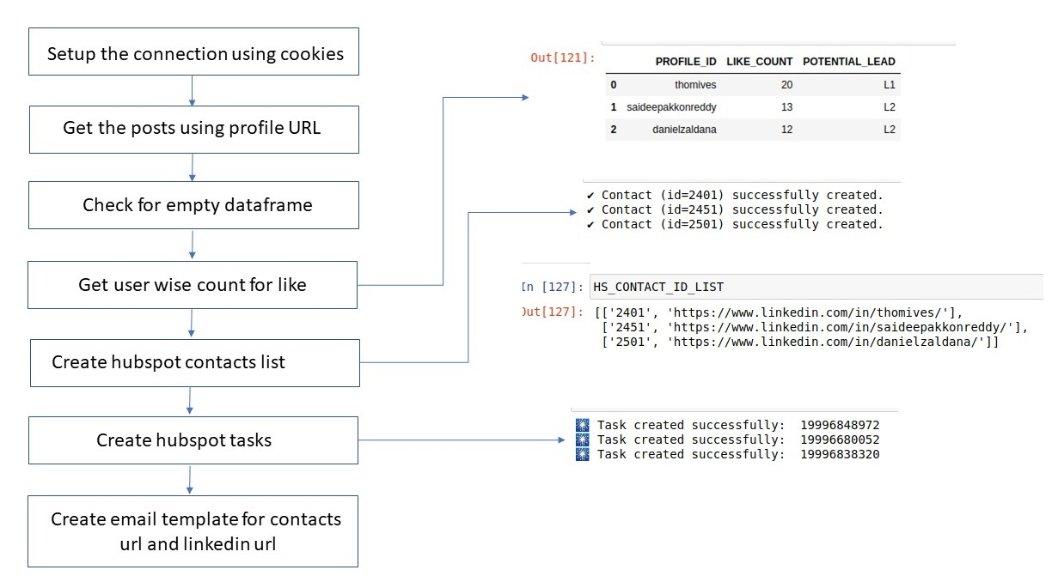
Functional Flow - LinkedIN

Slide 11
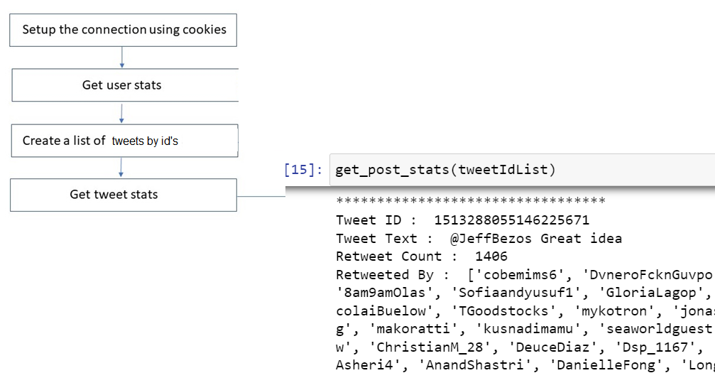
Functional Flow - Twitter

Slide 12
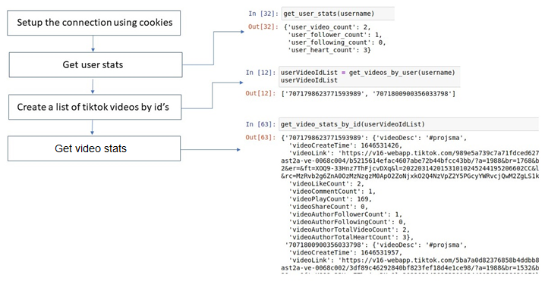
Functional Flow - Tiktok

Slide 13
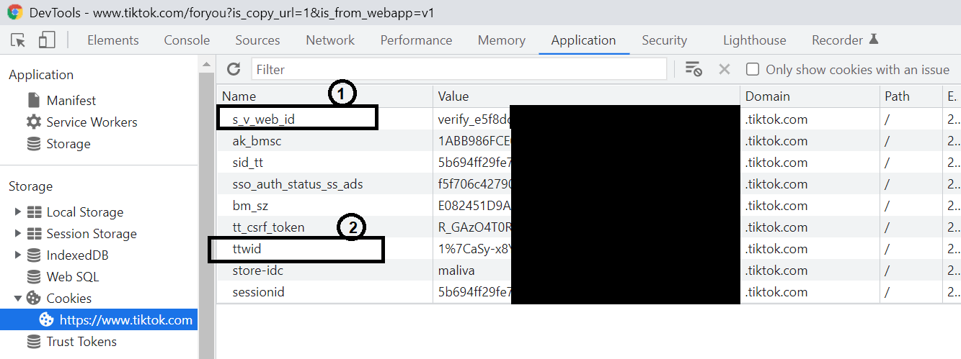
Getting Your Cookies
1) How to get cookies for linkedin: The parameters LI_AT and JSESSIONID are used to create a connection to linkedin api, where as the PROFILE_URL will then be used to get the list of posts.
https://www.notion.so/LinkedIn-driver-Get-your-cookies- d20a8e7e508e42af8a5b52e33f3dba75
2) bearer_token – the token used for authentication
https://developer.twitter.com/en/docs/authentication/oauth-2-0/bearer-tokens
3) How to get "s_v_web_id and "tt_webid".
While logged into your tiktok account, Click F12 to open developer console in your browser. Navigate to path Storage -> Cookies -> https://www.tiktok.com and on right hand side there are the parameters marked which you will need.
Page 5

Slide 14
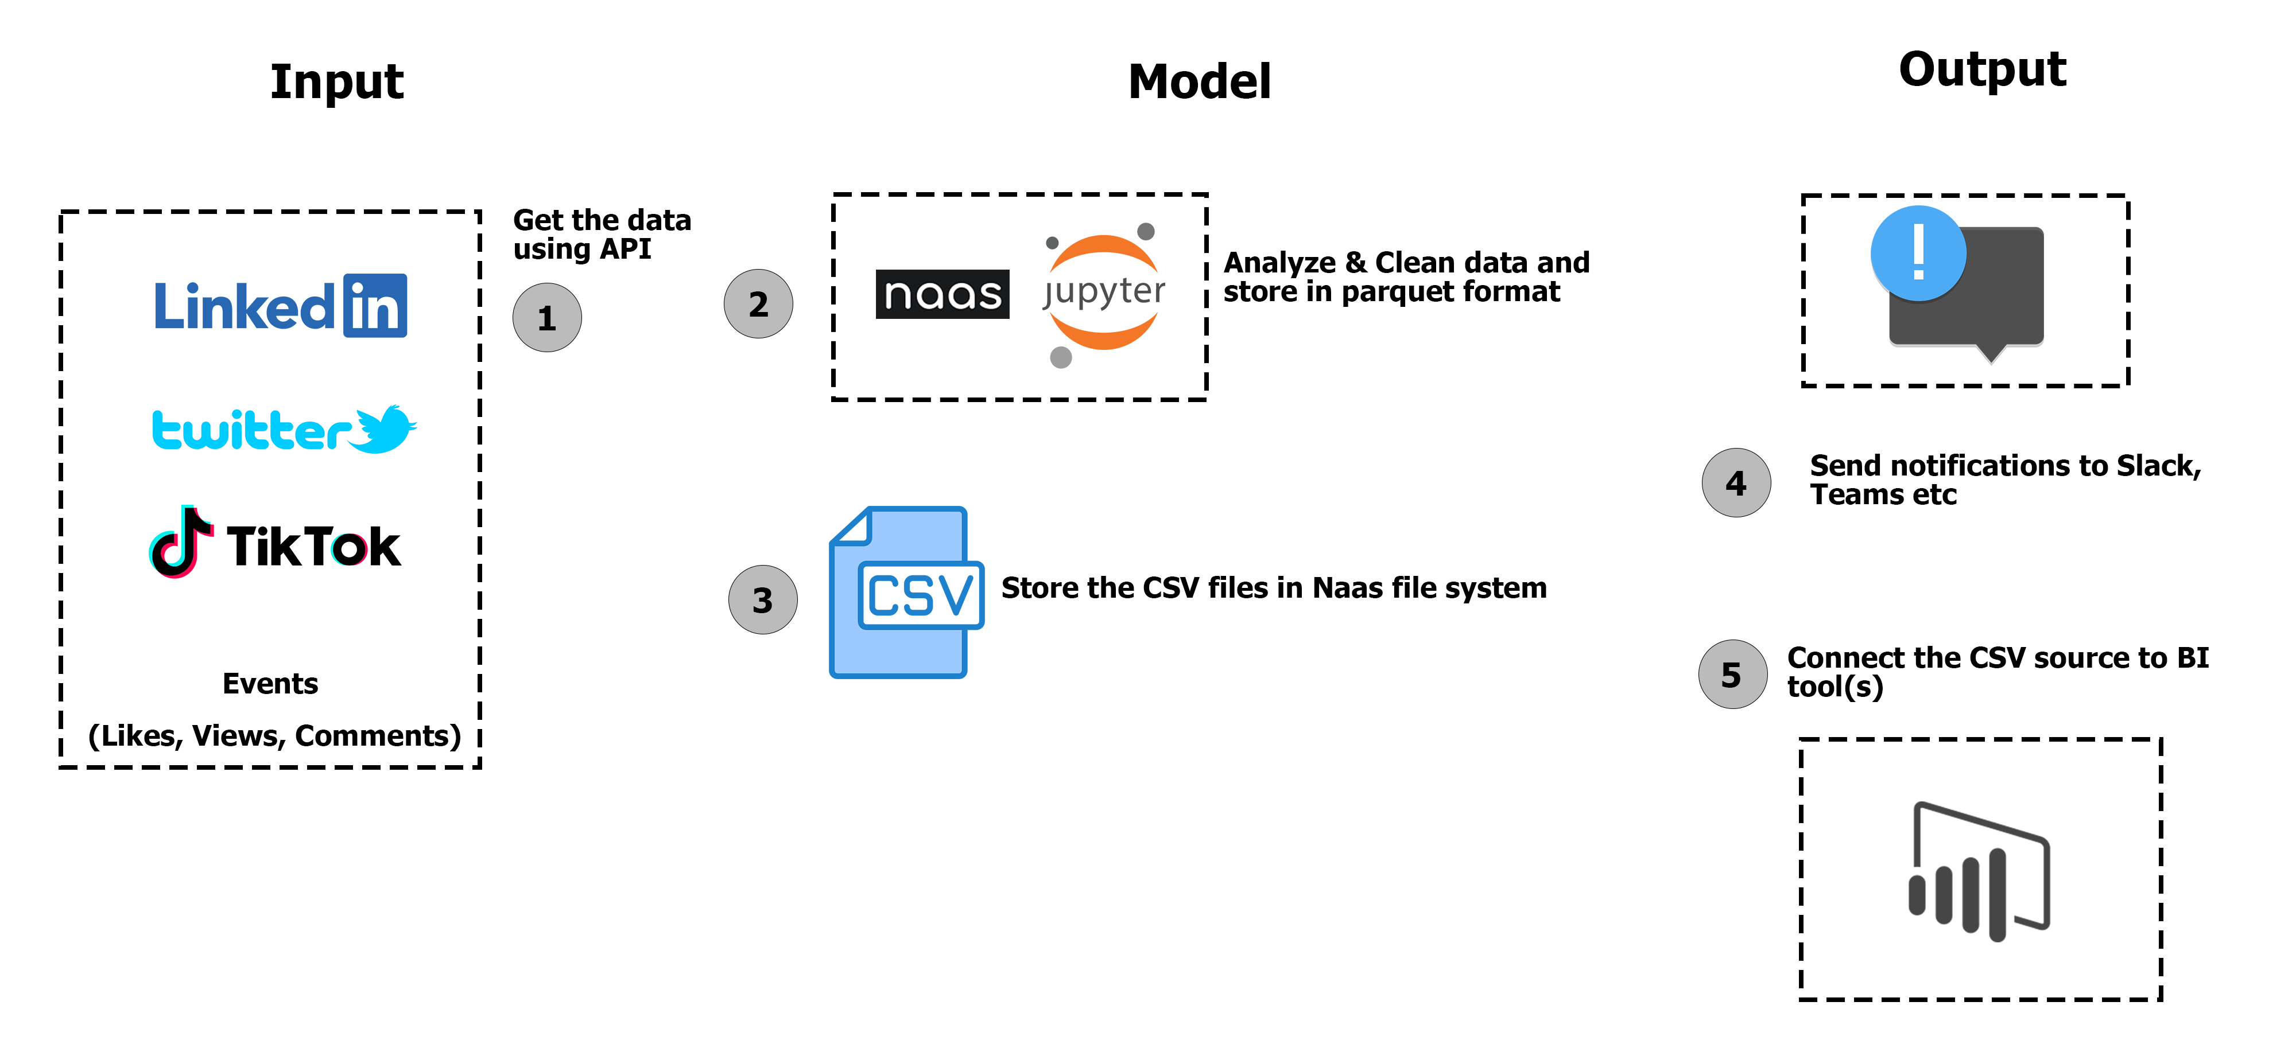
Architecture
Page 5

Slide 15
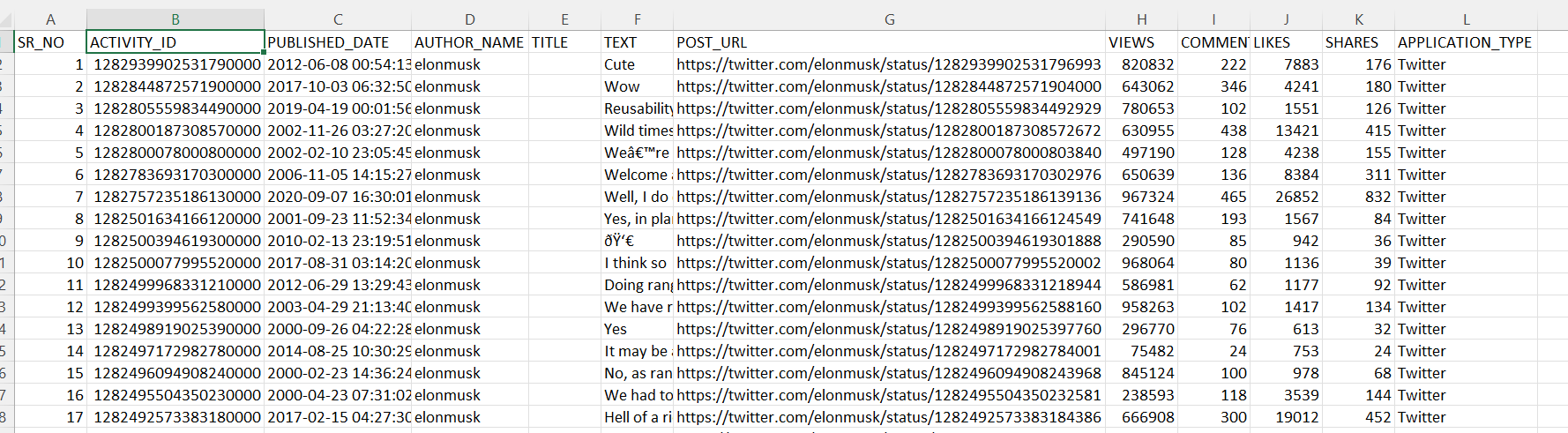
About dataset

Slide 16
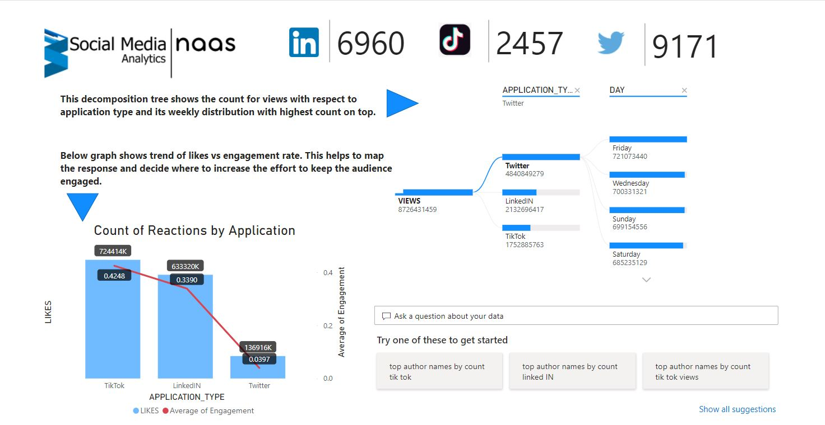
Dashboard
Page 5

Slide 17
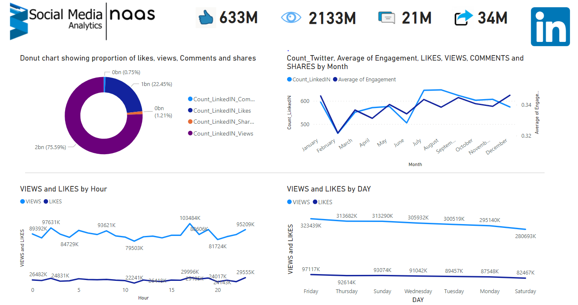
Page 5

Slide 18
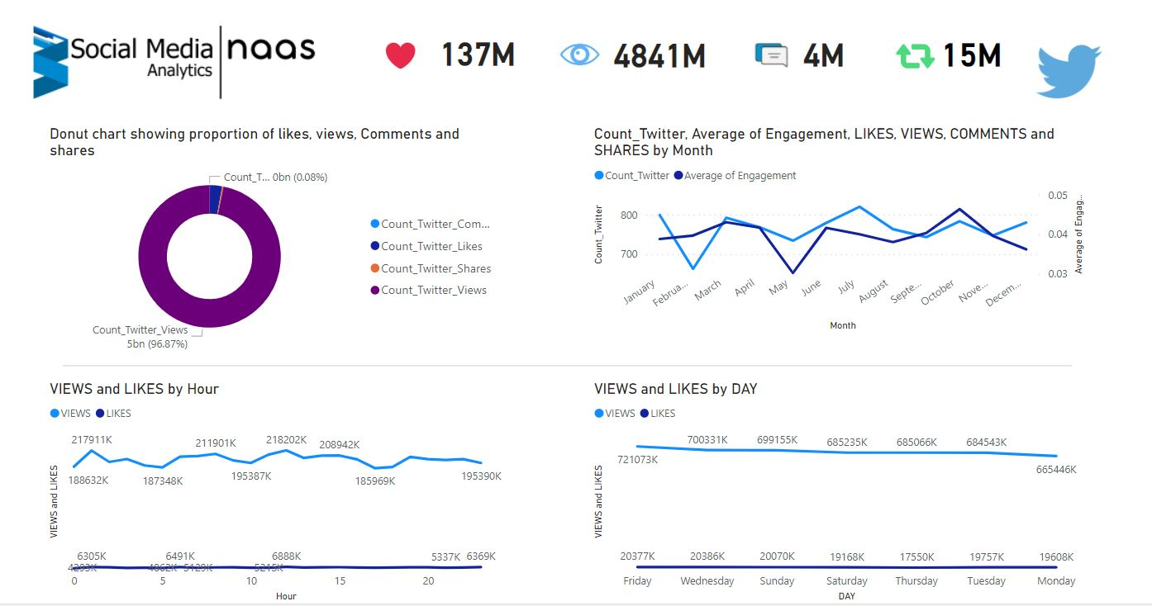
Page 5

Slide 19
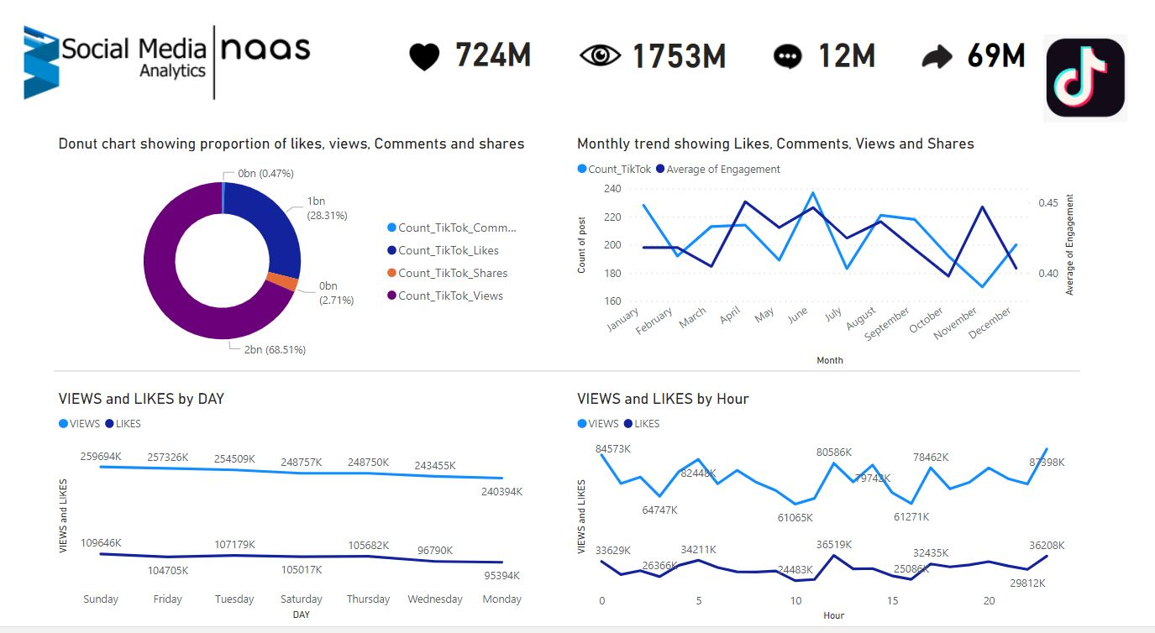
Page 5

Slide 20
Future Scope
Integration of more social media platforms
Sentiment Analysis on Text
Benefits of this model
As a result of our analysis, we can suggest which social media to focus for paid promotions. For example in our case
study, we observed it to be twitter as there is a very less overall engagement.
We also analyzed that TikTok has the most active users on sunday whereas for twitter and linkedin it is on friday which
results in more visibility. So particular days can be targeted for better reachability.
Page 5

Slide 21
Thank You
Presented By:
Megha Gupta
Alok Chilka
Riddhi Deshpande

