Slide 1
Assembly
++

Slide 2
Caloni
@
.com.br
MBR
Interrupções
Hook de API
RE Trojan
10 ANOS SEGURANÇA DA INFORMAÇÃO
SCUA INFORMATION SECURITY S/A

Slide 3
push
pop
add
push
mov
push
...
REPETIÇÃO

Slide 4
push ebp
mov ebp,esp
mov eax,dword ptr [y]
add eax,2
mov dword ptr [x],eax
mov eax,dword ptr [x]
int SimpleFunc(int y)
{
int x = 2 + y;
return x;
}
AMIGÁVEL

Slide 5
1
Gerando código assembly

Slide 6
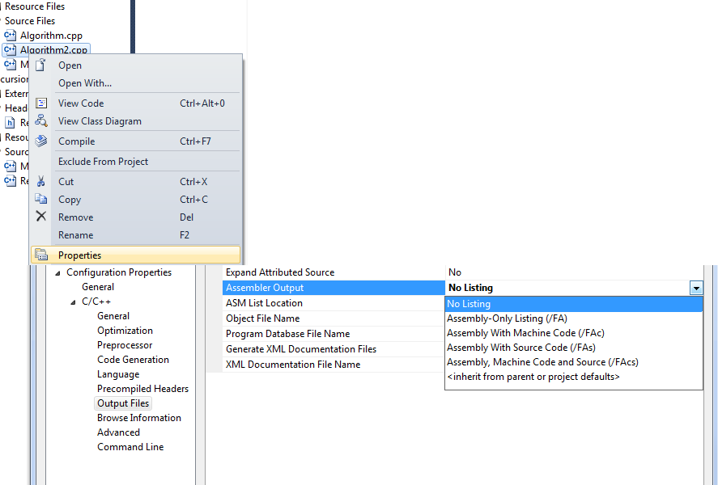
VS2010

Slide 7
WinDbg
> u
> uf sumSample

Slide 8
2
Guia Ultra-Rápido de Assembly

Slide 9
eip
esp
ecx
ebp
eax
VARIÁVEIS

Slide 10
call
push
mov
pop
ret
CÓDIGO

Slide 11
jmp
jle
jae
jge
jbe
CAIXA PRETA

Slide 12
3
Recursividade ilimitada

Slide 13
int Factorial(int n)
{
if (n > 1)
return Factorial(n - 1) * n;
else return 1;
}
003B167E cmp dword ptr [n],1
003B1682 jle Fact+3Bh (3B169Bh)
003B168B call Factorial
003B1693 imul eax,dword ptr [n]
003B169B mov eax,1
003B16B3 ret

Slide 14
int FactorialTail(int n, int a)
{
if (n < 0)
return 0;
else if (n == 0)
return 1;
else if (n == 1)
return a;
else
return
FactorialTail(n - 1, n * a);
}
ACUMULA VALOR
FINAL DA FUNÇÃO

Slide 15
int FactorialTail(int n, int a)
{
if( n < 0 )
...
return FactorialTail(n - 1, n * a);
...
}
00F91104 test ecx,ecx
00F91106 je FTail+16h (0F91116h)
00F9110D imul eax,ecx
00F91110 dec ecx
00F91111 jns FTail+4 (0F91104h)
00F9111B ret

Slide 16
4
STL aumenta performance?

Slide 17
for( size_t i = 0;
i < numbers.size();
++i )
{
sum(numbers[i]);
}
003011F7 add esi,dword ptr [edi+eax*4]
003011FA inc eax
003011FB cmp eax,ecx
003011FD jb ForSum+47h (3011F7h)

Slide 18
for_each(numbers.begin(),
numbers.end(),
Sum(total) );
00301292 add esi,dword ptr [eax]
00301294 add eax,4
00301297 cmp eax,ecx
00301299 jne FEachSum+42h (301292h)

Slide 19
5
Assembly
64 bits

Slide 20
EAX
RAX
ESP
RSP

Slide 21
r8
r15
CR
DR
TR
CONTROL
TEST
DEBUG

Slide 22
1
Assemblando
2
ASM 4 Dummies
3
GNU is Not Unix
4
STL e a Tartaruga
5
Assembly 64.0

Slide 23
Obrigado
++

Slide 24
New Coin!
WinDbg
Profiling

