Slide 1

Debug Remoto
Wanderley Caloni

Slide 2
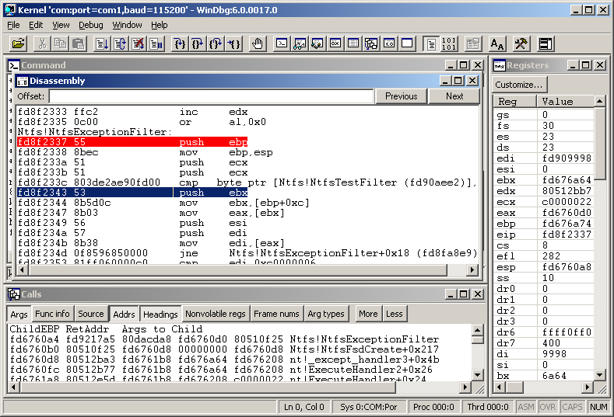
Windbg -remote tcp:server=vmw7, port=6666
.server tcp:port=6666

Slide 3

Windbg -remote tcp:server=vmw7, port=6666
WinDbg/Ntsd/Cdb -server tcp:port=6666

Slide 4
Windbg -remote tcp:server=vmw7, port=6666
dbgsrv -server tcp:port=6666

Slide 5
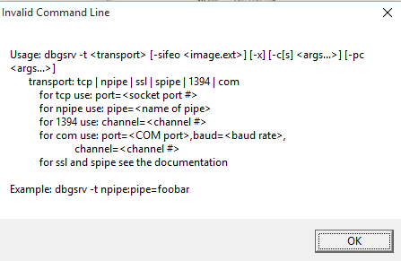
Windbg -remote tcp:server=vmw7, port=6666
dbgsrv -t tcp:port=6666

Slide 6
Windbg -premote tcp:server=vmw7, port=6666
dbgsrv -t tcp:port=6666

Slide 7
Windbg -premote tcp:server=vmw7, port=6666
.server tcp:port=6666
dbgsrv -t tcp:port=6666

Slide 8
Windbg -premote tcp:server=vmw7, port=6666
Windbg -remote tcp:server=vmw7, port=6666
.server tcp:port=6666
dbgsrv -t tcp:port=6666

Slide 9
dbengprx.exe [-p] -c tcp:server=srv,port=6666 -s tcp:port=6667
dbengprx.exe [-p] -c npipe:server=srv,pipe=NPipe -s tcp:port=6667
dbengprx.exe [-p] -c com:port=COMPort,baud=BaudRate -s tcp:port=6667
dbengprx.exe [-p] -c tcp:clicon=srv,port=666 -s tcp:port=6667

Slide 10
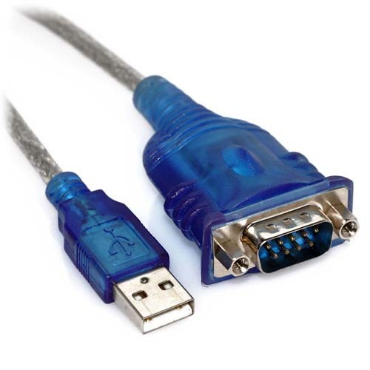

bcdedit /dbgsettings
bcdedit /copy {current}
bcdedit set debug on
windbg.exe -k com:port=1,baud=115200,resets=0,reconnect -b

Slide 11
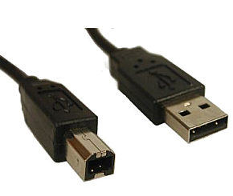
bcdedit /dbgsettings
bcdedit /copy {current}
bcdedit set debug on
windbg.exe -k usb2:targetname=USBString -b

Slide 12

windbg.exe -k com:pipe,port=\\.\pipe\com_1,resets=0,reconnect -b

Slide 13
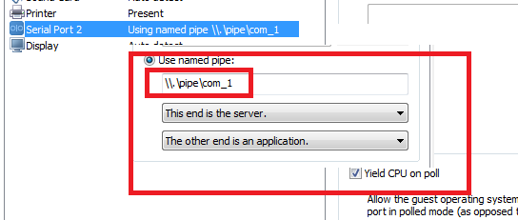
windbg.exe -k com:pipe,port=\\.\pipe\com_1,resets=0,reconnect -b

Slide 14
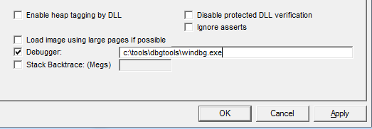
GLOBAL FLAGS

Slide 15
PROCESS
DEBUGGER
USER
KERNEL
CABLE
DEBUGGER

Slide 16
