Slide 1
Flu Outbreak in Southeast Asia
Dummy Data Example

Slide 2
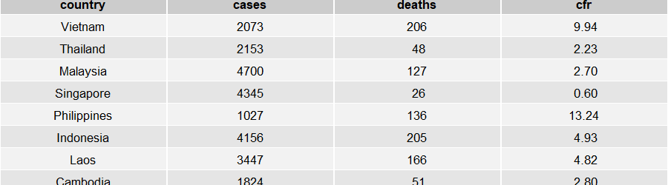
Overview of Cases and Mortality

Slide 3
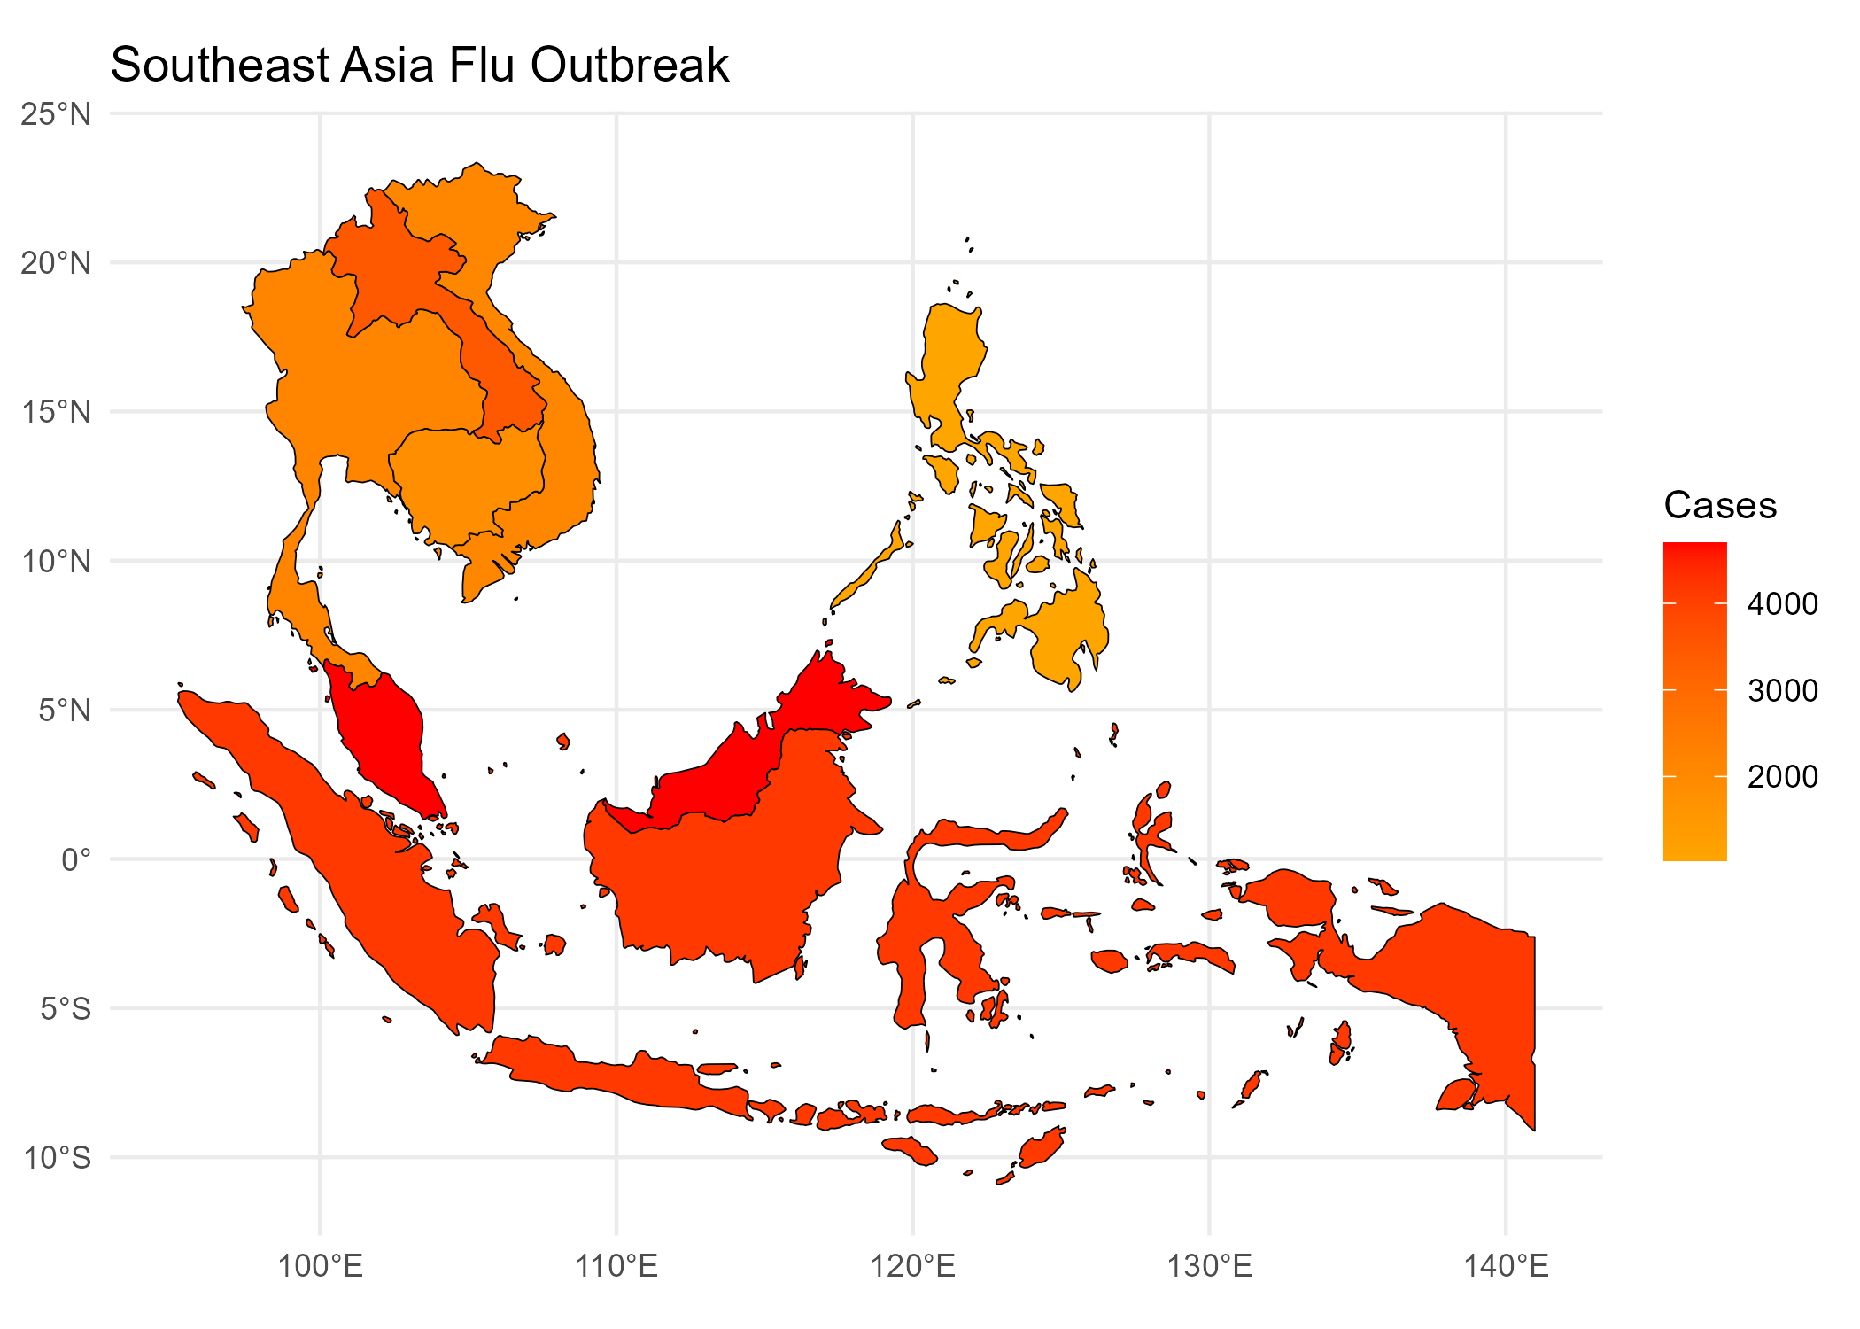
Flu Outbreak Map
Open Interactive Map

