Slide 1
Ride Sharing
TEAM 7

Slide 2
ASSUMPTIONS and Restrictions
Considered Feb 2016 NYC taxi data.
We are considering fixed source – JFK Terminals
Dynamic Queue Based Pool Window.
Dynamic Gridding.
Maximum number of Passenger is 3
User rating is randomly assigned
Simultaneous bookings is not possible

Slide 3



ALGORITHM

Slide 4
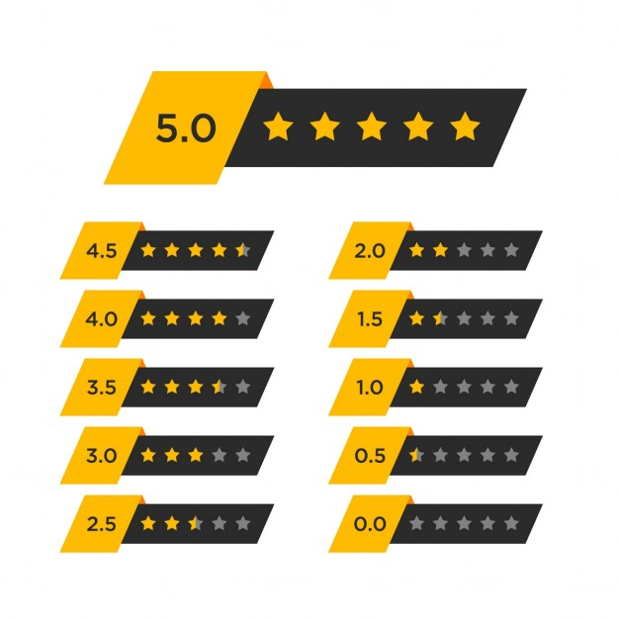


1
2
3
4

Slide 5


1
2
3
4

Slide 6
1
2
3
4

Slide 7



1
2
3
4

Slide 8


Preference?
Save Time
Save Money
Delay?
Individual Taxi
Pool window +Delay

Slide 9
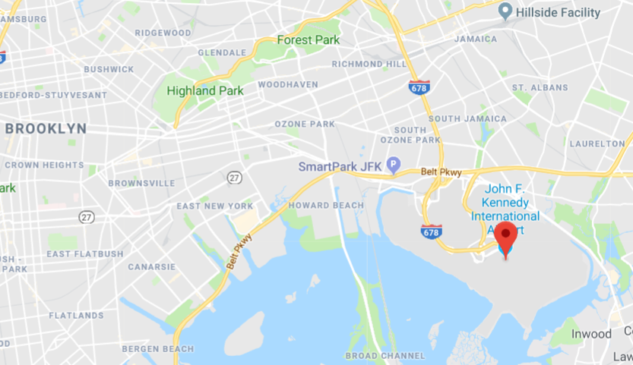
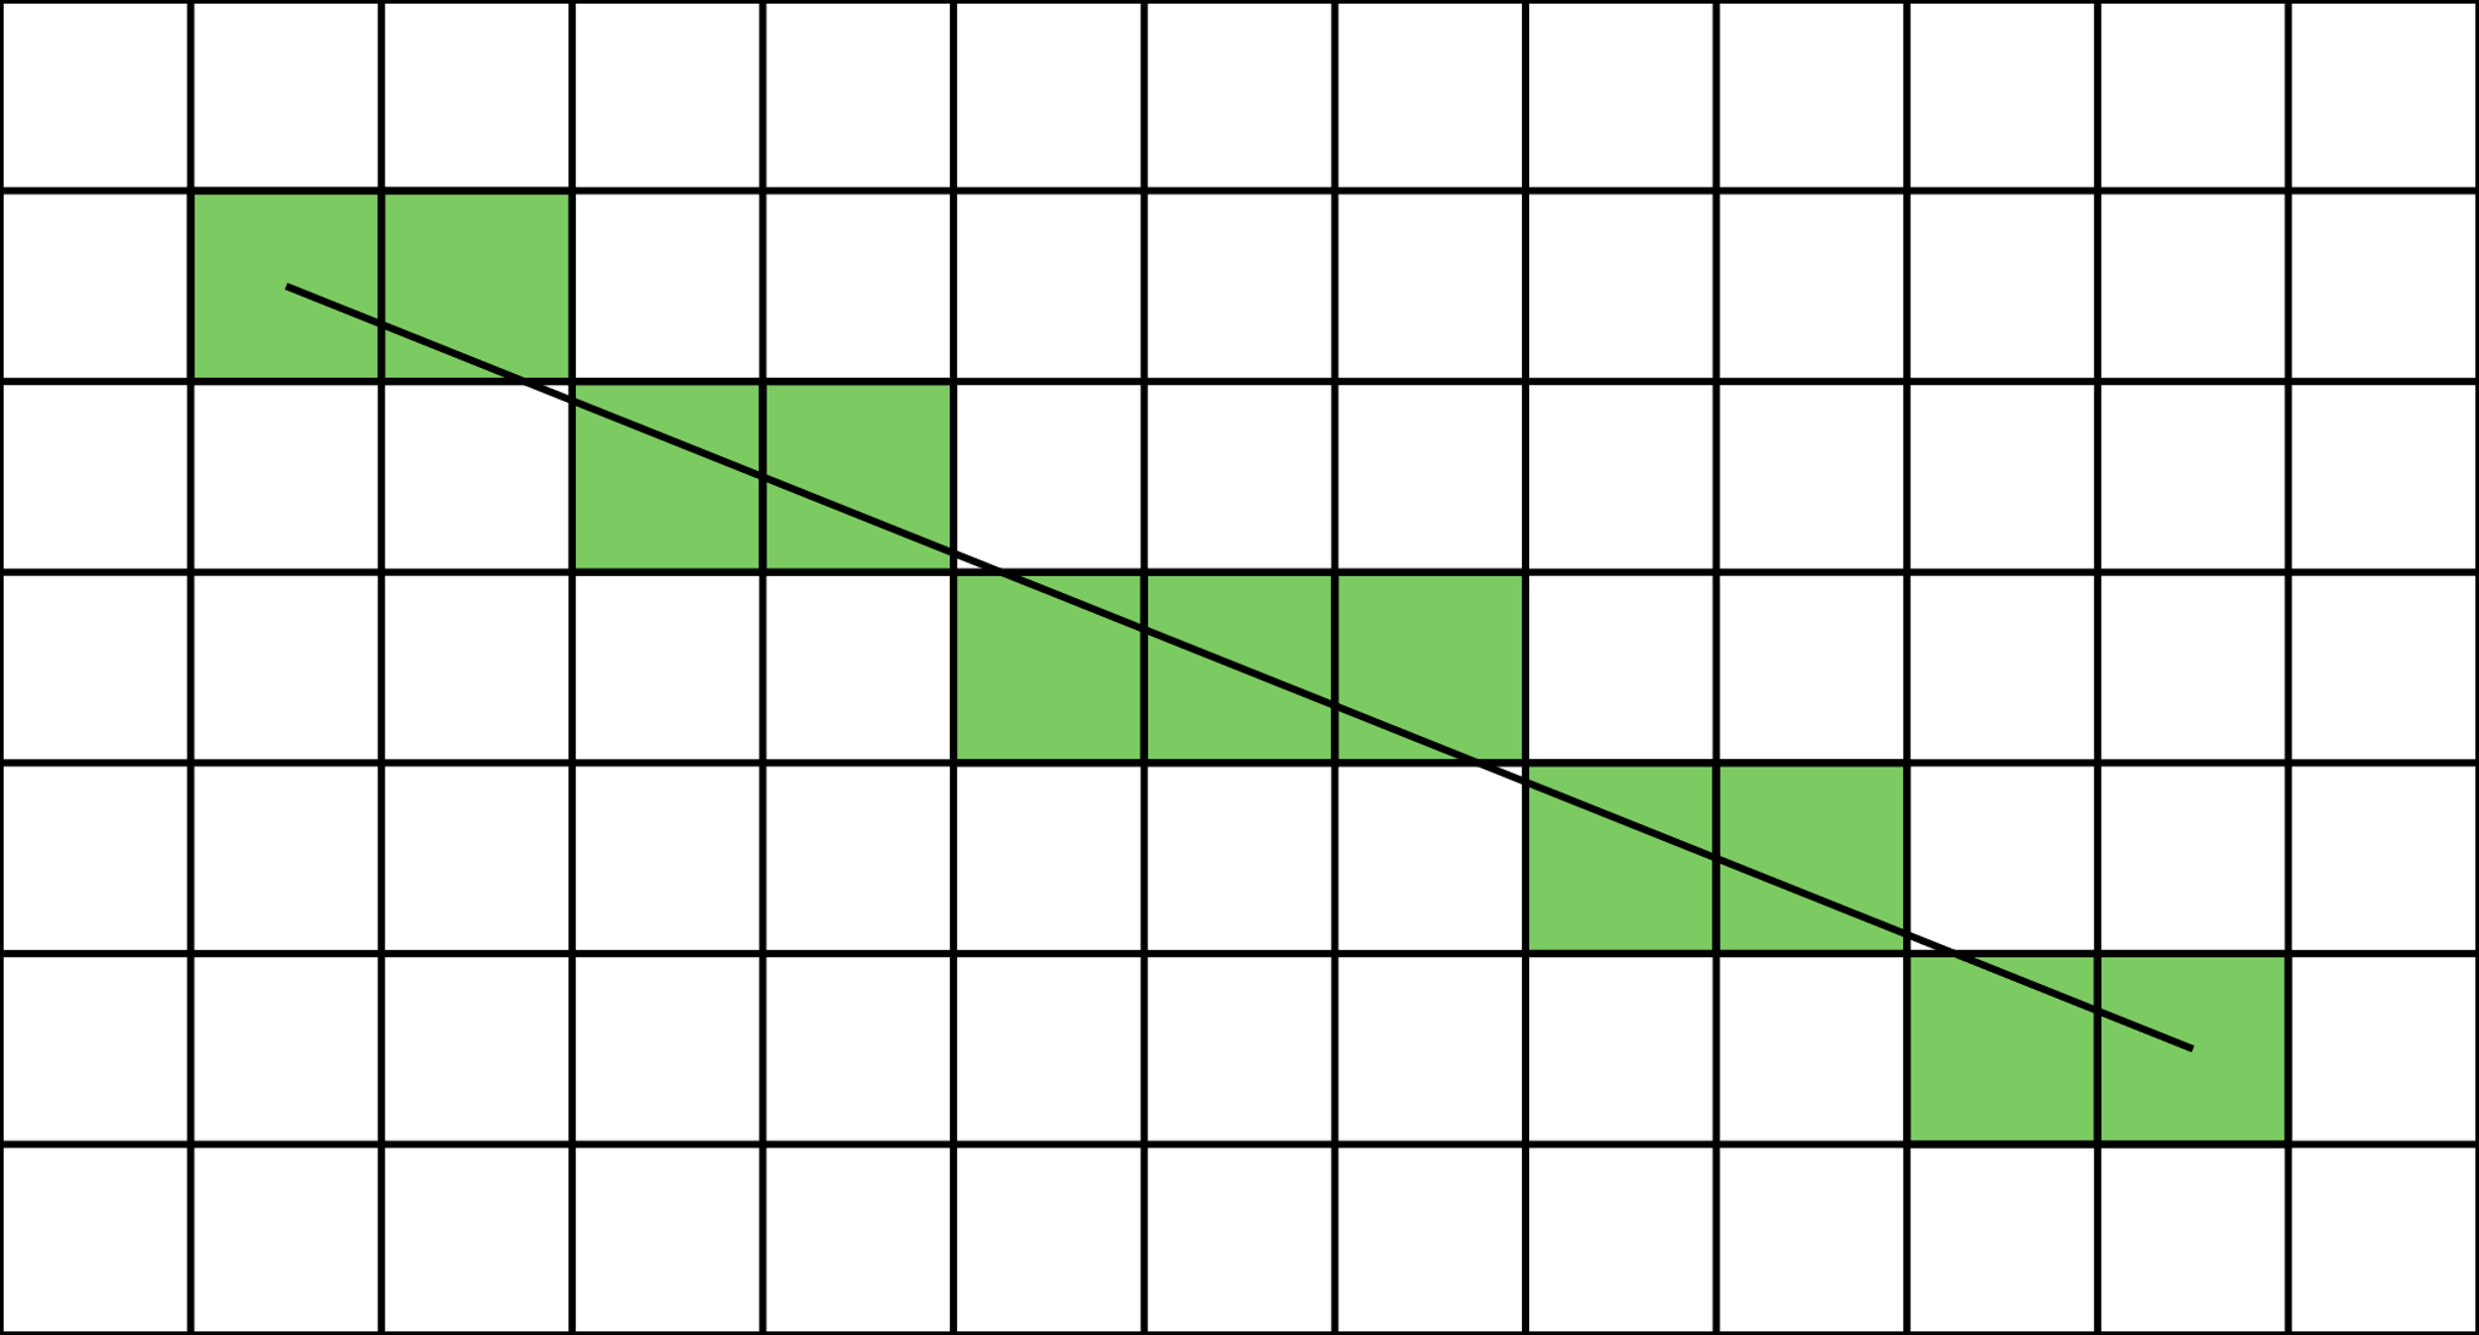
Extended Bresenham + DBSCAN clustering Algorithm
Cluster with max-user rating

Slide 10
Routing Algorithm
From the active pool determine the maximum rated customer and his preference.
If the preference is Save Time : Drop him first , get the next customer from the pool based on his rating and the distance .
If the preference is save money : Determine the optimal shortest route.

Slide 11

5000 TRIPS SPAN OF 6 DAYS

Slide 12


Slide 14
Total Trips Covered Daily

Slide 15
Total Trip Distance Covered Daily in Miles

Slide 17
Passenger Count Distribution

Slide 18

RECAP ON User Saving
Higher the rating, higher the reward.
Standard 20% saving is added by default.
If the user has “Save Money” preference they will get additional savings. Otherwise saving will go the company
If user preference is “Save Money” Applicable savings are added on top of standard saving as below
If User rating > 4.6 – 22% additional saving
If User rating > 4.3 – 12% additional saving
If User rating > 4.0 – 4% additional saving

Slide 19
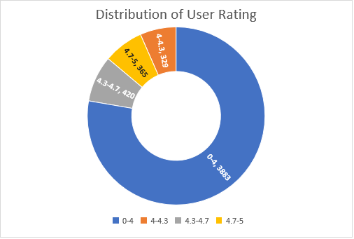
Expenditure and User RATING

Slide 20

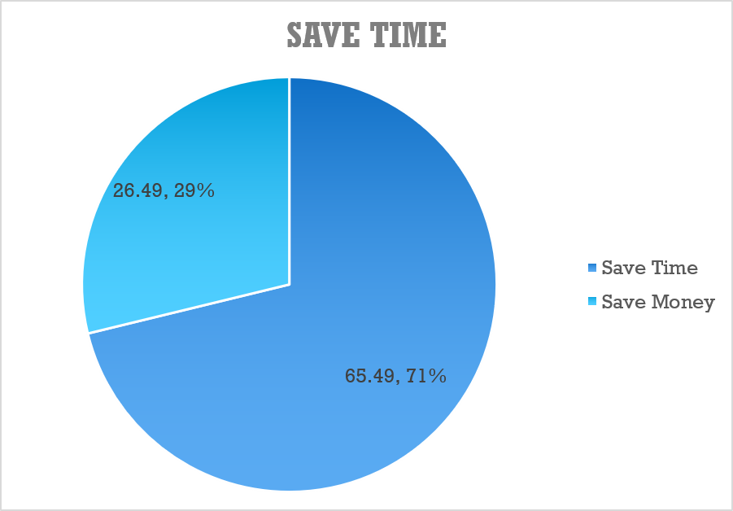
Time in Hours

Slide 21
Experiments

Slide 22
THANK YOU

