Slide 1
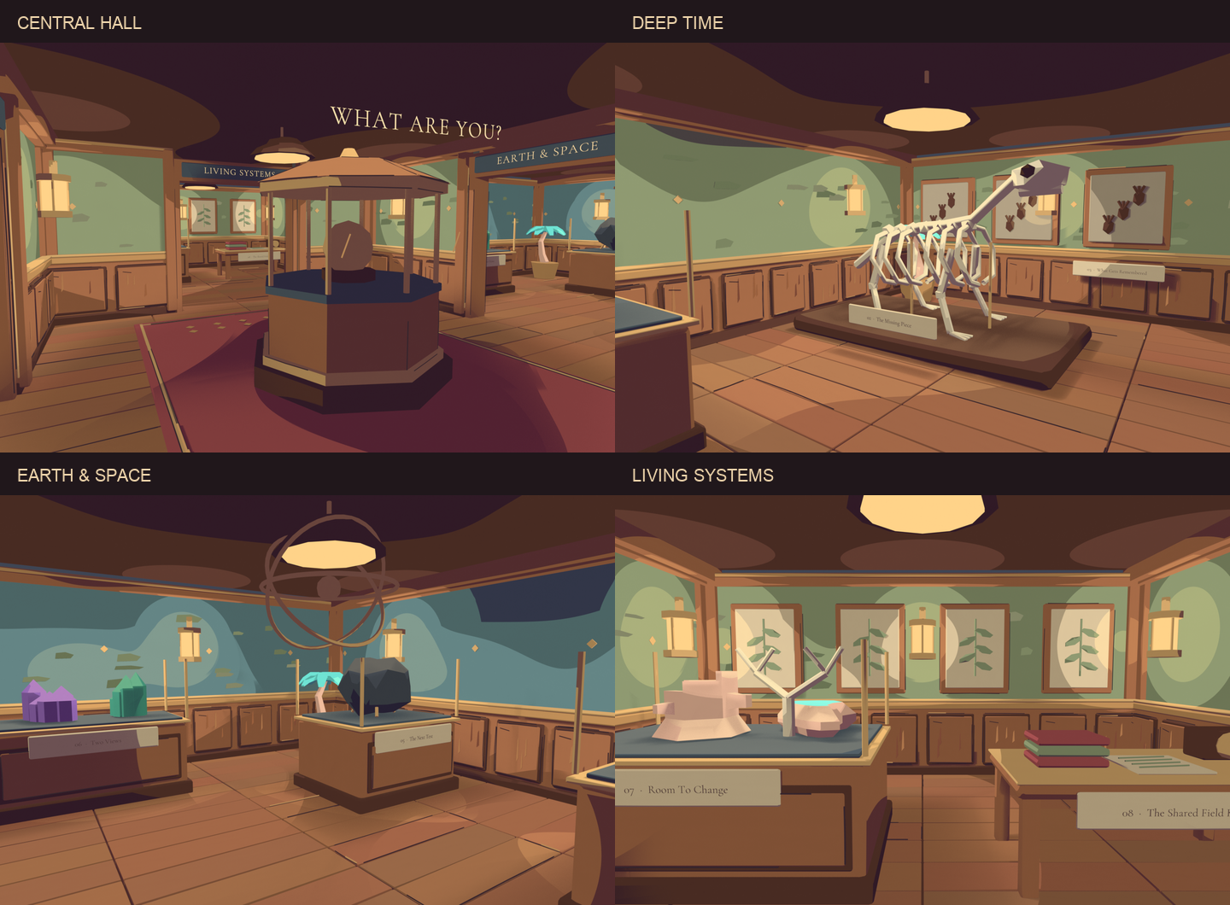
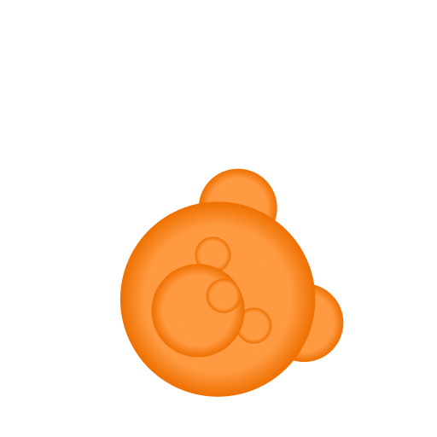
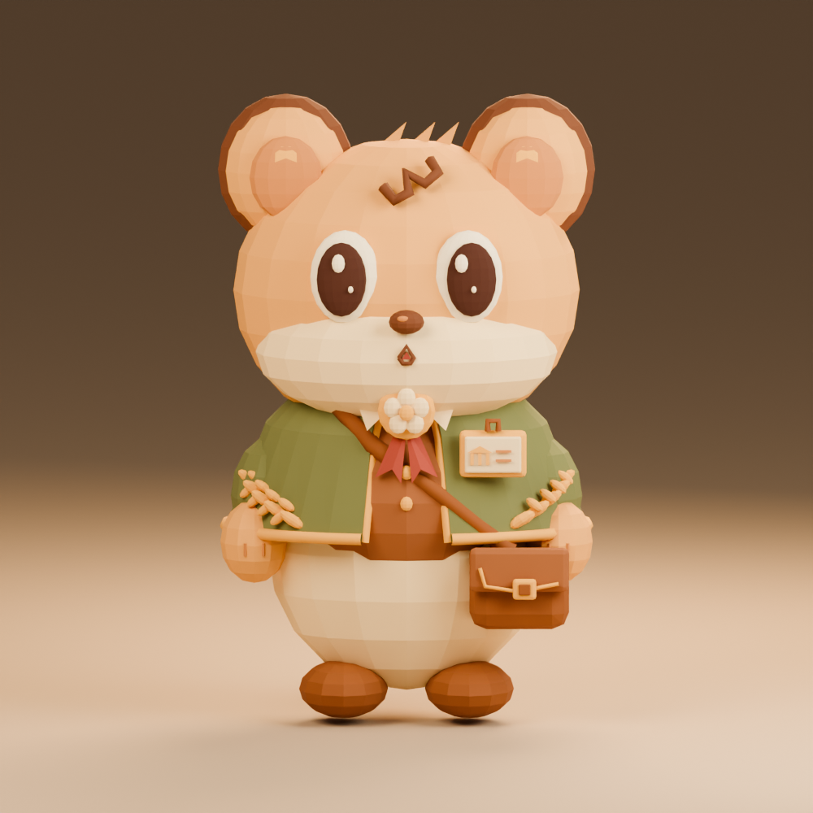
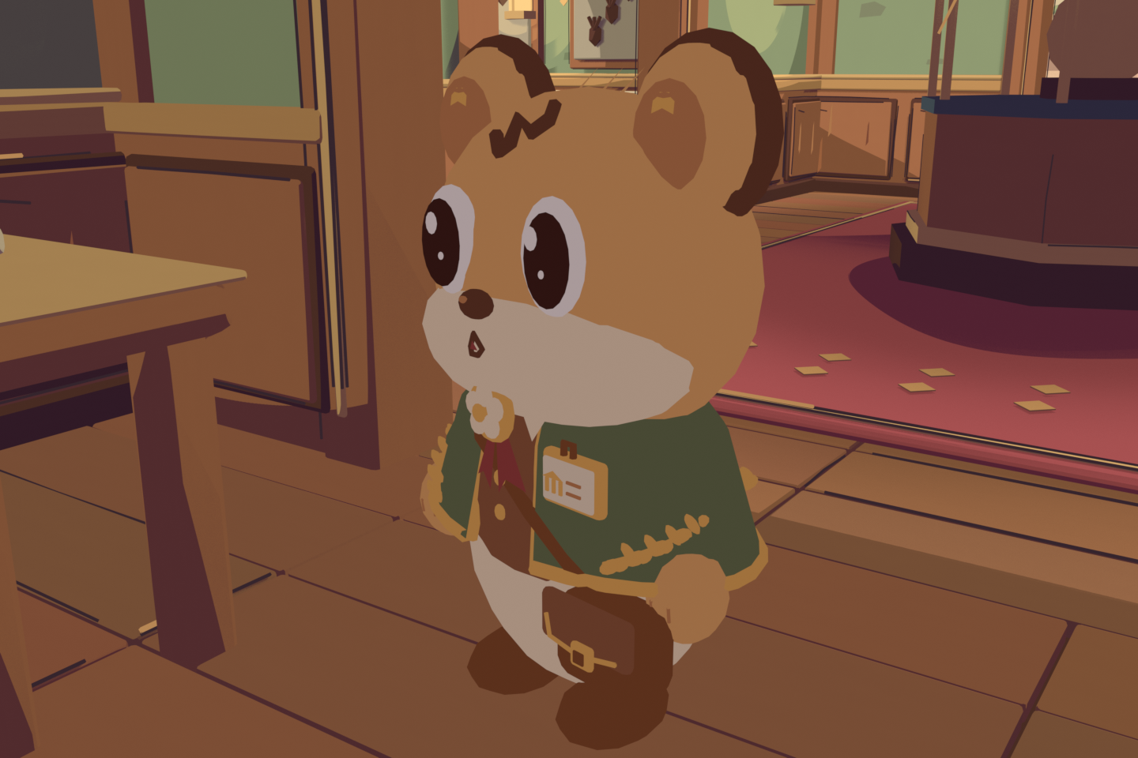
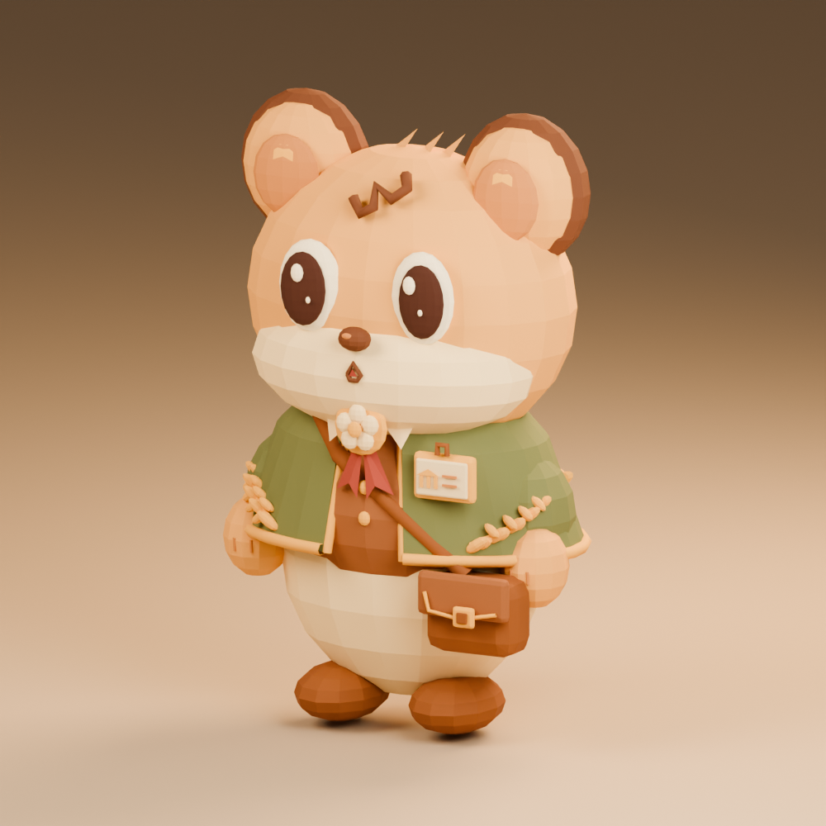
The Quiet Collection
Phillicia Lim (A0324165J)
e1527072@u.nus.edu

Slide 2
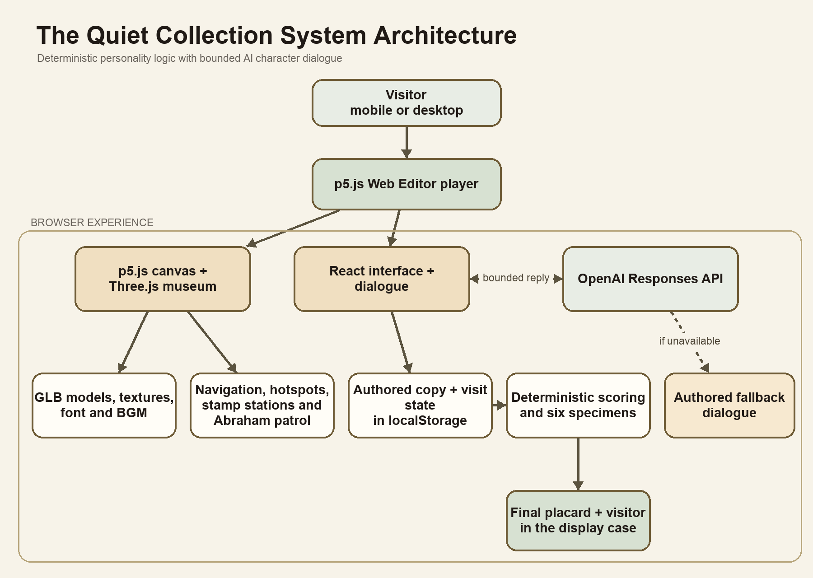
System Architecture

Slide 3
Prompts and Context
Abraham’s system prompt
• Role: a small museum administrator in a mysterious natural history museum
• Voice: warm, cute, mildly oblivious, and never technical
• Behaviour: answer briefly, remember the visit, and avoid revealing the appraisal early
• Limits: do not mention APIs, scoring logic, or claim consciousness
Context sent with each reply
• Visitor name and current location
• Completed stamp stations and selected answers
• Objects and easter eggs discovered
• Recent conversation turns
• Final specimen result, once available
The model returns only Abraham’s dialogue. Authored fallback lines keep the interaction working when the API is unavailable.

Slide 4
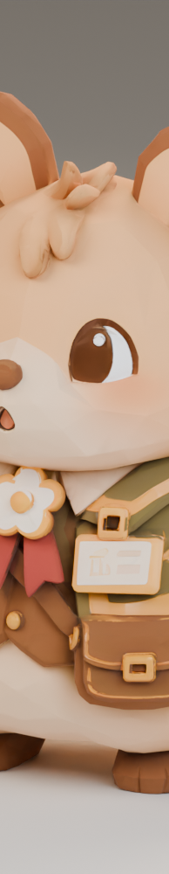
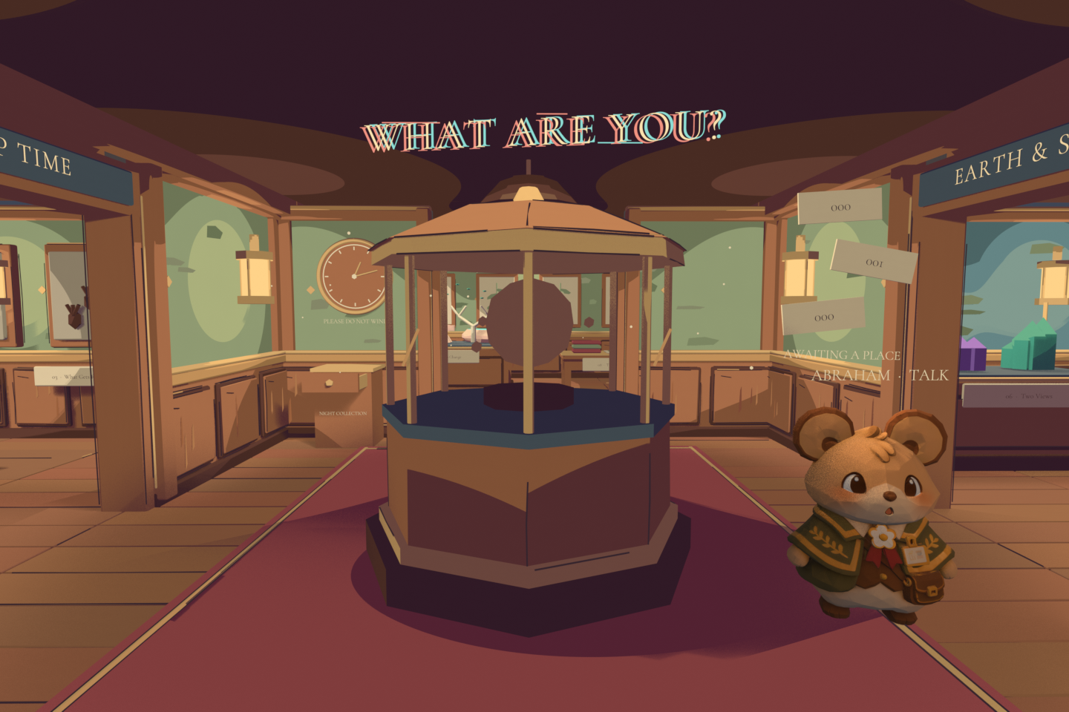
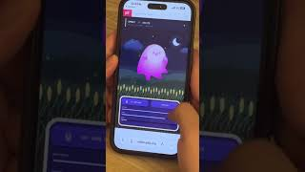
Interaction Patterns
Exploration gradually reveals the quiz
Explore with drag, pinch, zoom, and a joystick. Stamp stations reveal questions when approached.
Tap Abraham. He stops, approaches, and speaks through the dialogue layer.

Slide 5
Scoring and Result Logic
The eight stamp questions add points across four trait axes: Imagination, Control, Affiliation, and Response. Each answer changes one or more axes.
After all stations are complete, quiz.mjs compares the two strongest traits and maps the pair to one of six real specimens: paper nautilus eggcase, caddisfly case, sea bean, glass sponge skeleton, fulgurite, or starling feather.
The result never depends on the language model. Deterministic scoring keeps outcomes consistent, while Abraham’s generated text provides a personal interpretation using the visitor’s choices and conversation history.

Slide 6
Reflection
At the beginning, I treated the project as a personality quiz with a 3D setting. The idea became stronger when I reversed the relationship: the visitor is an unknown entity, Abraham is the appraiser, and the final result places the visitor inside the display case. This gave the interaction a clearer narrative purpose.
Most of the development involved balancing atmosphere with usability. Early versions used panels, labels, and instructions that made the experience feel like a form placed over a game. I gradually removed prompts, reduced camera movement, replaced movement buttons with a joystick, and allowed users to discover the stamp stations through exploration. The museum still needed guidance, but that guidance had to feel like part of the world.
Abraham changed through iteration as well. His first dialogue sounded too formal for a cute hamster. I rewrote his prompt so he could remain helpful while sounding warm, slightly oblivious, and occasionally unsettling. Keeping the quiz result deterministic also mattered. The model interprets the visit, but does not decide the specimen, which makes the experience more consistent and testable.
Building for p5.js created practical limits around 3D assets, audio upload size, and browser-held API keys. I learned to compress assets, separate authored fallbacks from live responses, and test the project on mobile as early as possible. The final project feels less like a quiz page and more like a small game that slowly reveals what it has been doing.

