Slide 1
Delhi’s Groundwater Scenario

Slide 2
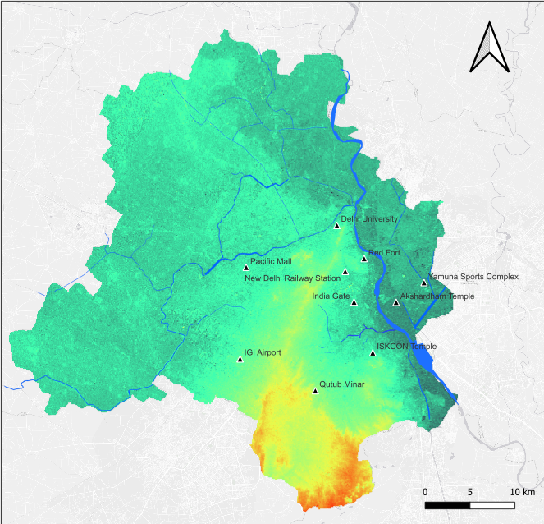
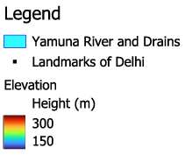

Delhi Digital Elevation Map
Nazafgarh Drain
Barapullah Nallah
340
170

Slide 3
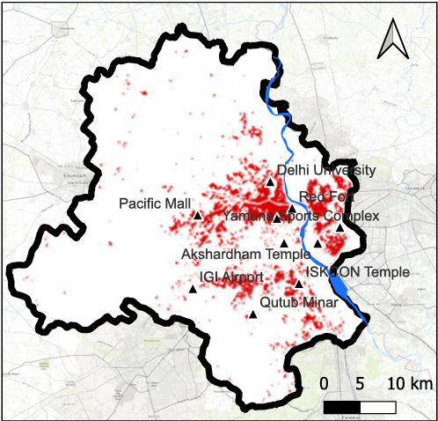
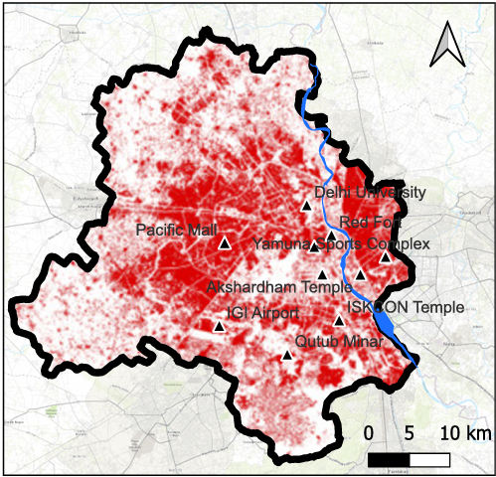
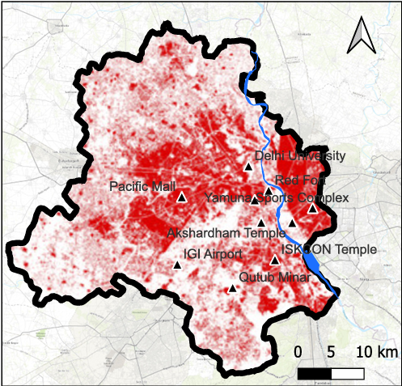
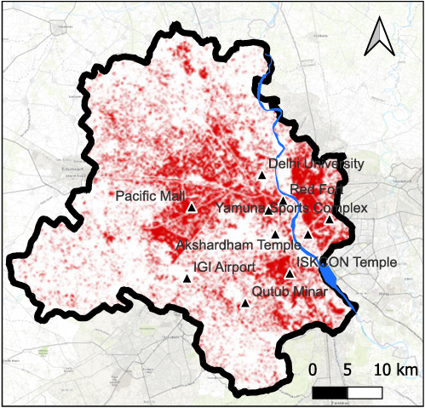
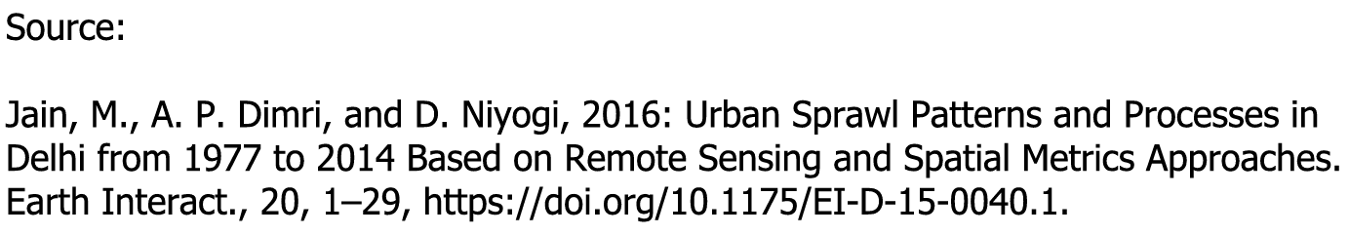
Delhi Built Up Area Growth Scenario
1977
Between 1989 and 2019, there has been an 38.24% increase in built up area as well as 5.6% decrease in forest area.
Source: Parveen, N., Siddiqui, L., Siddiqui, M.A. et al. Monitoring built-up area expansion led by industrial transformation in Delhi using geospatial techniques. Environ Sci Pollut Res 30, 106936–106950 (2023). https://doi.org/10.1007/s11356-022-23221-3
2014
2006
1993
South-West area of Delhi, including Dwarka and others, have shown the highest growth of built-up area between 2006-2014.

Slide 4
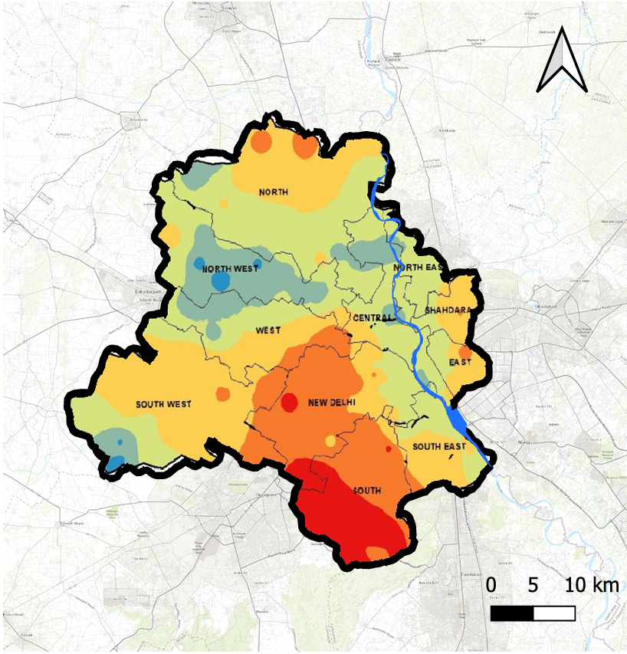
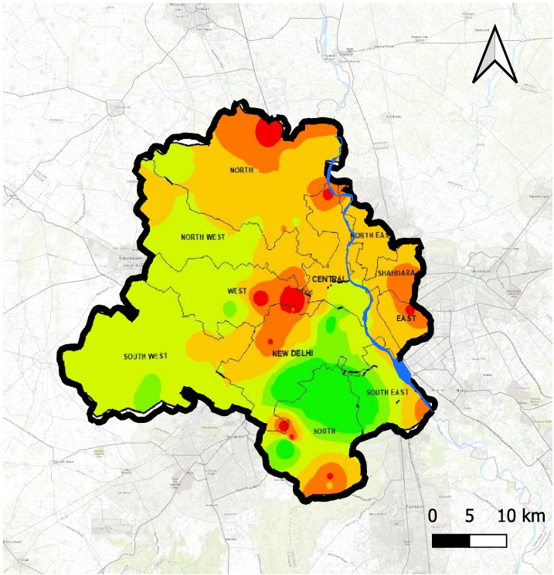
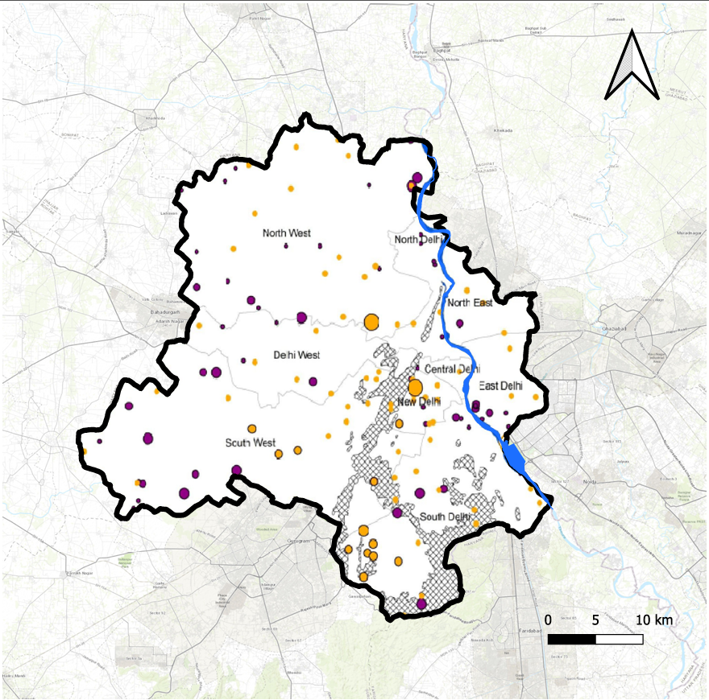
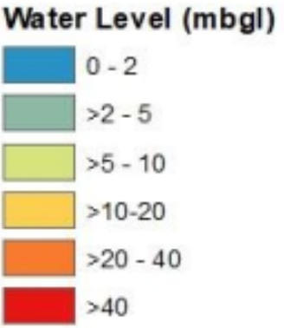
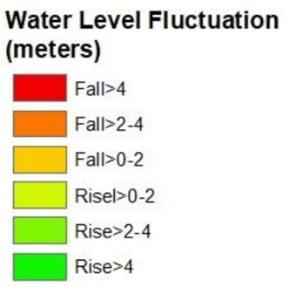
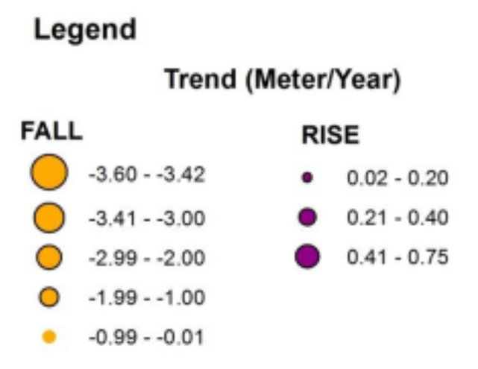
Delhi Groundwater Scenario
Source:
Master Plan of Delhi 2041
CGWB Groundwater Year Book NCT of Delhi 2021-22
NAQUIM Report on Delhi’s Shallow Aquifers
Delhi Depth to Water Level May 2021
Decadal Groundwater Fluctuation May 2011-21
Groundwater Trend 2005-14
Areas with low groundwater level: Chhatarpur, Dera Mandi, Fatehpur Beri, Aya Nagar, Kapashera, Gadaipur, Shekhawati Lines, Jaunapur
Areas with receding groundwater levels: West Patel Nagar, Baljit Nagar, Iari Colony, Pusa Institute, Tagore Garden, part of Patparganj, Jagatpur Gaon

Slide 5
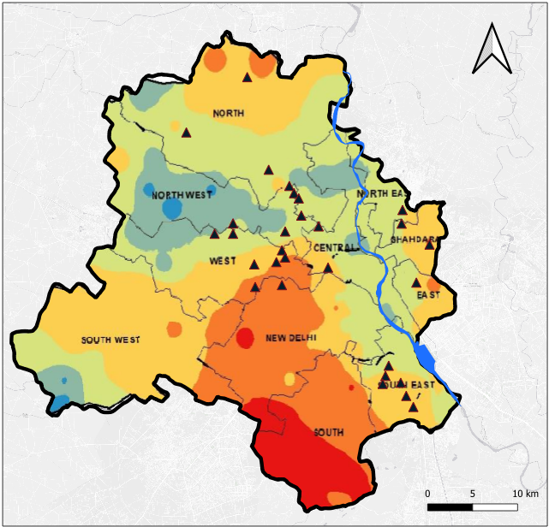
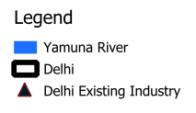
Delhi Industrial Areas
Source:
Master Plan of Delhi 2041
CGWB Report on Groundwater Quality in Shallow Aquifers of NCT of Delhi
https://www.dsiidc.org/aboutus
1. G.T. KARNAL ROAD INDUSTRIAL AREA
2. RAJASTHANI UDYOG NAGAR INDUSTRIAL AREA
3. S.M.A. INDUSTRIAL AREA
4. S.S.I. INDUSTRIAL AREA
5. WAZIRPUR INDUSTRIAL AREA
6. LAWRENCE ROAD INDUSTRIAL AREA
7. UDYOG NAGAR INDUSTRIAL AREA
8. D.S.I.I.D.C. SHEDS NANGLOI
9. MANGOL PURI INDUSTRIAL AREA
10. BADLI INDUSTRIAL AREA
11. NARELA INDUSTRIAL AREA
12. BAWANA INDUSTRIAL AREA
13. OKHLA INDUSTRIAL AREA (PH-1 & 2)
14. OKHLA INDUSTRIAL AREA (PH-3)
15. FUNCTIONAL INDUSTRIAL ESTATE FOR ELECTRONICS S-BLOCK
16. FUNCTIONAL INDUSTRIAL ESTATE FOR ELECTRONICS A-BLOCK
17. MOHAN COOPERATIVE INDUSTRIAL ESTATE
18. RANI JHASI ROAD INDUSTRIAL AREA
19. SHAHZADA BAGH INDUSTRIAL AREA
20. NARAINA INDUSTRIAL AREA (PH-1 & 2)
21. MAYAPURI INDUSTRIAL AREA (PH-1 & 2)
22. TILAK NAGAR INDUSTRIAL AREA
23. KIRTI NAGAR INDUSTRIAL AREA
24. D.L.F. INDUSTRIAL AREA
25. NAJAFGARH ROAD INDUSTRIAL AREA
26. JHILMIL INDUSTRIAL AREA
27. FRIENDS COLONY INDUSTRIAL AREA (SHAHDARA)
28. PATPAR GANJ INDUSTRIAL AREA
28. SHAHDARA INDUSTRIAL AREA

Slide 6
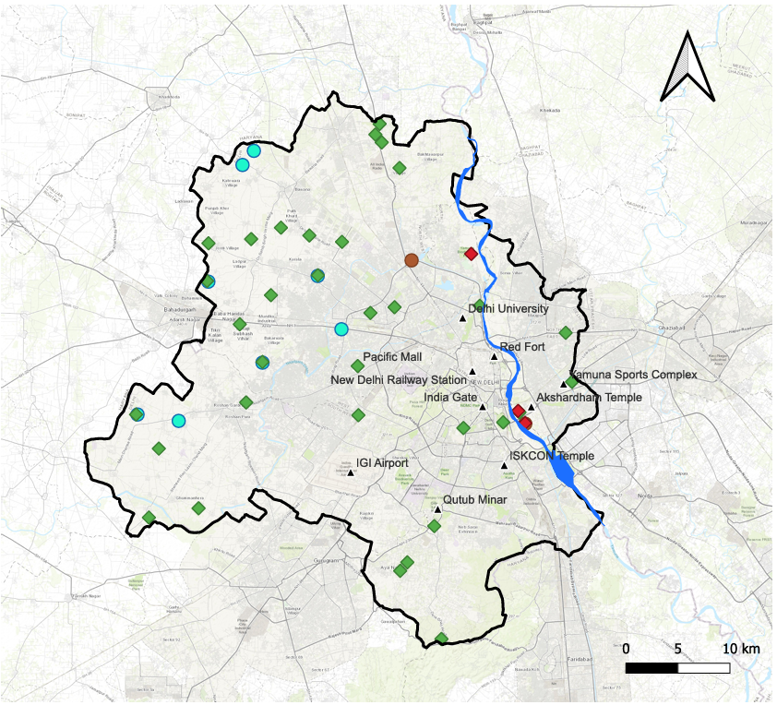
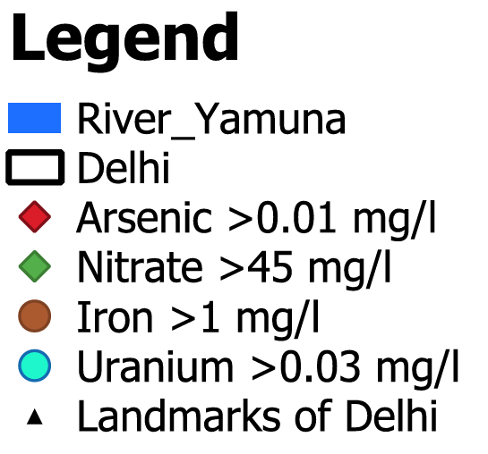
Delhi Groundwater Quality
Source:
Master Plan of Delhi 2041
CGWB Report on Groundwater Quality in Shallow Aquifers of NCT of Delhi
The locations where excess concentrations of arsenic, iron, nitrate, and uranium are present in groundwater

Slide 7
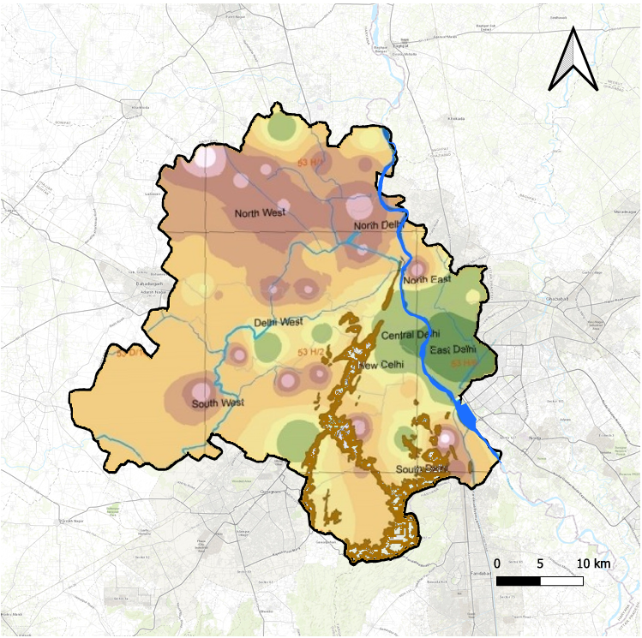
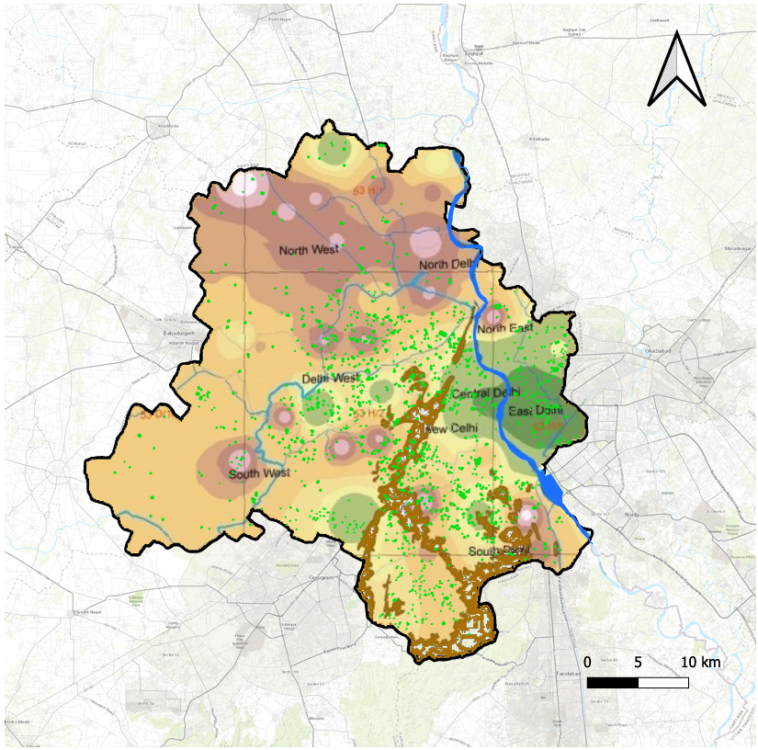
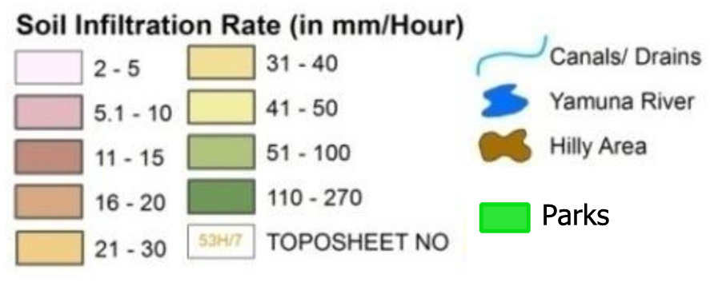
Infiltration Rate of Groundwater
Anand Vihar, Krishna Nagar, Patparganj
IGI Airport Area,
Mahipalpur
Source:
Master Plan of Delhi 2041
NAQUIM Report on Aquifer Mapping and Ground Water Management Plan of NCT Delhi

Slide 8
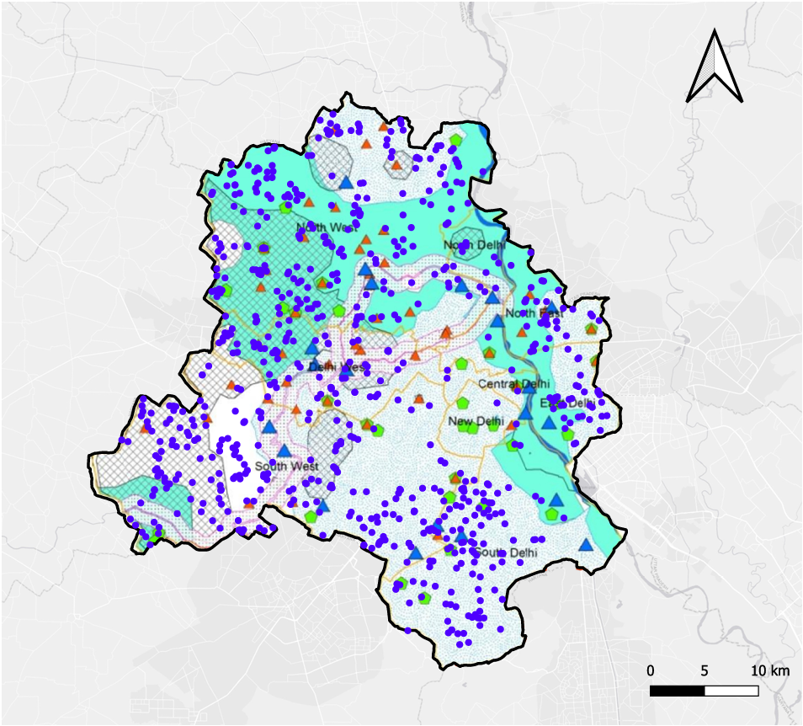
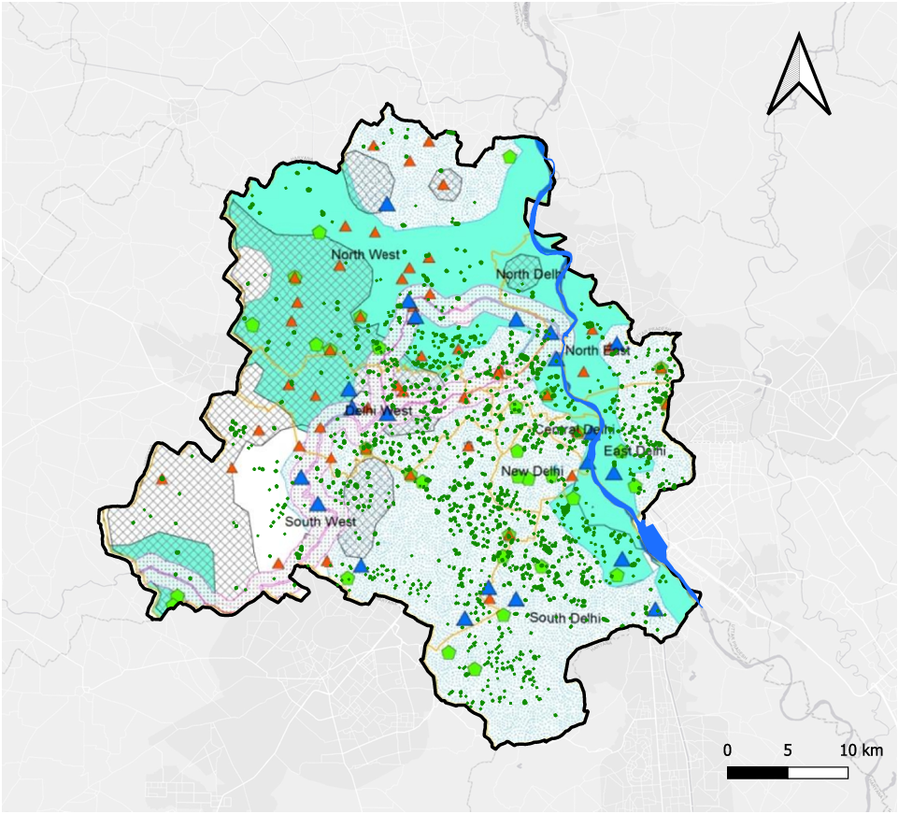
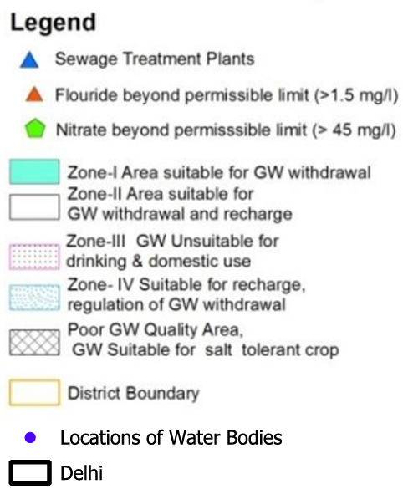

Groundwater Recharge Zones, Parks and Waterbodies
Zone IV: Narela, Bhaktawarpur Village
Parks: Smriti Van Park, Netaji Subhashchandra Park, Bhatta Park
Waterbodies: Smriti Van Park, Netaji Subhashchandra Park, Bhatta Park
Waterbodies: Najafgarh Lake
Zone II: Najafgarh, Deenpur, Roshanpura,
Shyam Vihar
Parks: Lokesh Park,
A.Kamla Park, Ajay Park, Mitron Forest Park,
Chawla Stand Park
Waterbodies: Hauz Khas Lake, Mehrauli Kishangarh Lake
Parks: Lodhi Garden,
Asola Wildlife Sanctuary, Garden of Five Senses, Sanjay Van, Nehru Park, Deer Park, Jahanpanah City Park, Hauz Khas District Park
Zone IV: Most parts of South and New Delhi suitable for recharge
Source:
Master Plan of Delhi 2041
NAQUIM Report on Aquifer Mapping and Ground Water Management Plan of NCT Delhi

