Slide 1
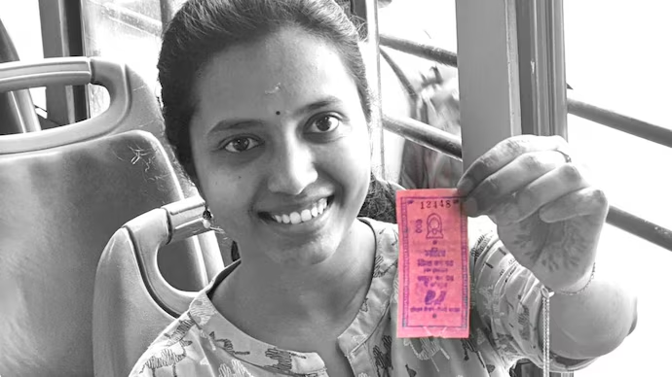
Sharanya Sahu
‘Pink Pass’:
Free Bus Scheme for Women in Delhi, India
Image Source: India Today newspaper
Notes:
Image Source: https://www.indiatoday.in/cities/delhi/story/pink-passes-in-delhi-buses-touch-100-crore-mark-2336307-2023-02-18

Slide 2
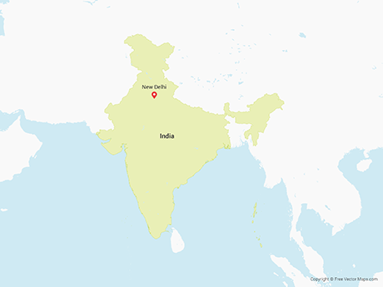
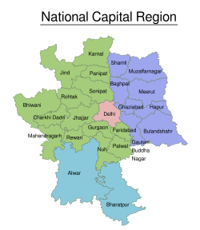
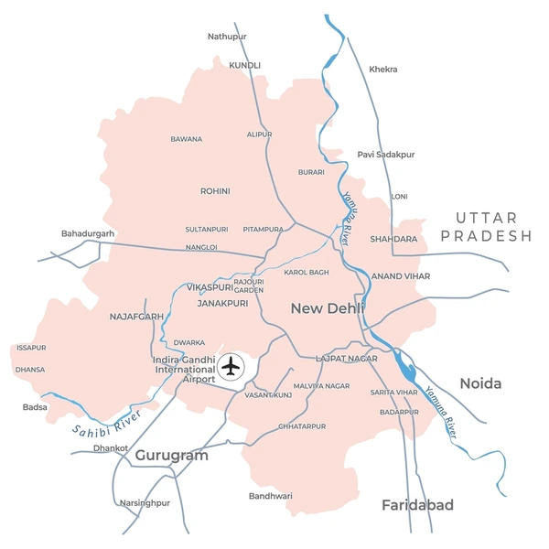
Delhi
Capital city/state of India with population 16 million + (2011), projected 26 million + in 2036
National Capital Region with a population of 49 million + (2011)
The city covers 1500 sq. km, consisting of 11 districts
Sex ratio: 0.86 (2011)
2022 -23 Worker Population Ratio (WPR): 56.0% for male population, 11.1% for female population
Image sources: Free vector maps, Wikimedia Commons, Shutterstock
Notes:
Image sources:
https://www.google.com/url?sa=i&url=https%3A%2F%2Ffreevectormaps.com%2Fsearch%3Fq%3DNew%2520Delhi%26ref%3Dtag&psig=AOvVaw1NN2nWZn8ew0Iej5XK6Isg&ust=1763595361110000&source=images&cd=vfe&opi=89978449&ved=0CBYQjhxqFwoTCMCPt-Pv_JADFQAAAAAdAAAAABAL https://www.google.com/url?sa=i&url=https%3A%2F%2Fcommons.wikimedia.org%2Fwiki%2FFile%3ANational_Capital_Region_%2528India%2529.svg&psig=AOvVaw24DsdKBHiDxfpJAjfeKdCD&ust=1763595469460000&source=images&cd=vfe&opi=89978449&ved=0CBkQjhxqFwoTCMDxiaLv_JADFQAAAAAdAAAAABAL
https://www.google.com/url?sa=i&url=https%3A%2F%2Fwww.shutterstock.com%2Fsearch%2Fdelhi-city-map%3Fimage_type%3Dillustration&psig=AOvVaw2a81vvvaS4lTuM-4oNbKz9&ust=1763595813274000&source=images&cd=vfe&opi=89978449&ved=0CBkQjhxqGAoTCMDezcLw_JADFQAAAAAdAAAAABDZAQ
Information Sources:
https://web.archive.org/web/20160406160207/http://ncrpb.nic.in/pdf_files/Annual%20Report%202014-15.pdf
https://delhiplanning.delhi.gov.in/sites/default/files/Planning/ch._19_demographic_profile.pdf
https://des.delhi.gov.in/sites/default/files/inline-files/women_and_men_in_delhi_2024.pdf

Slide 3
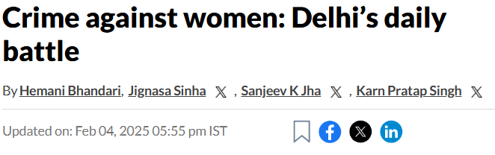
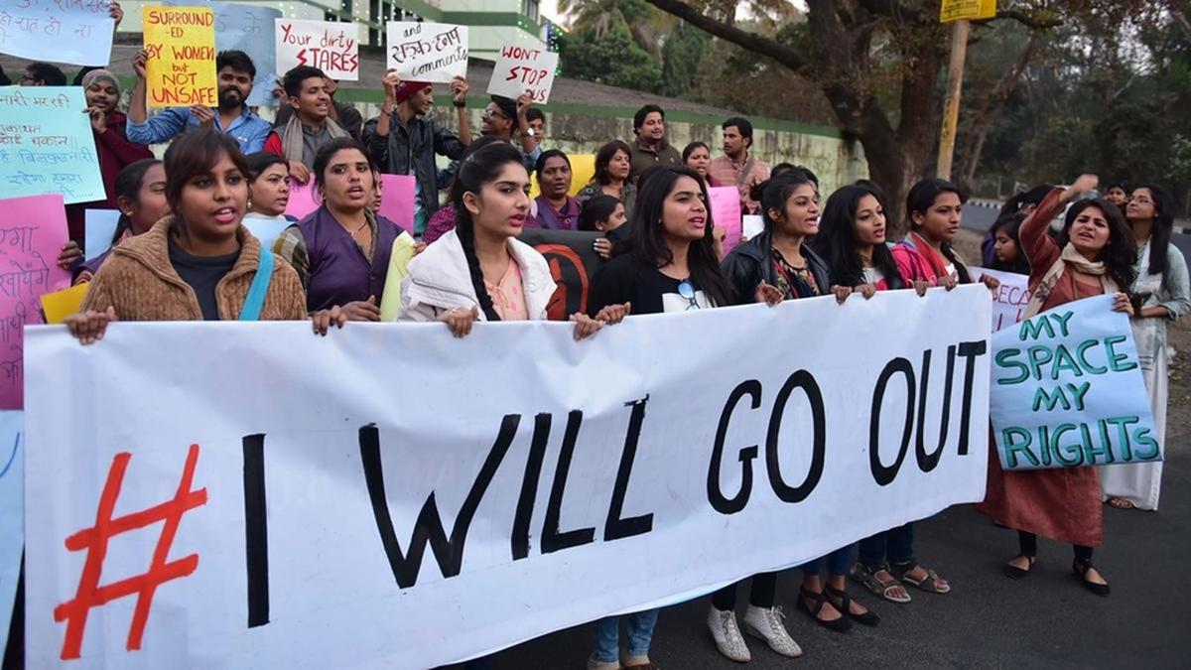
Women’s Safety: A Major Concern
Over 70% of women feel unsafe in public spaces
Delhi records over 1500 cases of gendered violence every year
“For women in the Capital, the concept of safety remains not just a pipe dream, but a concept that many have long given up hope on.”
Hindustan Times, 2025
Image source: The Hindu
Notes:
https://www.hindustantimes.com/cities/delhi-news/delhis-everyday-battle-in-continuation-since-decades-101738671925303.html
“For women in the Capital, the concept of safety remains not just a pipe dream, but a concept that many have long given up hope on.”
https://www.thehindu.com/news/cities/Delhi/poor-nari-ranking-exposes-women-safety-gaps-in-delhi/article70023648.ece
Women’s access and safety in transportation is a major concern.
https://politicalsampark.com/womens-safety-and-empowerment-a-key-election-issue-in-delhi/

Slide 4
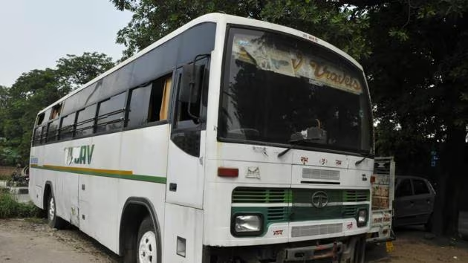
A woman, Jyoti Singh, was fatally assaulted on this bus.
She was determined to bring the perpetrators to justice, supplying details to police until her demise. She was posthumously nicknamed ‘Nirbhaya’, or the one with no fear.
Her story snowballed into massive public outrage and indignation.
The issue exploded in 2012, becoming a matter of national outrage.
Image Source: Hindustan Times
Notes:
https://timesofindia.indiatimes.com/india/what-is-nirbhaya-case/articleshow/72868430.cms
Image source: https://www.hindustantimes.com/delhi/2012-delhi-gang-rape-verdict-she-survived-13-days-because-she-was-tough-says-doctor-who-treated-victim/story-KTTn0TkHZaIkyODmg38n5M.html

Slide 5
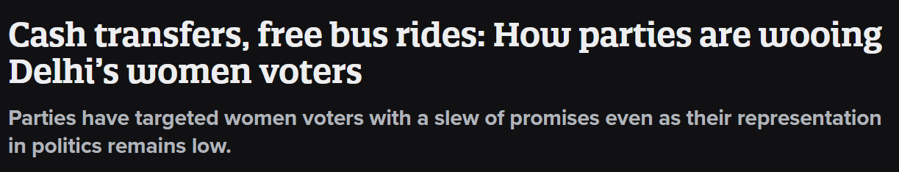
Women’s safety is a highly politicized and emotionally resonant issue in Delhi. It remains a major public concern.
Notes:
Image source: https://www.newslaundry.com/2025/01/20/cash-transfers-free-bus-rides-how-parties-are-wooing-delhis-women-voters

Slide 6
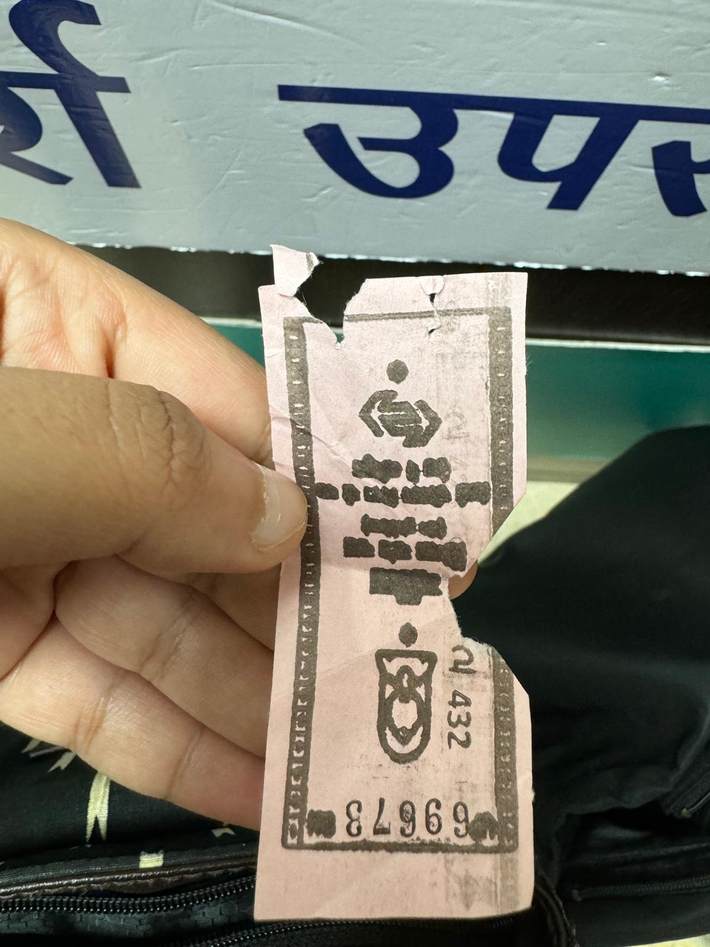
Image Source: Sharanya Sahu
Policy Response: Making Public Transit Accessible to Gender Minorities
Delhi Transportation Commission (DTC) and Delhi Integrated Multi-Modal Transport System (DMITS) buses
Since 2019, women and transgender people ride for free
1.4 million+ people use it every day
Notes:
https://www.ndtv.com/india-news/pink-tickets-out-aadhaar-linked-pass-for-delhi-womens-free-bus-rides-8897156
https://dp.ashoka.edu.in/ash/wpaper/paper105_0.pdf

Slide 7
1 billion tickets issued by 2024
1/4 women now using buses has started using buses after the bus travel was made fare-free
75% of women spending less on transportation
Inspired similar policies in other states (Kerala, Karnataka, Tamil Nadu)
24% increase in paid employment of women in economically marginalized groups
Impact
Notes:
https://www.greenpeace.org/static/planet4-india-stateless/2024/10/c293ab29-riding-the-justice-route-1-compressed.pdf
https://www.ideasforindia.in/topics/social-identity/fighting-gender-inequality-through-mobility-assessing-delhi-s-pink-ticket-scheme.html

Slide 8
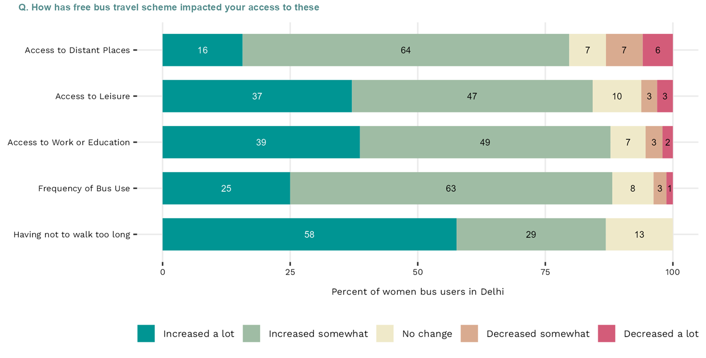
Impact
Source: ideasforindia.in
Notes:
https://www.greenpeace.org/static/planet4-india-stateless/2024/10/c293ab29-riding-the-justice-route-1-compressed.pdf
https://www.ideasforindia.in/topics/social-identity/fighting-gender-inequality-through-mobility-assessing-delhi-s-pink-ticket-scheme.html

Slide 9
What else is desired?
More women bus staff and reserved seating
Better lighting and surveillance cameras at stop
Improved stop infrastructure - better shelters to protect people from the rain
Improving reliability of the service during peak and late hours
Notes:
https://www.greenpeace.org/static/planet4-india-stateless/2024/10/c293ab29-riding-the-justice-route-1-compressed.pdf

Slide 10
Women in Delhi, particularly women from caste-oppressed, migrant, and working-class backgrounds, have long been excluded from public space, transit, and employment.
Availability of public space and amenities isn’t enough, actively promoting the visibility of othered groups in public can tangibly reduce historic inequities.

