Slide 1
Project Architecture

Slide 2
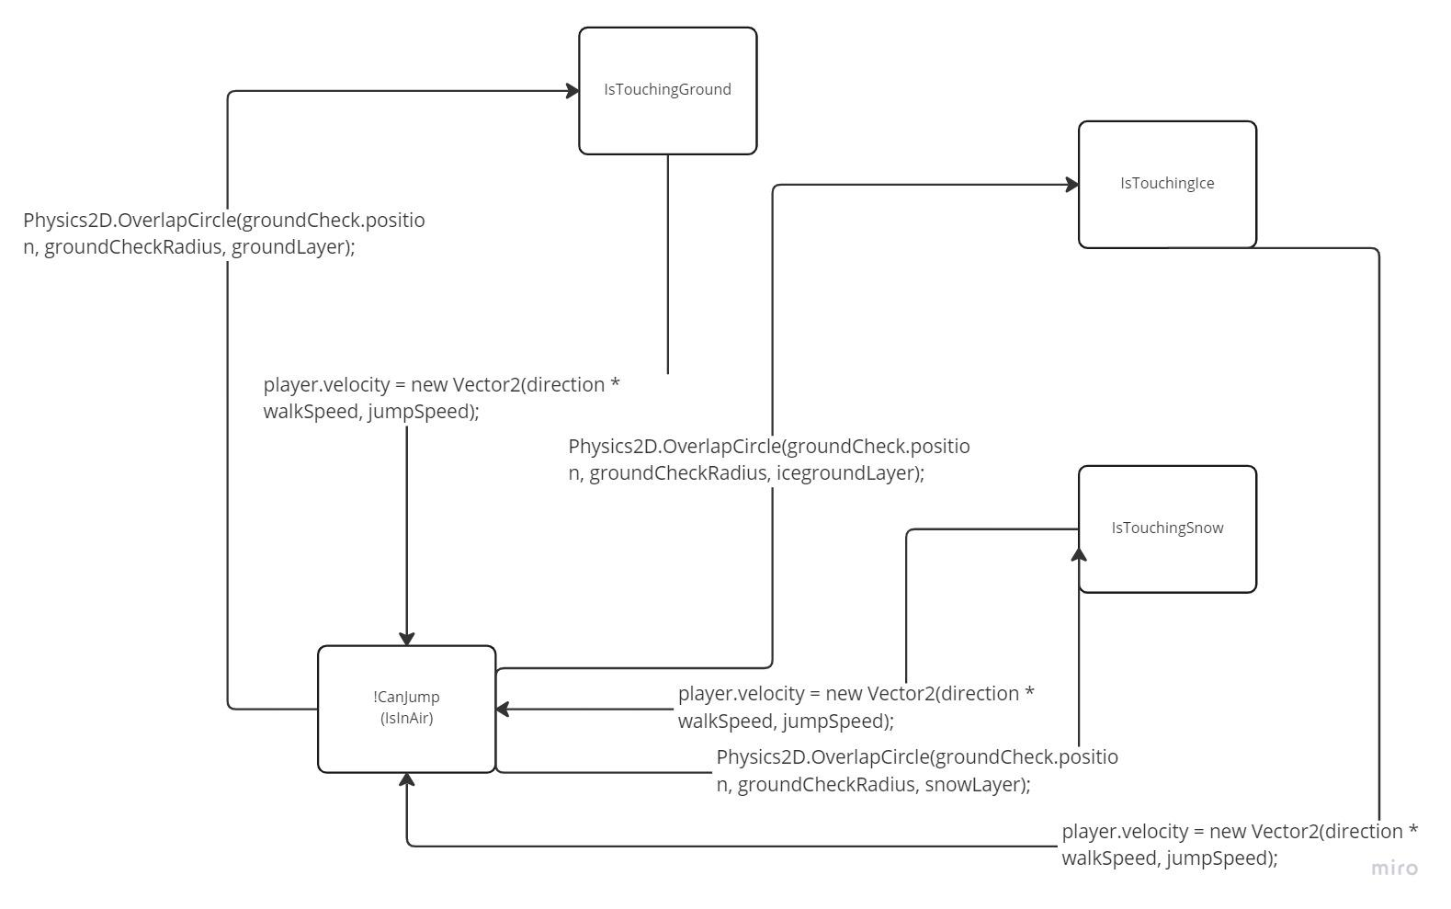
Player State Diagram

Slide 3
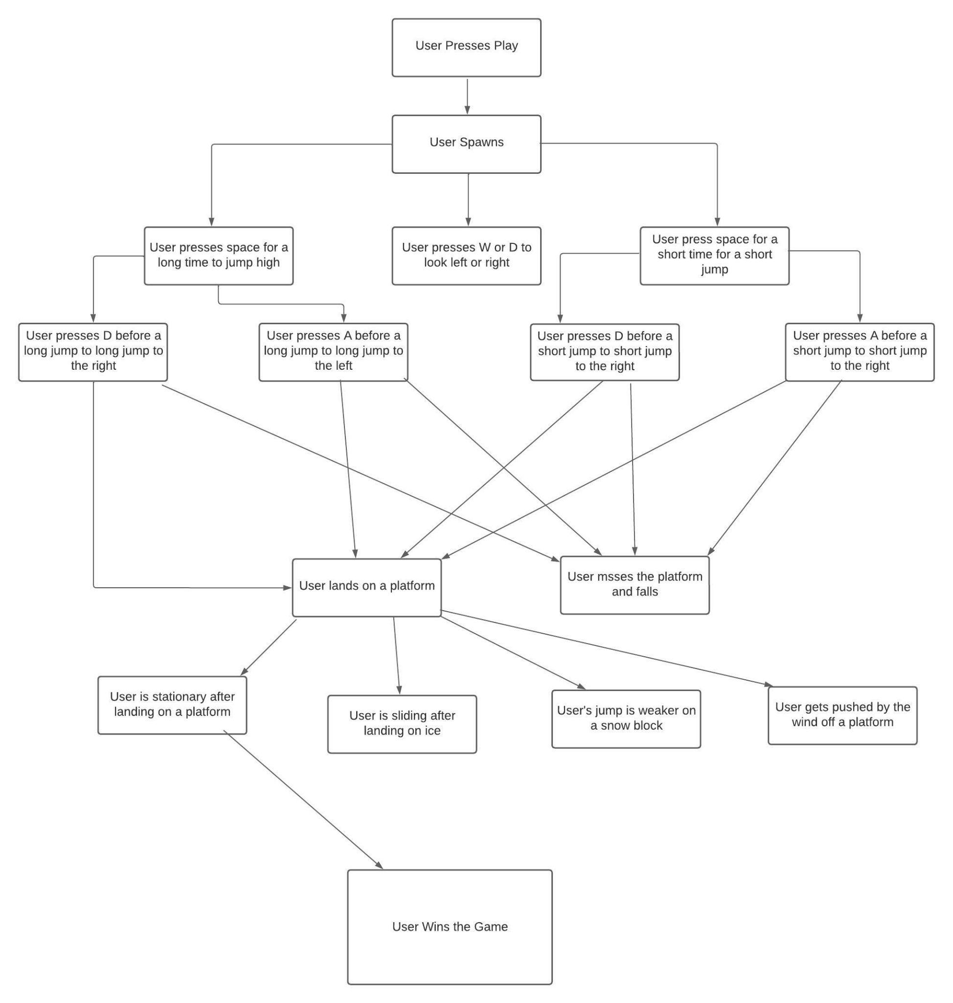
High Level Diagram of how the User Interacts with the Game

Slide 4
