Slide 1
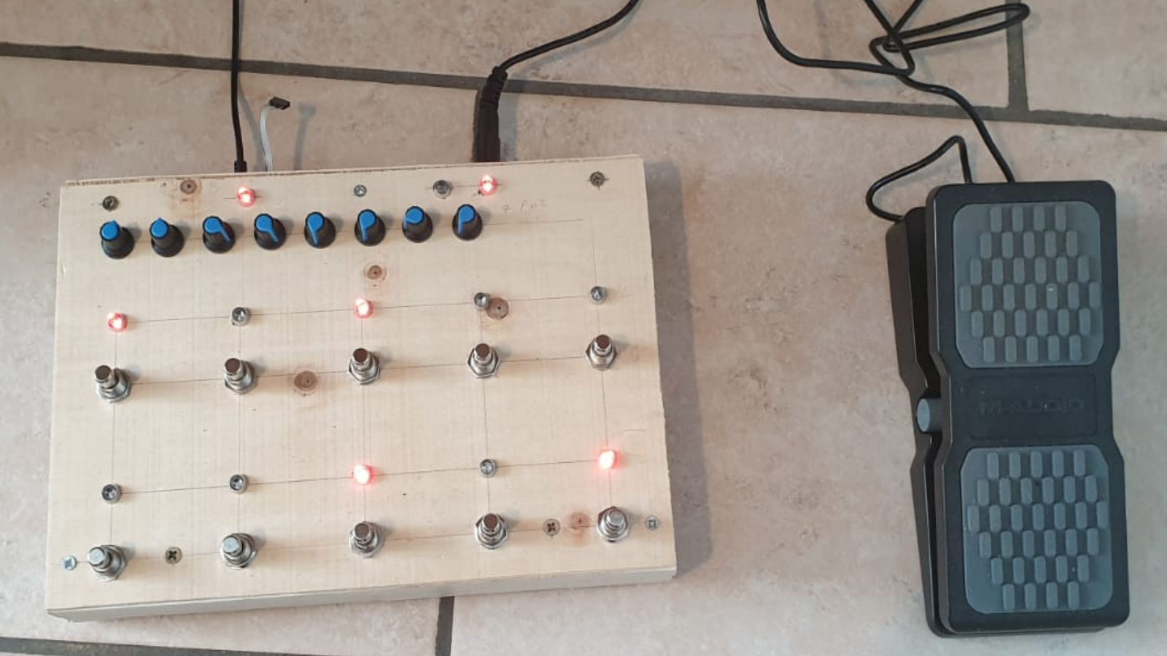
MidiPedalBoard
Features
  8 Potentiometers (7 general purpose + Mode)
  10 Stomps (9 general purpose + Page2)
  2 Expression inputs
How to use it
Page2/Looper Btn
  When activated (Led on) use second page for other buttons
  No CC is sent when pressed
Mode potentiometer (#8, the last one)
  Left => Normal mode: Btn sends 127 when activated (Led On) and 0 on deactivation
  Right => Bypass mode: Btn sends 0 when activated (Led On) and 127 on deactivation
  Half => Disable potentiometers CC
  No CC is sent when rotated
Button CC values (excluded Looper/Page2 Btn)
  {51, 52, 53, 54, 55, 56, 57, 58, 59}
  {61, 62, 63, 64, 65, 66, 67, 68, 69}
Potentiometers CC values (excluded Mode Pot)
  {18, 19, 20, 21, 22, 23, 24};
Expression pedal CC values
  {16, 17};
2 Exp Inputs and LEDs
USB and Activity LED
Mode potentiometer
Page2/Looper
9 General purpose
Buttons
7 General purpose
Potentiometers

Slide 2
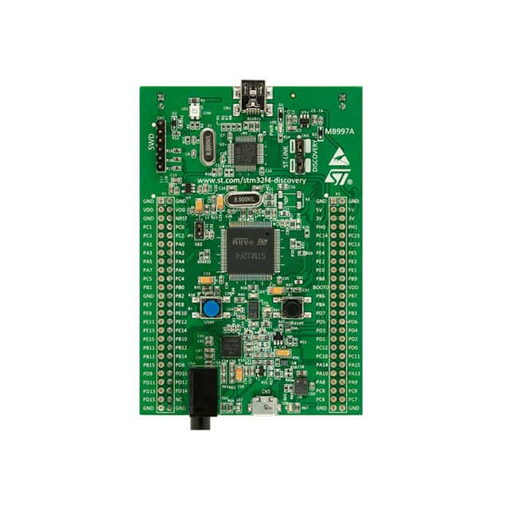
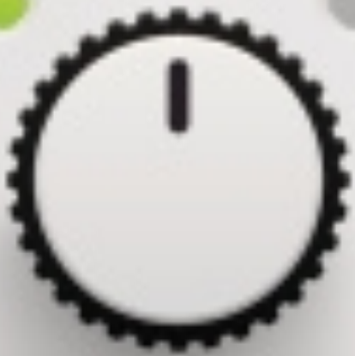
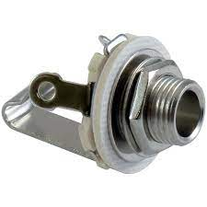
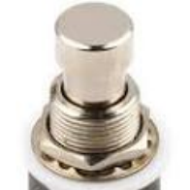
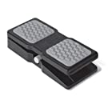
STM32pedalStomp
STM32F4DISCOVERY
Power
Exp1
Exp2
DRIVE BASS MID TRBL PRES VOL MAST
Features
Potentiometers: 8
Stomps: 10
LEDs: 13
Expression inputs: 2
FS5
UNDO
FS6
Play Once
FS7
PRE/POST
FS8
LOOPER
FS1
REC
FS2
Play/Stop
FS3
Half Speed
FS4
Reverse
TAP
Expression
pedals

Slide 3
STM32pedalStomp
Analog example controls
Preamp
Master volume
Distortion
Equalizer
Your effects pots
USB power indication
Fixed: power on
Flashing: communicating
Power
Stomp buttons and LEDs
Programmable functions
Expression
pedals

Slide 4
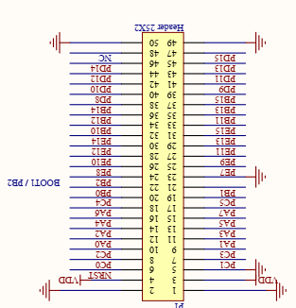
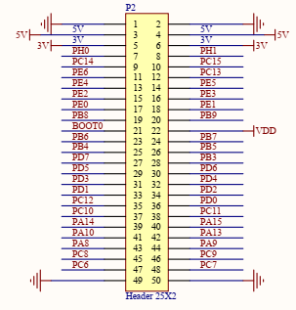
STM32 pin assignments
HW modifications
  Connect PA9 (P2.44) to 5V (P2.4) (USB power supply)
  Remove R46 (Enable Exp2)
Potentiometers (8) and expression inputs (2)
  PA0 ADC1_IN0 (removing SB20)
  PA1 ADC1_IN1
  PA2 ADC1_IN2
  PA3 ADC1_IN3
  PC1 ADC1_IN11
  PC2 ADC1_IN12
  PC4 ADC1_IN14
  PC5 ADC1_IN15
  PB0 ADC1_IN8 (Exp1)
  PB1 ADC1_IN9 (Exp2)
Higher row Stomp 1:5
  Btn: PE11:15
  LED: PB11:15
LEDs:
  LD_PWR: PE9
  LD_Exp1: PE8
  LD_Exp2: PE7
Lower row Stomp 6:10
  Btn: PE0,2,4,5,6
  LED:PD7,PB4,5,7,8
Board Btn and LEDs
  PA0 (PB blue)
  PD13 (LED3)
  PD12 (LED4)
  PD14 (LED5)
  PD15 (LED6)
Higher
LED
ADC
Lower

Slide 5
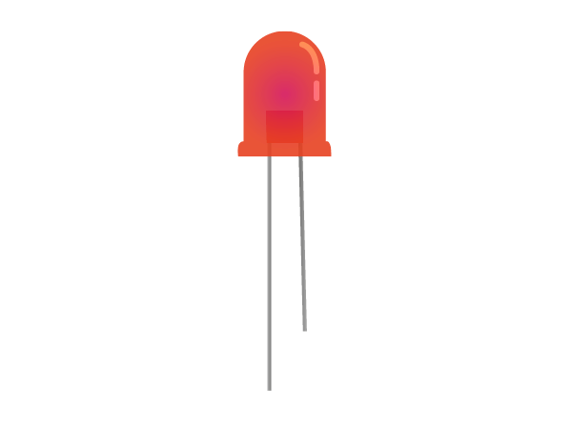
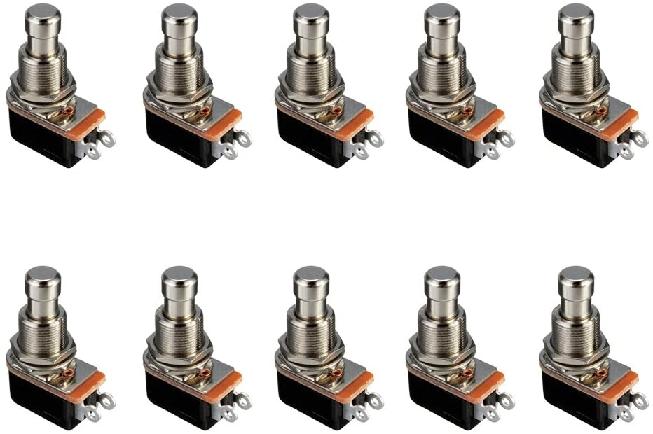
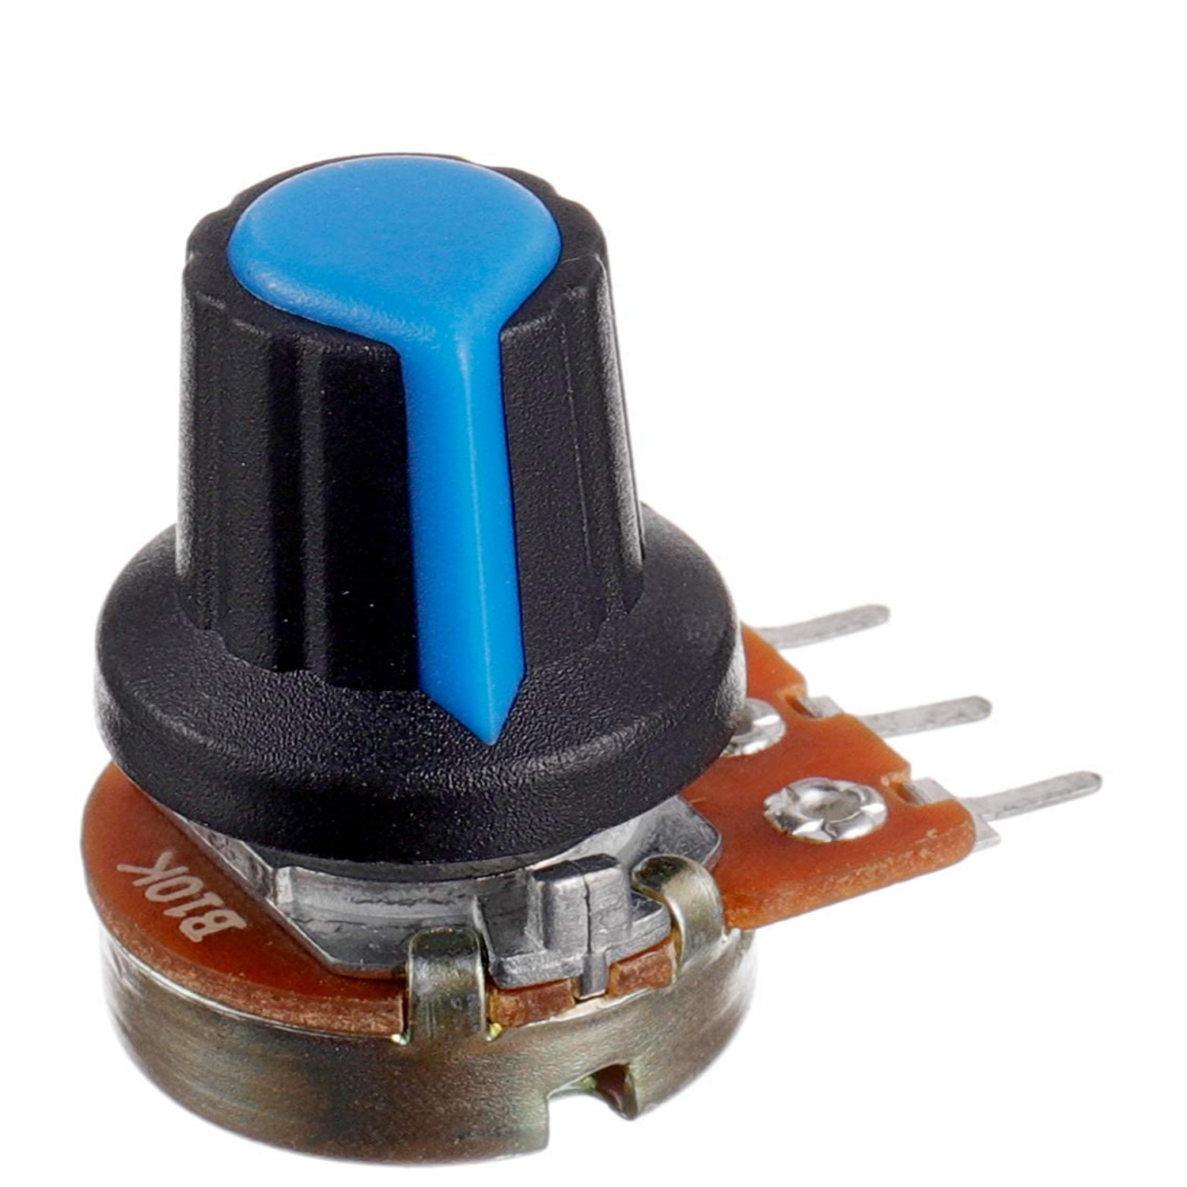
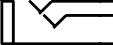

HW/SW
STOMP
LED
POT
Expression
pedals
To uC ADC pin
To uC pin
To uC pin
To uC pin
To uC LED pin
Pedal Pot 11k
R: Out
T: VDD
Trim Pot 52k
S: GND

Slide 6
Mechanical
30mm
25mm
100mm
25mm
20mm
92.5mm
30mm
Phi 7mm
80mm
30mm
80mm
Phi 8mm
80mm
Phi 12mm
20mm
Phi 13mm
17mm
30mm
60mm
30mm

Slide 7
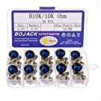
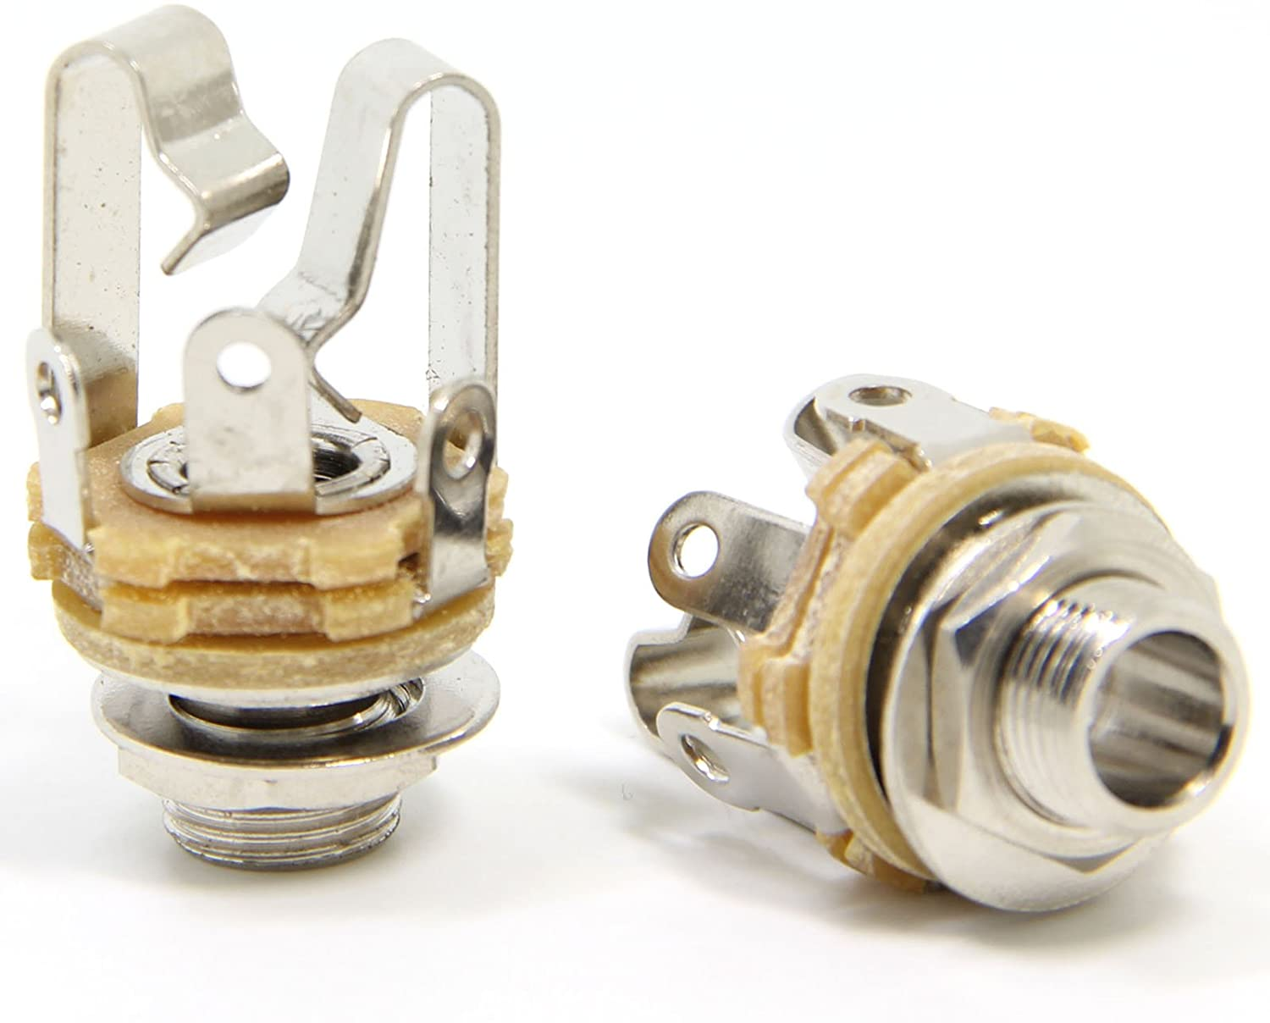
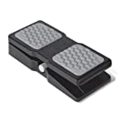
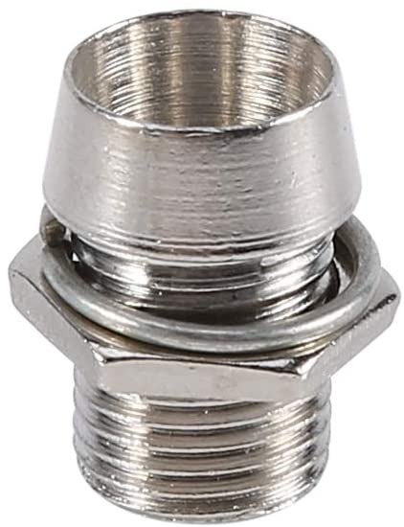
BOM
Stomp buttons
W
Phi: 11.5mm
W: 13 mm
H: 31mm
D: 9mm
STM32F411E-DISCO
  18 €
  Disc4 https://it.rs-online.com/web/p/strumenti-di-sviluppo-per-microcontrollori/8463503/
Potentiometers:
  8€ (price for 10), hole phi 6mm, knob phi 16mm
  https://www.amazon.it/dp/B07ZJL91YP
Stomps:
  22€ (price for 10), hole phi 10mm
  https://www.amazon.it/dp/B0734ZR3FY
LED mount 5mms:
  8.5€ (price for 20)
  https://www.amazon.it/PORTALED-ACCIAO-CROMATO-pannello-fissaggio/dp/B0162UO9VC
Jack TRS 6,35 mm (Expression inputs)
  7€ (price for 2)
  https://www.amazon.it/dp/B07BRQXQVL
Expression pedals (optional)
  17€ (each)
  https://www.amazon.it/dp/B000NLRWEI
Case:
  10€ ?
Others:
  13 red LEDs
  13x 1kOhm
TOT (no expr-pedal and expr inputs): 65€
TOT (1 expr pedal): 90€
H
D
Phi
Potentiometers
Phi: 6.5mm
D: 17mm
Expression
pedals
STM32F4Discovery
LED mount
Jack TRS
Phi: 9mm
D: 19mm
Phi: 8 mm

Slide 8
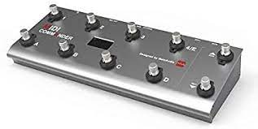
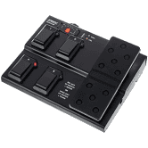
Other Devices
MeloAudio USB MIDI
MeloAudio USB MIDI
  10 Stomps
  No potentiometers
  2 expression pedal inputs
  130€
  https://www.amazon.it/dp/B07F1GLGCL
LINE6 FBV Express MKII
  4 stomps
  1 expression pedal
  No potentiometer
  Tuner (only if connected to line 6 devices via rj45)
  86€
  https://www.strumentimusicali.net/product_info.php/products_id/8316/line6-fbv-express-mkii.html
LINE6 FBV Express MKII

Slide 9
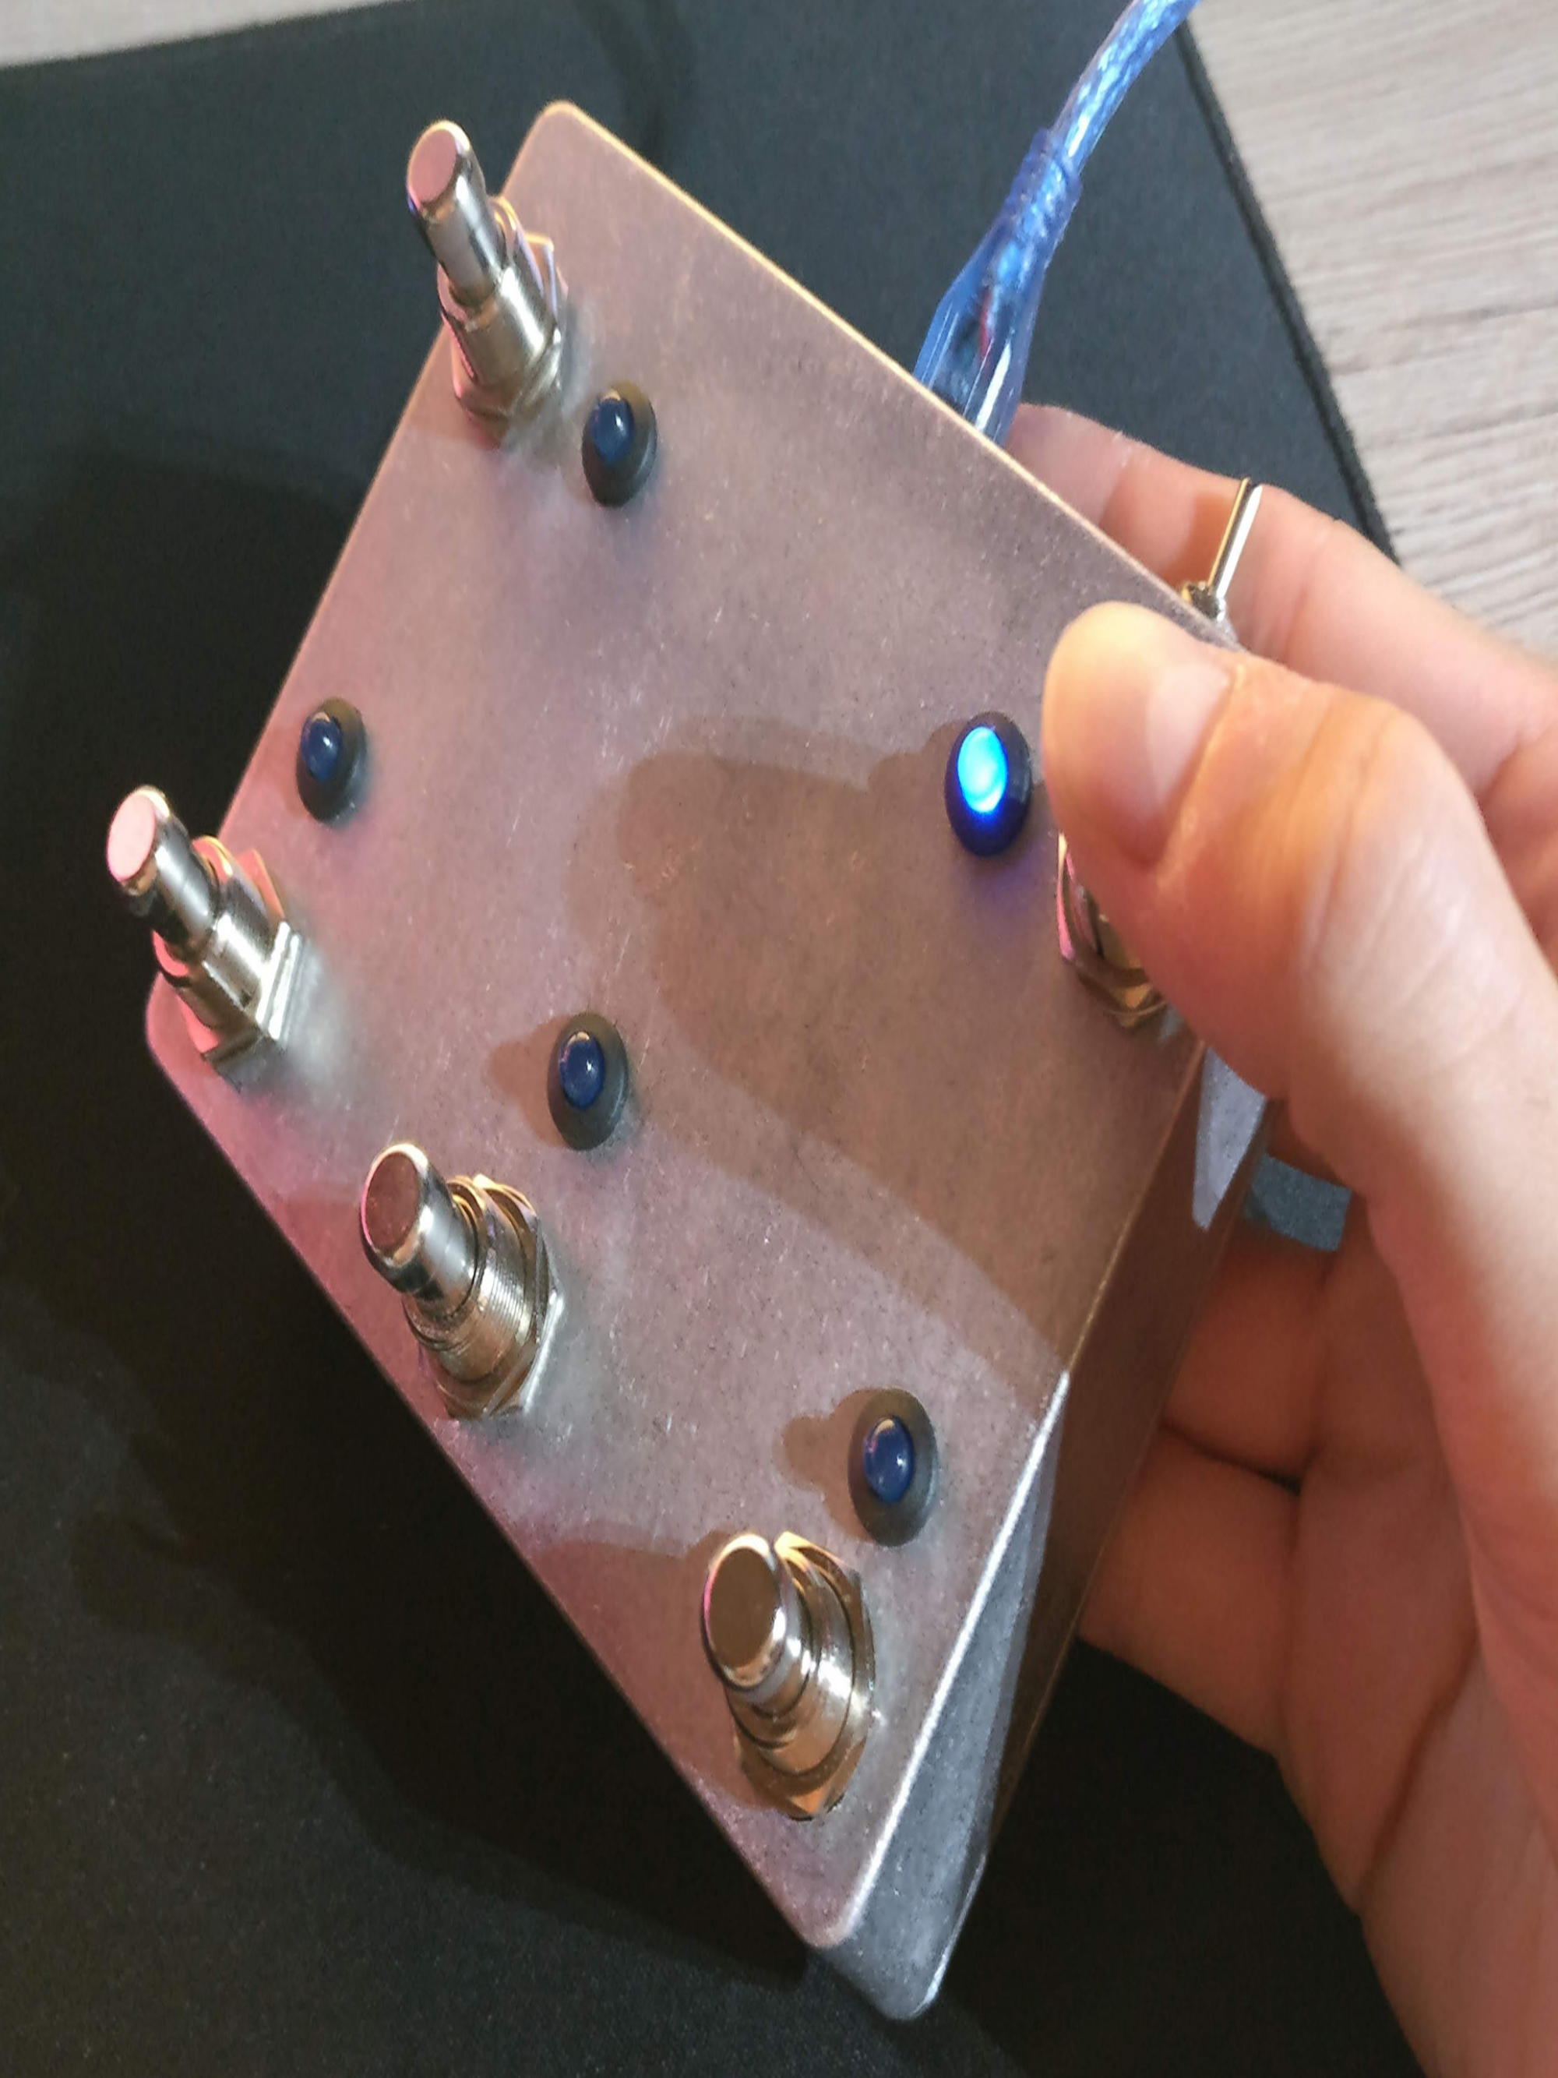
Other projects and resources
Arduino MIDI Footswitch
Arduino MIDI Footswitch
https://github.com/Hecsall/arduino-midi-footswitch
STM32 projects
https://github.com/keshikan/CureMIDI8
https://github.com/ripxorip/stm32_usb_midi
https://github.com/sebseb7/stm32-midi-demo
https://github.com/guitarfriiik/stm32_usb_midi
Midi tools
https://mountainutilities.eu/miditools
MIDI format
CC table https://www.midi.org/specifications-old/item/table-3-control-change-messages-data-bytes-2
Tempo (FF 51 03 xx xx xx) https://it.wikipedia.org/wiki/Musical_Instrument_Digital_Interface

Slide 10
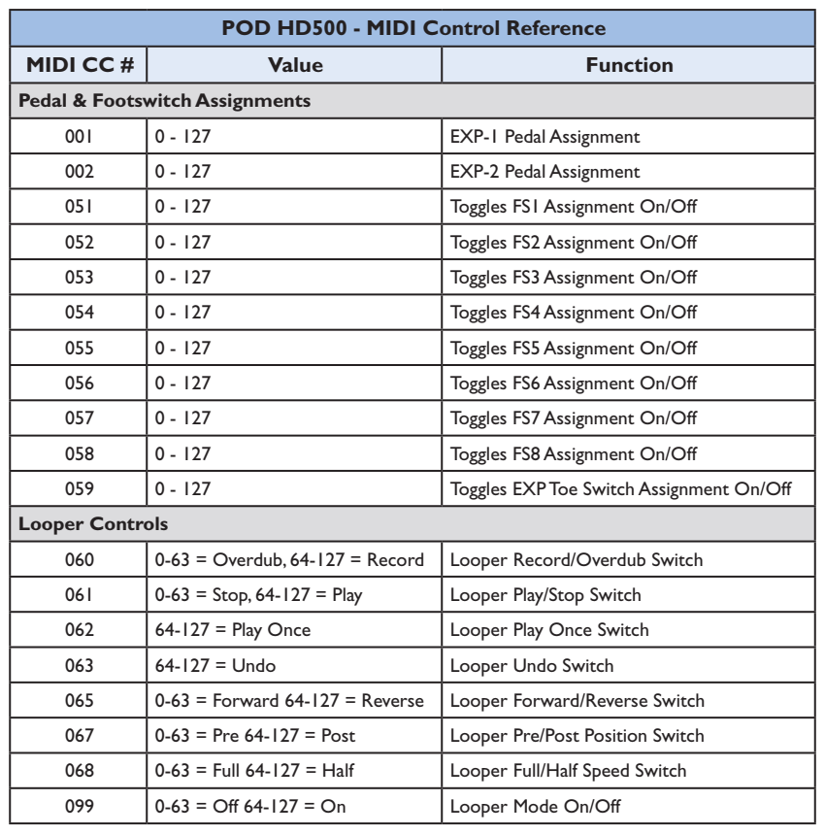
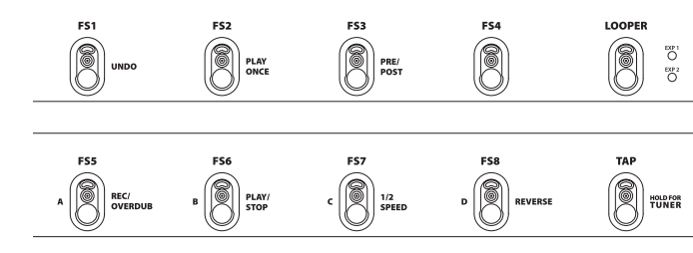
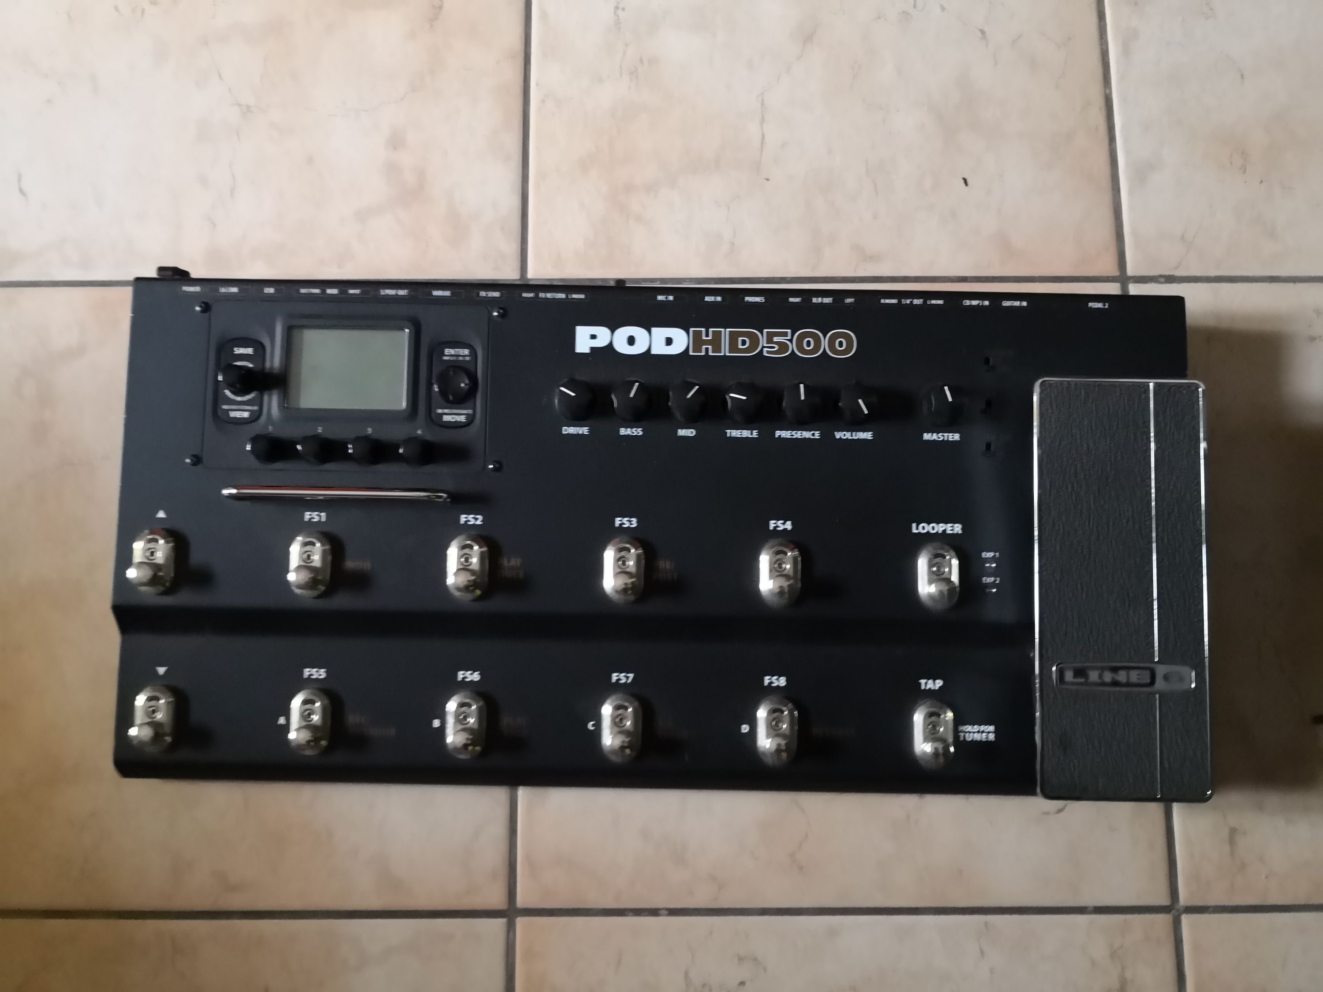
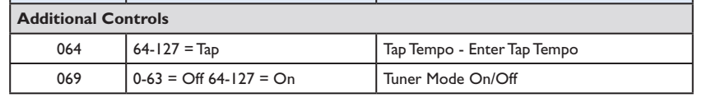
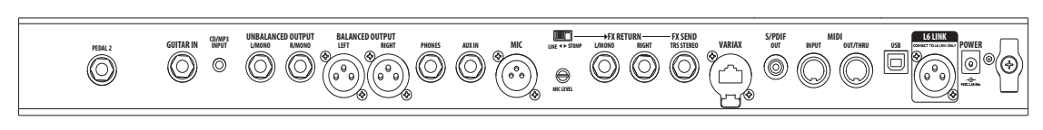
Line6 POD HD 500

