Slide 1

Walchand College of Engineering
(Government Aided Autonomous Institution)
Vishrambag, Sangli, 416415
Department of Computer Science & Engineering
Presentation on
1947
CaTsLeaf(Share-Ware)
AY:2023-24
Team Members:
21510026 : Jay Shirgupe
21510036 : Tushar Rathod
21510063 : Aradhya Pitlawar
Under the guidance of
Prof. Siddhraj Pujari
Date: 16/12/2023

Slide 2
Agenda
Abstract
Problem statement
Objectives
Methodology
UML diagrams
Technology stack
Implementation/Results
Outcomes/Applications
Conclusion
References
2

Slide 3
Abstract
In educational institutions and non-IT environments, the seamless management of software across multiple computers can be a daunting challenge, often exacerbated by the absence of technical experts. This project aims to address this issue by introducing a user-friendly, efficient, and secure system for remote software installation and deletion tailored for schools, colleges, and non-technical workplaces.
Our solution focuses on simplifying the software management process, allowing administrators to effortlessly install and delete software on numerous computers with just a single click. This project takes into account the unique requirements and constraints of educational institutions and nonIT settings, where technical expertise is scarce, but software management is critical.
3

Slide 4
Problem statement
Efficiently managing software installations and deletions on multiple computers in educational institutions and non-IT workplaces, often lacking technical expertise, is a pressing challenge. This project aims to develop a user-friendly, secure, and efficient system to address this issue
4

Slide 5
Objectives
To Create an intuitive admin interface for easy software installation and deletion, designed for
non-IT users.
● To Enable quick and seamless remote software deployment with minimal disruption to regular
workflows.
● To Implement robust authentication and authorization to secure software management in datasensitive environments.
● To Ensure compatibility with common educational software and provide flexibility for future
updates.
● To Implement a detailed logging and reporting system for troubleshooting and compliance
insights.
● To Provide training materials and ongoing support to empower effective use of the software
management system by administrators and users.
5

Slide 6
Methodolgy
1. Develop a mechanism for the admin-side application to select software files (e.g., .exe, .bat) to be
distributed to node PCs.
2. Implement socket programming to establish communication between the admin PC and node PCs
over the network.
3. Implement encryption and authentication mechanisms to secure the transmission of software files
and scripts with zipping.
4. Create a daemon or service on node PCs that continuously listens for incoming connections and
receives software and scripts.
6

Slide 7
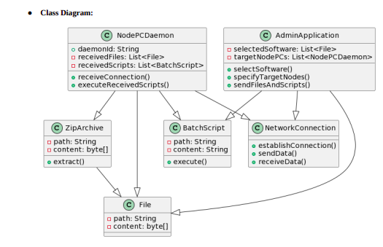
UML Diagrams
7

Slide 8
Technology Stack Font: Times New roman Size:28 alignment: Left
SOFTWARE & HARDWARE SPECIFICATION
Kivy Python Socket Programming Bash scripting PowerShell
8

Slide 9
Conclusion
In summary, our project has successfully tackled the challenge of streamlined
software deployment in networked environments. Our solution, based on a clientserver model, allows administrators to efficiently install software on multiple node
PCs within the same network.
By leveraging technologies like Python, socket programming, and batch scripting,
we've developed a robust and versatile system that minimizes administrative
overhead and reduces deployment time. This project is particularly valuable in
educational and corporate settings where frequent software updates and
installations are required.
<number>

Slide 10
Thank You
<number>

