Slide 1

ML 2023 Project
Slides demo (V0.1)
Authors (Name, Surname).
Team name Master degree (curriculum). Emails.
Date xx/yy/xyzz
Type of project: A / B / A with CM

Slide 2
Objectives
Describe/define in this slide your aim (in short): see section 1 of the file “ML-23-Report-info-...” for details
Slides general notes:
Read the lecture notes on the PRJ (ML-23-PRJ-...)
Read also the document “ML-23-Report-info-...” for further info
In particular follow the [*] sign that denotes “Lack of results in this part invalidates the report”
You can change the colors/font of the slides etc according to your preference (within the specified limits in the lecture)

Slide 3
Your contributions (may be more slides, but be schematic)
Code description, in short (see the file “ML-23-Report-info-...”)
Necessary features for the model implementation and the CUP application (see the file “ML-23-Report-info-...”: check list note, for the CUP application):
Type of models/Architecture/s (and numb. of layers for NN)
Type of activation function/s (NN)
Type of training algorithm/s
Batch/on-line/mb
Initialization of NN
Regularization schema/s
Stop condition/s
Be schematic: facts (by techniques names) and numbers

Slide 4
Models Novelties (may be more slides)
The novelties in your model/approach/techniques/implementation (if any) outside the standard approaches (i.e. beyond the necessary features/ordinary techniques specified in the previous slide)

Slide 5
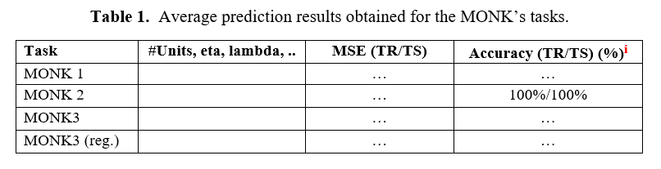
Monk Results 1 (may be more slides, but be schematic)
- Performance (see Table 1) and learning curves (MSE and accuracy plots for the 3 MONK’s tasks, see the next slide as an example of schema filled with the plot for the MONK2)
- Used hyper-parameters (including activation functions), please use the notation used in the course and not the notations of libraries etc, or you have to explain (prj B)

Slide 6
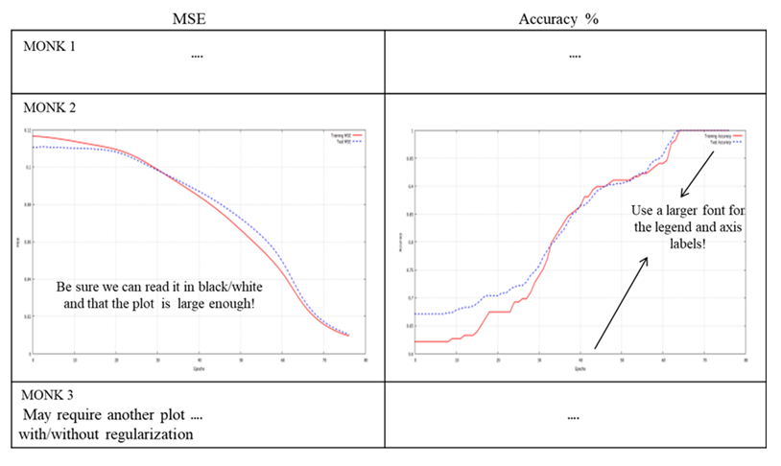
Monk Results 2 (may be more slides, but be schematic)

Slide 7
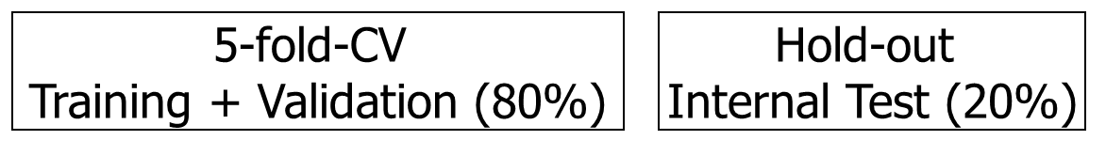
CUP Validation schema: data splitting
Typically the points 1-2 of the section 3.2 of file “ML-23-Report-info-...”
Which schema have you used for model selection and model assessment?
Validation schema can be easily reported in a graphical form, e.g.
Have you a final retraining?

Slide 8
CUP Validation schema: model selection
Typically the points 2-3 of the section 3.2 of file “ML-23-Report-info-...”
Schema and range of explored hyper-parameters (values used for the grid search, possibly table/tables): see the file “ML-23-Report-info-...” and also the check list note on the “Model selection”, for the CUP application
The synthesis of the hyperparameters setting must be reported on the slides, while a complete description can be inserted in a document within the code package (call it “hyperparameters-setting”) and in the Appendix slides (selecting what is more relevant).

Slide 9
CUP Results (many slides are possible)
Typically the points 4-9 of the section 3.2 of file “ML-23-Report-info-...”
In particular, do not forget:
to describe “your path” to reach your final model, i.e. the relevant choices that you made and the rational of that choices (selecting the relevant decisions & aspects that deserve to be described according to your feeling)
to specify how you selected the FINAL model (used on the blind test set). Which is it among the candidates and why? Also write the hyper-parameters of the final model
to report for the FINAL model used on the blind test set the TABLE with MEE for TR (training), VL (validation) and TS (internal TS) in the original scale
to report the plot of the learning curve of the final model

Slide 10
Discussion (may be more slides)
Discuss whether any proposed techniques or novelties improved or not the results, in terms of any performance (efficacy, efficiency, …)
Don’t forget to empathize the novelties that you introduced in your model (prj A or B) or used advanced techniques (prj B) w.r.t. to the results and/or any significant/critical analyses and any interesting finding/insight
I.e: don’t forget a “Discussion/Analysis” answering “what did you learn?” on the Models/Hyperparameters/Results/Efficacy/Efficiency, selecting/highlighting what is more significant in your opinion (time and space constraints helps!)

Slide 11
Conclusions
What you have drawn and what you learned (in short)
Blind Test Results: name of the result files and your nickname

Slide 12
Bibliography
See the section References of the file “ML-23-Report-info-...”

Slide 13
Appendix - not shown in the time slot
(may be many slides, but still use a reasonable number)
Material that is complementary to your presentation, but not directly presented: · Use appendix for large or other tables or plots (if needed); the slides out of the limit will be not necessarily read and therefore not necessarily evaluated!!!
Can be used to answer some questions during the oral discussion of the project
In the appendix you can use a smaller font (although readable. e.g. ≥11) and even smaller for tables

