Slide 1
Implementation of Classifier Tool in Twister
Magesh khanna Vadivelu
Shivaraman Janakiraman

Slide 2
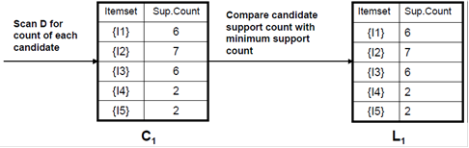
Apriori
Generating 1-itemset Frequent Pattern

Slide 3
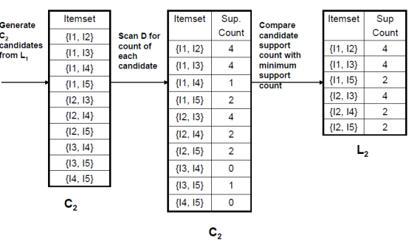
Apriori
Generating 2-itemset Frequent Pattern

Slide 4
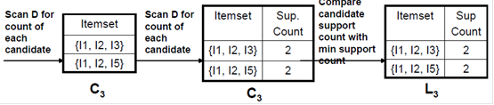
Apriori
Generating 3-itemset Frequent Pattern

Slide 5
Twister
Iterative Mapreduce
Configure once use many times
Map -> Reduce -> Combine
Static data configured with partition file reused through iterations
Provides Fault tolerant solution

Slide 6
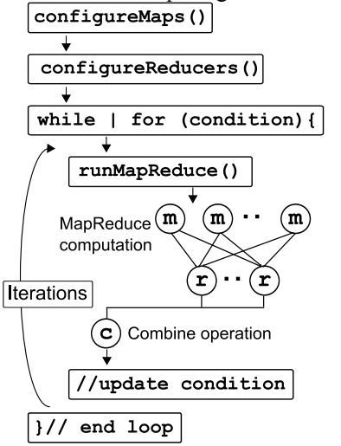
Twister

Slide 7
Implementation
Candidate generation
Map
Reduce
Combine
Generate frequent items
Iterate

Slide 8
Data Structures
Vector
String delimited by coma
StringValue
HashMap<String, Integer>

Slide 9
Inputs
Configuration file
Number of items & transactions
Minimum support count %
Partition file
Split data
Number of items & transactions

Slide 10

Inputs
Number of transactions
Number of Items

Slide 11
Challenges
Twister API
StringValue
Vector<String>
StringVector
toByte, fromByte

Slide 12
Challenges
runMapReduce()
runMapReduce(List<KeyValuePair>)
runMapReduceBCast(StringValue)

Slide 13
Time vs. Transactions

Slide 14
Time vs. Itemsets
Seconds
Itemsets

Slide 15
Time vs. Itemsets
5 Mappers
Seconds
Itemsets

Slide 16


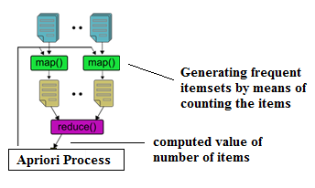
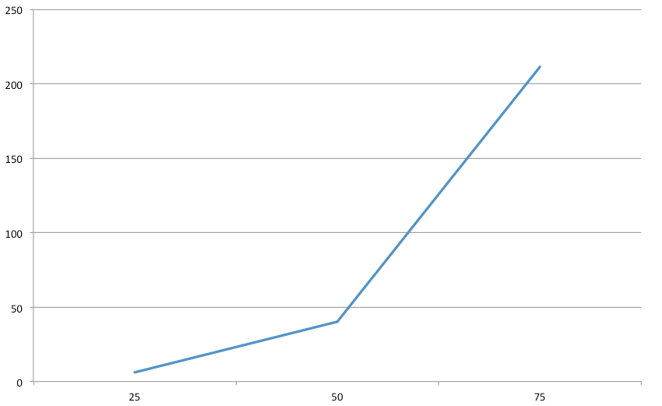
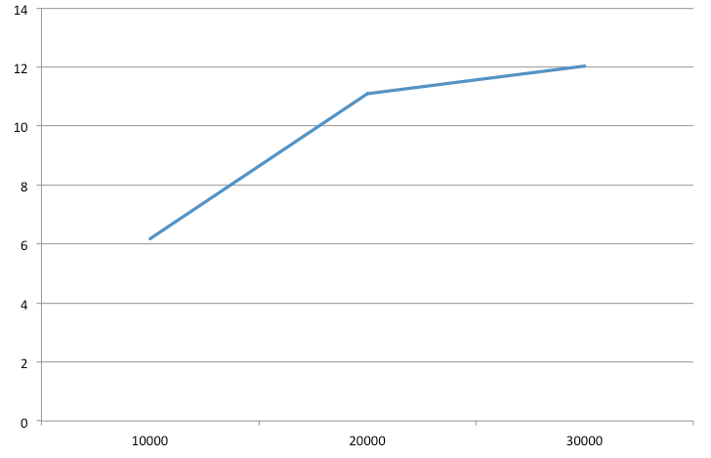
Implementation of Classifier Tool in Twister Magesh khanna Vadivelu, Shivaraman Janakiraman magevadi@indiana.edu, shivjana@indiana.edu
Motivation:
Architecture:
Results:
Mining frequent item-sets from large-scale databases has emerged as an important problem in the data mining and knowledge discovery research community. To overcome this problem, we have proposed to implement Apriori algorithm, a classification algorithm, in Twister, a distributed framework, that makes use of MapReduce. We specify a map function that processes a key-value pair to generate a set of intermediate key-value pairs, and a reduce function that merges all intermediate values associated with the same intermediate key. Our implementation of Apriori algorithm runs on a large cluster of machines and is highly scalable. On an application level, we can use this Apriori algorithm to identify the pattern in which customers buy products in a supermarket.
Time vs. Itemsets.
Twister has several components. Client side is to drive MapReduce jobs. Daemons and workers which live on compute nodes manage MapReduce tasks. Connection between components are based on SSH and messaging software. To drive MapReduce jobs, firstly client needs to configure the job. It configures MapReduce methods to the job, prepares KeyValue pairs and configures static data to MapReduce tasks through partition file if required. Messages are transmitted through a network of message brokers with publish/subscribe mechanism.
Time vs. Transactions.
More transactions increases the execution time but not as much as Itemsets. This behavior is because transactions are static data cached in memory for each map-reduce cycle. Whereas Itemsets are broadcasted for each map reduce.

Slide 17
Demo

Slide 18
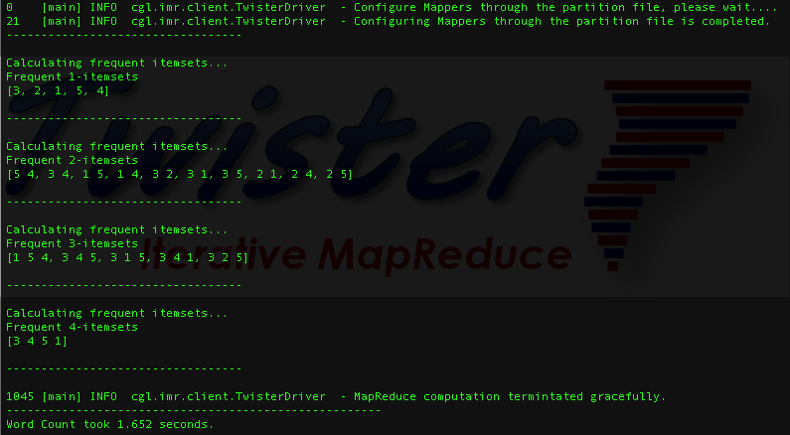
Output

Slide 19
Thank you

