Slide 1
THE GOOD, THE BAD & THE UGLY · EP.1
Off-plan is sold on projections.
Let’s see if they come true.
A REAL UNIT · A REAL STATEMENT OF ACCOUNT · REAL TRANSACTIONS
Calum MacLeod · @uaecalum

Slide 2
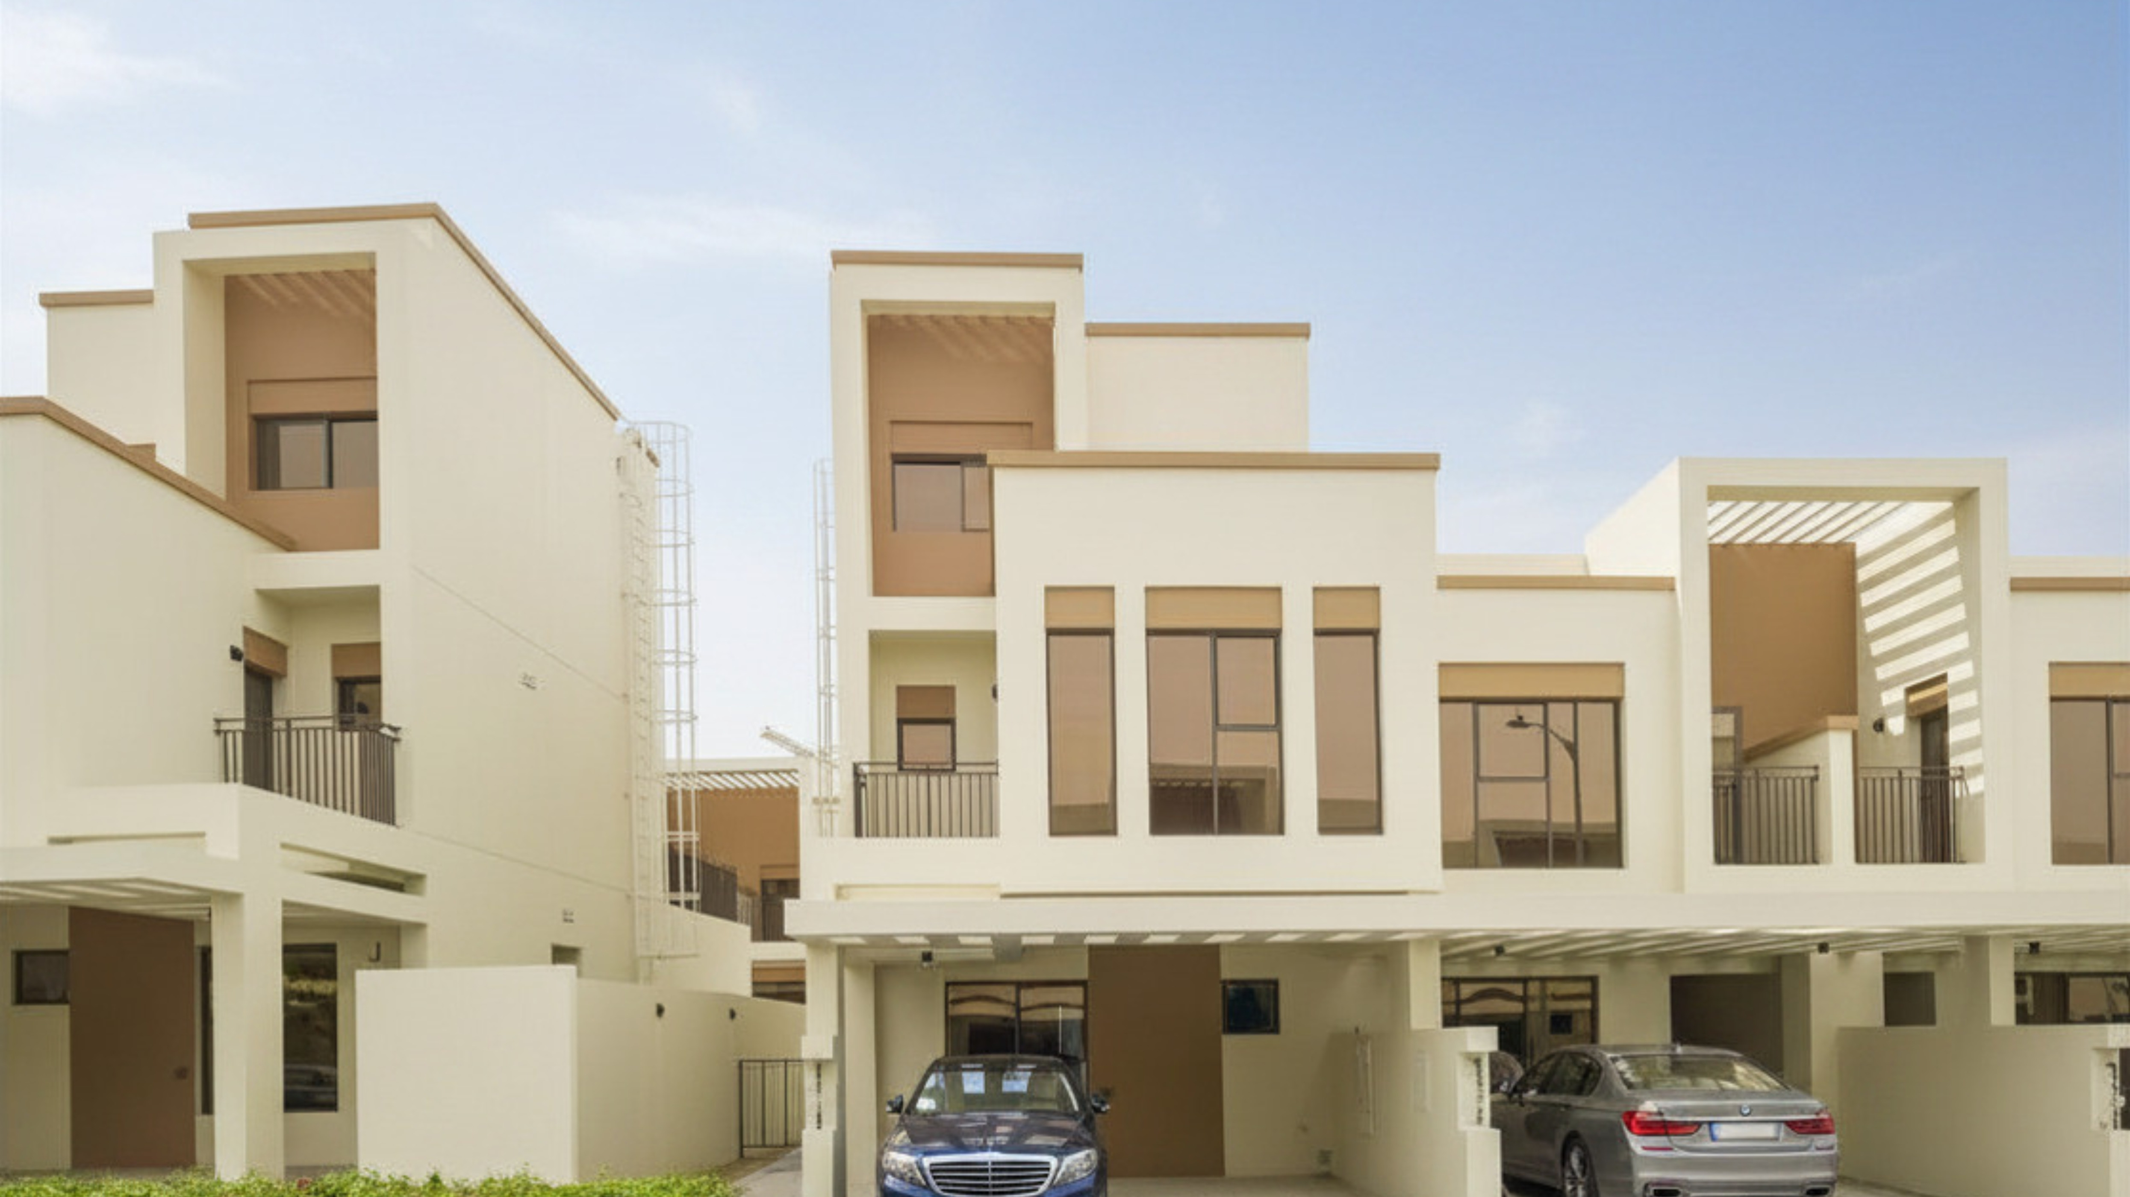
THE UNIT
01
4 Bed Townhouse
Costa Brava · DAMAC Lagoons
BOUGHT JANUARY 2022 · 50/50 PAYMENT PLAN

Slide 3
THE SERIES
02
The Good, the Bad
& the Ugly.

Slide 4
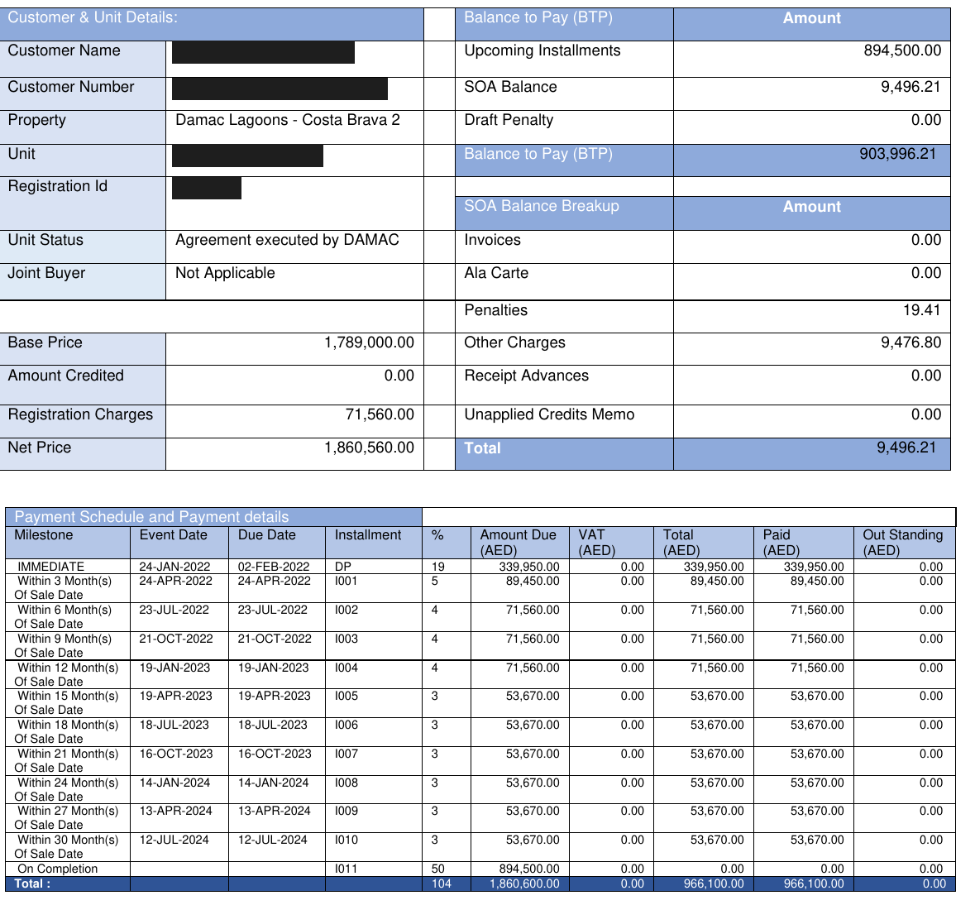
THE ACTUAL STATEMENT OF ACCOUNT
03

Slide 5
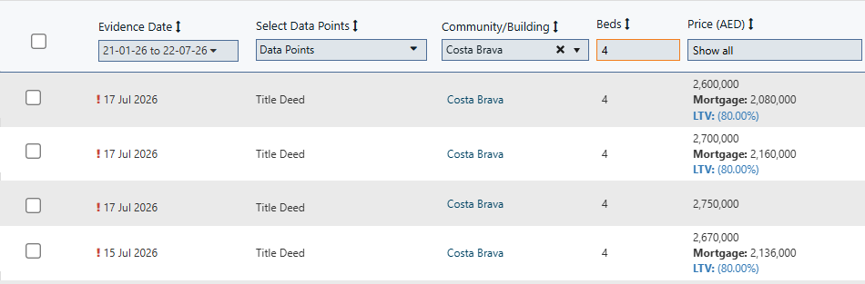
SELLING TODAY - LAST 7 DAYS
04
Four title deeds · 4 beds · Costa Brava · 15-17 Jul 2026 - coming out of the conflict window

Slide 6
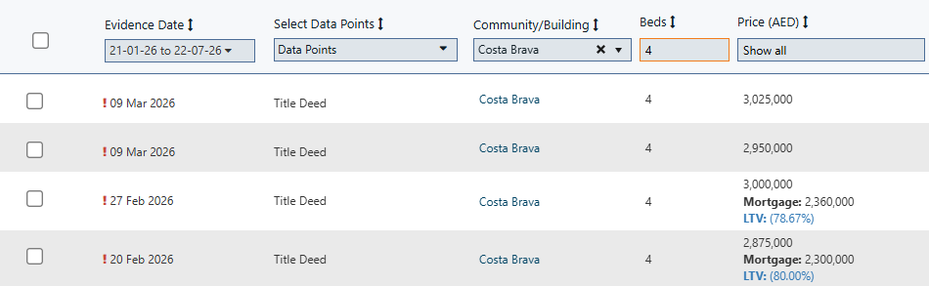
BEFORE THE CONFLICT - FEB / MAR
05
Same community, same bed count - four deeds, Feb-Mar 2026

Slide 7
THE MATHS - SELLING TODAY
06
Average of the 4 sales
PROFIT
Đ2,680,000
+Đ819,440
Purchase price (incl. 4% DLD)
Đ1,860,560
ROI on full price
44%
Actually paid in (50% + DLD)
Đ966,100
85%
ROE on cash in
Still owed at handover
Đ894,500
IRR (annualised)
17.8%
Cash back at handover sale: Đ1,785,500 from Đ966,100 in

Slide 8
THE MATHS - AT PRE-CONFLICT PRICES
07
Average of the 4 sales
PROFIT
Đ2,962,500
+Đ1,101,940
Purchase price (incl. 4% DLD)
Đ1,860,560
ROI on full price
59%
Actually paid in (50% + DLD)
Đ966,100
114%
ROE on cash in
Still owed at handover
Đ894,500
IRR (annualised)
22.4%
The conflict knocked ~Đ280K off the top - and it STILL returns 85% on cash

Slide 9
THE VERDICT
08
Real numbers. Handing over now.
This one worked.
Next episode: one that didn’t.
COMMENT THE PROJECT YOU WANT ON THE TABLE NEXT
@uaecalum · +971 55 350 2699

