Slide 1
THE GOOD, THE BAD & THE UGLY · EP.2
Bought (incl. 4% DLD)
LOSS
Đ3,206,174 · Sep 2024
−Đ706,174
Sold
Đ2,500,000 · Jun 2026
ROI on full price
−22.0%
Time held
21 months
−35.8%
ROE on cash in
Price per sqft
Đ1,382 → Đ1,121
IRR (annualised)
−22.4% / yr
60/40 plan + DLD: Đ1,973,030 in → Đ1,266,856 back · Đ33,627 lost per month held

Slide 2
THE SERIES
02
An off-plan investment
gone wrong.

Slide 3
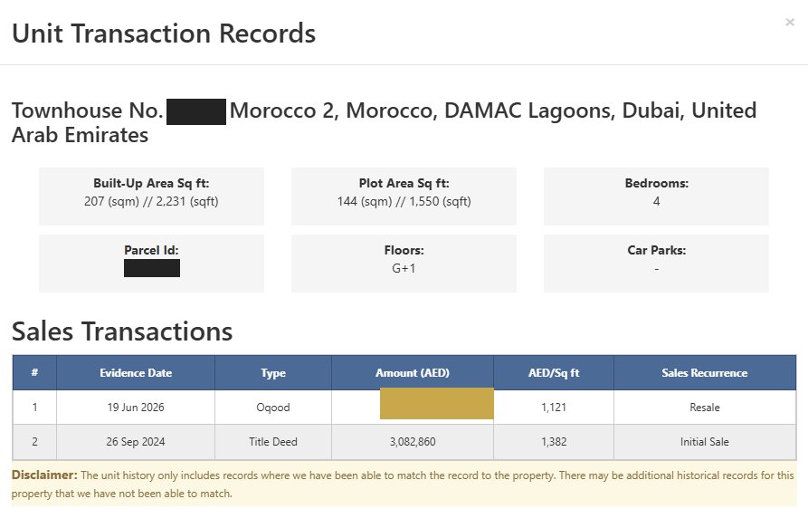
THE ACTUAL TRANSACTION RECORD
03

Slide 4
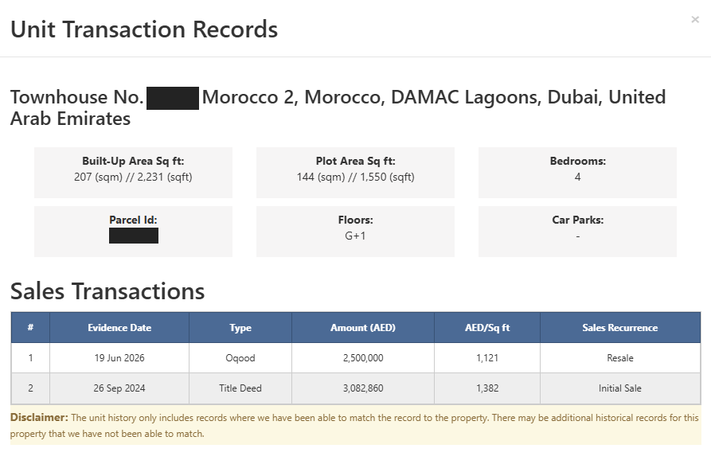
THE ACTUAL TRANSACTION RECORD
04

Slide 5
THE MATHS
05
Bought (incl. 4% DLD)
LOSS
Đ3,206,174 · Sep 2024
−Đ706,174
Sold
Đ2,500,000 · Jun 2026
ROI on full price
−22.0%
Time held
21 months
−35.8%
ROE on cash in
Price per sqft
Đ1,382 → Đ1,121
IRR (annualised)
−22.4% / yr
60/40 plan + DLD: Đ1,973,030 in → Đ1,266,856 back · Đ33,627 lost per month held

Slide 6
SAME COMMUNITY · OPPOSITE OUTCOMES
06
Costa Brava
Morocco
BOUGHT AT LAUNCH · JAN 2022
BOUGHT AT RELEASE · SEP 2024
Bought (incl. DLD)
Đ1,860,560
Bought (incl. DLD)
Đ3,206,174
Worth now
Đ2,680,000
Sold
Đ2,500,000
Held
4.5 years
Held
21 months
+Đ819,440
−Đ706,174
Same lagoons. The difference was the entry price.

Slide 7
THE VERDICT
07
Not every off-plan investment goes right.
Pick the right one.
Even timing on the SAME project can make or break the investment.
COMMENT THE PROJECT YOU WANT ON THE TABLE NEXT
@uaecalum · +971 55 350 2699

