Slide 1
Inside the LVM Measurement Planning Testbed
How every figure is produced: the functions, the data flow between them, and the checks behind each result
Station pose
Visibility
Error model
Network solve
Characteristic
Decision risk
Calum Tierney · Queen's University Belfast · Supervisor: Prof. Paul Maropoulos · Industrial partners: GKN Aerospace, AMIC
Notes:
Purpose of this deck: walk through the testbed's workflow end to end, so it's clear how each figure in results/ was produced and what each function contributes. The six circles are the six links of the physics chain in CLAUDE.md §2; every module in src/ implements one of them. Part 1 covers the chain (build steps 1-5), Part 2 the headline experiment that wraps an optimiser around it (step 6), and Part 3 maps every figure to the function that draws it.

Slide 2
One chain, six links
Every function in src/ implements one link; existing planning tools stop at link 4 and sum the diagonal
6
2
1
3
4
5
Station pose
where each tracker stands and points
geometry
Visibility
range, incidence, occlusion
geometry
Error model
sensor noise → 3×3 covariance per point
instruments
Coordinate covariance
joint solve over all stations
network
Characteristic uncertainty
Σ projected onto the tolerance
characteristics
Decision risk
JCGM 106: PFA and PFR
risk
Existing tools stop here: minimise trace(Σ)
planning (build step 6)
propose station poses → run the whole chain → score with an objective (A0 / A1 / B / C) → keep the best
numbers in circles = build step (CLAUDE.md §5)
Notes:
The order of the boxes is the order data flows; the numbers are the order they were built. The error model was built first because it carries the first reference-number gate (Hughes et al. 2011). Conventional LVM planners stop at the coordinate covariance and minimise its trace (A-optimality). This testbed carries on through two more links: project the covariance onto what each tolerance actually constrains, then turn that into the probability of a wrong conformity decision. Step 6 closes the loop: an optimiser proposes station poses, runs the chain, and keeps whichever scores best.

Slide 3
The physics chain
1
PART 1
Build steps 1–5: from sensor noise to the probability of a wrong accept or reject decision

Slide 4
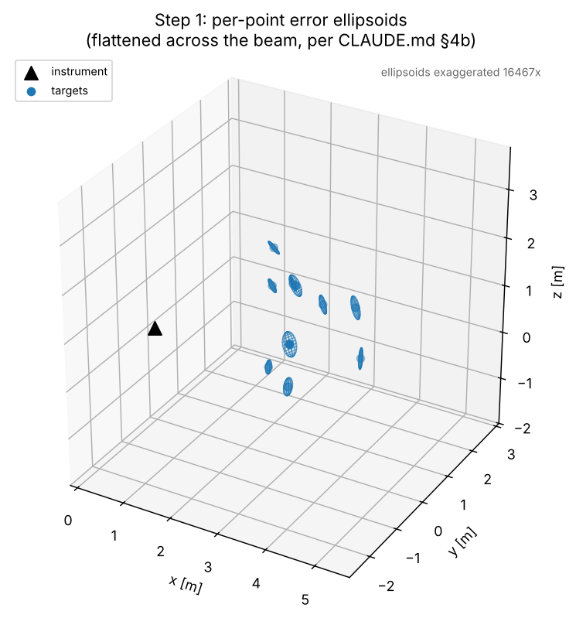
Laser tracker error model
1
Spherical sensor noise, propagated to a full 3×3 covariance per point, never a scalar
STEP
Sensor noise (Hughes et al. 2011, API T3)
σ_d = 1.216 µm (range) · σ_θ = 0.485″ (azimuth) · σ_φ = 0.694″ (elevation)
cartesian_to_spherical(point)
target in the station's frame → range d, azimuth θ, elevation φ
spherical_jacobian(d, θ, φ)
∂(x, y, z) / ∂(d, θ, φ): the angular columns grow with range d
LaserTracker.covariance_local
Σ = J · diag(σ_d², σ_θ², σ_φ²) · Jᵀ (+ σ_sys² · I if a systematic term is set)
covariance_global(point, pose)
rotate into the scene frame: R · Σ · Rᵀ
3×3 covariance per target → panel1_scene.png
make_panel1_scene(): 10 random points, one station, ellipsoids drawn exaggerated
GATE at 2.5 m: lateral 5–9 µm, radial ≈ 1.2 µm, ratio 5–7 : 1, long axes ⟂ beam
function in src/ or viz/
input / data object
output / figure
check or rejection
Notes:
Inputs are fixed by CLAUDE.md §4a: the a-posteriori sensor noise Hughes et al. measured on an API T3. They are never tuned. Each target is converted to the tracker's own spherical coordinates, then the spherical-to-Cartesian Jacobian maps the three independent noise terms into a 3×3 Cartesian covariance. Because the angular terms are multiplied by range, the ellipsoid is a flattened disc: thin along the beam (interferometer), wide across it (encoders). The anisotropy ratio is an output, and the step 1 test checks it lands in the 5–7:1 band. An optional isotropic systematic term models effects no placement can remove.

Slide 5
Can the station see the target?
2
Three independent yes/no checks, cheapest first, before any error model runs
STEP
range ≤ max range?
incidence ≤ max angle?
segment hits obstacle?
Station + target
position, surface normal, obstacle mesh
VISIBLE
yes
yes
no
no
no
yes
OUT_OF_RANGE
INCIDENCE_TOO_STEEP
OCCLUDED
check_target_visibility(...)
runs the three checks in this order: cheap ones first, ray-casting last
segment_intersects_mesh(origin, target, mesh)
Möller–Trumbore ray/triangle test against every triangle (box_mesh, load_stl)
GATE points behind an obstacle are unmeasurable
IN STEP 6 _visible_observations() filters every station–target pair of a candidate plan
function in src/ or viz/
input / data object
output / figure
check or rejection
Notes:
Visibility answers 'can it be measured at all' before step 1 answers 'how precisely'. Three independent conditions: range, incidence angle against the target's surface normal, and occlusion by a triangle mesh. The order is purely for speed: range and incidence are one dot product each, while occlusion tests the sightline against every triangle. In step 6 the same check filters every station–target pair; a plan that leaves a target unseen is disqualified rather than solved, because the solver's pseudo-inverse would otherwise give an unseen target zero variance, which would look perfectly measured.

Slide 6
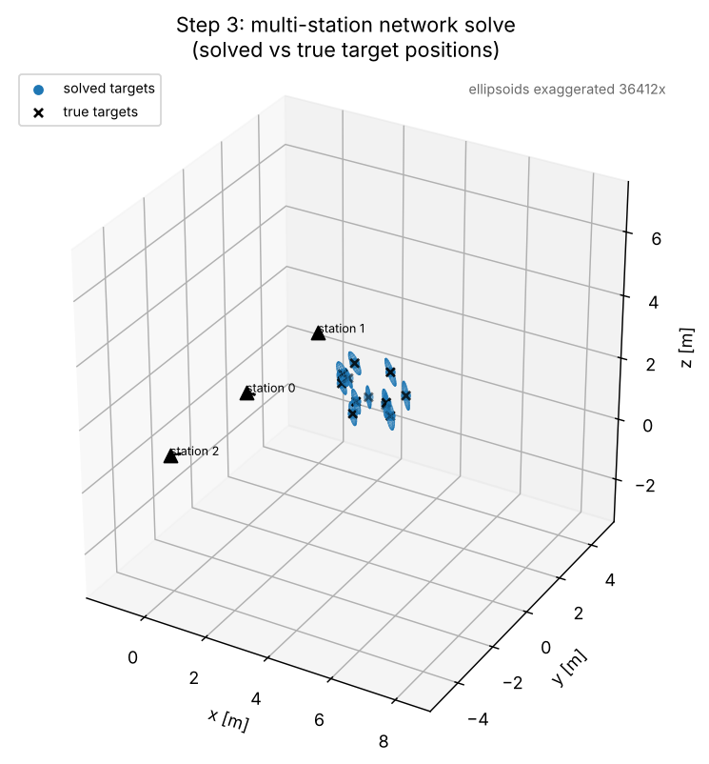
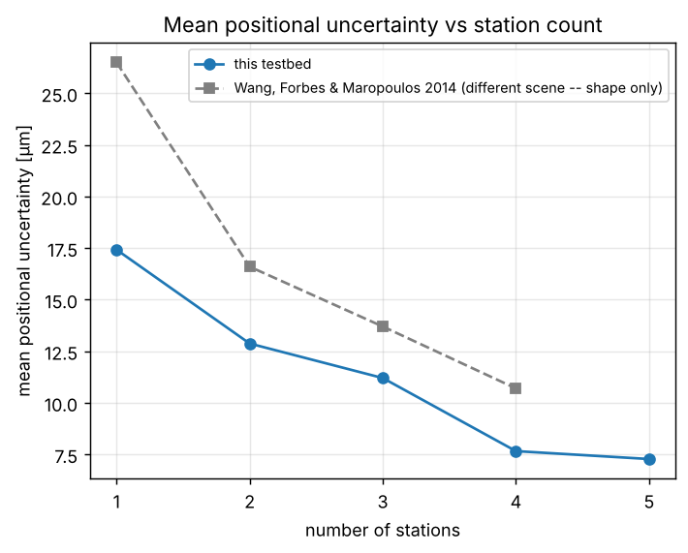
Multi-station network solve
3
Every station pose and every target solved together; the covariance comes from the fit itself
STEP
True targets + station poses
scene geometry; each station boresighted at the targets
simulate_observations(...)
noisy (d, θ, φ) per station–target pair · exact_observations(): noiseless, used for planning
perturbed_initial_guess(...)
rough starting point, as a real survey would have; anchor station kept exact
solve_network(...)
residuals ÷ σ · anchor fixed (removes 6 gauge DOF) · sparse Jacobian · scipy least_squares
make_panel2_network(): 12 targets, 3 stations, solved vs true positions
make_panel3_uncertainty(): 1 → 5 stations, against Wang, Forbes & Maropoulos (2014)
GATE uncertainty falls with station count and flattens after 4–5 stations
NetworkSolveResult
Cov = (JᵀJ)⁺ → full joint target covariance (+ σ_sys² per target)
function in src/ or viz/
input / data object
output / figure
check or rejection
Notes:
This is a standard bundle adjustment. Observations are raw spherical measurements; every residual is divided by its own sensor sigma, so the fit is weighted exactly by the step 1 noise model. One station is held fixed as the anchor, which removes the six rigid-body degrees of freedom the observations cannot resolve. Each observation touches one target and one station only, so the Jacobian is block-sparse and the solve scales roughly linearly with target count. The covariance is the pseudo-inverse of the normal matrix at convergence, kept in full, including cross-target correlation through shared station poses.

Slide 7
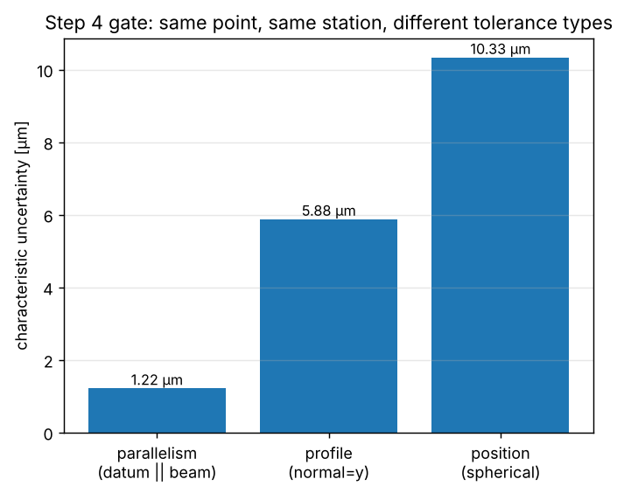
Project covariance onto the tolerance
4
The same point, measured from the same station, carries a different uncertainty for each tolerance type
STEP
Σ (3×3) + Characteristic(tolerance, datum, target_indices)
point covariance from step 3 · which tolerance, which datum, which target
tolerance.constraint_directions(datum)
which directions D does this callout actually constrain?
PositionTolerance
D = I: x, y and z (spherical zone)
ProfileTolerance
D = the surface normal (1 axis)
ParallelismTolerance
D = the datum normal (+ datum variance)
evaluate_characteristic(...)
Σ_proj = D · Σ · Dᵀ → u = √ trace(Σ_proj)
uncertainty_m per characteristic → panel4_characteristics.png
make_panel4_characteristics(): one point at 2.5 m, one station, three tolerance types
GATE same point, same station: 1.2 / 5.9 / 10.3 µm
function in src/ or viz/
input / data object
output / figure
check or rejection
Notes:
Each tolerance type knows which directions it constrains. A profile tolerance cares only about deviation along the surface normal; parallelism about deviation along an external datum's normal; a spherical position tolerance about all three axes. evaluate_characteristic projects the full 3×3 covariance onto those directions and reports the root of the projected trace. The figure puts one point at the 2.5 m reference range: parallelism along the beam picks up only the small radial sigma, profile across the beam picks up the large angular sigma, and position picks up everything. This is why a scalar uncertainty gets the risk wrong in a direction-dependent way.

Slide 8
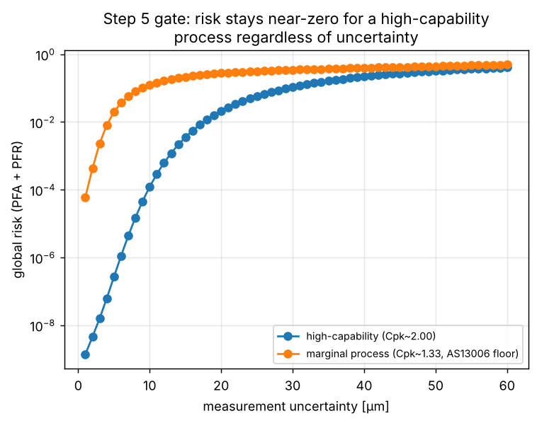
From uncertainty to decision risk
5
JCGM 106: the chance of a wrong accept or reject, given the process and the measurement
STEP
ProcessPrior(mean, std)
per feature cluster, not per characteristic
uncertainty_m
u for this characteristic, from step 4
DecisionRule
accept within ±50 µm (100 µm zone)
evaluate_conformity_risk(...)
Gaussian measurement error around each possible true value y, weighted by the process prior p(y)
_global_false_acceptance
PFA = ∫ outside tolerance p(y) · P(accept | y) dy
_global_false_rejection
PFR = ∫ inside tolerance p(y) · (1 − P(accept | y)) dy
RiskResult → panel5_risk.png
PFA, PFR and process Cpk for one characteristic · make_panel5_risk(): sweep u from 1 to 60 µm for both clusters
GATE a high-capability characteristic shows near-zero risk at any uncertainty
Clusters high-capability: Cpk 2.0 (GKN critical tier) · marginal: Cpk 1.33 (AS13006 floor)
function in src/ or viz/
input / data object
output / figure
check or rejection
Notes:
The risk layer needs three inputs: a process-capability prior for the cluster the characteristic belongs to, the measurement uncertainty from step 4, and the acceptance rule. False acceptance integrates, over every true value outside the tolerance, the chance the measurement nonetheless lands inside. False rejection does the reverse for true values inside. Both use scipy quad over a finite ±12σ window of the prior. The two clusters are sourced, not invented: Cpk 2.0 is GKN's critical/zero-defect target and Cpk 1.33 is the AS13006 minimum. The marginal process is where uncertainty actually moves the risk, which is the whole lever the project exploits.

Slide 9
The headline experiment
2
PART 2
Build step 6: same optimiser, same scene, four objectives. Which plan does each one choose?

Slide 10
Scoring one candidate plan
6
evaluate_plan() runs the whole chain once; every objective then reads the same result
STEP
every target seen? each station ≥ 3?
Candidate stations + anchor
poses proposed by the search; anchor always included
exact_observations
noiseless (d, θ, φ) for every station–target pair
_visible_observations
the step 2 check, applied to every pair
return None
plan disqualified
no
yes
objective_fn
A0 / A1 / B / C → one number
PlanEvaluation
u per characteristic + full covariance
evaluate_characteristic
step 4: project onto each tolerance
solve_network
step 3: joint fit, Cov = (JᵀJ)⁺
WHY NOISELESS? For this linear-Gaussian model, the covariance from exact observations equals a real noisy solve's (pinned by a test). Every plan is scored deterministically, with no random numbers.
WHY DISQUALIFY? If a target has no observations, the pseudo-inverse assigns it zero variance, so it would look perfectly measured. Refusing to solve is the only honest answer.
function in src/ or viz/
input / data object
output / figure
check or rejection
Notes:
This is the inner loop of every search. One candidate set of station poses, plus the fixed anchor, goes through the whole chain once: exact observations at the true geometry, the visibility filter, the network solve, and the projection onto every characteristic's tolerance. The result is not yet a score; it's a PlanEvaluation that any of the four objectives can read. That is how 'replace the objective, not the optimiser' is implemented literally. Two design choices are worth defending: noiseless observations, because the design covariance matches a noisy solve while being deterministic and fast; and disqualifying plans that leave a target unseen, because a pseudo-inverse silently reports those as perfect.

Slide 11
Four objectives, one evaluation
6
The search method is held fixed; only the scoring rule changes (CLAUDE.md §1, §3)
STEP
A0
objective_a0_trace_covariance
The field's own A-optimal criterion. Blind to tolerance direction.
Σ trace(Σ) over the toleranced points
A1
make_weighted_uncertainty_objective
Projected onto each tolerance, but every characteristic counts the same.
PlanEvaluation
from the previous slide
uniform_weights → Σ u
B
make_weighted_uncertainty_objective
Weights fixed before the search: a drop-in for existing weighted planners.
risk_derived_weights → Σ w · u, w = d(risk)/du at 8 µm
C
objective_c_direct_risk
Exact risk for every candidate, no linearisation: the direct test.
Σ (PFA + PFR) at each candidate's own u
Notes:
All four objectives score the same PlanEvaluation. A0 is what the field actually optimises: the trace of the raw coordinate covariance, which ignores what each tolerance constrains. A1 already uses the step 4 projection but weights every characteristic equally. B uses risk-derived weights: the slope of each characteristic's risk with respect to its own uncertainty at a fixed 8 µm reference, computed once before the search, normalised to mean 1. Its practical value is that an existing weighted-sum planner could use it without knowing anything about JCGM 106. C skips the linearisation and minimises the summed risk directly. constrained_objective() can wrap any of them with a hard uncertainty cap, a test-uncertainty-ratio style guard.

Slide 12
Searching for the best plan
6
Grid search where exhaustive search is affordable; a standard GA where it is not
STEP
Grid search: exhaustive
Genetic algorithm: scalable
hemisphere_candidate_poses(...)
24 poses: 12 azimuths × 2 elevations at 4 m, aimed at the centroid
bounds_m + seed_station_positions_m
a search box per station (x, y, z); optional known-good starts
itertools.combinations(...)
every distinct set of n stations: C(24, 2) = 276 plans
scipy differential_evolution
population of station-position vectors, evaluated in parallel
evaluate_plan + objective_fn
the full chain, then the score, for every plan
_StationPlacementCost
look_at_orientation → evaluate_plan → objective_fn
infeasible plans skipped
evaluate_plan returned None: counted in n_infeasible
infeasible → INFEASIBLE_PENALTY
1e6 rather than ∞, so the GA can still rank it
GridSearchResult
provably the best plan in the candidate set
GASearchResult
a good plan found, not a certified optimum
function in src/ or viz/
input / data object
output / figure
check or rejection
Notes:
CLAUDE.md §3 allows grid search or a standard GA, and nothing else, so results stay attributable to the objective. The two-cluster scene uses grid search: 24 candidate poses on a floor-reachable ring, every pair evaluated, 276 plans per objective. That is exhaustive, so the winner is provably the best in the candidate set. The 30 m wing scene needs a finer, larger search space, where combinations explode, so it uses scipy's differential evolution directly on continuous station positions. Infeasible candidates get a large finite penalty because the GA needs a number everywhere. A GA gives a good plan, not a certified optimum, which is why its results are cross-checked (Part 3).

Slide 13
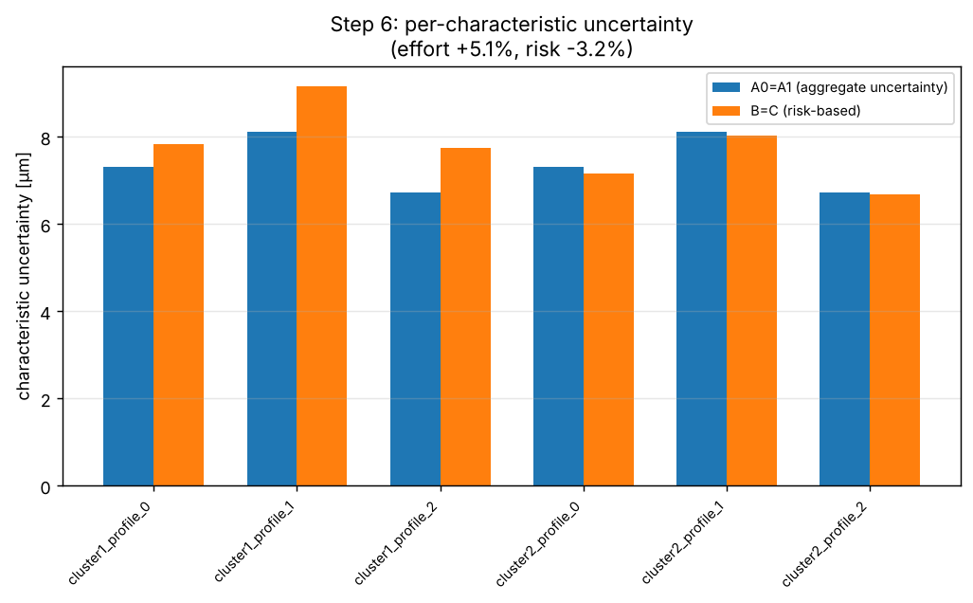
Headline experiment: two-cluster scene
6
run_headline_experiment() → panels 6, 7 and 8, regenerated by python -m viz.make_figures
STEP
default_two_cluster_scenario()
6 profile characteristics in 2 clusters (y ≈ ±2 m) · high-capability vs marginal · fixed anchor
uniform_weights · risk_derived_weights(8 µm)
computed once, before any search starts
grid_search_station_placement × 4
A0, A1, B, C: same 276 plans, same scene, only the score differs
HeadlineExperimentResult → PlanReport
stations, u per characteristic, global PFA and PFR → panel6a, 6b, 7
−3.2%
+5.1%
Variants +10 µm systematic term → *_systematic10um · mixed_tolerance_two_cluster_scenario() → *_mixedtol, panel8c
global risk, A0 = A1 → B = C
summed uncertainty, the price paid
function in src/ or viz/
input / data object
output / figure
check or rejection
Notes:
The headline experiment. One scene with a high-capability cluster and a marginal cluster, spatially separated so different stations genuinely serve them differently. The weights for A1 and B are computed once, before searching. Then the same grid search runs four times, once per objective. Result: the risk-based objectives move measurement effort from the high-capability cluster to the marginal one, reducing global risk by 3.2% at the cost of 5.1% more summed uncertainty. In this symmetric scene A0 and A1 pick the same plan, as do B and C; that is reported on the figures, not hidden. Variants add a 10 µm systematic term and a mixed-tolerance scene.

Slide 14
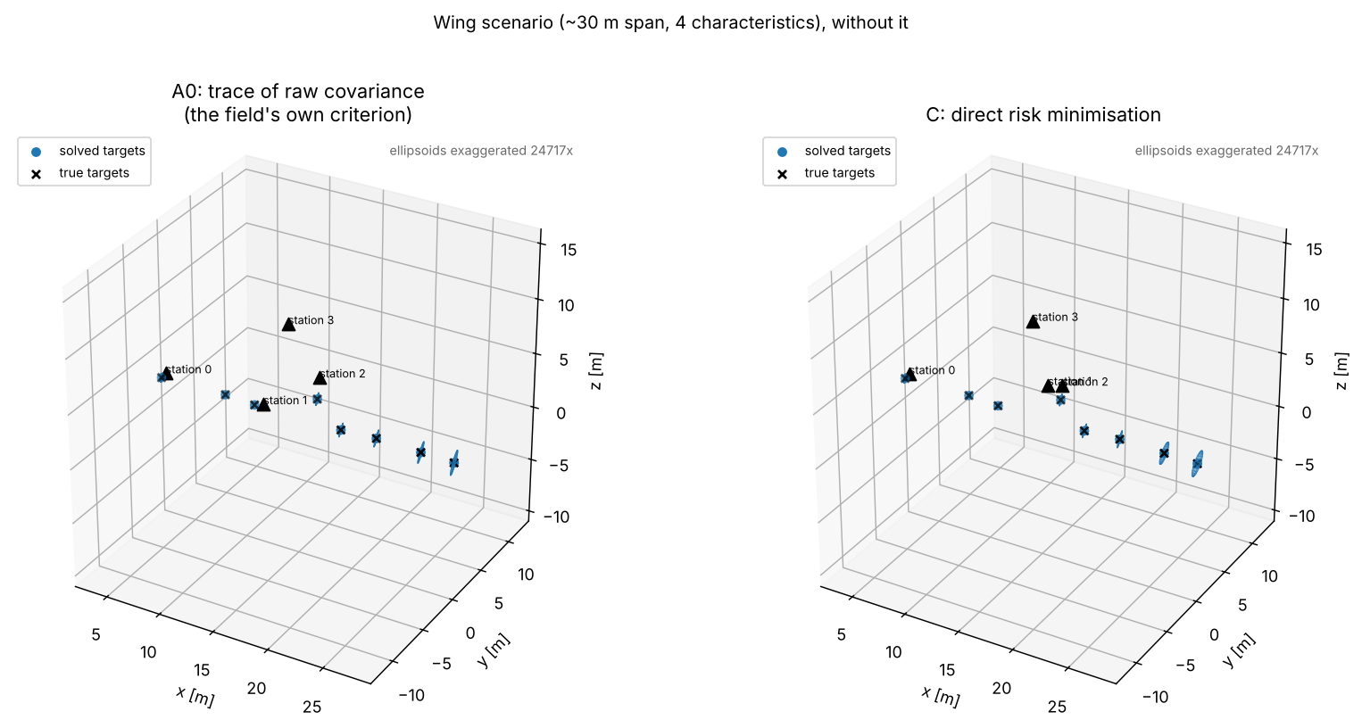
The wing scenario: occlusion, GA and seeding
6
run_wing_experiment() → panel 9, regenerated by python -m viz.make_wing_figures (about 14 minutes)
STEP
wing_four_point_scenario()
30 m span · 4 fittings + 4 tie points · support tower (box_mesh)
GA · A0
blind random start
GA · A1
seeded with A0
GA · B
seeded with A0, A1
GA · C
seeded with A0, A1, B
seeds
seeds
seeds
WingExperimentResult → _make_wing_panels
panel9a: station layouts (A0 vs C) · panel9b: per-characteristic bars
CHECK every winner is scored under every other objective's formula. An earlier −18.7% / −6.6% was withdrawn: it came from stations not rigidly tied to the network
−1.6%
−0.7%
risk, A0 → C, without the tower (GA noise ~1%)
risk, A0 → C, with the tower (GA noise ~1%)
Notes:
The harder scene: a single 30 m wing with four named fittings, four network tie points so stations near one end can still pin their own pose, and a support tower that blocks some sightlines. Grid search is combinatorially out of reach here, so each objective runs the GA. The objectives run in sequence and each later search is seeded with every earlier winner, a standard GA technique. That was adopted only after cross-checking caught two unseeded searches converging to clearly worse plans by their own measure. Correction: an earlier version of this slide reported 18.7% and 6.6% risk reductions. Those were wrong. The planner accepted stations that shared only one target with the network, which leaves that station free to rotate, and the covariance solve reports such a direction as zero variance. The search learned to exploit it. With rigid connectivity enforced, the four objectives are within 1.6% of each other, which is about the size of the GA's own imprecision. Three stations over 30 m leaves the uncertainty at 13 to 47 micrometres against a 50 micrometre tolerance, so total risk is about 0.8 for every objective.

Slide 15
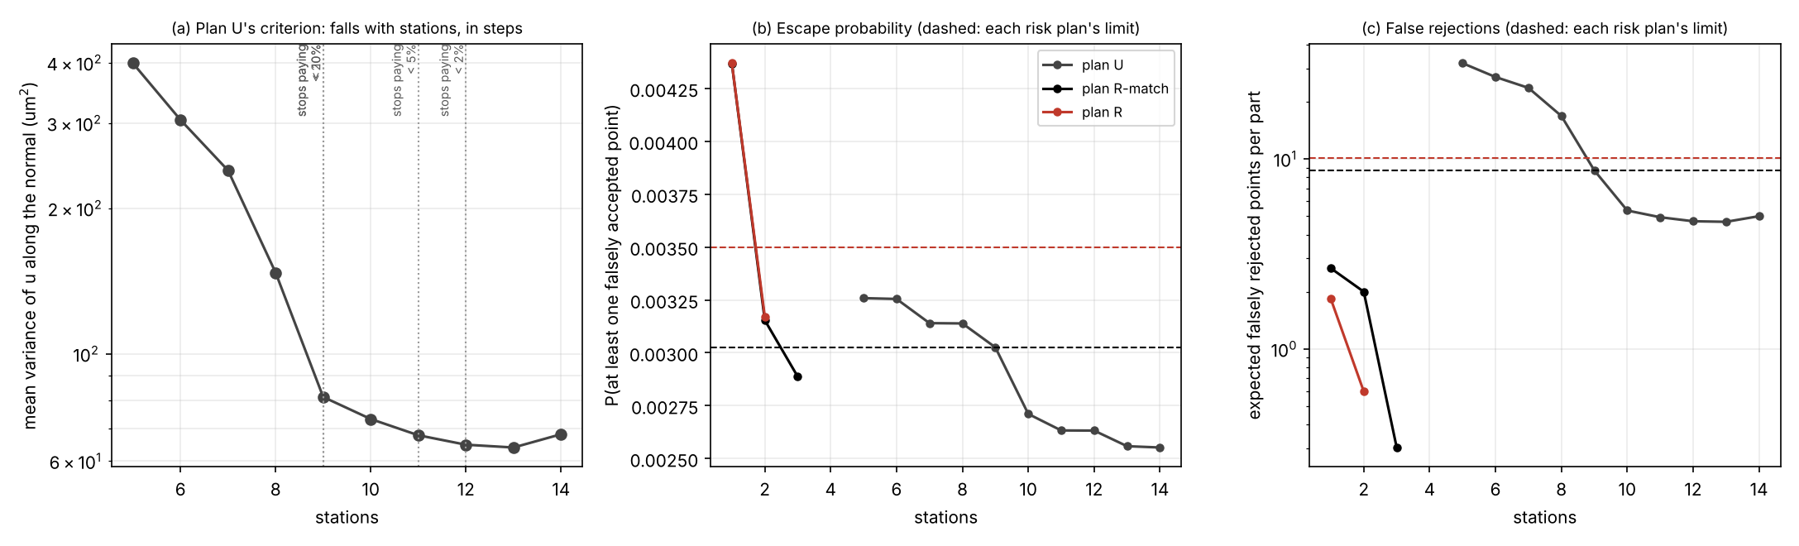
Wing box: uncertainty-driven vs risk-driven
run_inspection_experiment() → panel 10 · a separate experiment, outside the six-step ladder (CLAUDE.md §5)
build_wing_box_part()
500 points · 6 tasks · synthetic stand-in
visibility_matrix()
range · incidence · ray-cast
design_point_covariances()
rigid network, or rejected
projected_uncertainty_m()
u along the surface normal
RiskTable
JCGM 106 · cluster priors
Plan U · uncertainty-driven
A-optimal: minimise mean variance, every point measured; station count from the knee of the curve
Plan R · risk-driven
fewest stations with P(escape) and E[false rejects] within a limit; unmeasured points priced at process risk
9 → 3
−41%
29×
stations: U vs R held to U's own risk
shots (1151 → 679)
fewer expected false rejects
CAVEAT synthetic part, placeholder process clusters and priors. No published aerospace false-accept limit exists, so R is held to U's realised risk, not an invented one.
same GA, bounds and seeding for both plans; only the objective differs
Notes:
A separate experiment on a roughly 500 point wing box with six inspection tasks. The part is a synthetic stand-in because no CAD or point list was available. The chain is the project's own: visibility, then the covariance from the block-diagonal network form, then uncertainty along the surface normal, then JCGM 106 risk per point. Plan U is the conventional planner: every point measured, mean variance minimised, stations taken from where one more stops paying. Plan R minimises stations subject to a risk limit and may leave a point unmeasured, in which case it carries its process's own escape probability. No published acceptable false accept limit for safety critical aerospace inspection was found, so R is held to the risk plan U actually delivers. On the stand-in, U needs 9 stations and R needs 3, with fewer shots and about 29 times fewer expected false rejections. The hard TUR 4 to 1 rule could not be met at all.

Slide 16
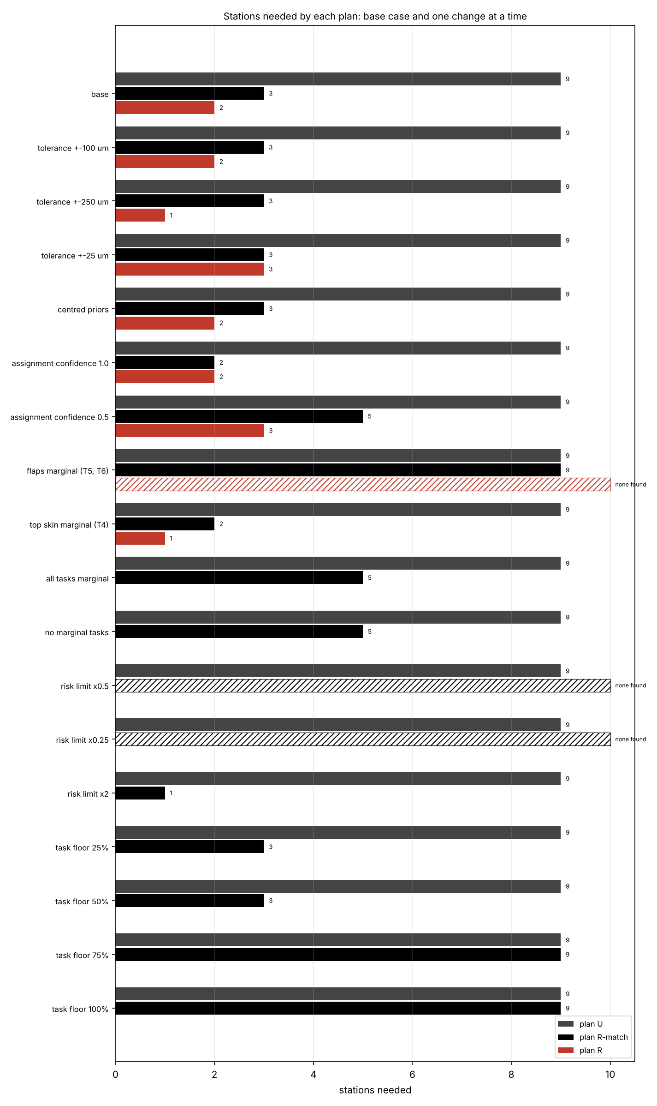
What the saving depends on
17 one-at-a-time changes; each is a full search (panel 10d)
ROBUST R needs 3 stations at ±25, ±50, ±100 and ±250 µm and under both prior shapes, because it is always held to whatever plan U delivers there. GA seeds: 3 every time.
SENSITIVE to the assumed cluster assignment: 2 stations if it is certain, 5 if it is only 50% reliable. A stricter limit cannot be bought: the process sets a floor on escape risk.
VANISHES if the hard-to-see flaps are the marginal cluster, or if policy requires ≥75% of every task measured: R needs 9, plan U's own layout. The saving exists because the expensive points are the ones that rarely fail.
Which features are marginal, and how reliably, is what real process data must decide.
Notes:
The headline depends on specific things, and the sensitivity panel says which. It does not depend on the tolerance or the shape of the process prior. It does depend on the confidence in the cluster assignment, and it disappears if the points that are expensive to see are the marginal ones, or if a sampling policy forces those points to be measured. A stricter risk limit than plan U delivers cannot be met by any plan, because the escape probability has a floor set by the process. These are exactly the quantities that need real data.

Slide 17
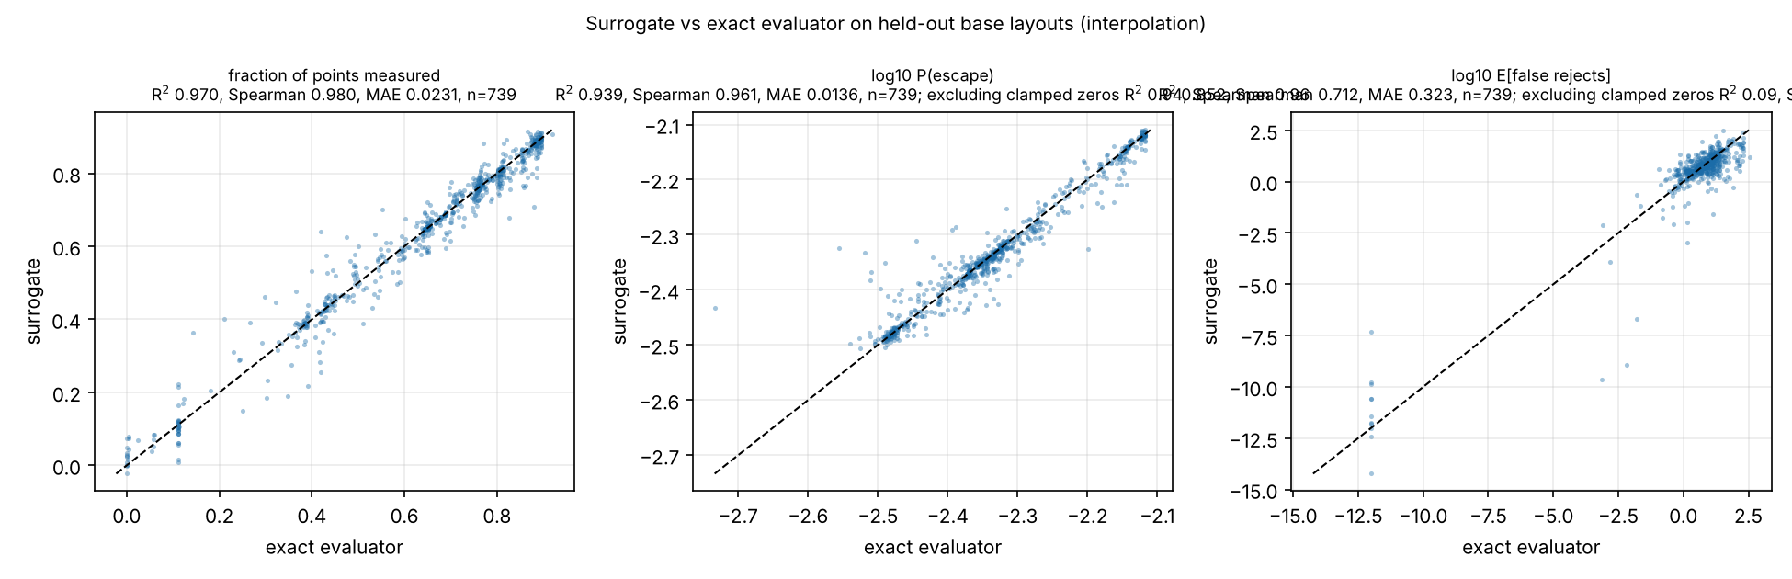
The ML surrogate and how it is validated
planning.surrogate · gradient-boosted trees (scikit-learn) standing in for the evaluator, never trusted without re-scoring
generate_layout_records()
12,743 simulated layouts
grouped_split()
by base layout; plus a held-out region
LayoutSurrogate
coverage · log risk · rigid?
surrogate_assisted_search()
GA on the surrogate, 4 rounds
evaluate_layout()
every plan re-scored exactly
R² 0.97
R² 0.09
fraction measured, held out; log P(escape) 0.94
E[false rejects], bulk of layouts
29–61×
no gain
held-out base layouts · every point is a layout the model never saw
CHECK used as the GA's objective with one round, none of the 60 best layouts met the limit at 2 or 4 stations, where the plain GA succeeds: the optimiser drives to where the model is wrong. Four rounds of exact re-scoring fix it.
fewer exact evaluations, same station count
in wall-clock: the evaluator is ~5–10 ms
Notes:
The brief asked for an ML model. The physics is known, so the model is a surrogate of the digital twin: given a station layout it predicts coverage, escape probability, expected false rejections and whether the network is rigid. The split is by base layout, because small perturbations of one layout are near-duplicates and a random split would leak. A second test holds out a whole region of the station box. Coverage and escape probability are predicted well; expected false rejections are not, outside the bulk. Used as the optimiser's objective, the surrogate is exploited, so the search re-scores a shortlist exactly and retrains. That reaches the same station counts with 29 to 61 times fewer exact evaluations, but not faster in wall-clock terms, because the exact evaluator is already fast. The value is later: slower physics, and real measurement data in the training set.

Slide 18
From code to figures
3
PART 3
Which function draws which figure, and how each result is checked

Slide 19
Every figure and the function that draws it
Three entry points: panels 1–8 are identical on every run; panels 9 and 10 are GA runs
viz/make_figures.py
main() · 2–3 min · deterministic
make_panel1_scene
panel1_scene · step 1 error ellipsoids
make_panel2_network
panel2_network · step 3 network solve
make_panel3_uncertainty
panel3_uncertainty · step 3 uncertainty vs stations
make_panel4_characteristics
panel4_characteristics · step 4 tolerance types
make_panel5_risk
panel5_risk · step 5 risk vs uncertainty
make_panel6_and_7
panel6a, 6b, 7 (+ _systematic10um) · step 6 headline
make_panel8_mixed_tolerance
panel6a/6b_mixedtol, panel8c · tolerance-mix check
make_wing_figures.py
make_panel9_wing
panel9a, 9b (+ _tower) · wing scenario
make_wingbox_figures.py
make_wingbox_figures
panel10a–e · wing-box experiment and ML
All outputs are written to results/ as .png
Notes:
Two commands produce every figure. python -m viz.make_figures runs panels 1 to 8 in about two to three minutes. Steps 1 to 5 use fixed random seeds and step 6 uses noiseless exact observations, so there is no randomness anywhere and re-running leaves the committed figures byte-for-byte unchanged. python -m viz.make_wing_figures runs the wing scenario's GA searches, about 14 minutes with every BLAS library pinned to one thread; it is kept separate because it is slow and, being a GA, not guaranteed bit-identical across machines. python -m viz.make_wingbox_figures runs the wing-box experiment in stages (experiment, seeds, surrogate, figures), about two and a half hours in all. viz/ only ever imports from src/, never the other way round, so no plotting code lives inside the physics.

Slide 20
How each result is checked
Every link has a gate, and no number is reported without a cross-check
185
0
≤ 5%
16
automated tests
figures changed on regeneration
design vs noisy covariance
GA cross-checks per scene
One gate per build step, checked against CLAUDE.md §4 reference numbers, e.g. 5–7 : 1 anisotropy at 2.5 m.
Fixed seeds and noiseless observations: re-running make_figures leaves git diff results/ empty.
A test pins the noiseless design covariance to a genuinely noisy network solve.
Each of 4 winning plans scored under all 4 objectives' formulas. This caught two wrong searches, and re-scoring later exposed an invalid-network loophole.
Notes:
Four layers of checking. First, the test suite: every physical claim gets a test against a reference number where one exists, and every build step has a gate that must pass before the next begins. Second, determinism: the main figures reproduce exactly. Third, the shortcut step 6 relies on, noiseless observations, is pinned to a genuinely noisy solve by its own test. Fourth, GA results are never taken on trust: each objective's winning plan is scored under every other objective's formula. In the wing scenario this caught two searches that had converged to clearly worse plans, which is what led to population seeding. Re-scoring the saved plans with a faster evaluator later exposed a feasibility loophole, stations tied to the network by a single target, and the wing numbers were corrected.

Slide 21
Reproducing every figure
Four commands from a fresh clone; full write-ups live in docs/
pip install -r requirements.txt && pip install -e .
pytest # 185 tests, about four minutes
python -m viz.make_figures # panels 1–8, 2–3 min, identical every run
OMP_NUM_THREADS=1 OPENBLAS_NUM_THREADS=1 MKL_NUM_THREADS=1 \
NUMEXPR_NUM_THREADS=1 python -m viz.make_wing_figures # panel 9, ~14 min
docs/step1–step6_*.md
the physics and results behind each build step
CLAUDE.md
reference numbers, design decisions, build order
README.md / SETUP.md
setup on Windows / VS Code, interactive app.py explorer
Notes:
Everything in this deck can be regenerated from a fresh clone with these commands. The first three take a few minutes in total; the wing-scenario figures take about fourteen minutes and need the BLAS libraries pinned to one thread per process so the parallel GA is actually faster rather than slower. The docs folder has a write-up per build step, including every result quoted here and the caveats that come with them.

