Slide 1
Global decision risk: PFA, PFR and where the priors come from
What a measurement result can and cannot tell you about a part, and how that is calculated when aerospace builds are few
Calum Tierney · Queen's University Belfast · Supervisor: Prof. Paul Maropoulos · Industrial partners: GKN Aerospace, AMIC
Notes:
Two questions are covered. First, what are the equations for the probability of false accept and false reject, and what do they say. Second, how are they calculated in an aerospace setting, where there are too few builds to estimate process capability the classical way. Every figure here is computed with the testbed's own risk module, using the placeholder process priors from the wing-box experiment, so they illustrate the mechanics; they are not measured process data.

Slide 2
A measurement is not the truth
Noise can flip the accept/reject decision, in two different ways
measurement says
accept
reject
tolerance zone [−T, +T]
true part is good
correct
good part shipped
false reject (PFR)
good part scrapped or reworked: cost, yield
true value Y (inside: a good part)
×
error E
true part is bad
false accept (PFA)
bad part ships: the safety risk
correct
bad part caught
measured X = Y + E (outside: rejected)
deviation from nominal →
A good part close to a limit can be measured outside it, and a bad part close to a limit can be measured inside it. How often depends on the size of E and on how many true parts sit near a limit.
Notes:
The true deviation of a feature from nominal, Y, is never seen. What is seen is X, which is Y plus a measurement error E. A part is accepted if X is inside the tolerance. That gives a two by two table. Two cells are right. The other two are the wrong decisions: a bad part shipped, called a false accept, probability PFA, and a good part scrapped, called a false reject, probability PFR. For a safety-critical part the false accept is the one that matters for safety; the false reject is what costs yield and rework.

Slide 3
Three ingredients
The risk is a calculation over a population, so it needs all three
1 Measurement error E ~ N(0, u²)
2 Tolerance and decision rule
3 Process prior Y ~ N(μ, σ²)
u is the standard uncertainty along the tolerance direction. It comes from the digital twin: station layout → visibility → instrument error model → coverage covariance → projection onto the surface normal. This is what the planner controls.
Tolerance ±T from the drawing. Under simple acceptance (JCGM 106's baseline) the part is accepted if |X| ≤ T. A guard band would accept only inside a narrower interval, trading PFA for PFR.
Where true parts fall before anyone measures: the mean offset and the natural spread of the production process. One prior per cluster of features that share a process, not one per feature.
measured value X = Y + E true value Y from the prior, error E from the instrument
This is global risk (JCGM 106): averaged over the whole process population. It is not the risk for one particular measured value, which would also need the measured value itself.
Notes:
Three things go in. The measurement error, from the testbed's chain. The tolerance and decision rule, from the drawing. And the process prior, which is the population of true values the process makes. The risk is global because it is averaged over that population: how often, across all parts the process makes, does a wrong decision come out. The specific risk for one measured value is a different, related quantity.

Slide 4
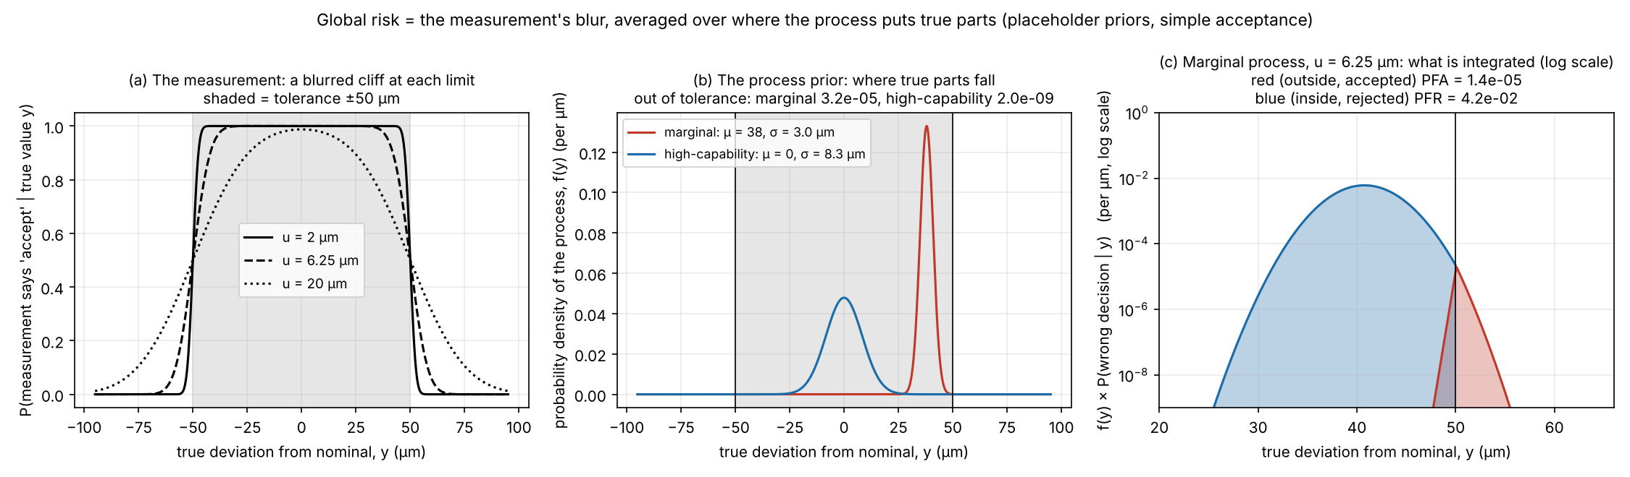
The equations
Accept probability from the measurement, averaged over the process (src/risk/jcgm106.py)
P(accept | y) = Φ((T − y)/u) − Φ((−T − y)/u)
chance the measurement says accept, if the true value is y
PFA = ∫ outside [−T,T] f(y) · P(accept|y) dy
bad part, measured as good: the out-of-tolerance mass of the process, times the chance noise lets it through
PFR = ∫ inside [−T,T] f(y) · (1 − P(accept|y)) dy
good part, measured as bad: the in-tolerance mass of the process, times the chance noise pushes it out
Notes:
Φ is the standard normal cumulative distribution. P of accept given a true value y is the Gaussian blur of the accept interval: close to 1 well inside the tolerance, one half exactly at a limit, close to 0 well outside. f of y is the process prior. PFA multiplies the prior by the accept probability and integrates over the out-of-tolerance region; PFR multiplies the prior by one minus the accept probability and integrates over the in-tolerance region. Both are one-dimensional and computed numerically. Panel c shows what is integrated for the marginal process; the vertical axis is logarithmic, so compare the printed values rather than the areas.

Slide 5
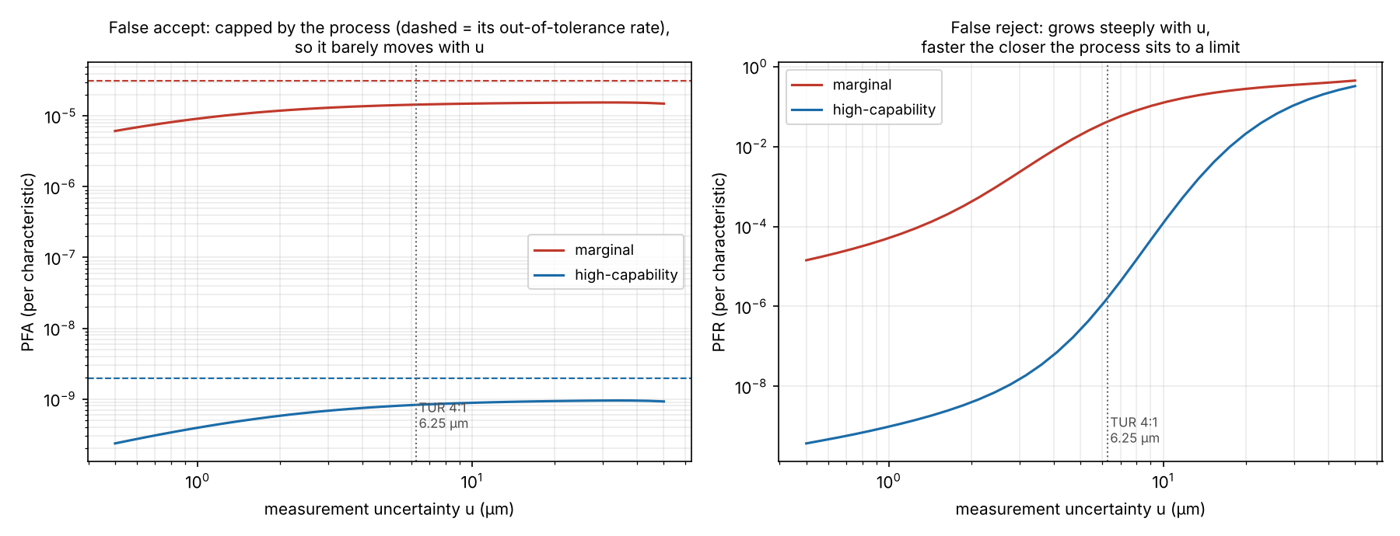
What the equations say
PFA is set by the process; PFR is set by the measurement
1 PFA can't exceed the process's own rate
PFA ≤ P(Y out of tolerance): 3.2×10⁻⁵ marginal, 2.0×10⁻⁹ high-capability. An unmeasured part escapes at exactly that rate.
2 PFR grows steeply with u
Marginal process: 5×10⁻⁵ at u = 1 µm, 4×10⁻² at 6.25 µm, 0.28 at 20 µm. Steeper the closer the process sits to a limit.
tolerance ±50 µm, placeholder priors; dashed = out-of-tolerance rate; dotted = TUR 4:1
3 u → 0 drives both to 0
SO WHAT Past a few µm, measuring harder barely lowers false accepts but cuts false rejects a lot. Where uncertainty is spent depends on which process is marginal.
u is the lever the planner holds: instrument, range, incidence angle, station layout, network ties.
Notes:
Left panel: PFA against measurement uncertainty. It sits just under a ceiling set by the process, the dashed line, and barely moves, because the ceiling is the fraction of parts that are actually bad. Right panel: PFR, which rises over several orders of magnitude, and rises sooner for the marginal process. For a safety-critical part this is the central finding: the consumer's risk is mostly decided by the process, and the plan mostly decides the producer's risk, plus which features are measured at all.

Slide 6
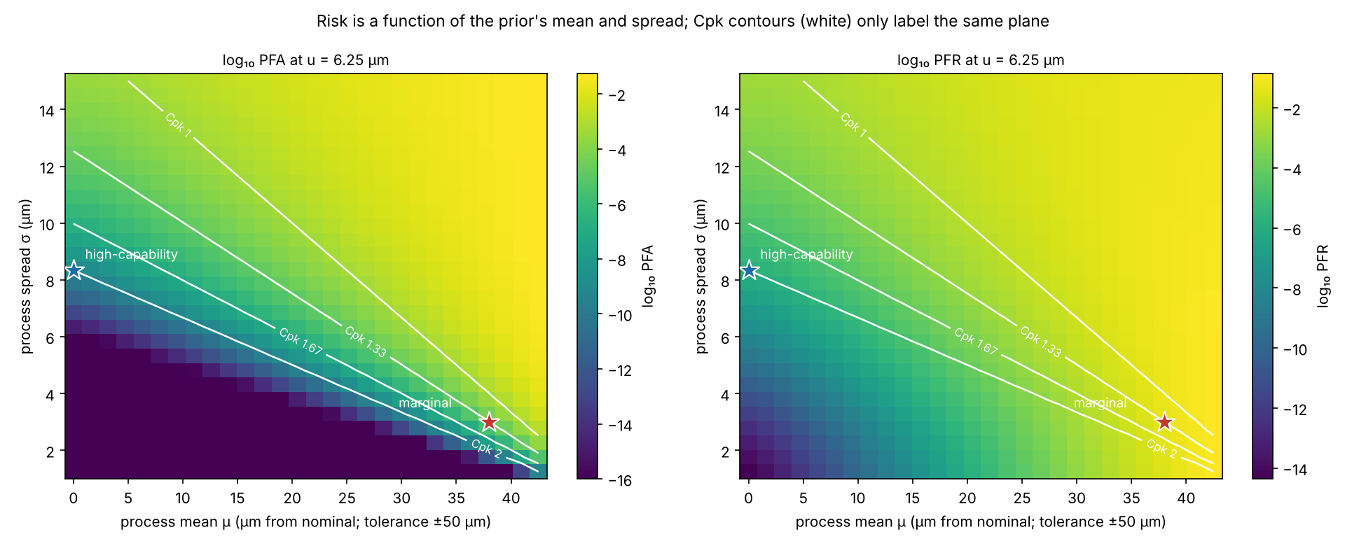
Cpk is a label, not an input
The integrals need the prior's mean and spread; Cpk just names a curve in that plane
Same Cpk, very different risk
Cpk = (T − μ)/(3σ) squeezes two numbers into one. At Cpk 1.33 and u = 6.25 µm:
• process biased to a limit (μ 38, σ 3 µm): PFR 4×10⁻²
• process centred, wide (μ 0, σ 12.5 µm): PFR 3×10⁻⁴
About 140× apart.
SO WHAT Not being able to compute a Cpk from 50 builds does not stop the calculation. It means μ and σ have to come from somewhere else, and the question is where.
Notes:
Each cell is the risk for a process with that mean and spread, with a measurement uncertainty of 6.25 micrometres against a plus or minus 50 micrometre tolerance. The white curves are lines of constant Cpk. The two stars are the placeholder processes used in the wing-box experiment: a marginal one pushed against a limit and a high-capability one centred with room. A single Cpk figure hides where the margin comes from, which changes false-reject risk by orders of magnitude. The code never uses Cpk: it uses the mean and the standard deviation directly.

Slide 7
The aerospace problem: too few builds
Classical capability needs ~50 samples of one characteristic; a wing programme doesn't supply them
T1 LE profile, right end
Per characteristic: impossible
Cluster A: marginal
one prior (μ, σ) shared by T1–T3: compound-curvature forming and machining
T2 LE profile, left end
One point on one wing, over a handful of builds, is a handful of samples. A per-point Cpk would be noise.
T3 free-form LE surface
T4 flat top skin
Cluster B: high-capability
one prior shared by T4–T6: flat skin and flap
Per cluster: feasible
T5 flap profile, right
Features sharing a production process behave alike, so their data can be pooled and one prior set per cluster (Schmitt et al.; CLAUDE.md §3).
T6 flap profile, left
placeholder assignment: no source says which wing-box features are harder to hold
500 characteristics (inspection points), in six tasks
Notes:
A characteristic is one toleranced thing to verify; in the wing-box experiment each of the 500 inspection points is one. A cluster is a group of characteristics made by the same production process, which therefore tend to go wrong in the same way. Classical process capability needs around fifty samples of a given characteristic, and aerospace builds too few units to supply that for any single point. So the prior is set once per cluster, pooling what is known about the process. The cluster assignment shown is the experiment's placeholder, not sourced.

Slide 8
Four ways to get μ and σ without 50 builds
Suggestions for the aerospace setting; none is implemented or sourced in the testbed yet
1 Elicit quantiles
2 Pool across features
3 Use your own data
4 Update with every build
Ask process engineers for what they can state: 'the typical deviation', 'the worst in 1 in 20 parts', 'is it biased to one side?' Two answers fit μ and σ directly. CLAUDE.md §3 specifies this route.
Non-conformance reports, first-article inspections, trial coupons, machine capability runs and other programmes' data for the same process all count as samples for the cluster, even if no single feature has 50.
One wing already has 60–120 measured points per cluster, and the twin knows each u. Since Var(X) = σ² + u², subtract the measurement part. Caveats: points are spatially correlated, and bias looks like offset.
Start from the elicited prior, update it as each build's data arrives (Bayesian). The plan for build 5 is better informed than the plan for build 1.
HONESTY Today every prior in the testbed is a placeholder (TODO(source) in the code). The results show which conclusions survive that: see slide 12.
Notes:
None of these is built in the repository yet; they are what could replace the placeholders. Elicitation is what CLAUDE.md specifies. Pooling is how a cluster gets data when no feature has enough. Estimating from the wing's own measurements works because the digital twin knows the measurement uncertainty, so the process spread can be recovered by subtraction, with the caveats on spatial correlation and bias. And a Bayesian update lets the prior sharpen as builds accumulate. If a prior cannot be pinned down, plan across a family of plausible priors.

Slide 9
Which cluster is a point in? That is uncertain too
CLAUDE.md §3: cluster assignment carries its own uncertainty and must be reported
PFA_i = c · PFA_label(u_i) + (1 − c) · PFA_other(u_i) PFR_i likewise
With confidence c the point's process is its labelled cluster; otherwise it is the other one. An unmeasured point escapes at the same mixture of the two out-of-tolerance rates and is never falsely rejected.
2.0×10⁻⁹
3.2×10⁻⁶
≈ 1,600×
escape risk of an unmeasured 'high-capability' point if c = 1.0
the same point if c = 0.9: a 10% chance it is really marginal
dearer to skip, from a 10% doubt about the label
EFFECT In the wing-box experiment the risk-driven plan needed 2 stations at c = 1.0, 3 at c = 0.9 and 5 at c = 0.5. How much you can safely skip hangs on how sure you are of the label.
Notes:
The step-5 risk module reports the assignment confidence but does not mix it into the numbers; the wing-box experiment does, as shown. The effect is large because the two clusters' out-of-tolerance rates differ by four orders of magnitude, so even a ten percent doubt about a point's label makes skipping it about sixteen hundred times more expensive in escape risk than it would be if the label were certain.

Slide 10
From one characteristic to a whole part
Sum over the points, then ask what the part-level risk is
E_FA = Σ PFA_i E_FR = Σ PFR_i
expected false accepts / false rejects per part, and the chance at least one bad point is accepted (points treated as independent: an approximation)
P_escape = 1 − Π (1 − PFA_i)
TUR 4:1 ⇒ u ≤ T / 8 (U = 2u)
ANSI/NCSL Z540.3 fallback rule: tolerance over expanded uncertainty at least 4:1
7.6×10⁻³
3.5×10⁻³
2.2×10⁻³
P_escape, 500 points, nothing measured
every point measured at the TUR limit (6.25 µm)
every point measured at 1 µm (about the best possible)
STRUCTURE Measuring everything perfectly only cuts escape risk by about 3.5× against measuring nothing. The process sets most of it. The plan decides which points are measured and how many false rejects it causes. (Wing-box placeholder priors, c = 0.9.)
Notes:
Part-level quantities are sums over the points. The escape probability is the chance that at least one point is falsely accepted. With the wing-box placeholder priors it is about 0.76 percent with nothing measured, 0.35 percent with every point at the TUR limit and 0.22 percent with every point at one micrometre. So the range between measuring nothing and measuring perfectly is only a factor of about three and a half; that is the structural fact behind the whole risk-driven planning argument.

Slide 11
What counts as 'acceptable' risk?
No published aerospace limit was found, so none was invented
Sourced anchors
Why they don't settle it
What the testbed does
ANSI/NCSL Z540.3 §5.3: PFA ≤ 2% per result, with TUR ≥ 4:1 only as a fallback. JCGM 106, ILAC-G8 and NASA-HDBK-8739.19-4 explain how to compute and control risk and set guard bands.
None is aerospace-specific and none gives a universal limit. Z540.3's 2% is about 600× looser than anything computed here (per-point PFA ≤ 3×10⁻⁵), so it constrains nothing.
Compares plans on relative terms: risk-driven plan held to the risk the conventional plan actually delivers, or to what a TUR 4:1 rule guarantees; the limit is swept. A programme limit drops in unchanged.
OPEN The programme or customer limit on false accept, and on false reject, and whether any inspection task may be left partly unmeasured, have to come from GKN / AMIC. That is a quality and safety decision, not a modelling one.
Notes:
Safety-critical does not come with a number. The anchors are Z540.3 and the JCGM documents, none specific to aerospace. The experiment avoids inventing a limit by comparing plans on relative terms and sweeping the limit. The absolute acceptable risk is an input that has to come from the programme.

Slide 12
What this means for planning
From the wing-box experiment: which conclusions survive placeholder priors (docs/wingbox_experiment.md §7)
Robust
Sensitive
Vanishes
Risk-driven plan needs 3 stations (against 9) at ±25 to ±250 µm and under both prior shapes, because it is held to whatever the conventional plan delivers there.
To cluster-assignment confidence (2 stations if certain, 5 at 50%), and a stricter limit than the conventional plan delivers cannot be bought: the process sets a floor.
If the hard-to-see flaps are the marginal cluster, or policy needs ≥75% of every task measured: the saving is zero.
To make it real, supply:
• μ and σ per cluster, by elicitation, pooling or data
• the cluster assignment and how sure you are of it
• real tolerances for each task
• the programme's acceptable risk, and any minimum sampling rule
Notes:
These are the findings from the wing-box experiment, all on a synthetic part with placeholder priors. The saving is not an artefact of tolerance or prior shape. It does depend on how sure the cluster label is, and it disappears if the points that are expensive to see are the ones whose process is marginal. Those are exactly the inputs that real process data has to supply.

Slide 13
Takeaways
Global risk is a population calculation: measurement blur averaged over where the process puts true parts
1
PFA and PFR are integrals
of the process prior against the chance the measurement accepts. PFA is capped by the process; PFR is driven by the measurement.
2
The inputs are μ and σ, not Cpk
Cpk is a label for a curve in that plane. Two processes with the same Cpk can differ ~140× in false rejects.
3
With few builds, set priors per cluster
by elicitation, pooling, the wing's own data and Bayesian updating, and report how sure the cluster assignment is.
4
Every number depends on those priors
so plan across plausible ones, and get the real μ, σ, assignment and acceptable-risk limit from the programme.
Notes:
Four points to leave with. The equations, the fact that Cpk is not an input, how to set priors when builds are few, and that every number rests on those priors.

