Slide 1
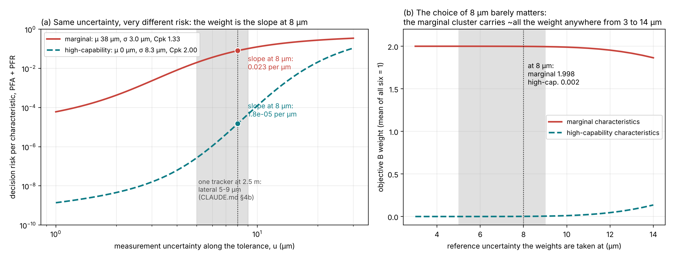
Two clusters, and why the weights use 8 µm
6
Objective B weights each characteristic by how fast its risk grows with measurement uncertainty
STEP
Marginal cluster · Cpk 1.33
Mean 38 µm, spread σ 3 µm, against ±50 µm. GKN's standard-process floor (the AS13006 minimum): legal, but sitting close to one limit. Out of tolerance: 3 in 100,000.
High-capability cluster · Cpk 2.0
Centred on nominal, σ 8.3 µm. GKN's zero-defect target for critical characteristics: plenty of room both sides. Out of tolerance: 2 in a billion.
weight = slope of risk at 8 µm
w ∝ d(PFA + PFR) / du at u = 8 µm
then scaled so the six weights average 1
Representative
One tracker at 2.5 m gives 5–9 µm across the beam (CLAUDE.md §4b). 8 µm sits inside that band.
Fixed before the search
Using each candidate plan's own u would change the scoring rule from plan to plan. B must stay 'same optimiser, different objective'.
Not sensitive
Anywhere from 3 to 14 µm the marginal cluster takes ~all the weight: at 8 µm its slope is ~1,240× the other's.
Notes:
The headline scene has two groups of characteristics made by two processes. The marginal process sits at GKN's standard capability floor, Cpk 1.33: legal, but with its mean 38 micrometres from nominal, close to the 50 micrometre limit, so a few micrometres of measurement noise can tip good parts out. The high-capability process is at GKN's zero-defect target, Cpk 2.0, centred with room on both sides. Objective B needs one weight per characteristic, and the weight is how fast that characteristic's risk grows as its uncertainty grows: the slope of the curve on the left, measured at 8 micrometres and scaled so the weights average one. Why 8? It is a realistic single-tracker uncertainty, inside the 5 to 9 micrometre band the error model predicts at 2.5 metres. It has to be one fixed value chosen before the search, because if each candidate plan were scored with weights from its own uncertainty, the scoring rule would move during the search and B would no longer be a fair comparison with A1. And the right panel shows the choice hardly matters: anywhere from 3 to 14 micrometres the marginal cluster gets almost all the weight. Objective C avoids the choice altogether by using the exact risk of every candidate.

