Slide 1
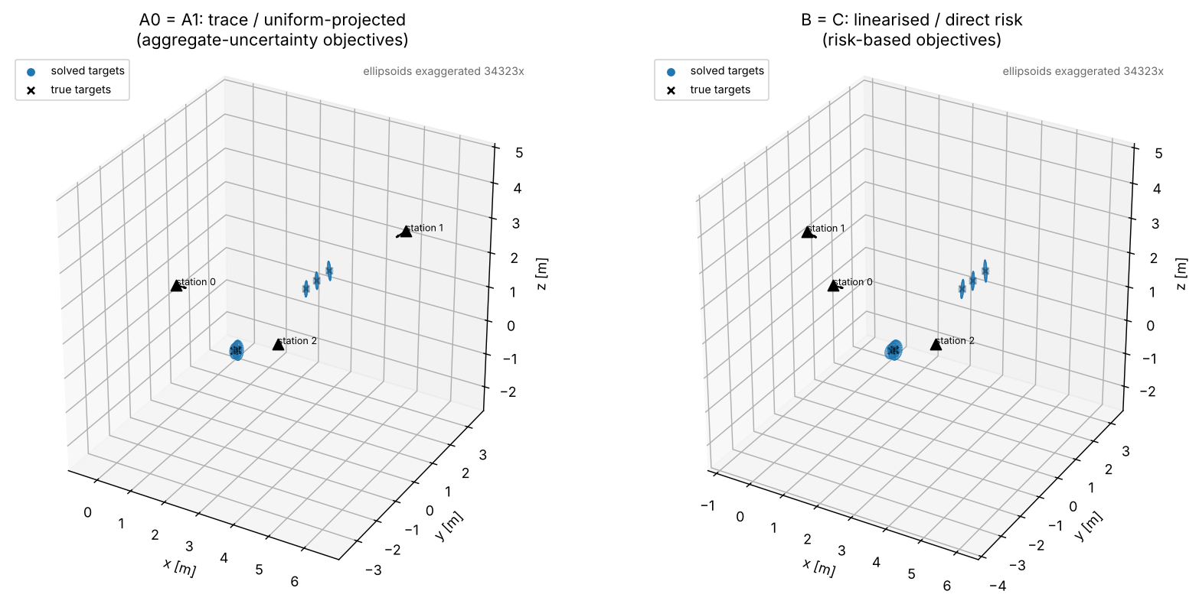
Next steps
From a test scene to large-volume use cases
today
large-volume aerospace structures: up to 30 m
0 m
5 m
10 m
15 m
20 m
25 m
30 m
1
Scale up the digital environment
2
Simulate on a real wing / fuselage
more stations
CAD model (STL)
hundreds of targets
inspection points + surface normals
longer ranges
simulate the measurement (steps 1–5)
today: 6 characteristics, a few metres
factory obstacles
station plan, before anyone measures
Notes:
So far the testbed runs on a deliberately small test scene: six characteristics, a few metres across, synthetic geometry. That was enough to build and check each step of the chain. The next step is to make the digital environment look like real large-volume metrology: structures from about 2 up to 30 metres, many more stations and target points, longer ranges where the angular error grows, and the jigs and towers that block sightlines on a factory floor. The second step is to drive it from a real part: load the CAD model of a wing or fuselage section and its inspection points, and simulate the measurement end to end, so a station plan can be compared and chosen before anyone sets up an instrument.

