Slide 1
PICA
Business Plan
A. Ball, N. Jen, A. Sterk, K. Wiersma

Slide 2
Outline
Mission Statement
Industry Profile
Business Strategy
Our Products
Marketing Strategy

Slide 3
Outline (cont.)
Location
Plan of Operation
Financial Forecast
Investment Proposal

Slide 4
Mission Statement

Slide 5
Industry Profile

Slide 6
Business Strategy
SWOT Analysis
Strengths, Weaknesses, Opportunities, Threats
Competitor Analysis
Differentiation

Slide 7
Our Products
Breakers
Base Station
E-Meter

Slide 8
Marketing Strategy

Slide 9
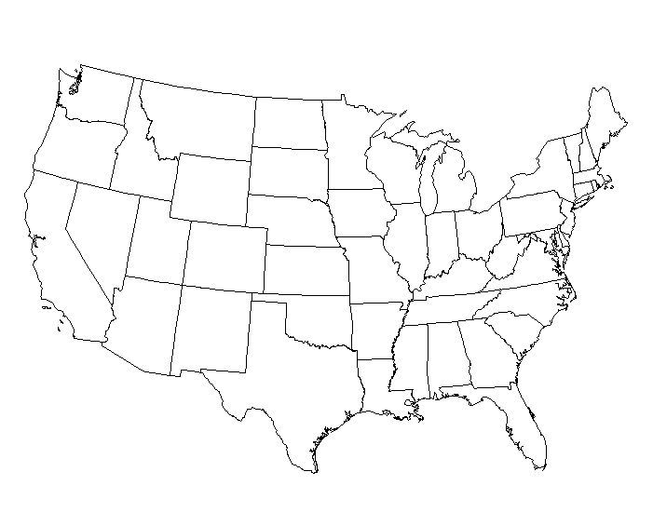
Location
Grand Rapids
Chicago
West & South

Slide 10
Plan of Operation

Slide 11
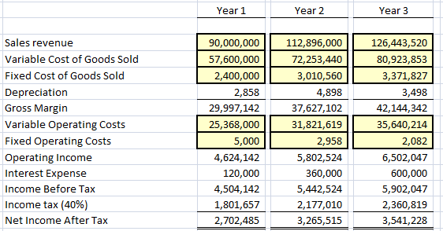
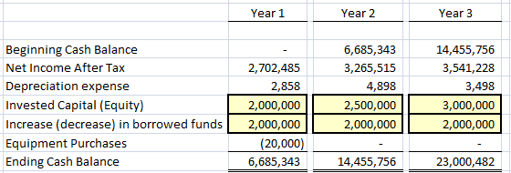
Financial Forecast Breakers

Slide 12
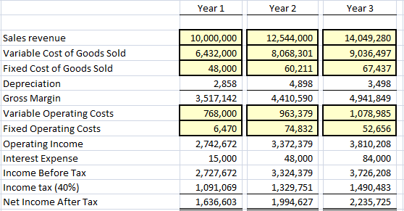
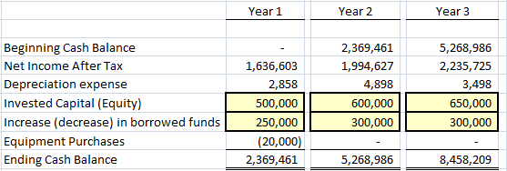
Financial Forecast Base Station

Slide 13
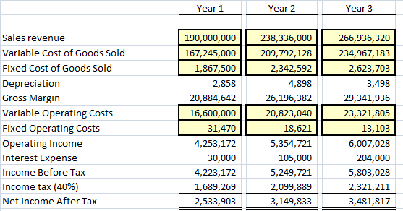
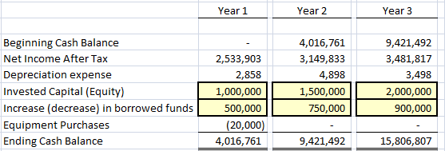
Financial Forecast E-Meter

Slide 14
Investment Proposal

