Slide 1

Team 01: PICA
Power Information Collection Architecture
Amy Ball, Nate Jen,
Avery Sterk, Kendrick Wiersma

Slide 2

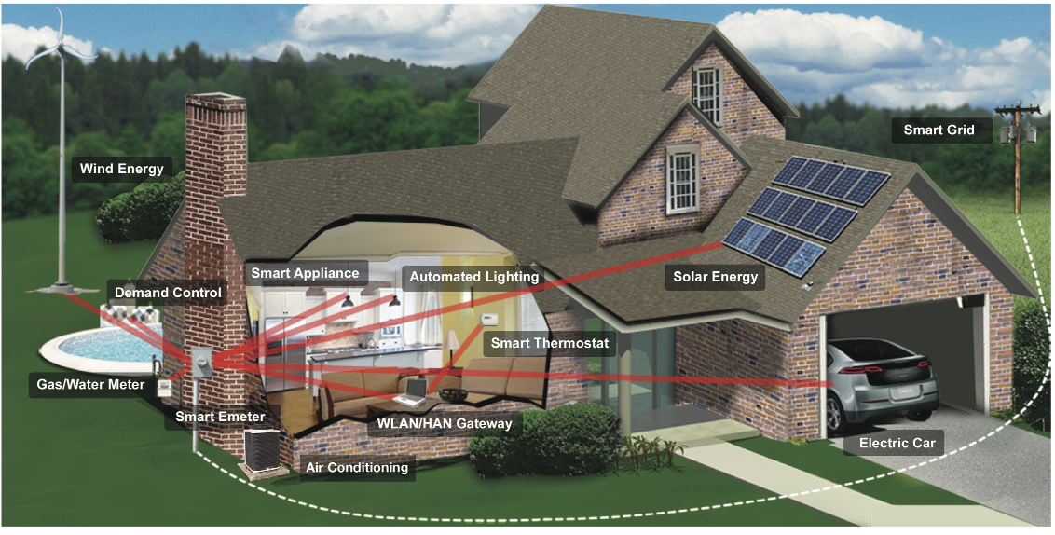
Home of the Future
?
?
?
?
?
?
?

Slide 3


The Problem
Consumers know only about their total power usage for the given billing period.
Consumers have no way to budget for how much energy they will consume during a billing period.

Slide 4

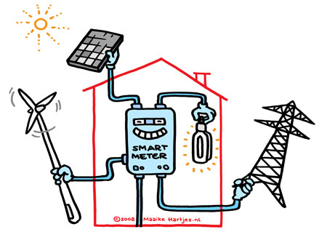
The Smart Meter

Slide 5
The Solution
Provides the ability to measure power on a circuit-by-circuit basis, providing the consumer with previously unavailable information.
Provides the capability to create a “power budget”, providing the consumer with a way to budget power consumption.

Slide 6


Modular Design
Market penetration
Adoption rate
Interoperability

