Slide 1

Team 01: PICA
Power Information Collection Architecture
Amy Ball (EE), Kendrick Wiersma (EE), Nate Jen (EE), Avery Sterk (EE)

Slide 2
Problem Statement
Currently, the power distribution network does not adequately handle local power generation, it is designed in a vertical fashion.
Consumers do not know enough about how, or where the electricity they purchase is being used.
Power companies cannot communicate in real-time to consumers when power is in short supply.

Slide 3
Project Goals
Track how power is used on a circuit-by-circuit basis.
Implement a power “budget” that allows the consumer to specify goals for power consumption.
Alert and/or notify consumers about real-time concerns involving the power system.

Slide 4
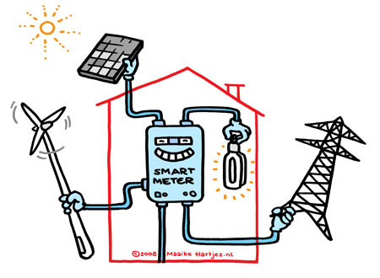
Customer
Average homeowner and businesses
Circuit-by-circuit analysis module
Central data collection base-station
Power utility companies
Smart meter module
Power line communications Module

Slide 5
Alternatives
T.E.D. (The Energy Detective)
Monitors whole installation power usage only.
Uploads usage data to a website to assist with tracking power usage.
Standard Power Meter
Monitors whole installation power usage only.
Requires specific knowledge to understand data output.

Slide 6
Obstacles
Electric Codes
System size
Budget
Schedule

Slide 7
Accomplishments
Market research
Identified several part venders who provide parts for a system similar to this.
Identified a potential project partner, Consumer’s Energy.
Begun to write system requirements

Slide 8
Design Norms
Responsibility
Transparency
Stewardship
Integrity

Slide 9
Questions or comments?

