Slide 1

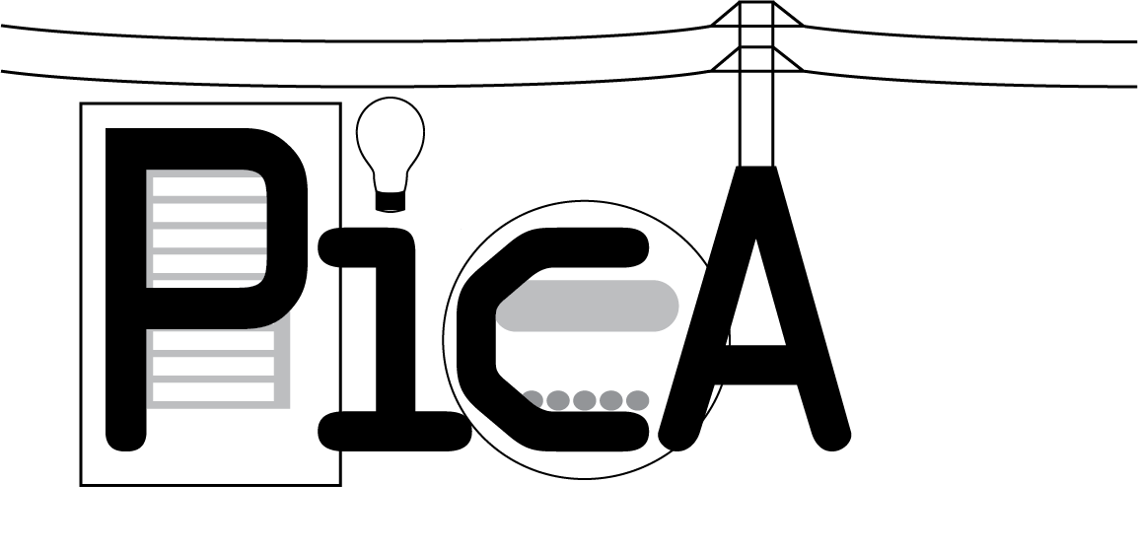
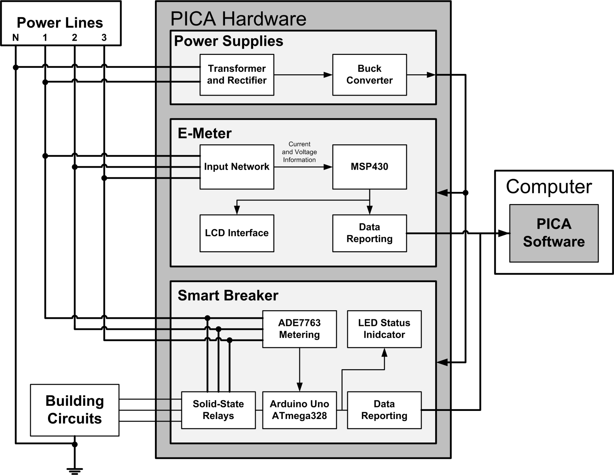
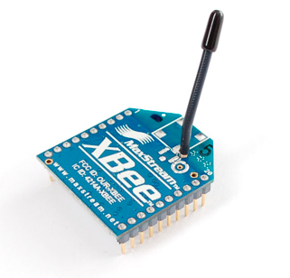
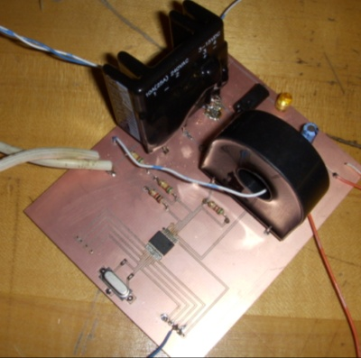
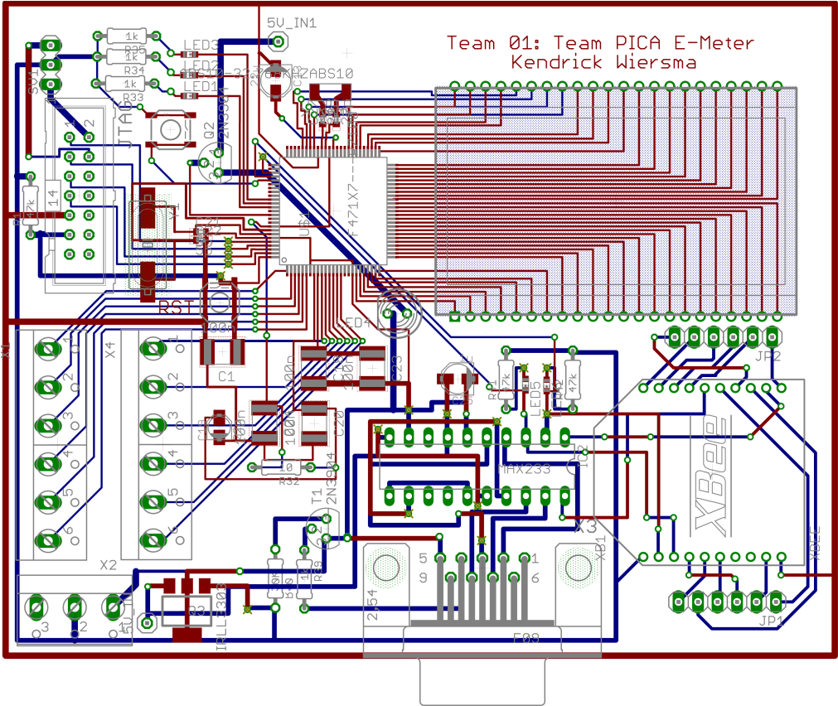

Power Information Collection Architecture
E-Meter:
The E-Meter provides real-time information about total power consumption in a home. It features a Texas Instruments MSP430 MCU.
Monitors current and voltage for 3 phases
Computes power for up to three phases
Displays power on an easy-to-read LCD screen
Problem Overview:
Despite recent technological advances, most Americans rely on electric meters that run on decades-old metering technology. At the same time, Americans have become accustomed to accessing large amounts of real-time data, which traditional meters cannot provide. Moreover, both the demand for electricity and the price for its energy have continued to rise.
Smart Breakers:
The solid state breakers provide real-time circuit monitoring and control. Each breaker consists of a solid-state relay, and an ADE7763, each controlled by an Arduino microcontroller.
Measures voltage and current
Provides typical breaker functionality
Sends usage and status to the base station
Our system uses advanced metering technology so that homeowners can have
Real-time information on total power usage
Localized power usage information
An easy-to-use interface for this information
Xbee Radio
Smart Breaker Demo Board
Base Station:
The base station software runs on a Linux PC and uses an Xbee radio to interact with the other devices.
Gathers data from other PICA devices
Analyzes the data for relevant information
Displays usage information with an understandable interface
Provides control of the other PICA devices
Amy Ball (EE), Kendrick Wiersma (EE),
Nathan Jen (EE), Avery Sterk (EE)
E-Meter Logic Board Schematic

