Slide 1
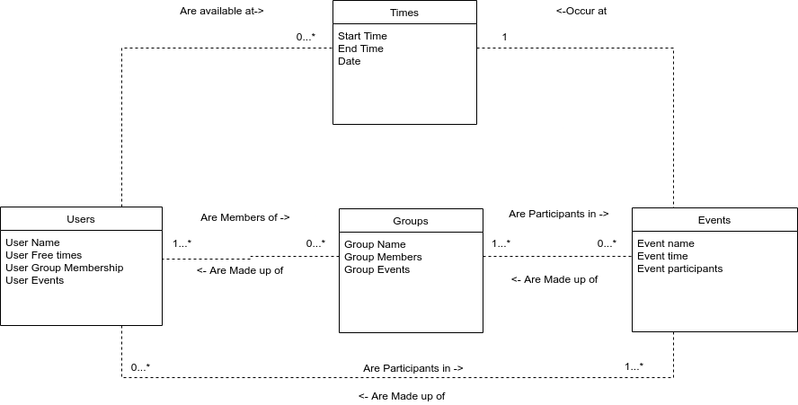
Notes:
So you can see here that a user could have be free a variety of times during the week or not at all.

Slide 2
Notes:
Similarly, a user could be a part of as many groups as possible, or none at all. However, a group has to have at least one user as a group member.

Slide 3
Notes:
And finally, a user be a participant in as many events as they want, or none at all.

Slide 4
Notes:
Groups, just like users, are able to be a part of as many events as possible, or none at all.

Slide 5
Notes:
And finally, an event can only happen once, so it only has one time.

