Slide 1
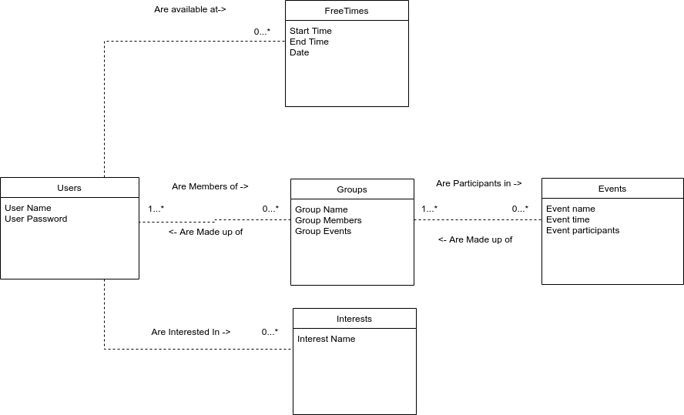
Notes:
Groups, just like users, are able to be a part of as many events as possible, or none at all.

Slide 2
Notes:
Groups, just like users, are able to be a part of as many events as possible, or none at all.

Slide 3
Notes:
Groups, just like users, are able to be a part of as many events as possible, or none at all.

Slide 4
Notes:
Groups, just like users, are able to be a part of as many events as possible, or none at all.

Slide 6
Notes:
Groups, just like users, are able to be a part of as many events as possible, or none at all.

