Slide 1

Canine Convention
Henry Baldacci, Sarah DeYoung, Eric Klomp, Gia Mien Le, Valerie Vreugdenhil

Slide 2
Demo

Slide 3
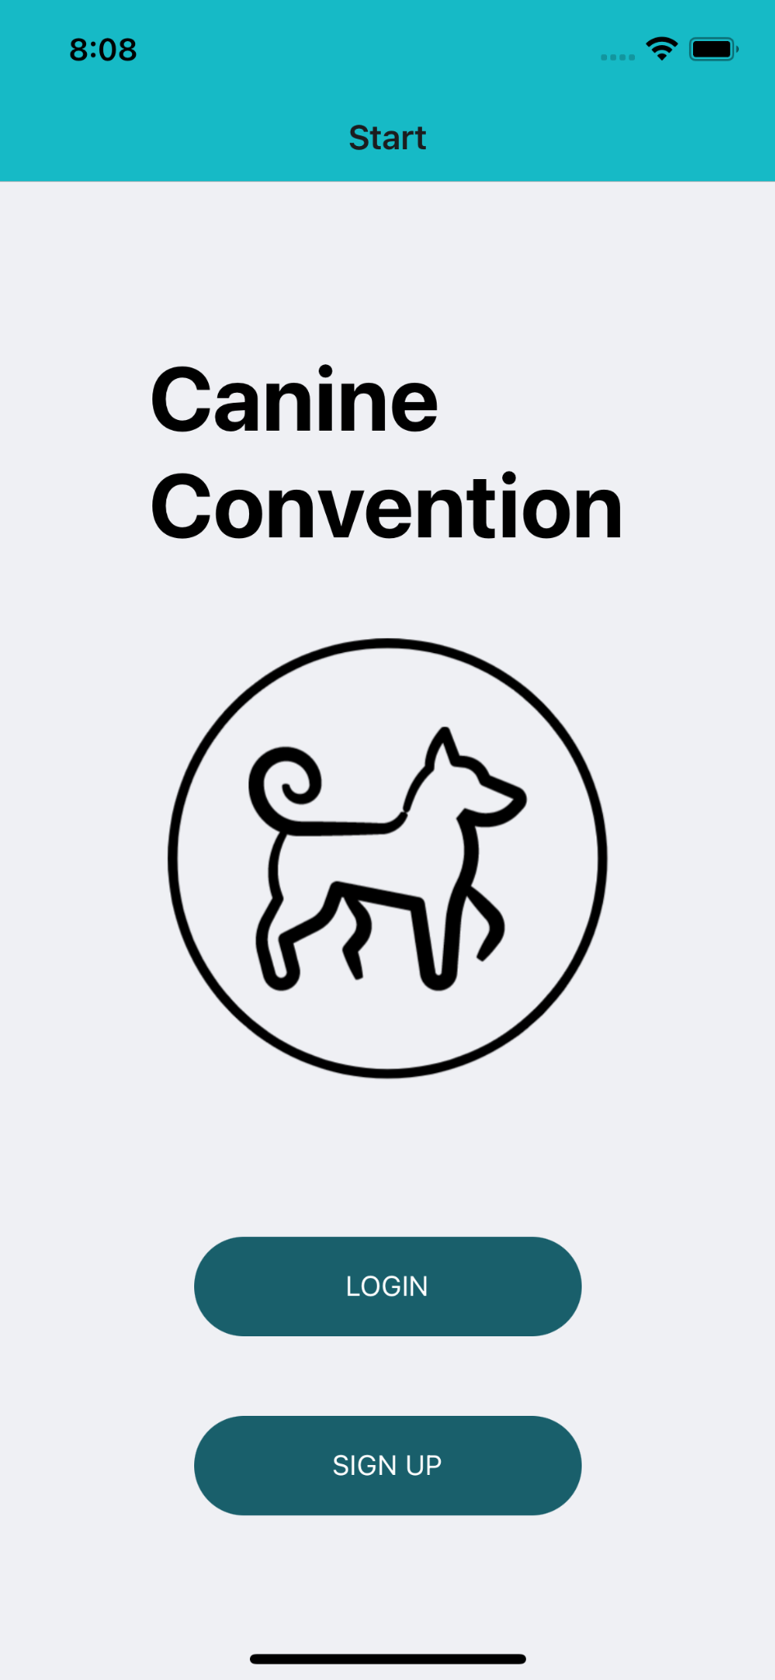
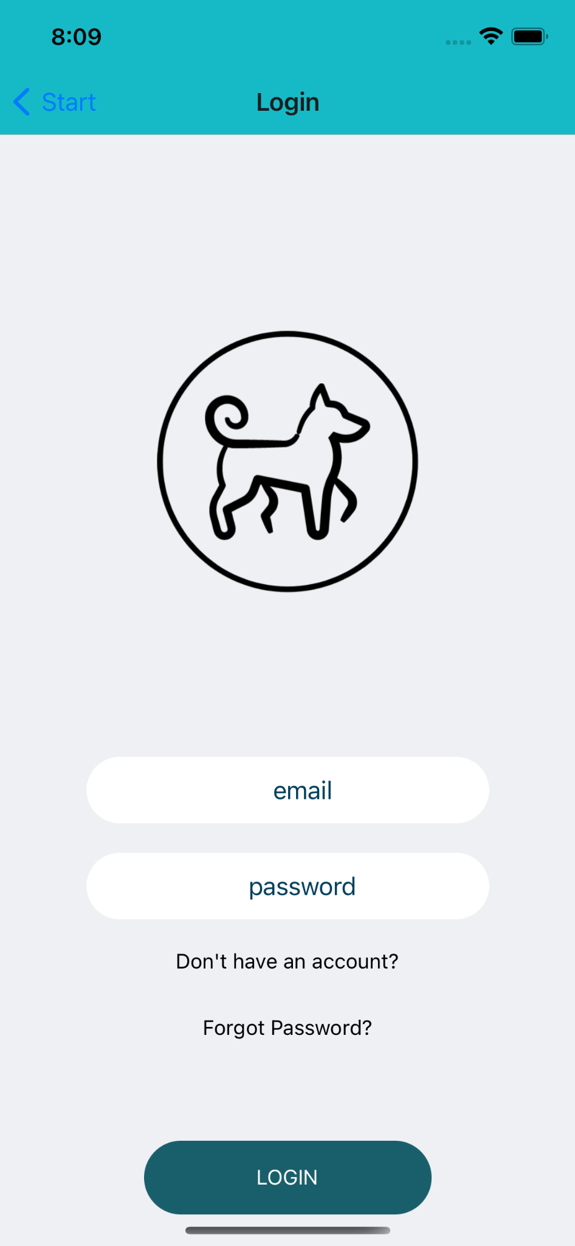

Slide 4
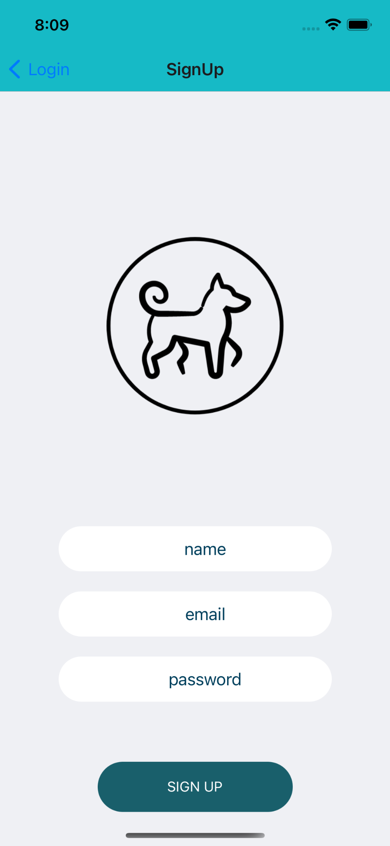
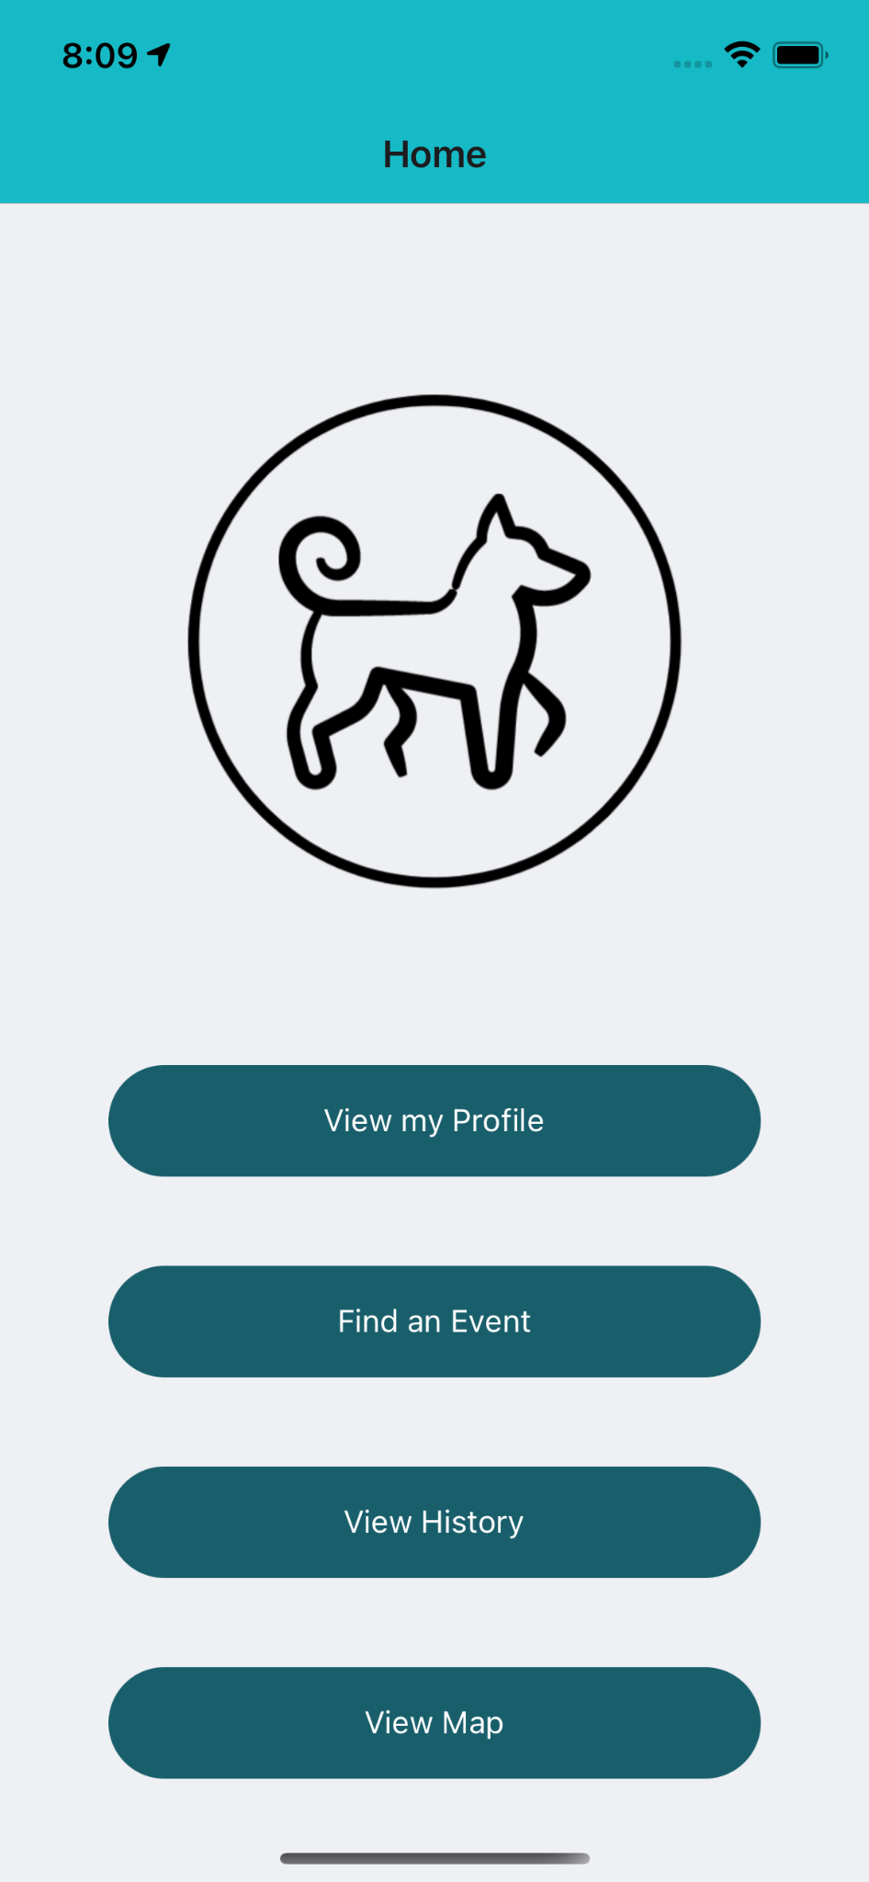

Slide 5
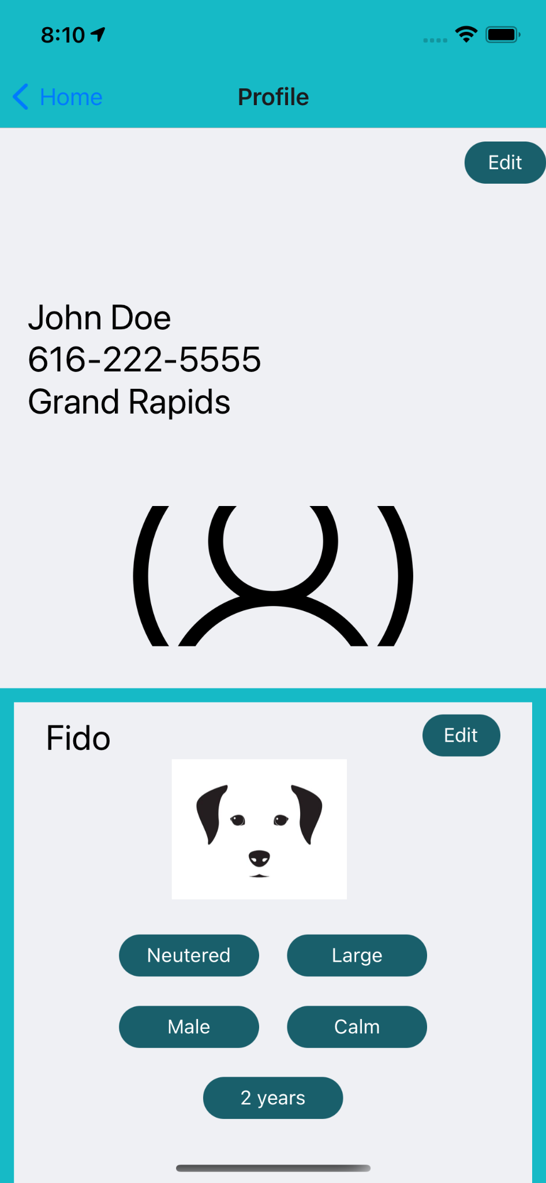
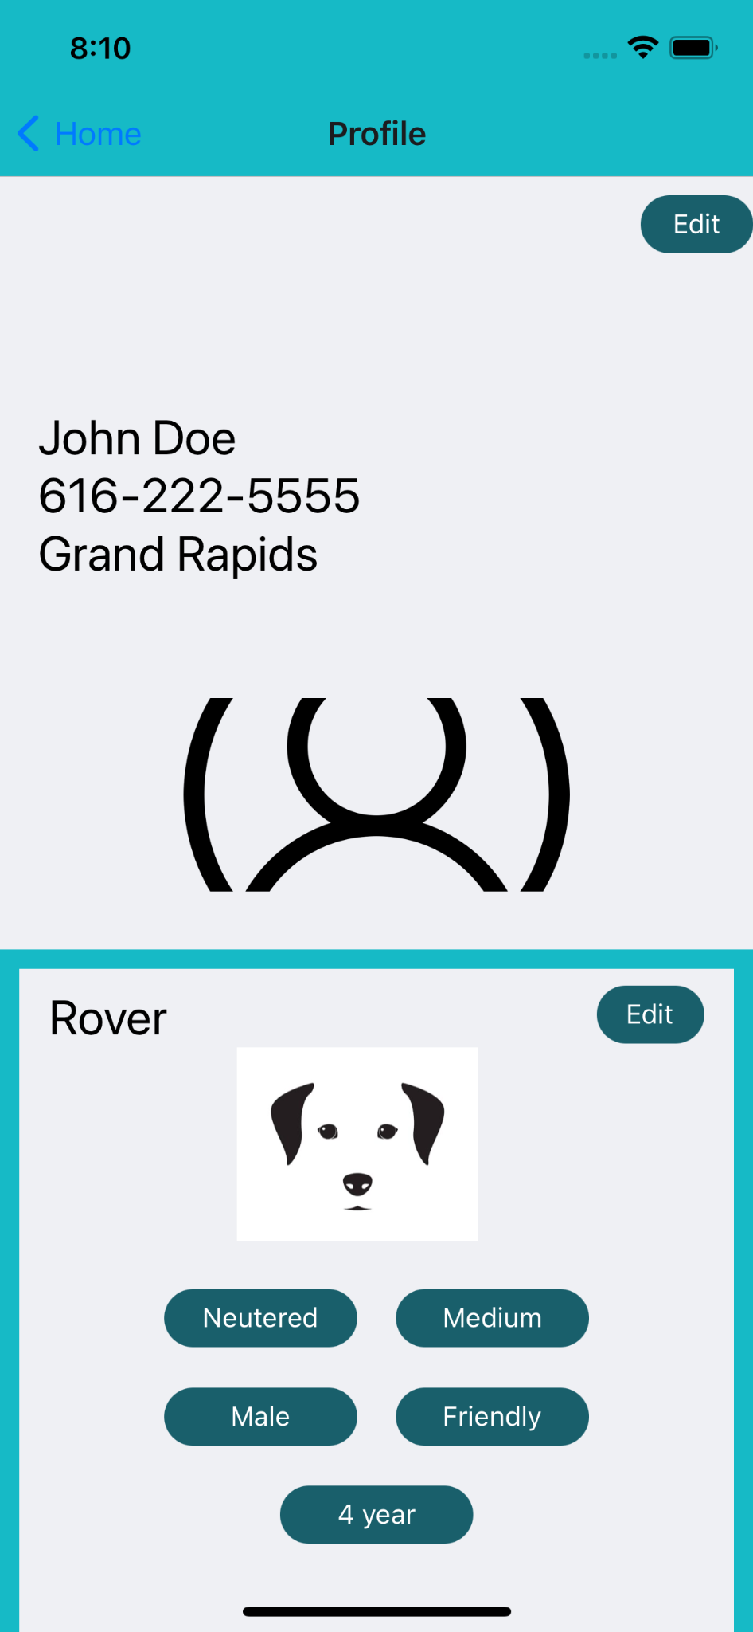

Slide 6
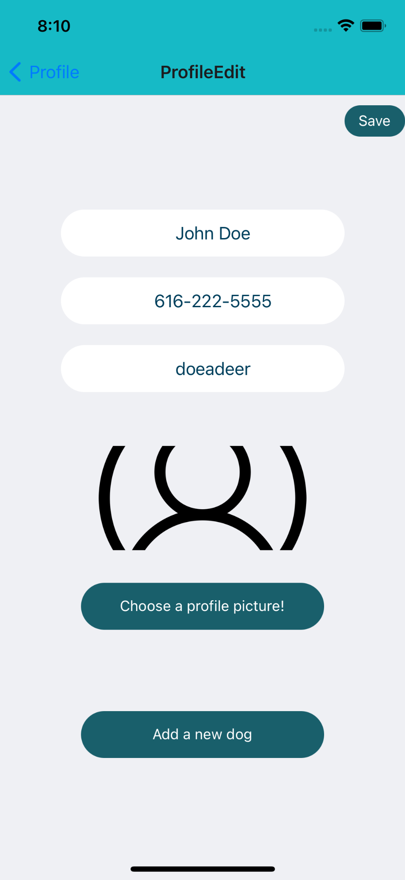
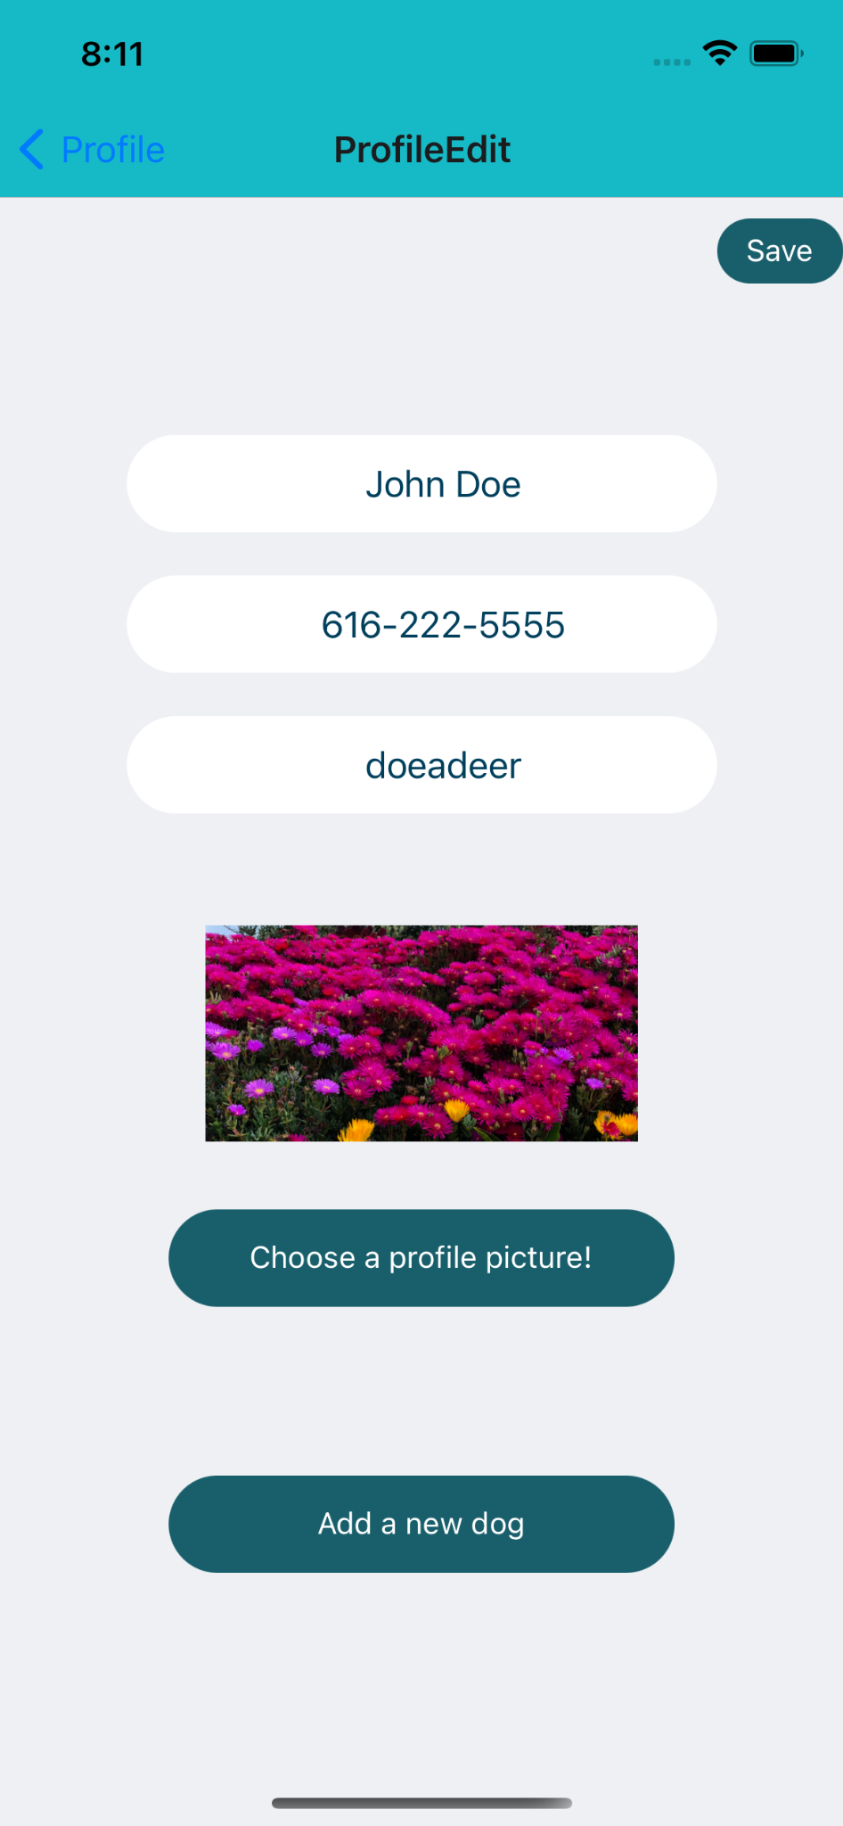

Slide 7
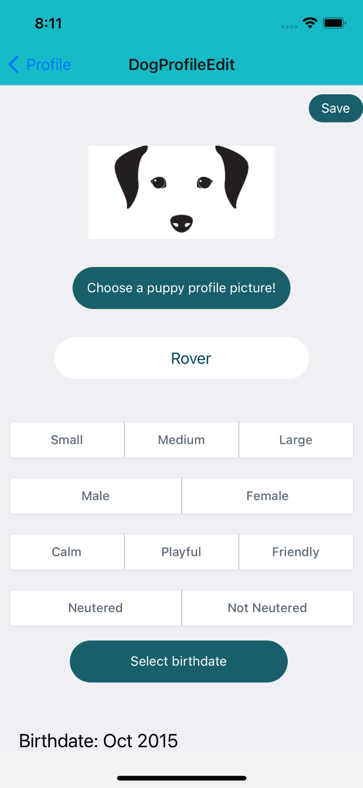
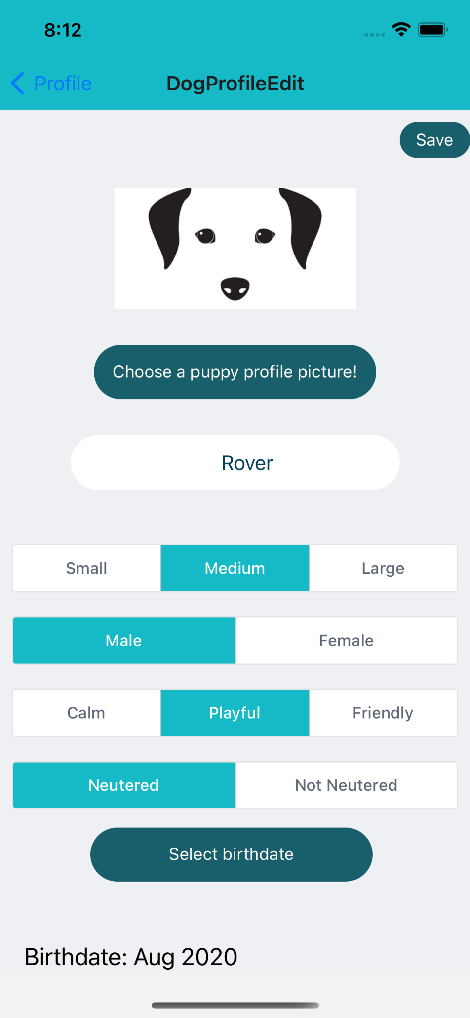

Slide 8
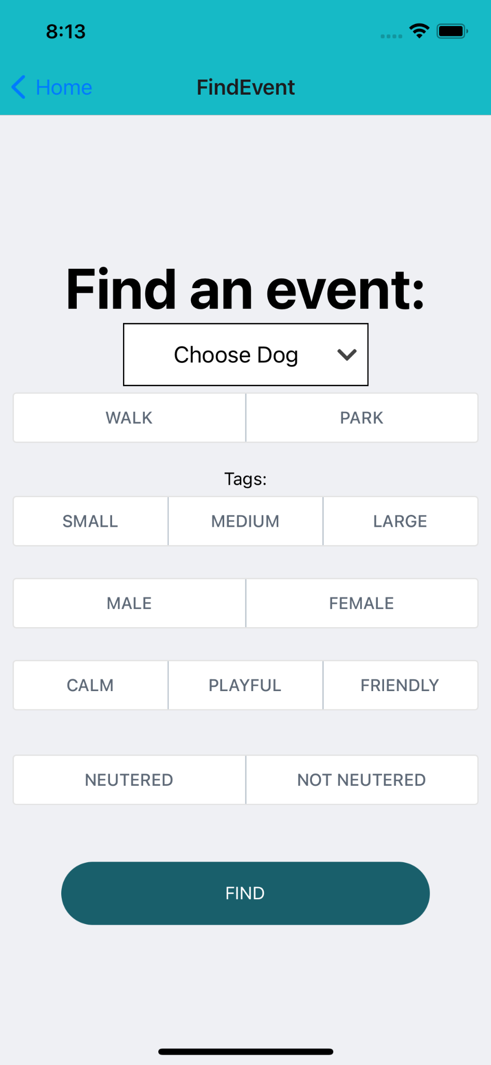
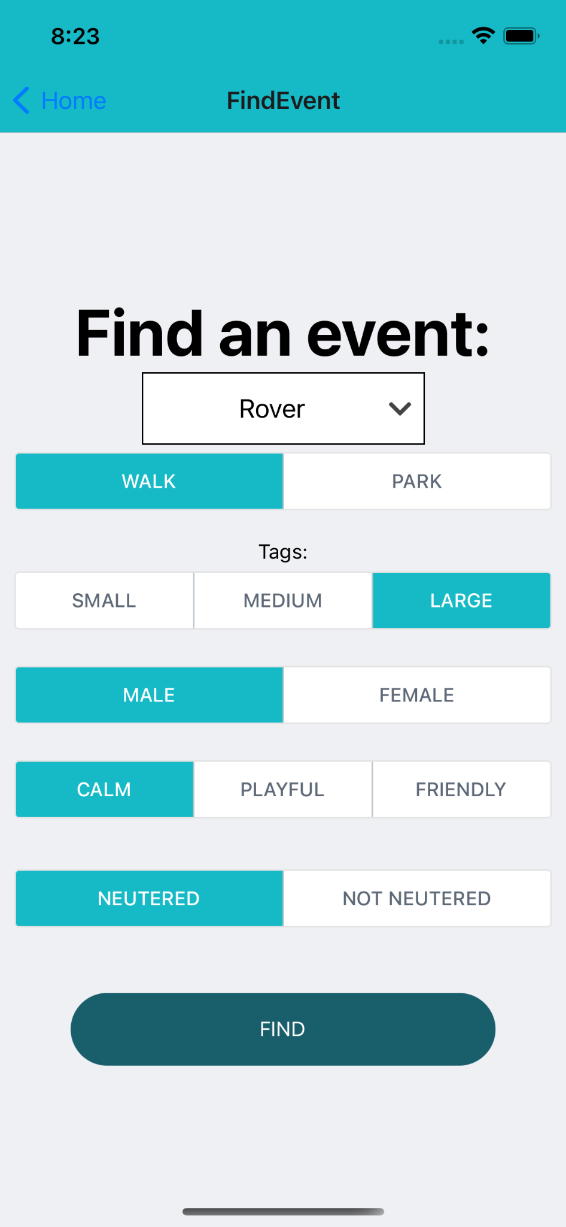

Slide 9
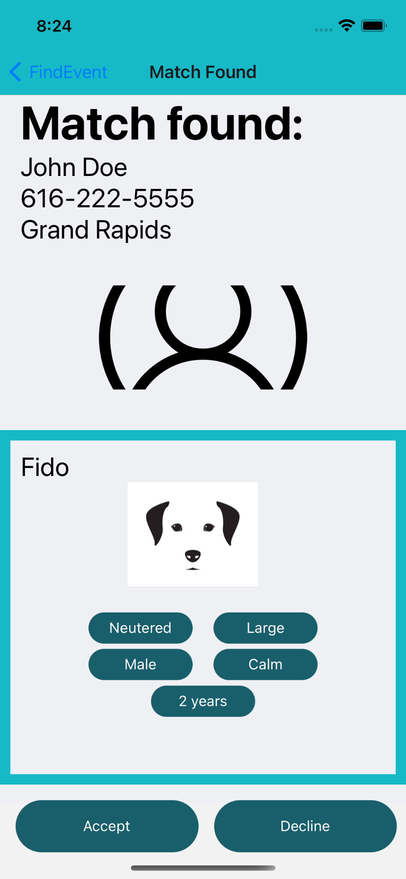

Slide 10
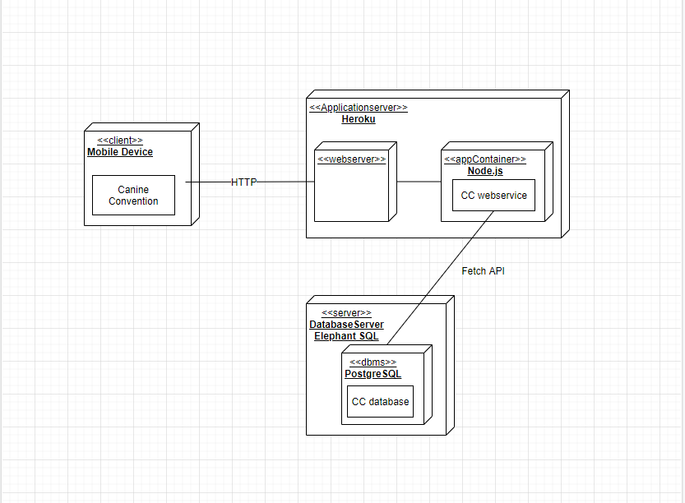
Deployment Diagram

Slide 11
Changes Based on User Testing
Bubbles to the Profile page
Arrows to the History page
Delete Button red
Actual text on edit pages
Change Styling on Dog Profile Tags

Slide 12
Assessment
Strengths:
Nice - looking interface
Easy to use
Weaknesses:
Usability limited by user base
Can’t schedule events for the future

Slide 13
Future Work Needed
User authentication
Event matching
Multi-dog events
Friends and messaging feature

Slide 14
Assessment - societal implications
Improves mental and physical health and social skills for person and dog
Encourages outdoor activity
Encourages engagement with local area

Slide 15
Thanks for listening

Slide 16
Questions

