Slide 1
Be A Ruby
CS 262 Team A
Matthew Walstra, Anne Gritter, and Adam Zentner

Slide 2
Vision Statement…
Be A Ruby
Their problem
The app

Slide 3
User Stories…
Volunteer:
Located at Be A Ruby Trailer
Subtract inventory of products trailer when item is removed from the trailer
Keep an accurate inventory of products on a given trailer
Admin:
Could be located anywhere
Be able to add and subtract from each Be A Ruby trailer individually
Track inventory across all Be A Ruby Trailers

Slide 4
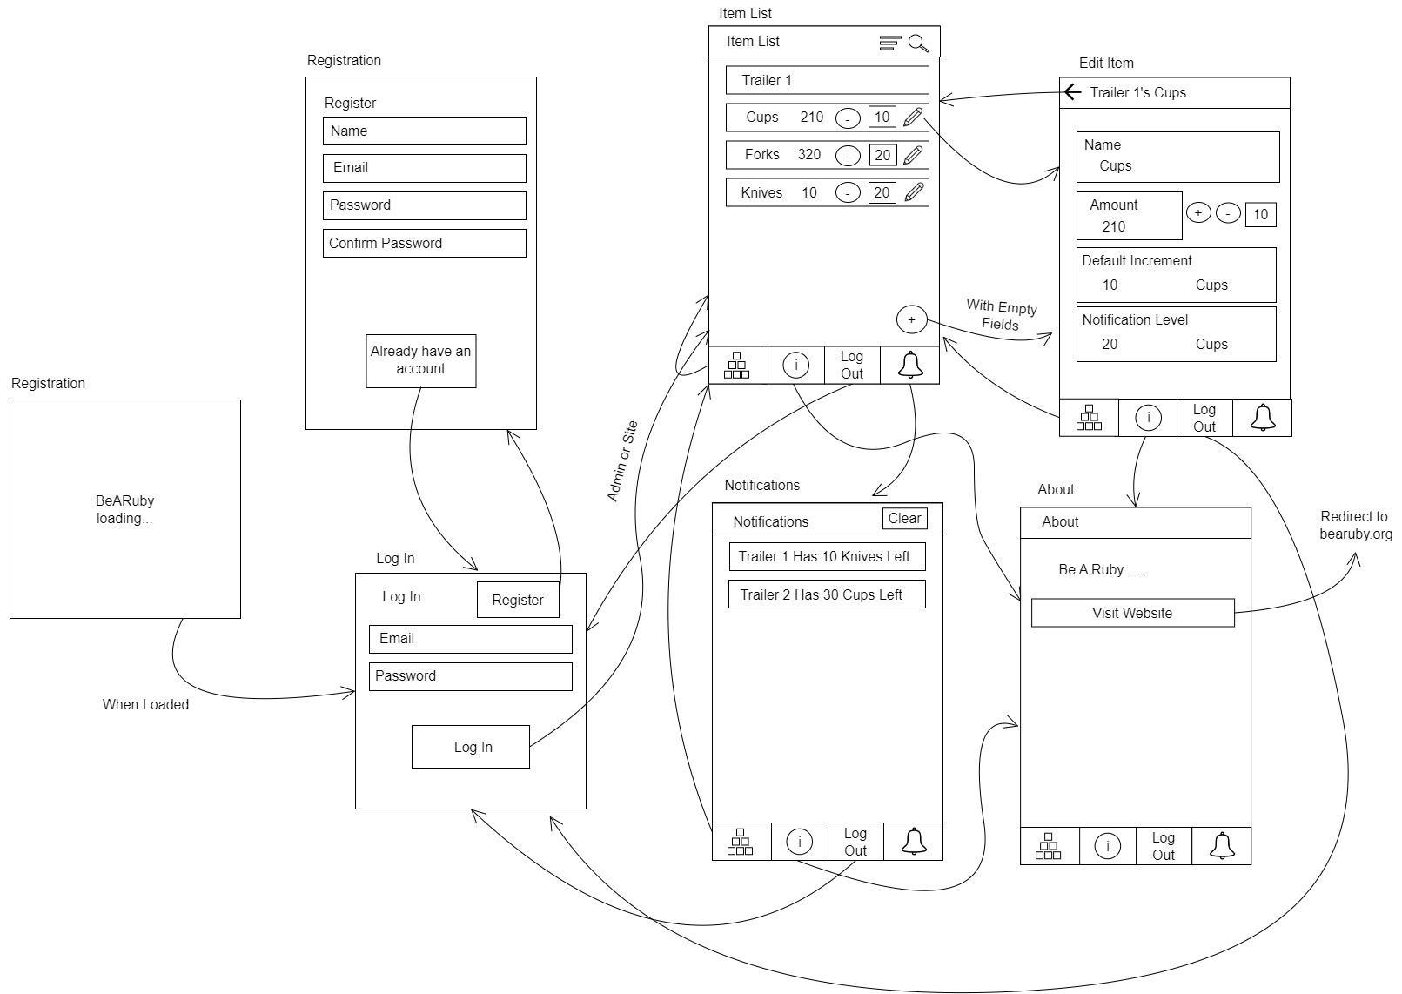
User Interface Design…

Slide 5
Technologies Used…
React Native - Expo managed app
PostgreSQL on ElephantSQL
Heroku app Service with RESTful API

Slide 6
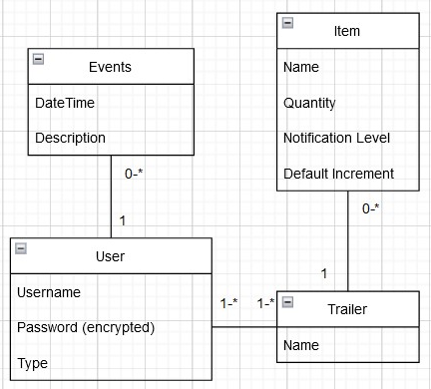
Application Domain…

Slide 7
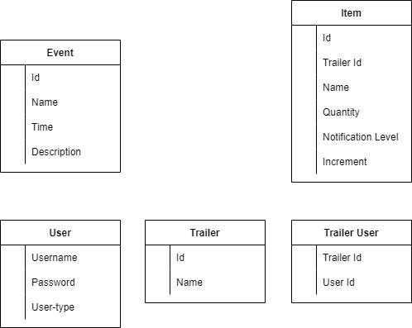
Information Systems Design…
HTTP Queries to the Heroku Service
Get Upcoming Events
Get Items by Trailer
Update Item
Create Item
Get User

Slide 8
Status Report…
Current App Functionality:
Admin, site, and volunteer login designations
Register new user screens and process
List of items with manipulatable quantities
Admin-only item edit screen
What we still want to implement:
Event, Notification, User Permissions, and About Screens
Undo
Data service

Slide 9
Thank You

Slide 10
Questions?

