Slide 1
Template
template

Slide 2


Slide 3
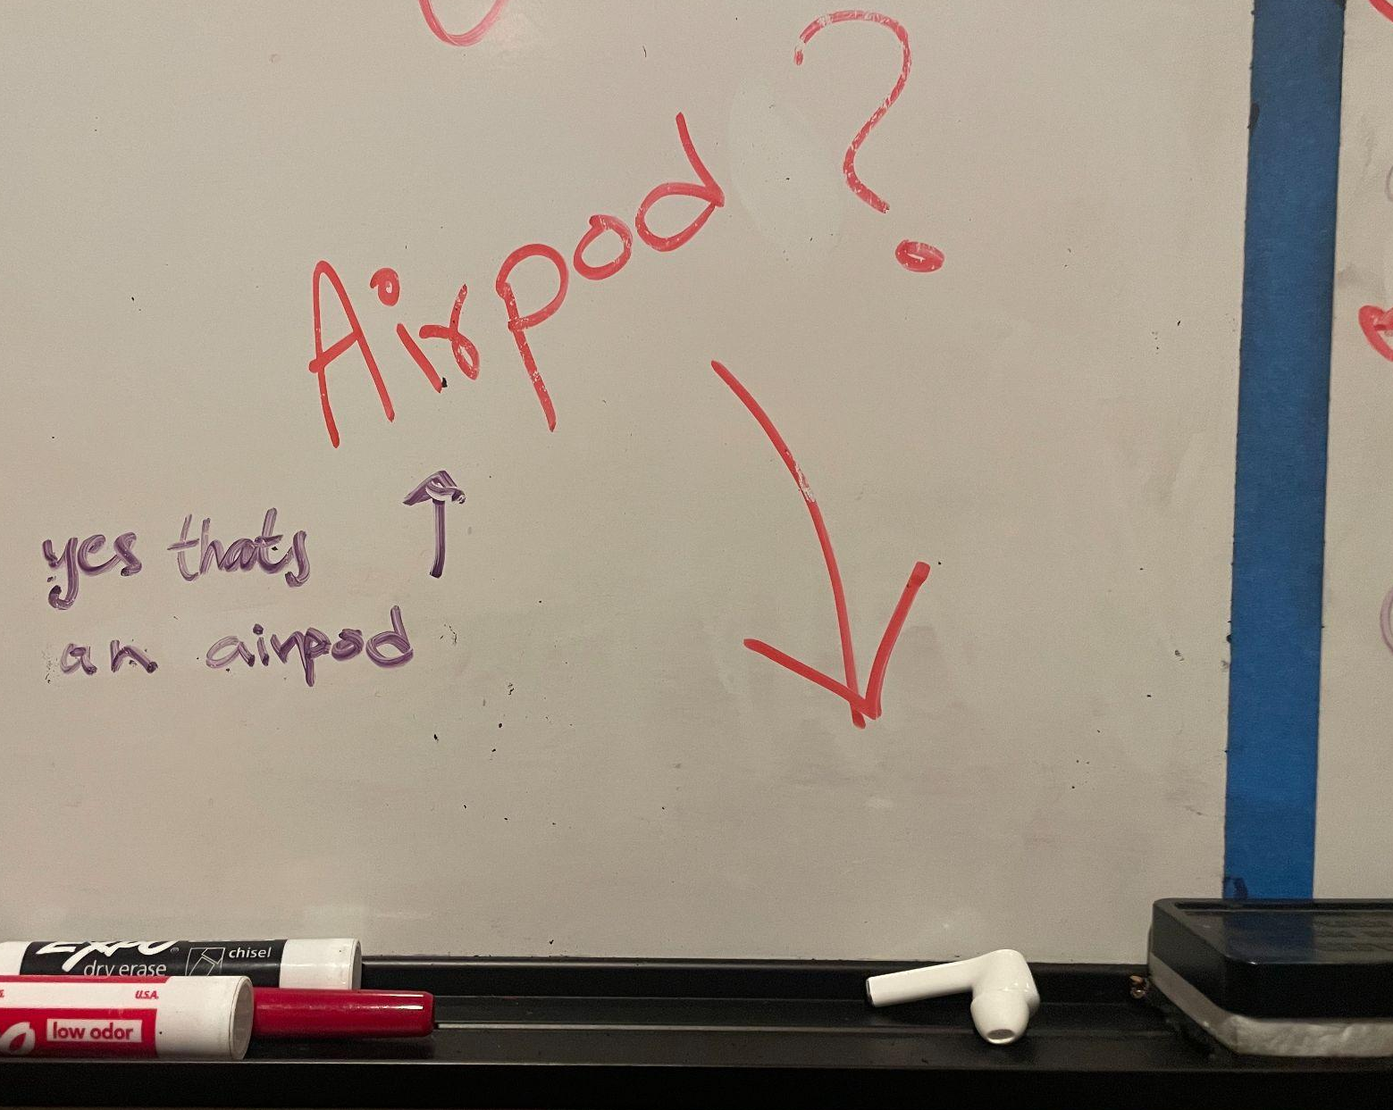
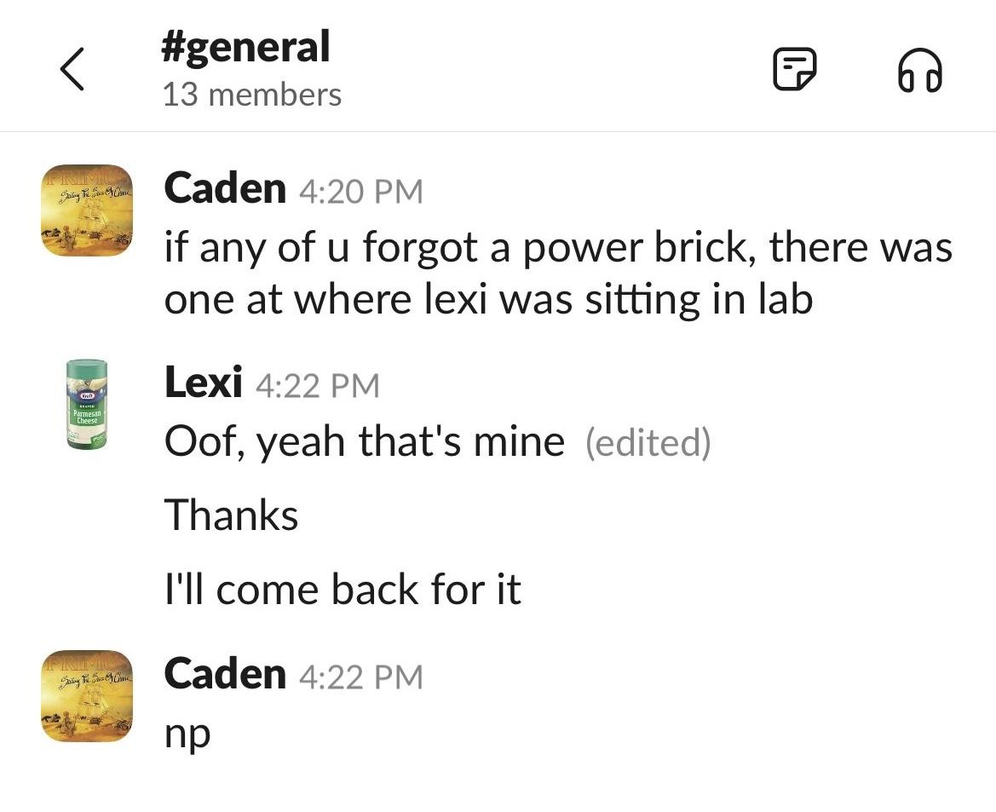
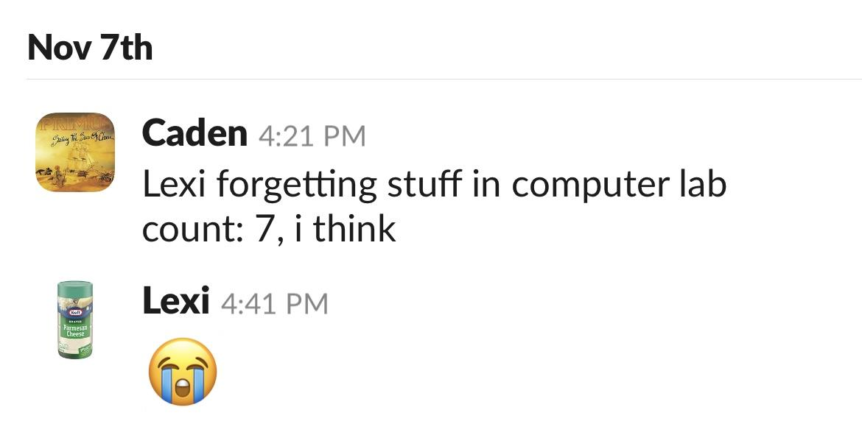
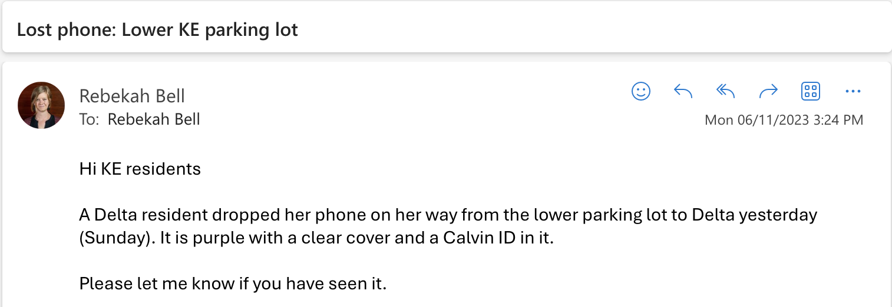

Slide 4
Vision
Exclusively for Calvin University
Seamless lost and found retrievals
User-friendly and intuitive

Slide 5
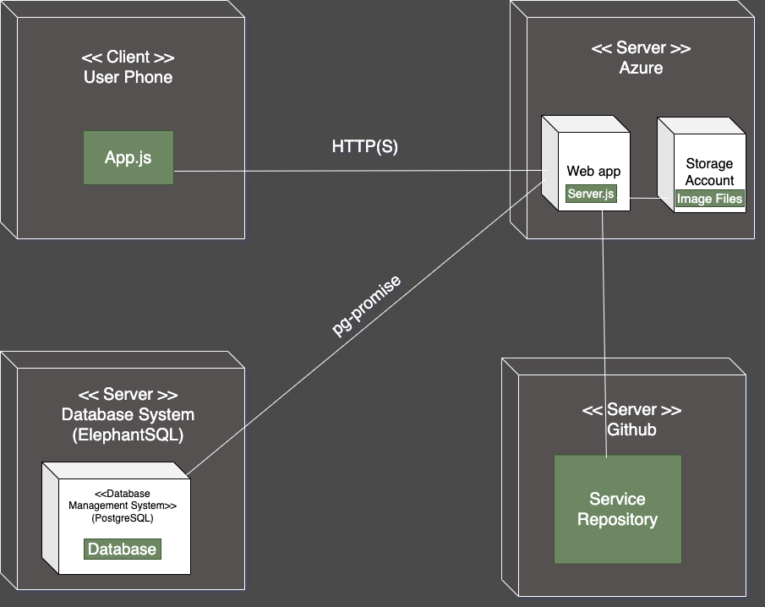
Deployment Diagram

Slide 6
DEMO

Slide 7


Assessment

Slide 8
Questions?

Slide 9
Thank you!

