Slide 1
Template
template

Slide 2
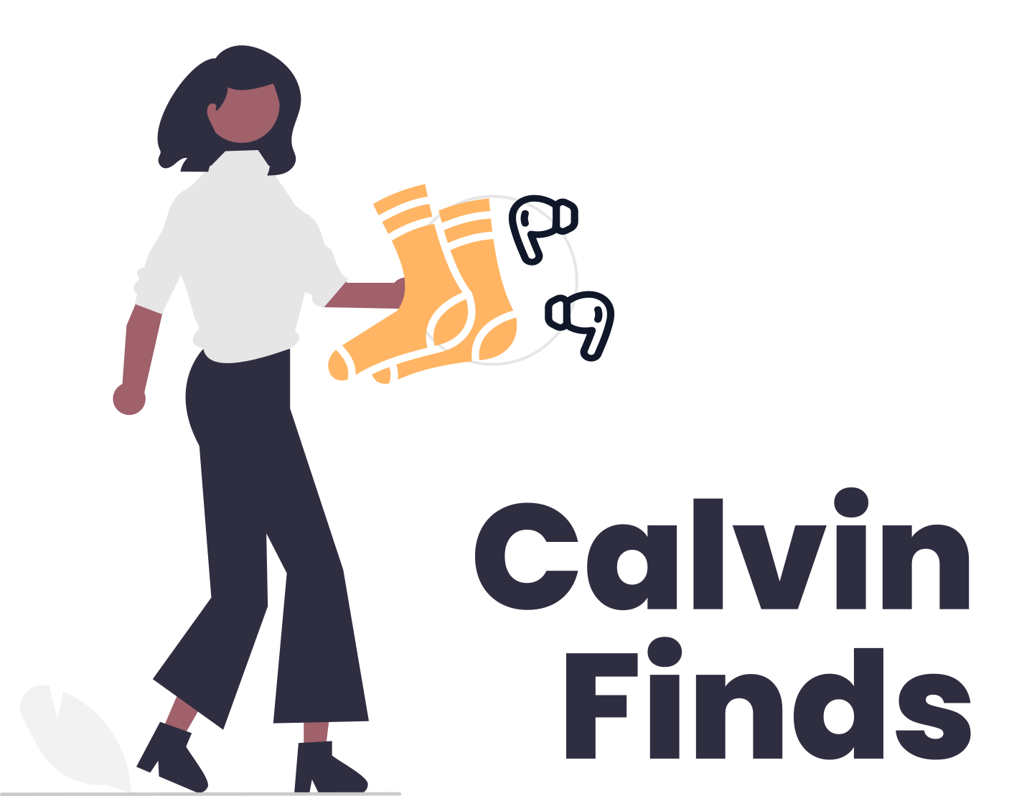

Slide 3
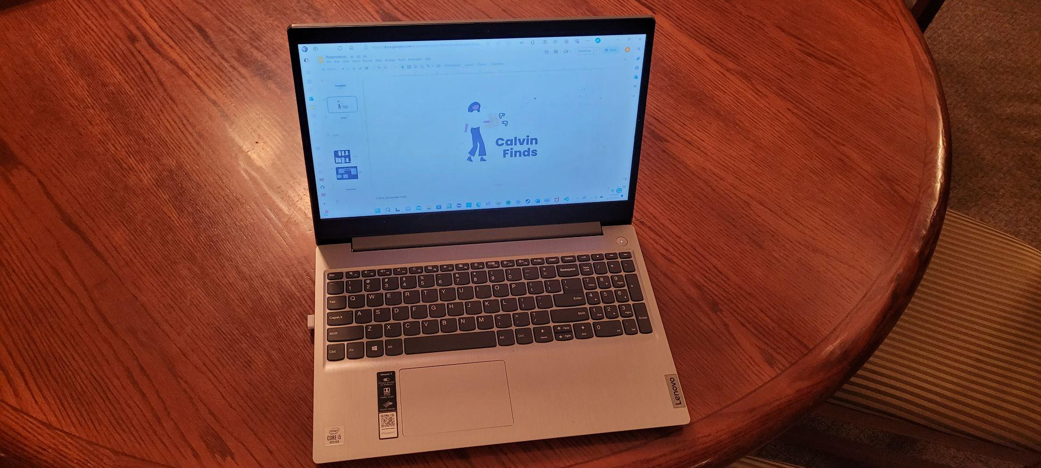
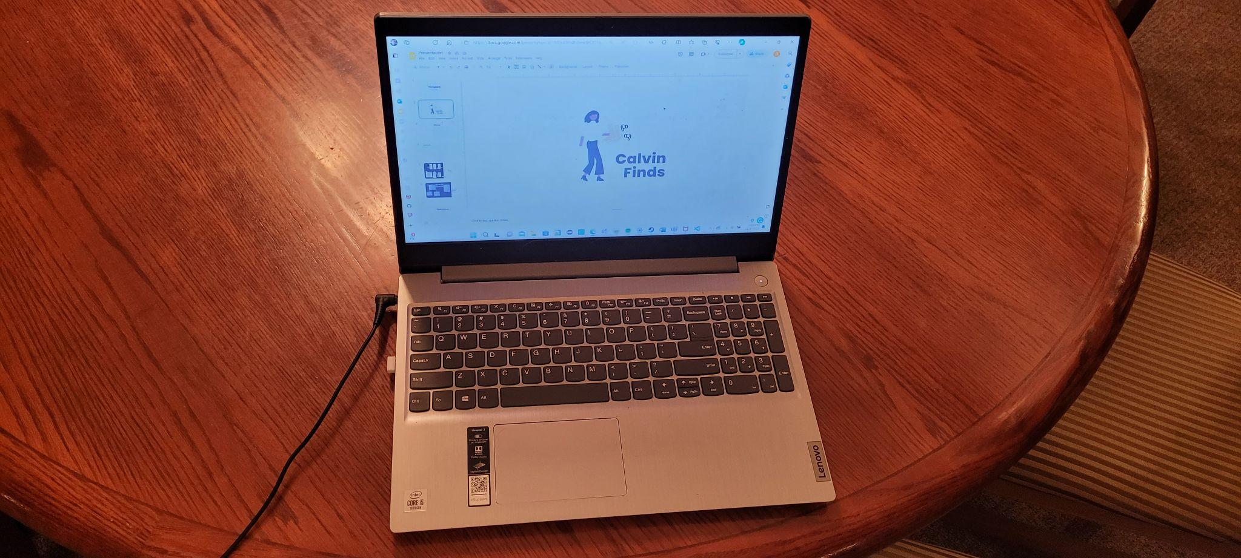
Vision
Our app, Calvin Finds, is designed to foster a collaborative community within Calvin University, where you can come together to locate your misplaced belongings.
Calvin Finds is a mobile app to help the lost and found center at Calvin University.
I lost my charger as a user what should I do?

Slide 4

User Stories
Completed User Stories
User knows when items are lost
User can search for items
User can view their posted and claimed items
Not Completed User Stories
User can comment on a given item.

Slide 5
DEMO

Slide 6
UI
Model
Only go through what haven’t done
Password reset process
Lost Item / Found Item

Slide 7
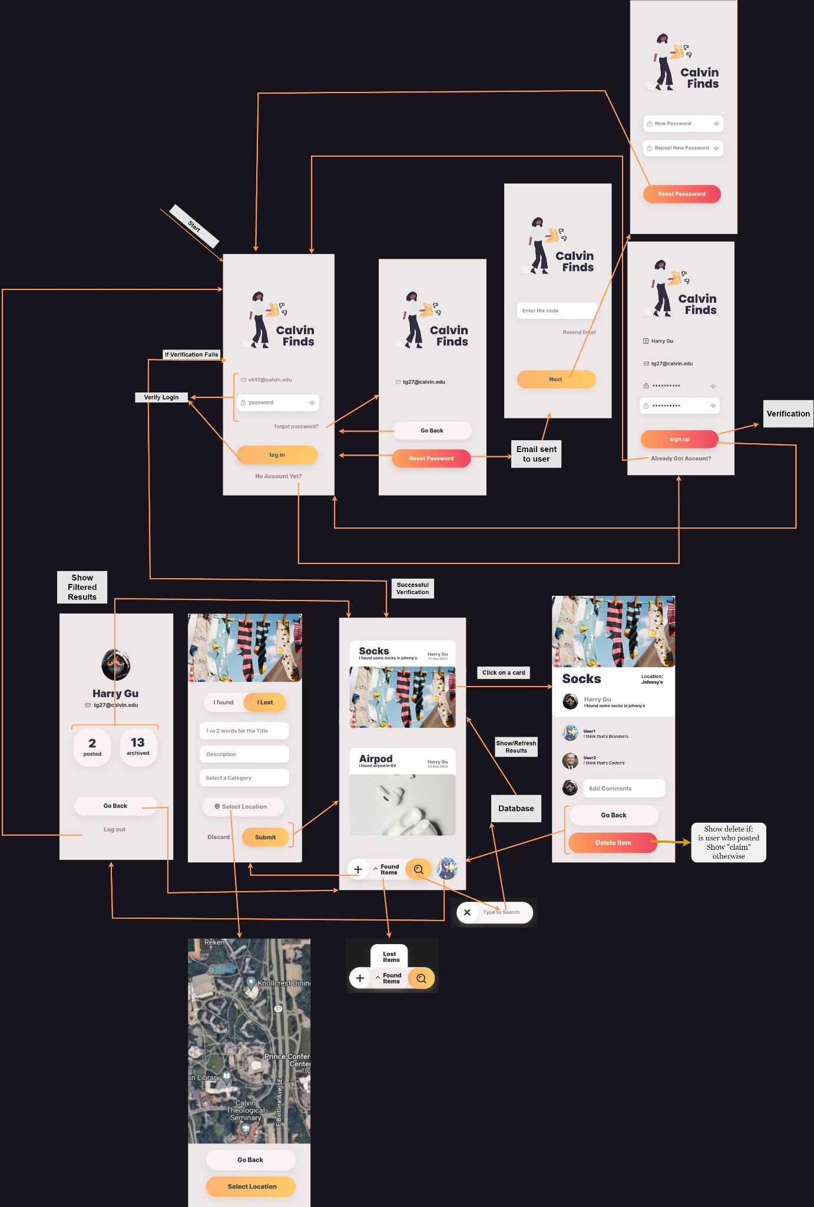

Slide 8
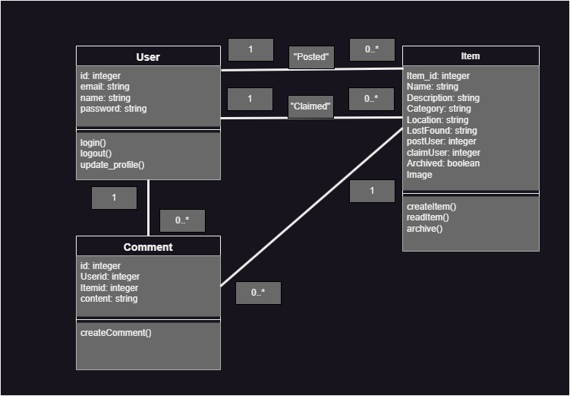
Domain
Model

Slide 9
Questions?

Slide 10
Thank you!

