Slide 1

SwoleMate Demo
Team I: Allison, Jeton, Zhonglin (Loya), Madi, Alim
Notes:
Address User Stories here

Slide 2
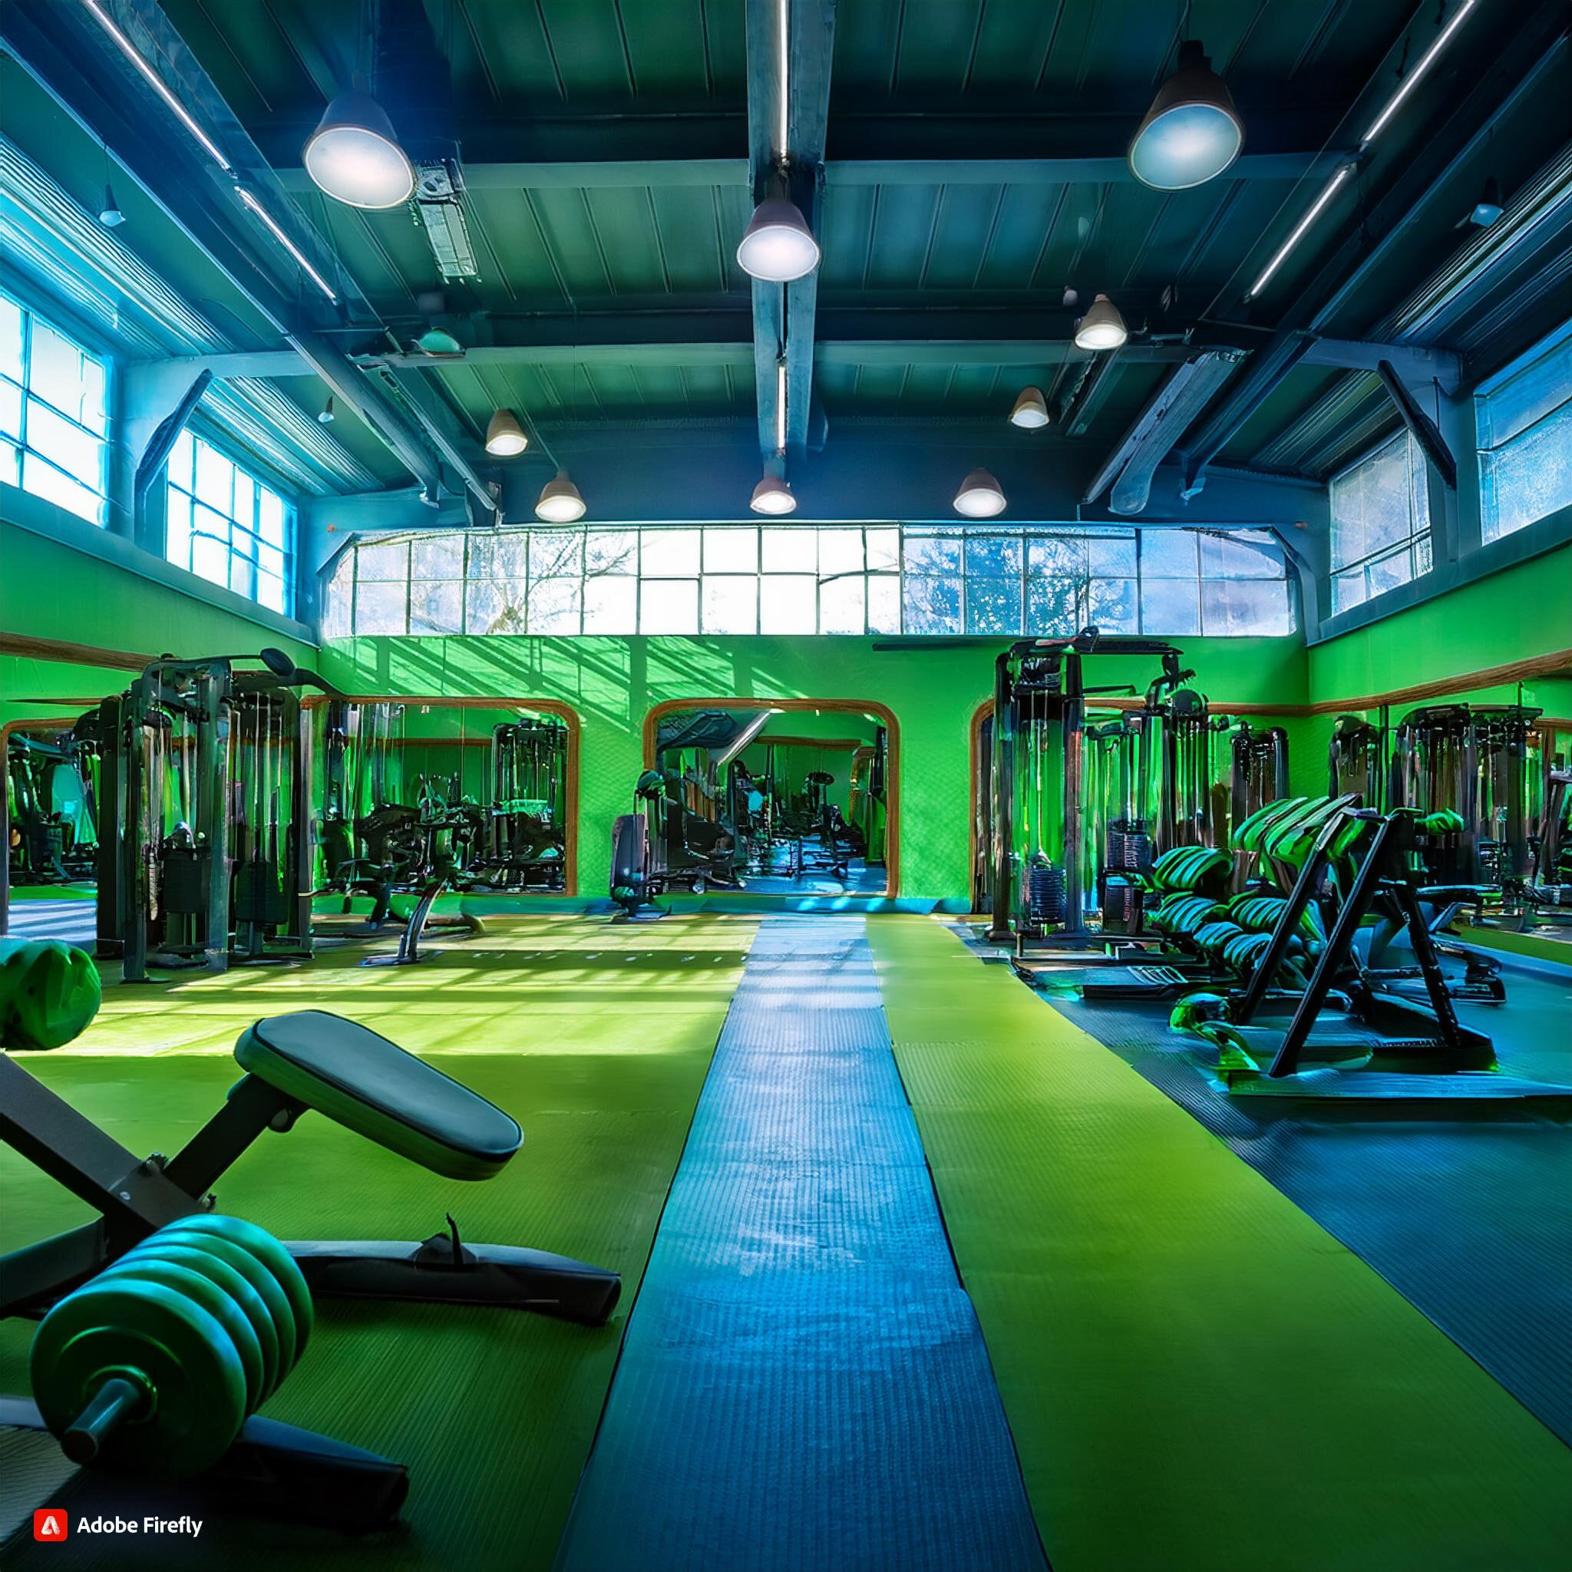
What is SwoleMate?
Addressing Fitness Challenges
Filtered Matching System
Enhanced Social Experience
Unique in Market
Notes:
Problem Statement / Vision Statement

Slide 3
Application Demo

Slide 4
Technology Stack
TypeScript
FIGMA
Tailwind CSS
Prettier
Sequelize
Mermaid
Notes:
Problem Statement / Vision Statement

Slide 5
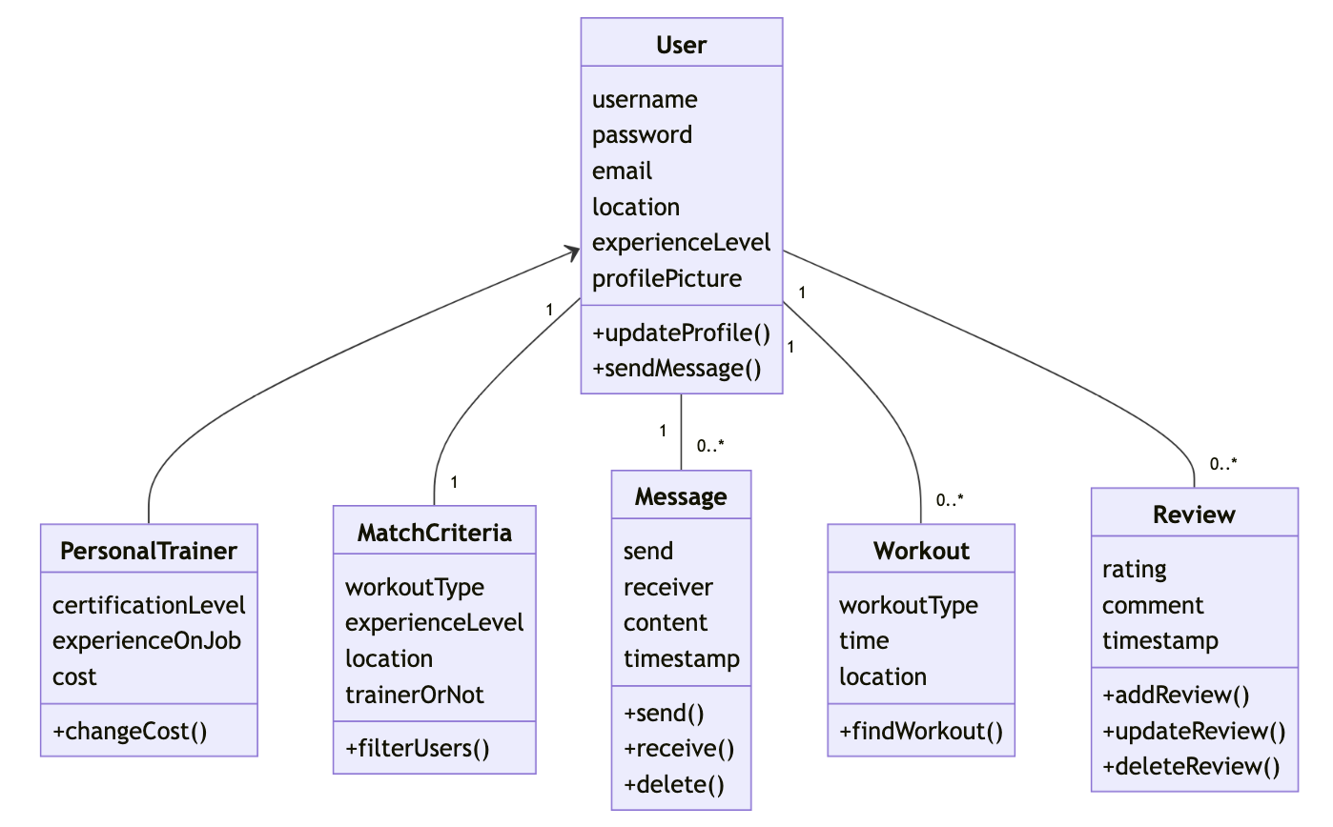
Domain Model

Slide 6

What have we accomplished?
What’s left?
Notes:
Problem Statement / Vision Statement

Slide 7
Questions?

