Slide 1
EventSphere
Daniel Chae, Sungmin Choi, Brian Huynh, Youngha Kwon, HaDong Park

Slide 2

Vision
Our aim
The goal
Event Discovery
Customization
Community Building
Convenience
Our goal is to become the primary event hub for students, supporting involvement and enhancing campus life.
Notes:
Chae

Slide 3
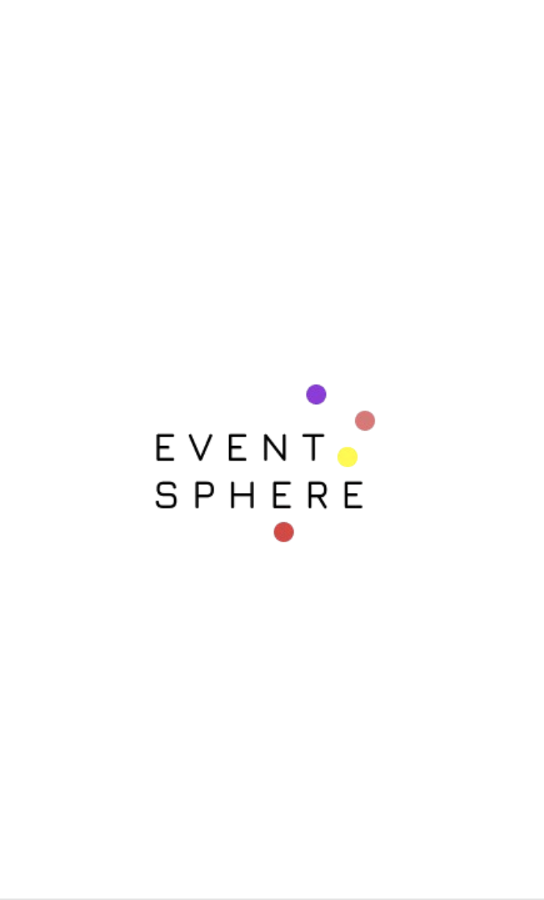
DEMO
IT’S TIME FOR THE DEMO!
Notes:
HaDong

Slide 4
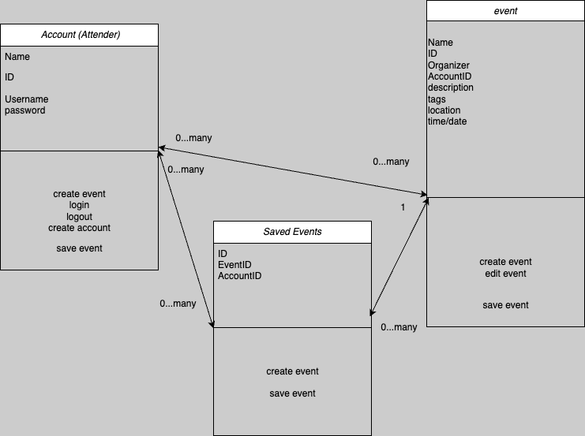
Domain Model
Notes:
Chae

Slide 5
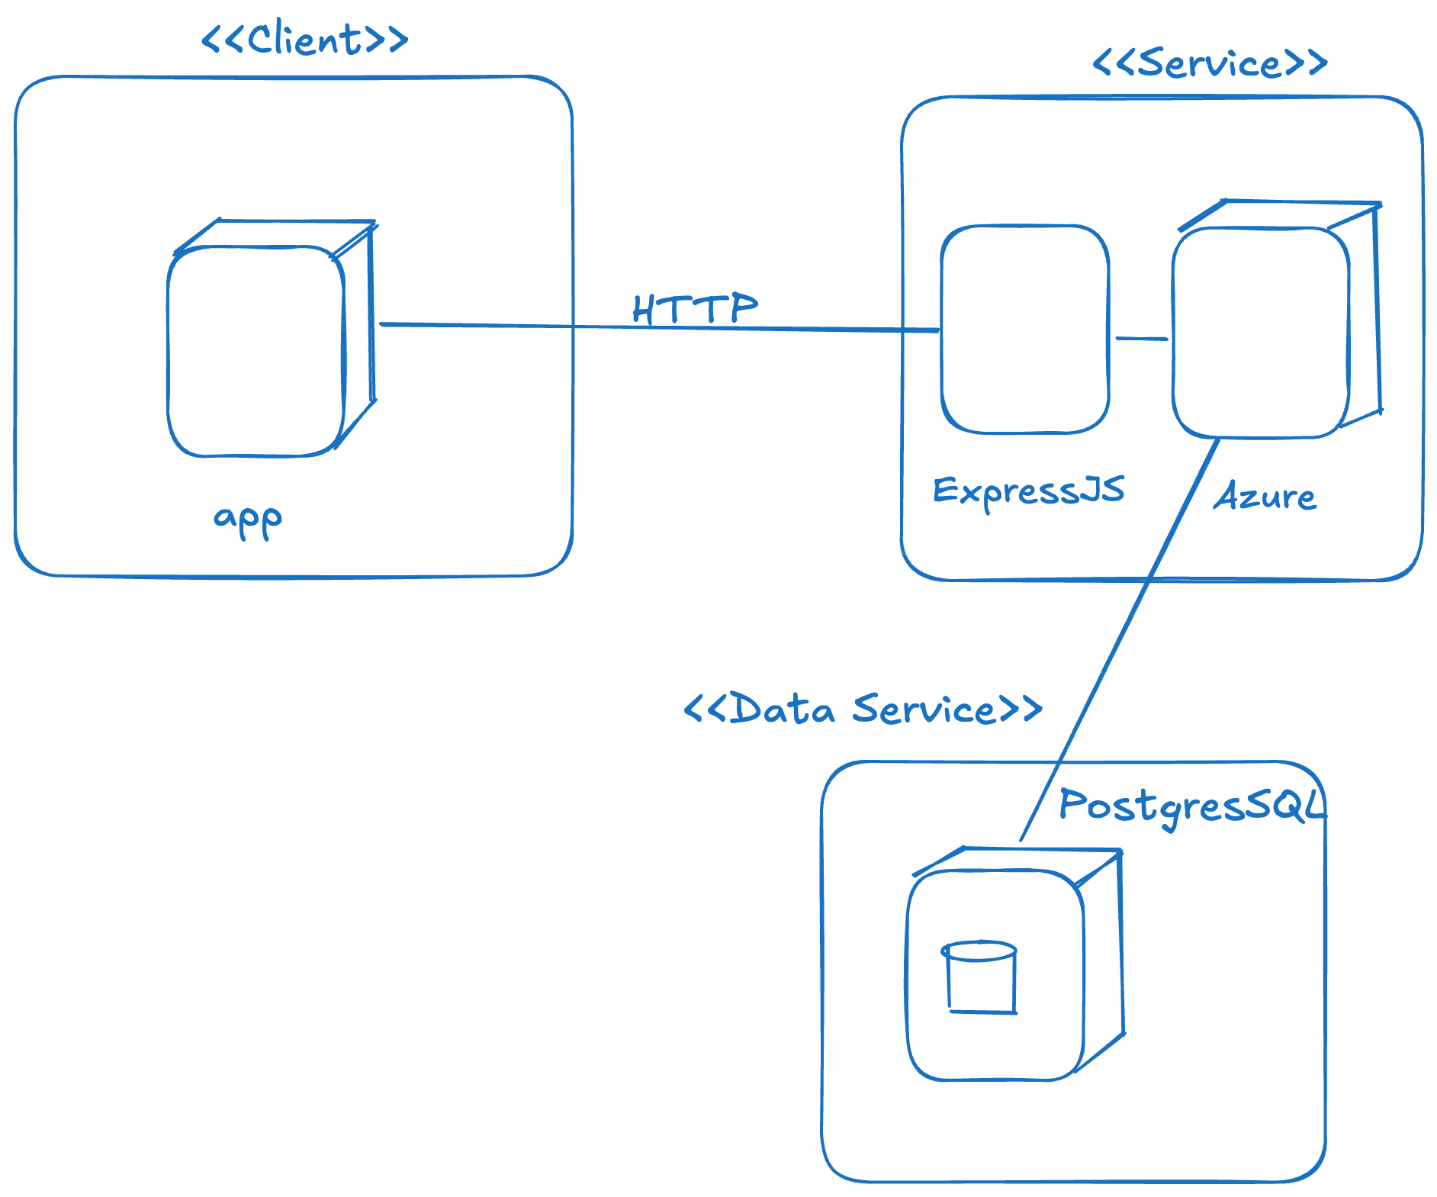
Deployment Diagram
Notes:
Chae

Slide 6
Strengths and Weaknesses
Strengths
Weaknesses
CRUD functionality
Simple design
Straightforward user experience
Not engaging enough
Lacks captivating elements
Progress was limited

Slide 7
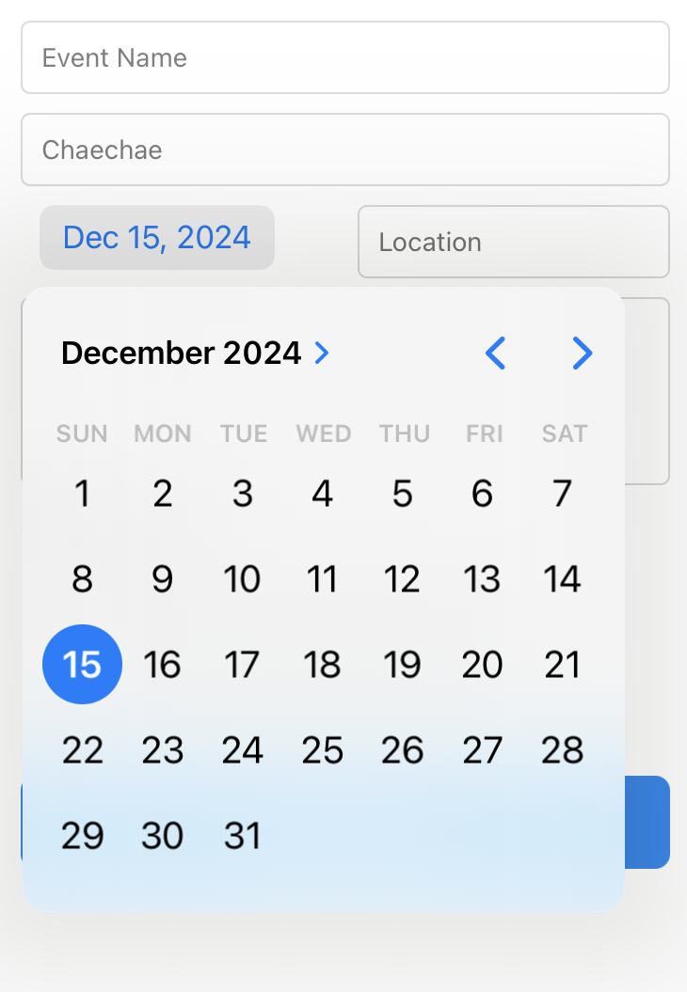
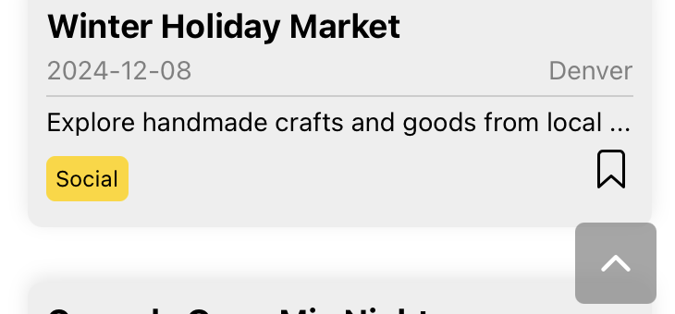
Changes from Feedback
Date Picker instead of manual entry
Added scroll to top button
Notes:
Brian

Slide 8
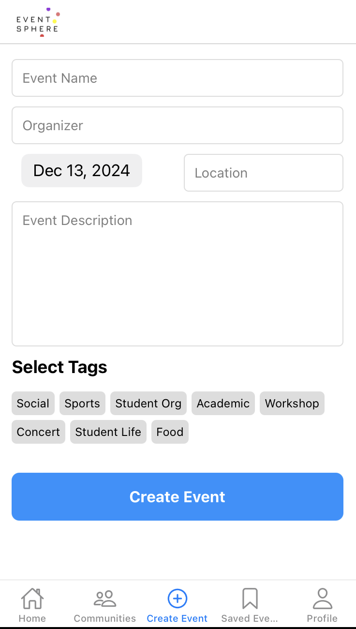
Features
Create Events
Notes:
Brian

Slide 9
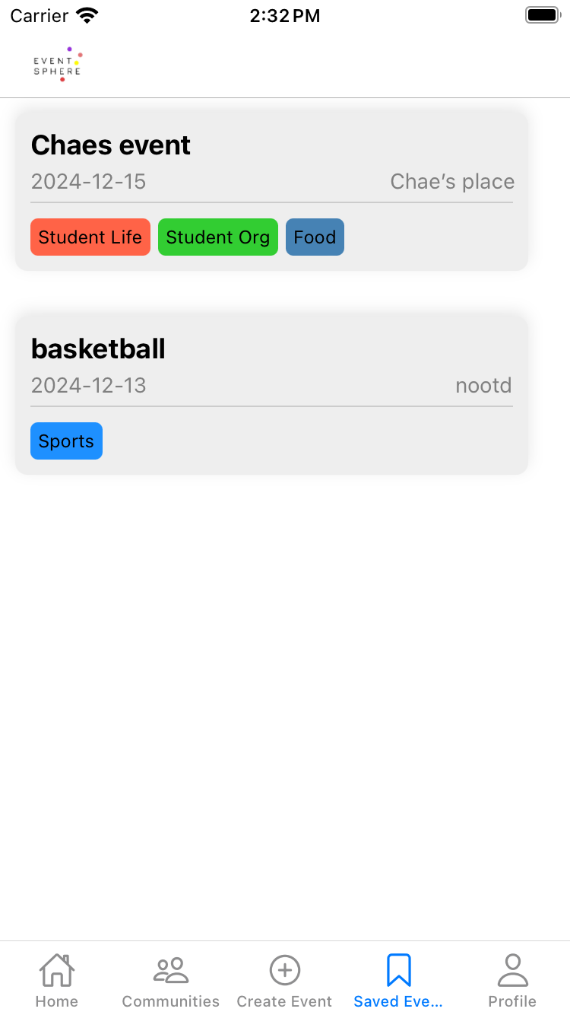
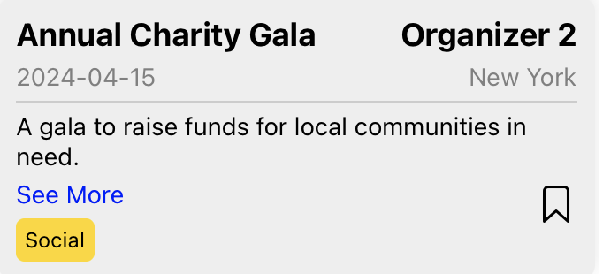
Features
Saved Events
Notes:
Brian

Slide 10
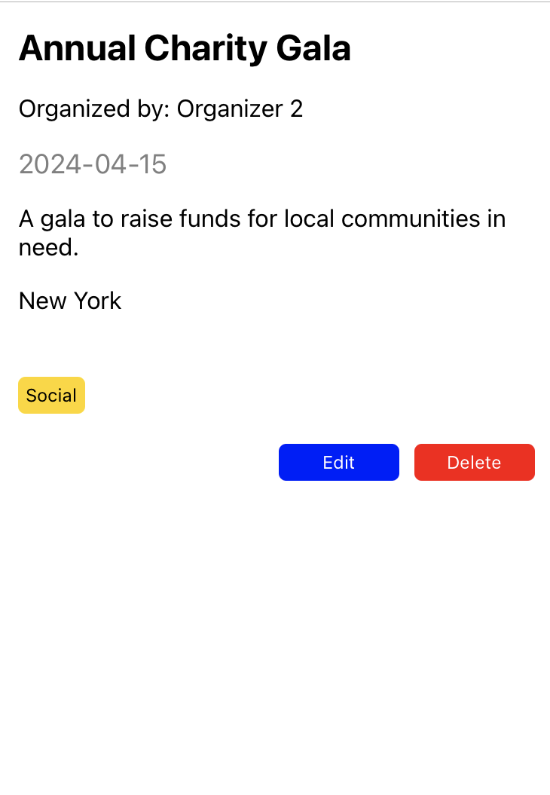
Features
edit/delete function
Notes:
Brian

Slide 11
Future Work
1
2
3
Integrate a map for event locations
Add a calendar feature
Support for club organizations
4
5
6
Enhanced user management tools
RSVP functionality
Notifications and event-sharing capabilities
Notes:
YoungHa

Slide 12
Ethical and Societal Implications
Digitalization of an existing system
People could stop looking at actual poster boards or other existing event boards in exchange for this app.

Slide 13
QNA TIME
Ask any questions!

