Slide 1

GROUP CART
Guli, Aisha, Nick and Adam

Slide 2
Vision
Goal: A collaborative grocery checklist app for shared households.
Users: Families, roommates and students living together at Calvin.
Core Idea:
  Real-time shared grocery list
  Price tracking for budgeting transparency
  Reduces duplicate purchases and food waste
Difference of our App- Combines collaboration and budgeting accountability
Notes:
This is our vision statement, talk about what the app is about and how different it is compared to apps that are similar.

Slide 3
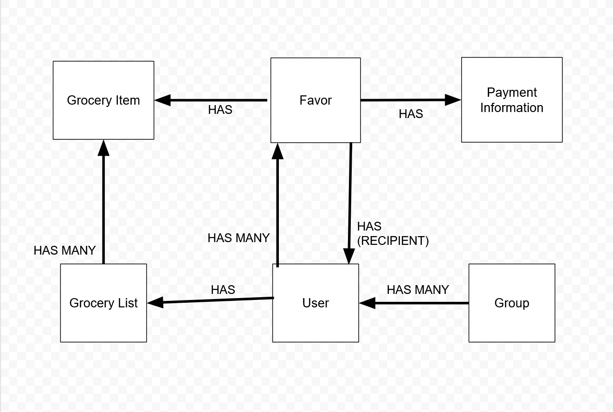
I.S Design
Notes:
Information Systems Design
Backend: Azure-hosted REST API service with dummy endpoints.
Database: SQL schema in progress (foundation complete).
Technology stack:
Frontend: React Native and Expo
Backend: TypeScript / Express
Hosting: Azure
Tools: GitHub, Trello, Clockify, Figma, Slack

Slide 4
Demonstration of App
Notes:
Nick can demo?

Slide 5
Analysis and Design
Application Domain
Problem space: Shared shopping organization and budget transparency.
Environment: Multi-user mobile app.
Stakeholders: Household members, students (Calvin housing on campus and off).
Notes:
Possible users

Slide 6
Key User Stories
Add and remove items from “My List.”
Navigate between tabs (My List, Group Cart, Profile, Favors).
View shared list (“Group Cart”) updated in real-time.
Record item prices for shared budgeting.
Future plan - Invite or join groups and manage user profiles.
Notes:
This slide talks about the user stories in general
Future plan includes:
Invite or join groups and manage user profiles.
Login and authentication
Edits list within a group cart

Slide 7
Demonstration of User Stories

Slide 8
User Interface Design
Designed mockups for:
  Login / Create Account
  My List (add/remove/prioritize items)
  Group Cart view
  Profile (editable, personalized color & letter avatars)
  Favors/Transaction (owed/owing)
Accessible color choices (exclamation marks for priority).

Slide 9
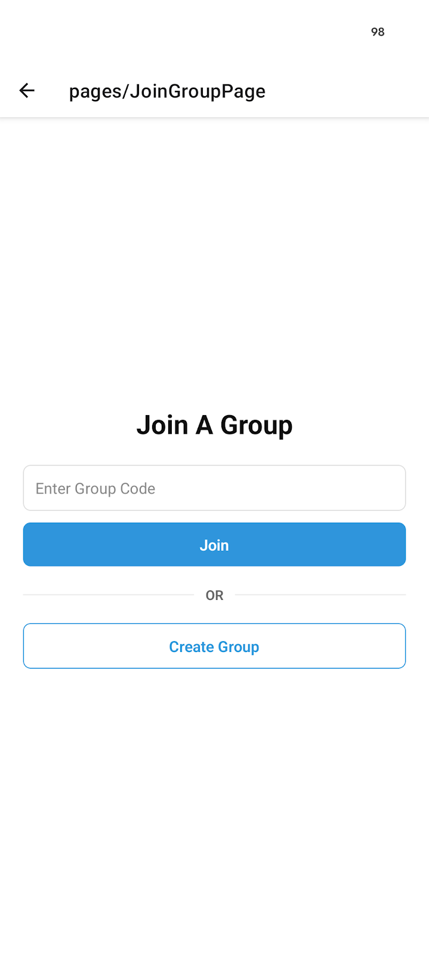
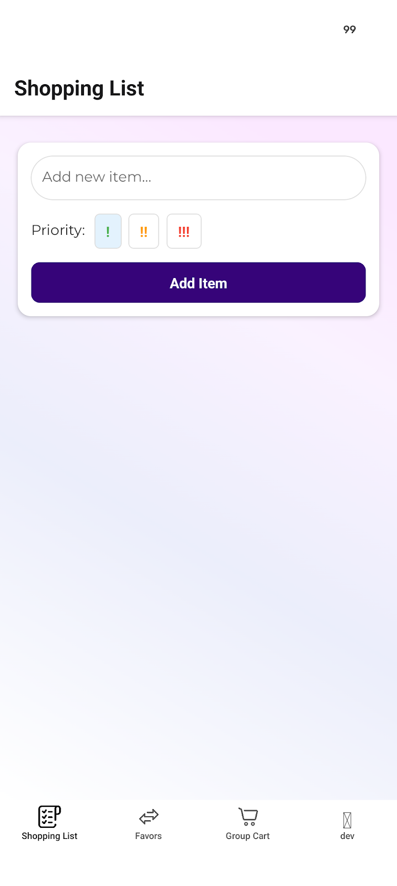
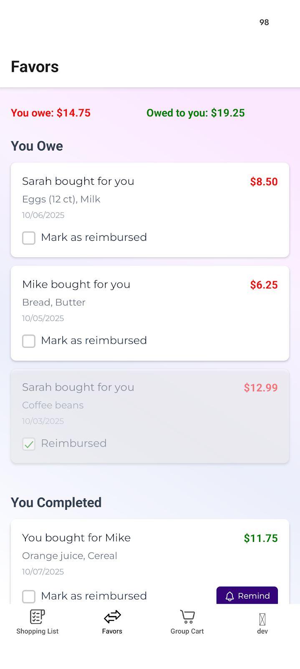
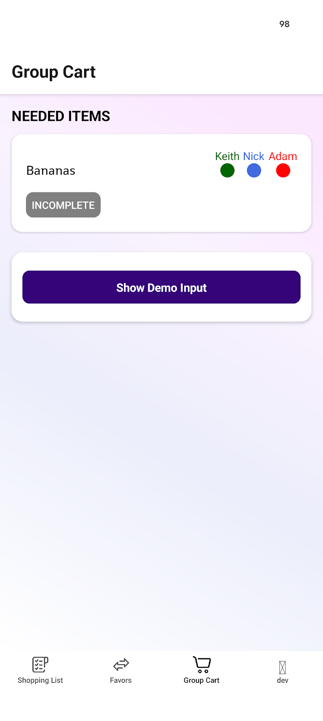
User Interface Design
Notes:
User Interface Design
Designed mockups for:
Login / Create Account
My List (add/remove/prioritize items)
Group Cart view
Profile (editable, personalized color & letter avatars)
Favors/Transaction (owed/owing)
Accessible color choices (exclamation marks for priority).

Slide 10
Information Systems Design
Backend: Azure-hosted REST API service with dummy endpoints.
Database: SQL schema in progress (foundation complete).
Auto deployments configured on main branch.
Technology stack:
  Frontend: React Native and Expo
  Backend: TypeScript / Express
  Hosting: Azure
  Tools: GitHub, Trello, Clockify, Figma, Slack
Notes:
This slide talks about the information system design and what was used and so on

Slide 11
Status Report
Completed:
Functional React Native app with 4 tabs and navigation
UI mockups for all major pages
Backend service deployed on Azure
In Progress and Next Steps:
Database integration (SQL schema → API)
Deciding how users will be added to groups
Enhanced styling and user testing

Slide 12
Questions

