Slide 1
#All-Hallelujah-Team:
CoupleBond
Team members: Anna St. Clair, Mary Chen, Monica Zhang,
Martin Liu, Simon Lin

Slide 2

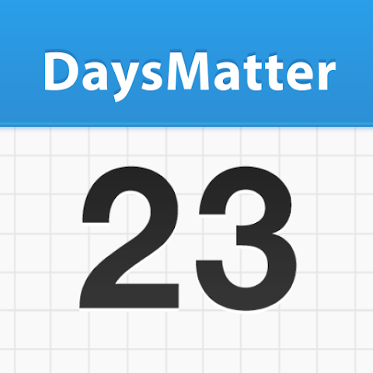
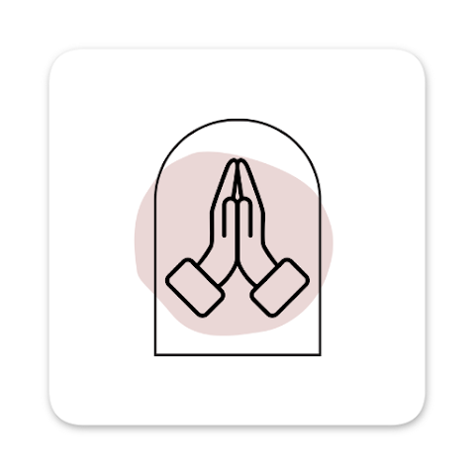
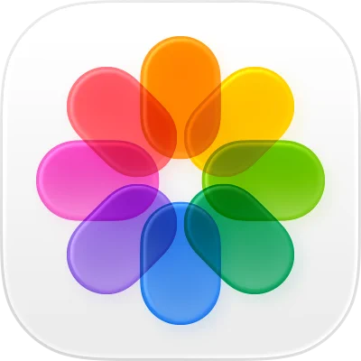





Sarah
Days Matter
My Prayer Room
WhatsApp
David
Photos
Messenger
TO-DO
Google Calendar
Notes:
Meet Sarah and David—a Calvin couple trying to honor God in their relationship. Between classes, chapel service, projects, and part-time jobs, life gets overwhelming. Their memories are scattered across multiple apps. They want to pray together regularly, but their prayer intentions get lost in the busyness of life. They've missed anniversaries and lost track of spiritual growth. Couples today juggle too many apps — Photos, Days Matter, Prayer apps, Messenger, Google Calendar, WhatsApp… everything is scattered across different places. They need ONE place that understands their relationship AND their faith—not just another common generic app."

Slide 3
Vision
CoupleBond is a private mobile app that helps Christian couples organize life, grow spiritually, and celebrate their God-given journey—together.
Notes:
Martin
"What makes CoupleBond different? While WhatsApp is great for chatting and Google Photos stores pictures, neither understands your RELATIONSHIP or your FAITH. We integrate everything—shared lists, prayer reflection, anniversary reminders, calendar events, bible reading plan, memory timeline—in ONE private space designed specifically for two people building a Christ-centered life together.
"CoupleBond embodies Ecclesiastes 4:9—'Two are better than one.' CoupleBond will be a private mobile app that helps Christian couples organize life, grow spiritually, and celebrate their God-given journey—together.

Slide 4
Demo
Notes:
Also demo the help features.

Slide 5
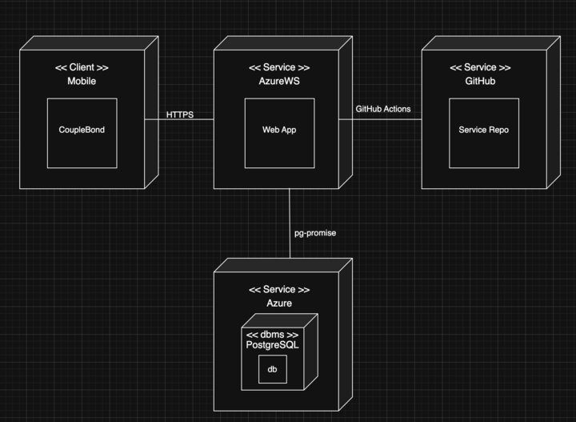
Design
Notes:
This diagram shows our mobile app connecting to a web app on Azure using HTTPS. The web app is deployed from GitHub and stores data in a PostgreSQL database hosted on Azure through pg-promise.

Slide 6
Design
Emoji Placement
Photo Collage Usage
Calendar Implementation
Unmatch Location
Help Page
Notes:
Emoji: Improved emoji status layout for better visual clarity and easier interaction
Photos: Refined photo-taking interface to reduce user hesitation
Calendar: Updated calendar time selector for clearer and more consistent use
Unmatch: Increased visibility of the unmatch option, with possible direct access from partner profile
Help: Added a help page for common questions and help icons on each page to guide users

Slide 7
Assessment
Overall: great faith and activity functionality
Strengths: devotion (Calendar, Daily Bread)
Weaknesses: “digitalizes” relationships
What’s next? Sarah and David continue their relationship!
Notes:
Overall, we would like to say that we love the way CoupleBond has turned out and its functionality is great. It has encaptured all that we wanted to do in the app to integrate faith into a relationship and help couples dedicate more time to each other and to God.
We will say that Postman’s first idea, “All technology is a trade-off”, plays an important role in the development of our app. CoupleBond could be seen as a trade-off for in-person planning events or communicating face-to-face, so we want to be mindful of how much CoupleBond really plays a role in people’s relationships.
Strengths: For our strengths, we believe that CoupleBond provides lots of encouragement and support for couples to grow in their faith together while they communicate / keep in touch online. Planning events with the calendar feature and reflecting on God’s word with Daily Bread help couples stay committed to in-person time with one another as well as understanding God.
Weakness: To address our weaknesses, we realize that CoupleBond could “digitalize” a relationship to some extent, and that is not the goal of our app. We have aimed at focusing our app to help couples spend more time with each other in person rather than relying on communication through a screen.
One message that we do not want users to take away from our app is that couples need to always be connected with one another online in order for their relationship to work. Sure, we could take Postman’s 5th idea of “media is mythic” and say that this is just the way the world evolving, but that’s not necessarily true.
CoupleBond is an app for two people like Sarah and David who want a way to intentionally devote their time to each other and to God.
If we chose to carry on Sarah and David’s journey and extend their experience to others, we would have to take the next steps towards deploying our app, which would include finalizing our materials, doing some more user tests on our current product, and submitting a build to the app store once we are satisfied and getting that approved. Of course, the biggest part of all of this would be maintaining the app and keeping it up to date as technology changes.

Slide 8
Thank you for listening!
Q&A
Do you have any questions?
Notes:
Overall, we wanted to design an app that was intentional for helping couples make more time for God and each other in their relationships, and with the digital age we’re living in, we thought CoupleBond was the perfect product for people in the same situation as Sarah and David. Thank you stakeholders for your feedback, professors for your support, and audience for listening.

