Slide 1

PARKMASTER
By IdealTeAm

Slide 2
Parking Trouble?

Slide 3
User Demo

Slide 4
Vision Statement
TARGETED TOWARDS PRIVATE COMPANIES
TOOL TO CREATE PARKING LOTS
Tool to help with organization and scheduling
INTERFACE TO MANAGE USERS AS ADMIN
INTERFACE TO VIEW PARKING AS USER

Slide 5
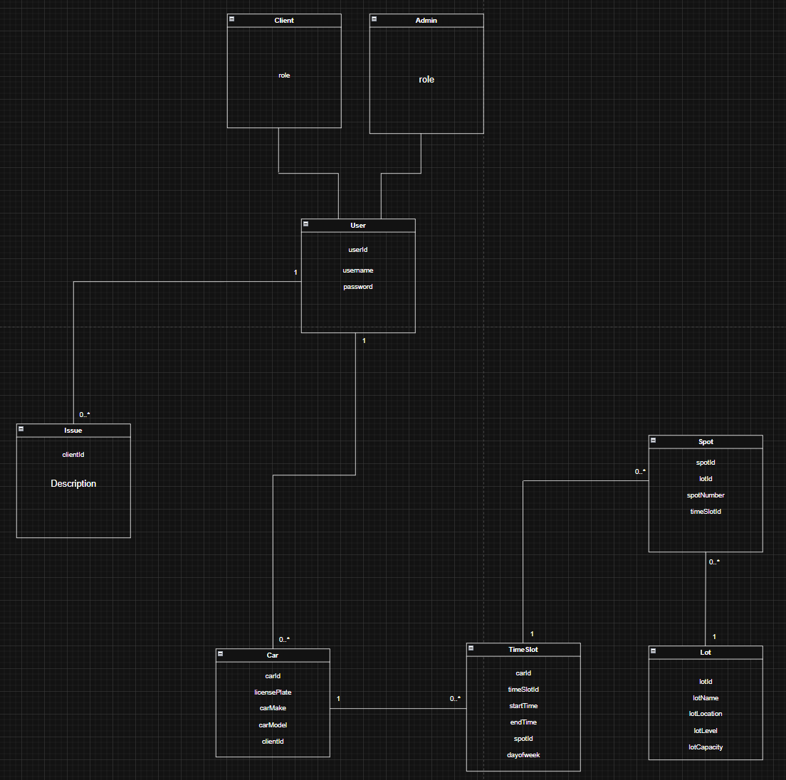
Domain Model

Slide 6
Questions?

Slide 7
Thanks For Listening

Slide 8
Database Model
(or at least plans)

Slide 9
Human Technology Interaction Model
(or at least plans)

