Slide 1

PARKMASTER
By IdealTeAm

Slide 2
Parking Trouble?

Slide 3
User Demo

Slide 4
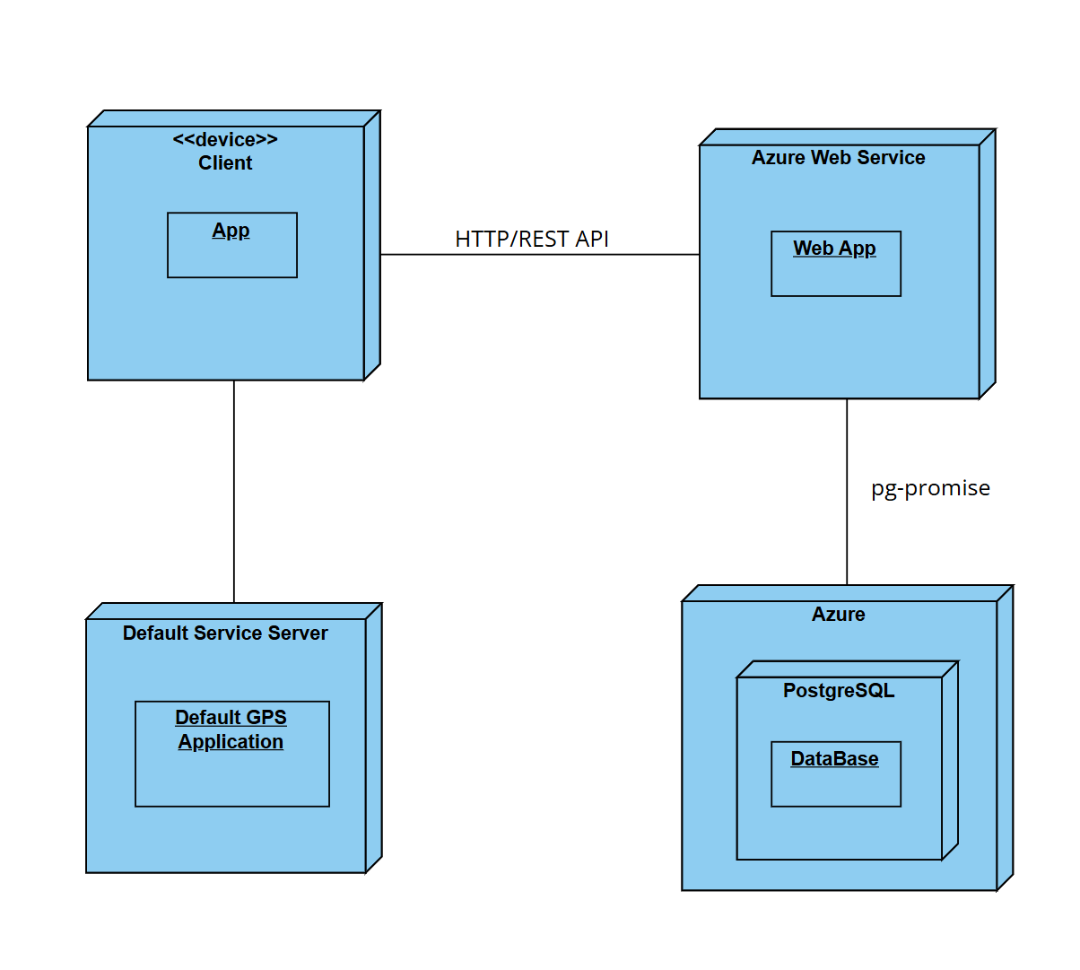
Deployment Diagram

Slide 5
Vision Statement
TARGETED TOWARDS PRIVATE COMPANIES
TOOL TO CREATE PARKING LOTS
Tool to help with organization and scheduling
INTERFACE TO MANAGE USERS AS ADMIN
INTERFACE TO VIEW PARKING AS USER

Slide 6
Admin Demo

Slide 7
Development Progress
User scheduling
User profiles
Admin lot management

Slide 8
Future
Development
Future development ideas here
Discuss n. Postman idea

Slide 9
Questions?

Slide 10
Thanks For Listening

