Slide 1

PARKMASTER
By IdealTeAm

Slide 2
Parking Trouble?

Slide 3
Vision Statement
TARGETED TOWARDS PRIVATE COMPANIES
TOOL TO CREATE PARKING LOTS
Tool to help with organization and scheduling
INTERFACE TO MANAGE USERS AS ADMIN
INTERFACE TO VIEW PARKING AS USER

Slide 4
User Demo

Slide 5
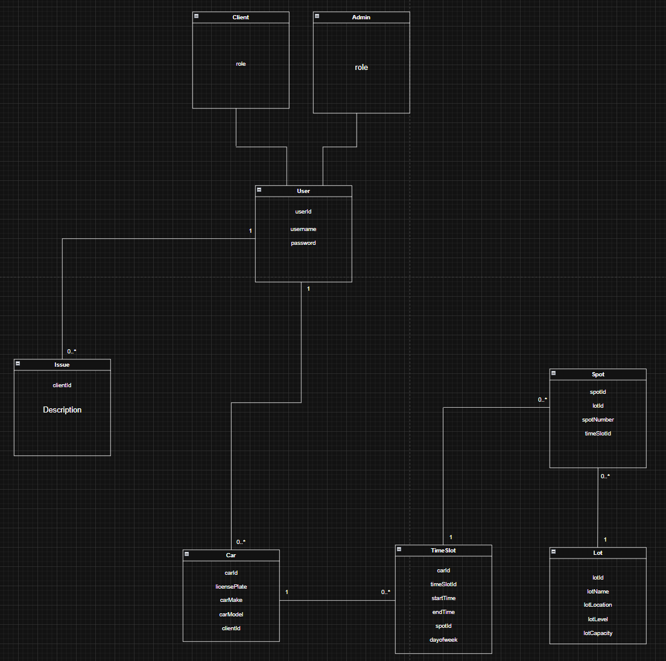
Domain Model

Slide 6
Progress Update
Most main features are near complete
Scheduling in progress
Database in progress
Overall polish

Slide 7
Questions?

Slide 8
Thanks For Listening

