Slide 1
Multi-threading In kdb+
Calvin Wright
Thursday 18th March 2021

Slide 2





Presentation Agenda
1. Overview
2. Incorporating
3. Benefits vs Limitations
4. Live Demo
5. Conclusion + Q&A

Slide 3
Presentation Agenda
1. Overview
2. Incorporating
3. Benefits vs Limitations
4. Live Demo
5. Conclusion + Q&A

Slide 4
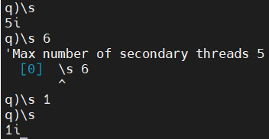
Kdb+ starts in single-threaded mode by default. This ensures data consistency and that there are no race conditions, as all commands are executed in the order they are received. Multi-threading in kdb+ is achieved by spawning multiple secondary threads.
To start a q process with multiple threads you can pass the -s N flag.
Is it always a good idea to use multiple threads?
Overview
Notes:
1.
Each thread in kdb+ needs its own core allocated to it, this can be physical or virtual. So multi-threading is only possible in a multi-core system and limited by the number of cores you have.
Parallel execution is explicitly invoked by using two built-in functions: peach and .Q.fc.
2.
If not specified N defaults to 1. Also note that you can’t add (but can remove) the number of threads on the fly. If you wish to add the number allocated you will have to restart your process.
3.
Although using multiple cores can give us additional compute power and therefore the ability to speed up queries we must also be aware that at the system level each thread is a separate component and when they are passing data between each other this will also take time. For this reason single threaded operations are often preferred in kdb+ but we will see later when you will want to multi-thread.

Slide 5
Multithreaded primitives - KDB 4.0 With the latest release of kdb there exists some ability to naturally take advantage of multiple threads. Primitives
Overview
atomics: abs acos and asin atan ceiling cos div exp floor
log mod neg not null or reciprocal signum sin sqrt
tan within xbar xexp xlog + - * % & | < > = >= <= <>
aggregate: all any avg cor cov dev max min scov sdev sum svar var wavg
lookups*: ?(Find) aj asof bin binr ij in lj uj
index: @(Apply At) select .. where delete
misc: $(Cast) #(Take) _(Drop/Cut) ,(Join) deltas differ distinct
next prev sublist til where xprev
select ... by**
Advantages
No overhead of splitting and joining large vectors. For simple functions, direct execution can be much faster than .Q.fc
Operating on one vector at a time can avoid inefficient scheduling of large, uneven chunks of work:
Notes:
1.
This doesn’t mean kdb will automatically multithread when beneficial, but now a select number of the inbuilt functions will begin to use multiple-threads when called on lists of over a certain number. – at the moment it is in the order of 10⁵ vector items, depending on the primitive.

Slide 6
Presentation Agenda
1. Overview
2. Incorporating
3. Benefits vs Limitations
4. Live Demo
5. Conclusion + Q&A

Slide 7
Incorporating
Each thread in kdb+ needs its own core allocated to it, this can be physical or virtual.
peach : Used in the same way as the each keyword. It will execute the function over multiple secondary processes, passing the arguments and results between the secondary processes and the main thread using IPC serialization.
q)f peach x // execute function f on each x over secondary threads
.Q.fc : This modifies an existing function such that a vector argument is distributed across multiple threads.
q).Q.fc[f] z // cuts z into n (available threads) parts and executes f in parallel
avg (primitive) : Can split the work of a large vector to multiple cores and aggregate.
q).Q.fc[f] z // cuts z into n (available threads) parts and executes f in parallel
Notes:
1.
So multi-threading is only possible in a multi-core system and limited by the number of cores you have.
Parallel execution is explicitly invoked by using two built-in functions: peach and .Q.fc.

Slide 8
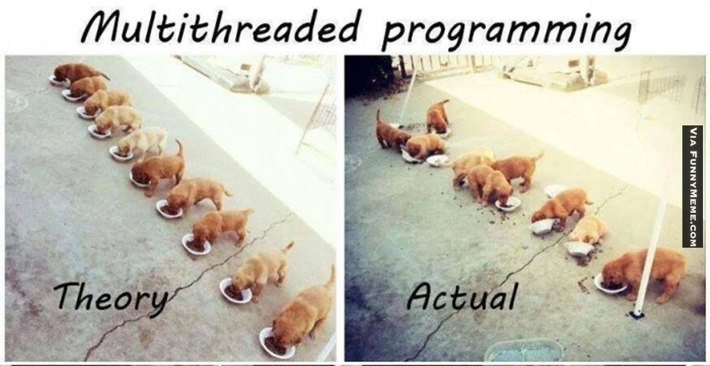
Incorporating
How are threads assigned to tasks?
Notes:
1.
As described previously .Q.fc will cut the task into evenly sized chunks, and then each allocated a thread.
With peach, the tasks are not logically assigned and it could be beneficial to organize your tasks before running the function.
2.
When we ordered the tasks each thread was assigned the same number of large tasks as small tasks and total time was significantly reduced. Obviously there is the tradeoff between organizing tasks at the beginning but from this example was well worth it.
3.
Show the assigning demo

Slide 9
Incorporating
Parallel execution is also implicitly invoked in kdb+ when used as part of a multi-threaded HDB.
t1 | t2 | t3
thread 1
thread 1
Query
Select from tbl where date in
2021.01.01 2021.01.02 2020.01.03
X
Result
Aggregated tbl view
2021.01.01
thread 1
2021.01.02
thread 2
2021.01.03
thread 3
Y
Notes:
1.
So when you write a query in the HDB without referencing peach or .Q.fc it will still use parallelization, as long as it has sufficient cores and threads allocated to the process.
2.
The leader thread (thread 1) will instruct the additional threads to go to each partition, execute the query and retrieve the results. The leader will then combine result set.

Slide 10
Ways To Incorporate
Data Migration
A large task like data migration, batch inserts, HDB alterations are good examples of when to use as many threads as possible for mainly 2 reasons.
Threads 1 | Read | Transform | Write
Threads 4
T-1
T-2
T-3
T-4
file_1
partition 1
q process
read file
file_2
q process
update tbl
q process
write tbl
partition 2
file_3
partition 3
file_4
partition 4
T-1
T-2
T-3
file_1
partition 1
q process
read file
file_2
q process
update tbl
q process
write tbl
partition 2
file_3
partition 3
file_4
partition 4
Notes:
Each task can be separated into large (time-consuming) and evenly distributed chunks.
The system often won’t be operational to other users during these actions so fully using up all of the CPUs will not affect the end user.

Slide 11
Presentation Agenda
1. Overview
2. Incorporating
3. Benefits vs Limitations
4. Live Demo
5. Conclusion + Q&A

Slide 12
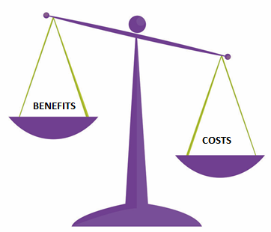
Benefits & Limitations
Rule of Thumb
Larger time taken for function to run, more benefit of threads.
Larger the returned value is, less benefit of threads.
Time | Benefit
Size | Benefit
\t -9!-8!Result
Notes:
As we now know you can split up the work done by using multiple threads. But at some point the result must be aggregated and sending data between these threads can be expensive. The parallel overhead from copying data to secondary threads can be estimated by using the -8! operator to serialize the argument and then de-serializing with the -9! operator.

Slide 13

Benefits & Limitations
Limitations
Can’t be used if you are updating global variables.
Can cause data consistency issues due to race conditions. First in list may not complete first.
Must be careful that cores are not being overused. Make sure to appropriately taskset your processes. If deploying a Platform solution use an instance.csv file.
Licences - KX charge on a per core basis so multithreading may not be the best option for a client even if it offers performance benefits.
q)f:{.temp.test,:x}
q).tmp.test:()
q)f peach 1 2
'noupdate: `. `.temp.test
[2] f:{.temp.test,:x}
^
[0] f peach 1 2
q)`:test.txt set""
`:test.txt
q)l:string each `A`B`C`D`E
q)h:hopen`:test.txt
q)f:{h(x)}
q)f peach l;
q)get`:test.txt
"ACEDB"

Slide 14
Benefits & Limitations
DataBase Optimizations Using Multi-threading
Kdb+ supports parallel I/O to address the disk-contention issue outlined earlier. This requires a specific hardware arrangement, usually direct-attached storage, with multiple disks residing on separate I/O channels.
IO Bottleneck
Multi-threaded Query
Date 1
Single IO lane
Date 2
Date N
IO lane 1
Date 1
Multi-threaded Query
Date 3
Date N
IO lane 2
Date 2
Date 4
Date N+1
Useful commands for checking IO: sar, iostat, iotop, lsof
Notes:
To allow simultaneous access across partitions, the database structure is modified to use segments. Segmentation adds an additional layer above the partitioned structure. A simple example of this structure would be to split a date-partitioned database across two disks, by saving alternating days on each segment.

Slide 15
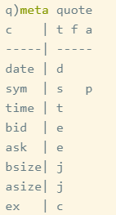
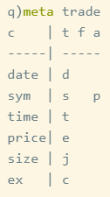
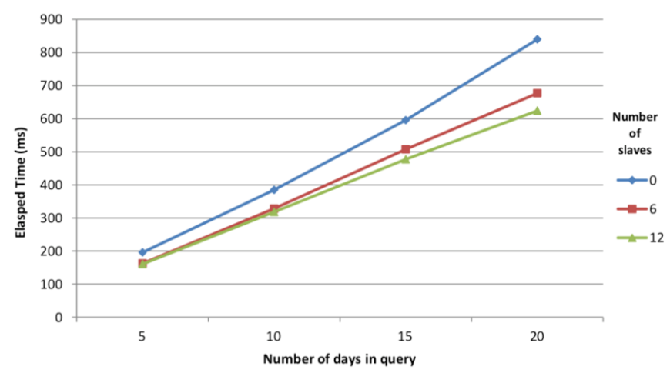
Benefits & Limitations
Query Optimizations Using Multi-threading
The test database is a standard TAQ schema containing simulated data for the S&P 500 components for one month, partitioned by date.
select from quote where date in d, sym in `GOOG`AAPL`YHOO`AMZN`EBAY
Notes:
There are approximately 20,000 quotes per tick symbol per day. In each of the test cases outlined in this section, the kdb+ session is restarted between each test and the disk cache flushed using io.q.

Slide 16
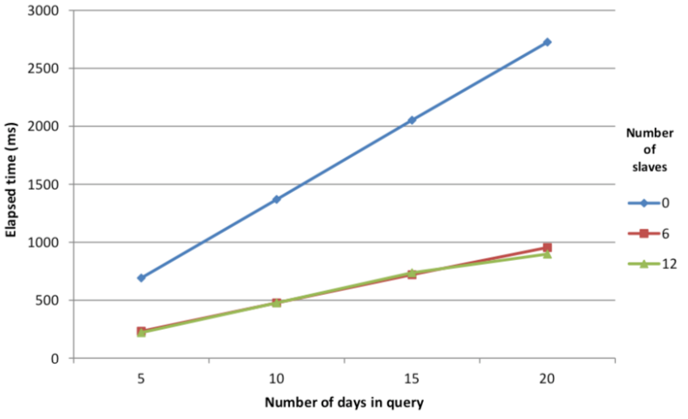
Benefits & Limitations
Query Optimizations Using Multi-threading
One area in which there are significant advantages to using parallel operation is when we are performing aggregations over a partitioned HDB.
// Standard query form using map-reduce select vwap: size wavg price by sym from trade where date in 5#date
Increasing the number of secondary processes available for calculation does not improve performance significantly as reading the data from disk becomes the limiting factor.
Notes:
For most common aggregation operations, kdb+ has a built in map-reduce feature.
Adding additional secondary processes will only increase the number of processes attempting to read from the disk simultaneously.

Slide 17
Presentation Agenda
1. Overview
2. Incorporating
3. Benefits vs Limitations
4. Live Demo
5. Conclusion + Q&A

Slide 18
Live Demo Video
Notes:
For most common aggregation operations, kdb+ has a built in map-reduce feature.
Adding additional secondary processes will only increase the number of processes attempting to read from the disk simultaneously.

Slide 19
Presentation Agenda
1. Overview
2. Incorporating
3. Benefits vs Limitations
4. Live Demo
5. Conclusion + Q&A

Slide 20

Q&A

Slide 21
Q&A
Additional Reading
https://code.kx.com/q/wp/multi-thread
https://code.kx.com/q/kb/mt-primitives/
https://code.kx.com/q/database/segment/
https://bencane.com/2012/08/06/troubleshooting-high-io-wait-in-linux/

Slide 22
Contact Information
Calvin Wright
Data Analyst, Seoul, South Korea
Calvin.wright639@gmail.com
https://www.linkedin.com/in/calvin-wright-871ba1105/
Thank you

