Slide 1
Extension:
Multiplication & Division
Specifications

Slide 2
Extension Description
Main Goal
  Add a computation unit and control unit to support multiplication and division instructions
  Add two special registers ($HI & $LO) for these instructions
4 New R-type Instructions
  mult $rt $rs ({$HI,$LO}=$rt*$rs)
  div $rt $rs ($HI=$rt/$rs, $LO=$rt%$rs)
  mfhi $rd ($rd=$HI)
  mflo $rd ($rd=$LO)
$0
$1
.
.
$31
Multiply
Divide
HI
LO

Slide 3
Instructions
Instrcution | op/func | Meaning
mult $rs $rt | 0/24 | Multiply $rs with $rt, and store upper 32 bits in $HI, lower 32 bits in $LO
div $rs $rt | 0/26 | Divide $rs by $rt, and store the remainder in $HI, the quotient in $LO
mfhi $rd | 0/16 | Move the data from $HI to $rd
mflo $rd | 0/18 | Move the data from $LO to $rd

Slide 4
Architectures (1/2)
There are two implementation styles
1. Iterative Approach
  Use multiple cycles for ALU computation of mult and div, and one cycle for other ALU computation
  During mult/div iterations, the successive instructions should be stalled to avoid hazards (Longer execution time)
  Simple control signals for hazard free execution
  Check “IterMultDiv.pdf” for more

Slide 5
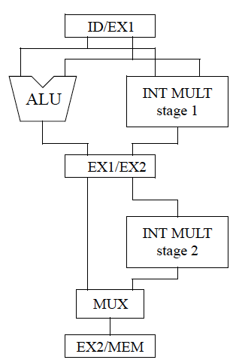
Architectures (2/2)
2. Pipeline Approach
  Use pipelined multiplication and division units
  ALU stage will be further separated into multiple pipeline stages (for example, 2 stages of ALU in right figure)
  No stalls during successive mult/div (Shorter execution time)
  Complicated forwarding schemes

Slide 6
Comparison Metrics
Base on the test program “I_mem_MultDiv”
Score 1 (MD_S1): Total synthesis area (um²)
  MD_S1 = total area of MIPS core
Score 2 (MD_S2): Total execution time (ns)
  MD_S2 = total execution time of test program
Score 3 (MD_S3): Minimum clock period (ns)
  MD_S3 = clock period of MIPS core

